Slide 1
CGI
Devops automation challenge Junior

Slide 2



Overview
EC2 server1
EC2 server2
CGI-Ansible-Master
CGI-Ansible-Node
Jenkins
CI/CD

Slide 3
CGI-Ansible-Master
Install ansible
copy the pem file from local to Ansible-master
(scp –i xyz.pem eu.pem ec2-user@publicip:~)
Edit the inventory file under /etc/anisble and add the nodes list
Ansible nodes –m ping

Slide 4
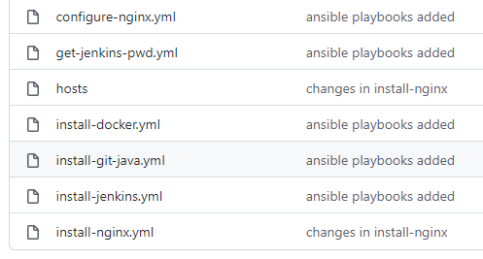
CGI-Ansible-Master
Write Playbooks for installations

Slide 5
What to install on ansible-node
Install Java
Install git and clone
Install Jenkins + start jenkins
Configure jenkins website
Install docker + start docker
Install nginx + start nginx
Configure nginx config file
Create SSL certificate for nginx website

Slide 6
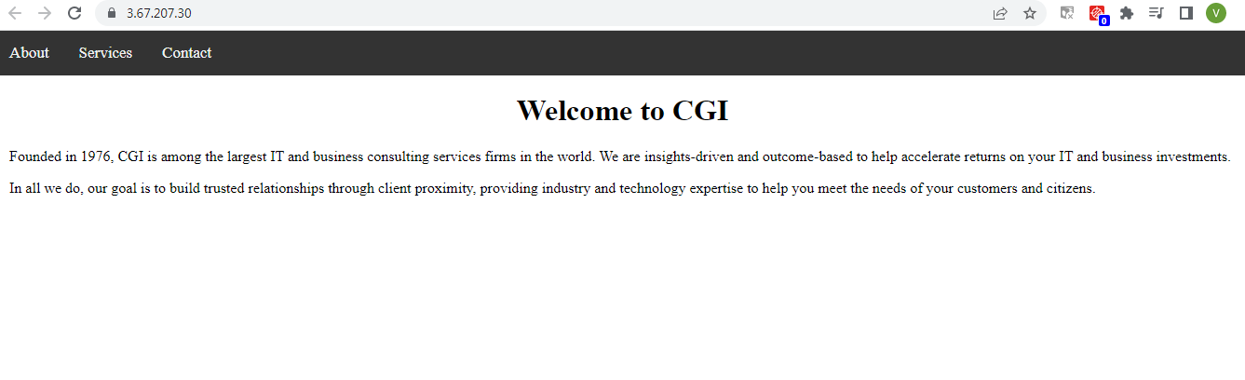
nginx website

Slide 7
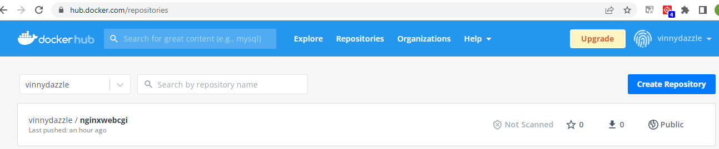
Docker container

Slide 8
Jenkins CI/CD
Build pipeline
Git clone
Docker build
Docker push

