Slide 1


Mercedes Benz Online Dealership
Vincent Gonzalez

Slide 2

Background
Mercedes Benz Online Dealership is being created to allow customers to look up any vehicle for sale.
Sometimes it can be difficult to go car shopping with our schedules.
Mercedes Benz Online Dealership will provide a platform to purchase vehicles online.

Slide 3
Benefits
Providing target customers with a website to choose and order their vehicles from anywhere.
Instead of going out car shopping for a day you can purchase a vehicle from the comfort of your own home.
Improves the lives of consumers by having an ease of access to buying a vehicle.

Slide 4
Key Features
Login with account information that’s secure
Register new accounts
Search through all Mercedes Benz vehicles in the database at once
Admins ability to Add/Edit/Delete any Cars/Accounts/Orders

Slide 5
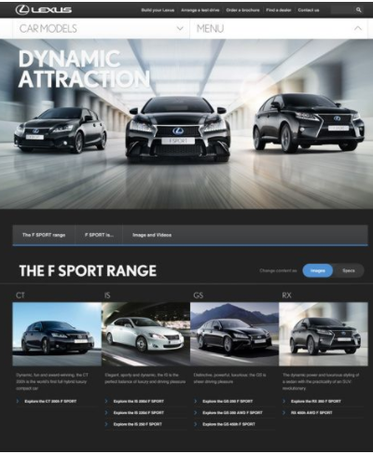
Similar Applications
Lexus vehicles company, is the most direct comparison

Slide 6

Live Demo

