Slide 1
CGB1201 – JAVA PROGRAMMING
Department of Artificial Intelligence and Data Science
Academic Year: 2024 – 2025 (Odd Semester)
Register Number :2303811724321121
Name :Vigneswaran K
Year :II
Semester :III
Section :B
Date :3-12-24

Slide 2
TITLE OF THE PROJECT
AUCTION
MANAGEMENT SYSTEM

Slide 3
ABSTRACT
Overview of the Auction Management System for hosting and managing auctions online.
Highlights Java-based architecture for user interaction and real-time bidding.

Slide 4
INTRODUCTION
Defines the purpose: simplify auction processes for buyers and sellers.
Scope: Supports user registration, item listing, and bid tracking.

Slide 5
JAVA PROGRAMMING - CONCEPTS USED
Object-Oriented Programming (OOP): Used classes for User, Item, Bid, and methods like placeBid() for modularity.
JDBC (Java Database Connectivity): Connected to MySQL for storing user, item, and bid details.
Multithreading: Enabled real-time bid updates and concurrent user actions.
Java Swing/JavaFX: Designed an interactive GUI for auction management.

Slide 6
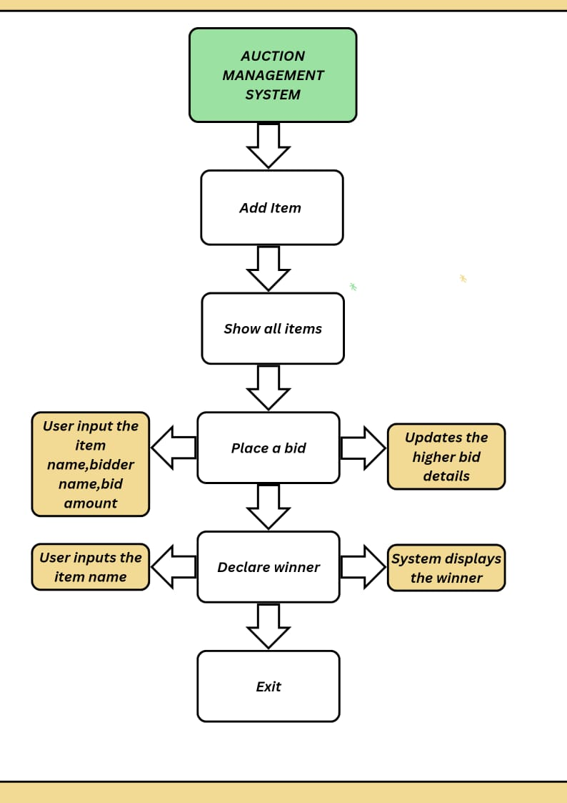
PROPOSED ARCHITECTURE

Slide 7
MODULE DESCRIPTION
LOGIN MODULE
•Handles user authentication for both Auctioners and Participants.
•Ensures secure access to the auction system.
BID MANAGEMENT MODULE
Stores and manages all bids submitted during the auction.
Provides methods to add bids, retrieve bid details, and determine the highest bid.

Slide 8
MODULE DESCRIPTION
TIMER MODULE
Implements a countdown timer to manage the auction's time limit. Automatically ends the auction and triggers winner declaration when the timer expires.
PARTICIPANT DETAILS MODULE
A newly added module to display a detailed list of participants and their bids.Provides a separate screen for auctioneers to review bid information transparently.

Slide 9
MODULE DESCRIPTION
WINNER DECLARATION MODULE
•Determines the highest bidder once the auction concludes.
•Announces the winner and displays bid details on the auction screen.

Slide 10

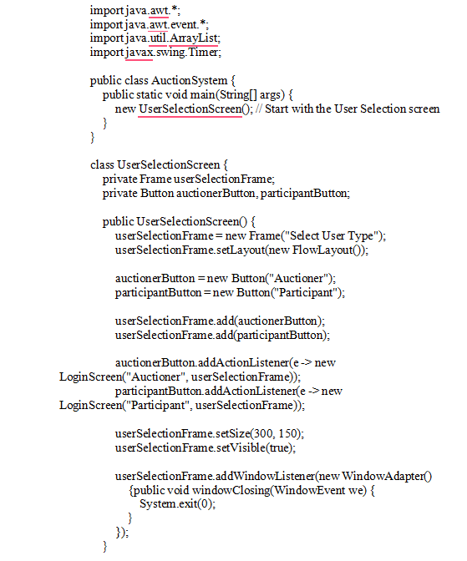
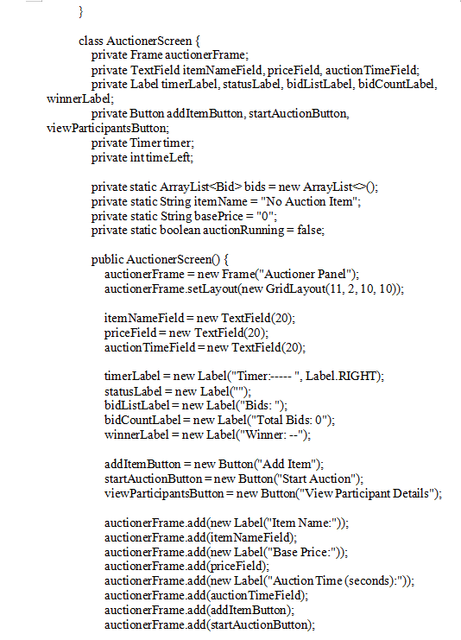
SOURCE CODE

Slide 11
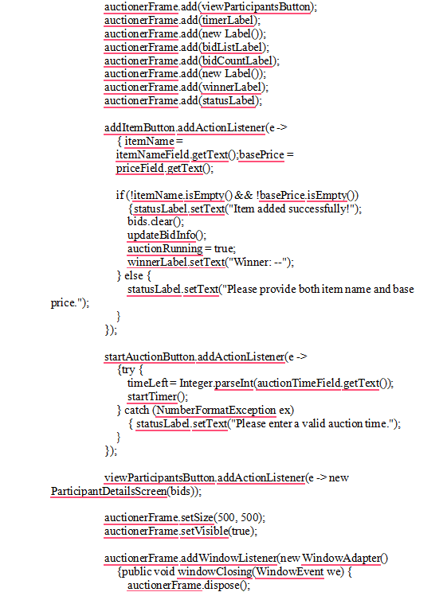
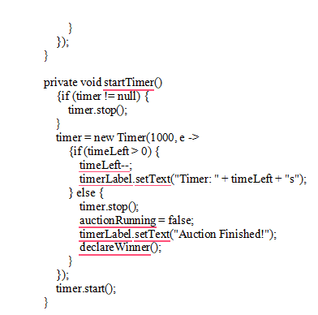
SOURCE CODE

Slide 12
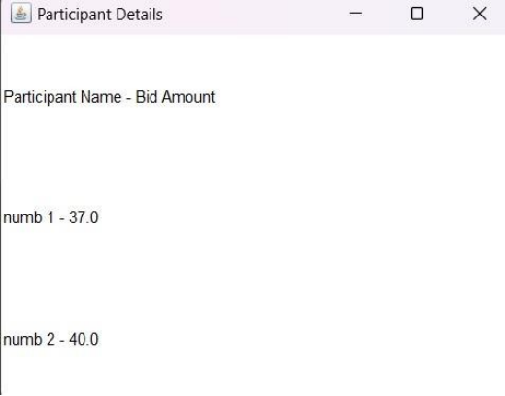
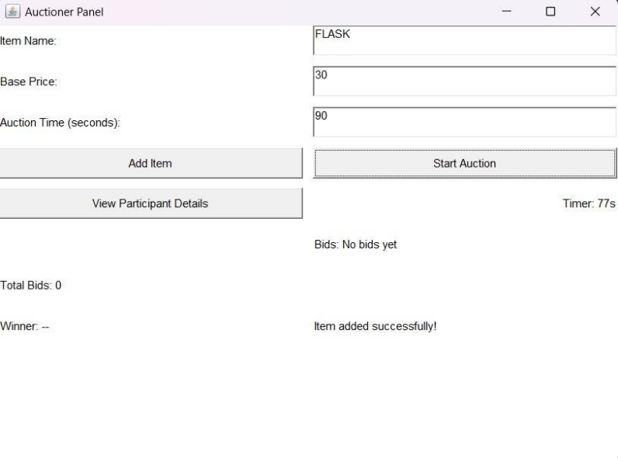
RESULTS AND DISCUSSION

Slide 13
CONCLUSION
Simplifies the auction process using Java-based automation.
Future scope: Enhance with mobile app integration and AI-based auction analytics.

Slide 14
THANK YOU

