Slide 1
FUTURE SALES PREDICTION

Slide 2
Phase 1: Problem Definition and Design Thinking
A problem definition is a clear, concise statement that outlines the specific issue or challenge that needs to be addressed. It sets the stage for problem-solving and guides the process of finding a solution. A well-defined problem provides a clear understanding of what needs to be achieved and helps in generating effective solutions.
Design thinking is a problem-solving approach that emphasizes empathy, creativity, and collaboration to develop innovative solutions. It is a human-centered approach that seeks to understand the needs and perspectives of the people who will use or be affected by a product, service, or system

Slide 3
Problem Definition
The problem is to develop a predictive model that uses historical sales data to forecast future sales for a retail company. The objective is to create a tool that enables the company to optimize inventory management and make informed business decisions based on datadriven sales predictions. This project involves data preprocessing, feature engineering, model selection, training, and evaluation.

Slide 4
Design Thinking
Data Source
Data Preprocessing
Model Training
Evaluation

Slide 5
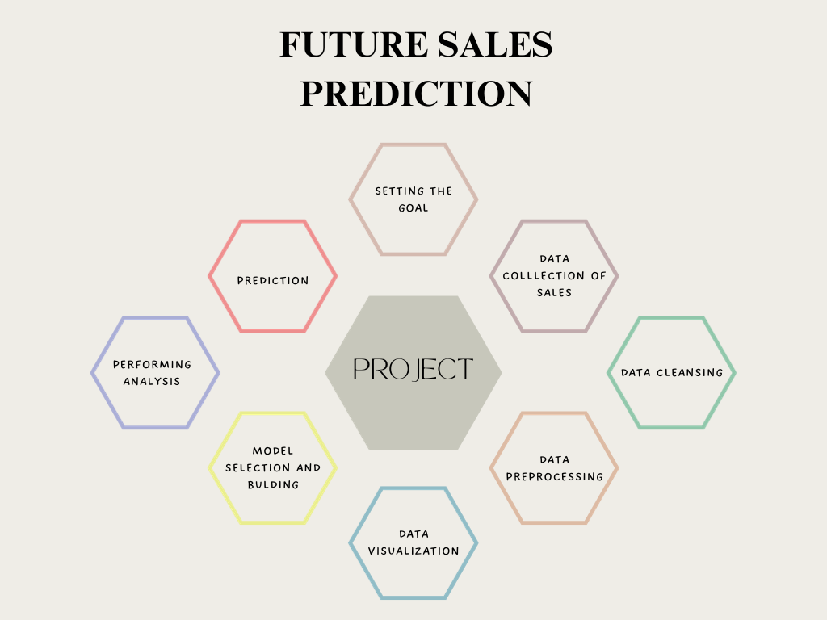

Slide 6
Data Preprocessing
Clean and preprocess the data, handle missing values, and convert categorical features into numerical representations.
Create additional features that could enhance the predictive power of the model, such as time-based features (e.g., day of the week, month).
Choose suitable time series forecasting algorithms (e.g., ARIMA, Exponential Smoothing) for predicting future sales.

Slide 7
Data Source
Utilize a dataset containing historical sales data, including features like date, product ID, store ID, and sales quantity.
Structured Data:
Databases: Relational databases like MySQL, PostgreSQL, or NoSQL databases like MongoDB, where data is organized in tables or collections with predefined schemas.
CSV/TSV Files: Comma-separated values (CSV) or tab-separated values (TSV) files that contain rows and columns of structured data.

Slide 8
Unstructured Data: Text Data: Includes emails, documents, social media posts, articles, and any other form of text. It can be used for tasks like sentiment analysis, text classification, and named entity recognition. Images: Photos, scanned documents, or any other visual data. Convolutional Neural Networks (CNNs) are commonly used to process and analyze image data. Audio Data: Speech recordings, music files, or any form of audio. Techniques like speech recognition and audio classification can be applied. Video Data: Moving images with a temporal component. Video analysis may involve tasks like object detection or action recognition.

Slide 9
Semi-Structured Data:
JSON/XML Data: Data that is organized hierarchically with tags or keys, commonly used in web applications and APIs.
HTML Documents: Web pages that can be parsed to extract information using techniques like web scraping.

Slide 10
Machine learning preprocessing involves preparing and cleaning data before it's fed into a model. There are various techniques and algorithms used for this purpose. Here are some commonly used preprocessing algorithms:
Imputation:
Normalization and Standardization:
Min-Max Scaling: Scales features to a specific range (e.g., [0, 1]).
Z-score Standardization: Scales features to have a mean of 0 and standard deviation of 1.
Encoding Categorical Variables:
One-Hot Encoding: Creates binary columns for each category.
Label Encoding: Assigns a unique integer to each category.
Binary Encoding: Combines one-hot encoding and label encoding to save memory.
Text Preprocessing:
Tokenization: Divides text into individual words or tokens.
Stopword Removal: Eliminates common words (e.g., "the", "and") that don't provide much information.
Stemming and Lemmatization: Reduces words to their base or root form.
.

Slide 11
Model Training
Train the selected model using the preprocessed data.
Model training is a crucial step in the machine learning workflow where a machine learning algorithm learns patterns in the data. The goal of training is to enable the model to make accurate predictions or decisions when presented with new, unseen data.

Slide 12
Evaluation
Evaluate the model's performance using appropriate time series forecasting metrics (e.g., Mean Absolute Error, Root Mean Squared Error).
A model is evaluated to assess its performance and determine how well it generalizes to new, unseen data. The evaluation process provides insights into the model's strengths and weaknesses, helping to make informed decisions about its suitability for a given task.

