Slide 1
Future Sales Prediction

Slide 2
PHASE2: INNOVATION
INTRODUCTION
IMPORTING DATASET
DATA PREPROCESSING
MODEL SELECTION
MODEL TRAINING
EVALUATION
L

Slide 3
What is Future Sales
"Future sales" refers to the anticipated revenue or volume of products or services that a business or individual expects to generate in the upcoming time period. It's a prediction of the sales performance for a specific period, which could range from days to months or even years into the future. Accurate forecasting of future sales is crucial for business planning, resource allocation, inventory management, and overall financial stability.

Slide 4
Future sales prediction
Future sales prediction, also known as sales forecasting, is the process of using historical sales data, along with other relevant information and predictive techniques, to estimate or predict the future sales performance of a product, service, or business. The goal is to make informed decisions about production, inventory, marketing, and resource allocation based on these forecasts.

Slide 5
Dataset source
The dataset for the above mentioned project was obtained from kaggle website.
Kaggle is an popular dataset providing source,where obtained datasets are with high quality and less errors.

Slide 6
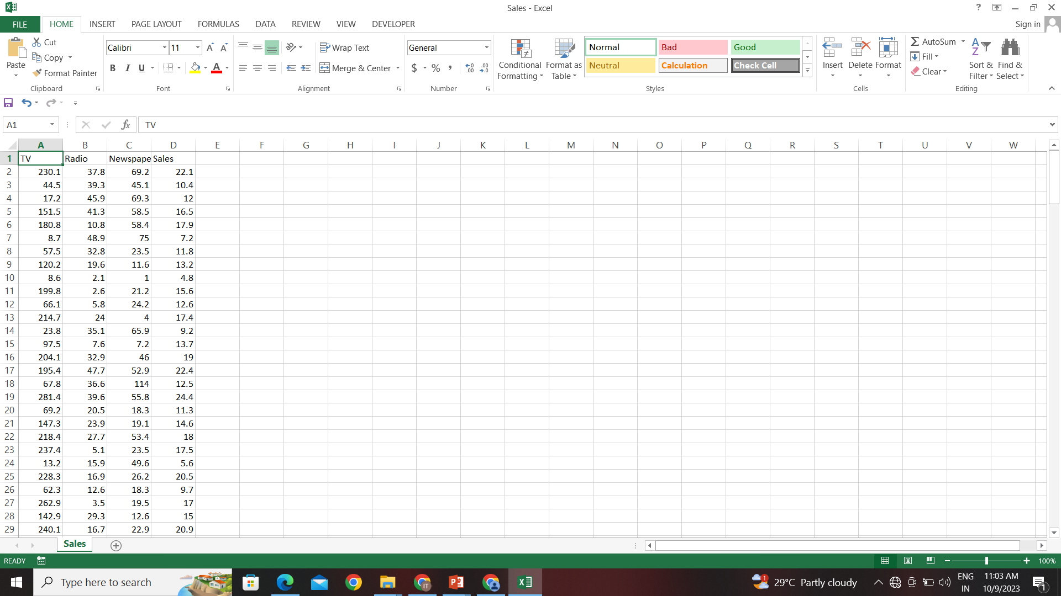
Imported dataset

Slide 7
Details about the columns
The above dataset contains the following dataset:
1)Tv:
Contains the amount of sales of tv.
2)radio:
Contains the amount of sales of radio.
3)Newspaper:
Contains the amount of sales of newspaper.
4)Sales:
Contain the sales amount

Slide 8
Data cleansing
Filling missing value
Identify and decide how to deal with missing data points (e.g., imputation, removal, or interpolation).
Removing Duplicate Records:
Identify and remove identical or redundant rows in the dataset.
Handling Outliers:
Identify and decide whether to remove, transform, or keep outliers based on their impact on the analysis.
Standardizing Formats:
Ensure consistent formats for data (e.g., date formats, units of measurement) to avoid discrepancies.

Slide 9
LIBRARYS USED
1)PANDAS:
The Pandas library in Python is an open-source data manipulation and analysis tool built on top of the Python programming language. It provides easy-to-use data structures and data analysis tools, making it an essential library for working with structured data.
Data Structures(dataframe and series)
Data Manipulation
Data Loading and Saving
Data Indexing and Selection
Handling Missing Data
Pandas is a powerful tool that simplifies many aspects of data handling and analysis in Python, making it an essential library for data scientists, analysts, and researchers.

Slide 10
2)Numpy
NumPy (Numerical Python) is an open-source Python library that provides support for large, multi-dimensional arrays and matrices, along with a collection of high-level mathematical functions to operate on these arrays. It forms the foundation for numerical and scientific computing in Python
Efficient Numerical Operations
Mathematical and Logical Operations
Efficient Memory Handling
NumPy is a fundamental library in the Python ecosystem and plays a crucial role in scientific computing, data analysis, and various other numerical applications. It's a cornerstone for many other libraries in the data science and scientific computing stack.

Slide 11
Matplotlib
Matplotlib is an open-source Python library used for data visualization. It provides a wide range of tools for constructing plots, graphs, histograms, and other visual representations of data. Matplotlib is widely used in scientific computing, data analysis, machine learning, and various other fields where visualizing data is crucial.
Flexible Data Visualization
High-Quality Output
Wide Range of Plot Styles
Matplotlib is a powerful library that provides the tools necessary for creating a wide range of high-quality data visualizations in Python. It's a cornerstone in the data science and scientific computing stack, often used in conjunction with libraries like NumPy, Pandas, and Seaborn.

Slide 12
Scikit-learn
scikit-learn, often abbreviated as sklearn, is an open-source machine learning library for Python. It provides a wide range of machine learning algorithms, as well as tools for data preprocessing, model evaluation, and model selection. Scikit-learn is one of the most popular and widely used libraries for machine learning in the Python ecosystem.
Wide Range of Machine Learning Algorithms:
Model Evaluation and Selection
Performance and Efficiency
Scalability

Slide 13
Process to download libraries
Step1:Go to settings
Step2:Click on the python interpreter
Step3:Click on the “+” the package column
Step4:Search for the required package
Step5:Click on the “install package”
Step6:the required package is installed

Slide 14
Time series Forecasting Techniques
Forecasting techniques like LSTM (Long Short-Term Memory) and Prophet are used for predicting future values or trends based on historical data.
They are particularly effective in time series analysis, where data points are collected at regular intervals over time.

Slide 15
LSTM(Long Short-term Memory)
Long Short-Term Memory (LSTM) is a type of recurrent neural network (RNN) architecture that is designed to handle long-term dependencies in sequential data.
It is particularly effective for tasks involving time series data or sequences of data points.

Slide 16
How lstm works:
Step 1 (Forget Gate): Decide what information to discard from the cell state based on the current input and previous hidden state.
Step 2 (Input Gate): Decide what new information to store in the cell state.
Step 3 (Update Cell State): Combine the previous cell state, the information to forget, and the new information to get the updated cell state.
Step 4 (Output Gate): Decide what information to output from the cell state.

Slide 17
Prophet
The Prophet algorithm, developed by Facebook, is designed to handle time series data with strong seasonal patterns, multiple seasonality, and holiday effects.
It employs an additive model that combines various components, including trend, seasonality, holiday effects, and potentially other user-specified components.

Slide 18
How to train and test Data
To split your data into training and testing sets, you can use the
train_test_split function from the sklearn.model_selection module. This
function randomly shuffles and partitions your data into two subsets,
typically one for training and one for testing.
Code:
from sklearn.model_selection import train_test_split
# Assuming 'X' is your input data and 'y' is your target variable
X_train, X_test, y_train, y_test = train_test_split(X, y, test_size=0.2, random_state=42)

Slide 19
In the above dataset there are four main features
TV
Radio
Newspaper
Sales
In,this dataset TV,Radio,Newspaper are independent variables and Sales is dependent variable.Based on the this we have to find the future sales

Slide 20
X: Input features (independent variables).
y: Target variable (dependent variable).
test_size: The proportion of the dataset to include in the test split.
In this example, it's set to 20%, meaning 80% will be used for training.
random_state: Seed for the random number generator.
Setting this ensures that the split is reproducible.
After running this code, you will have X_train, X_test, y_train, and
y_test containing the training and testing sets for both your input
features and target variable.

Slide 21
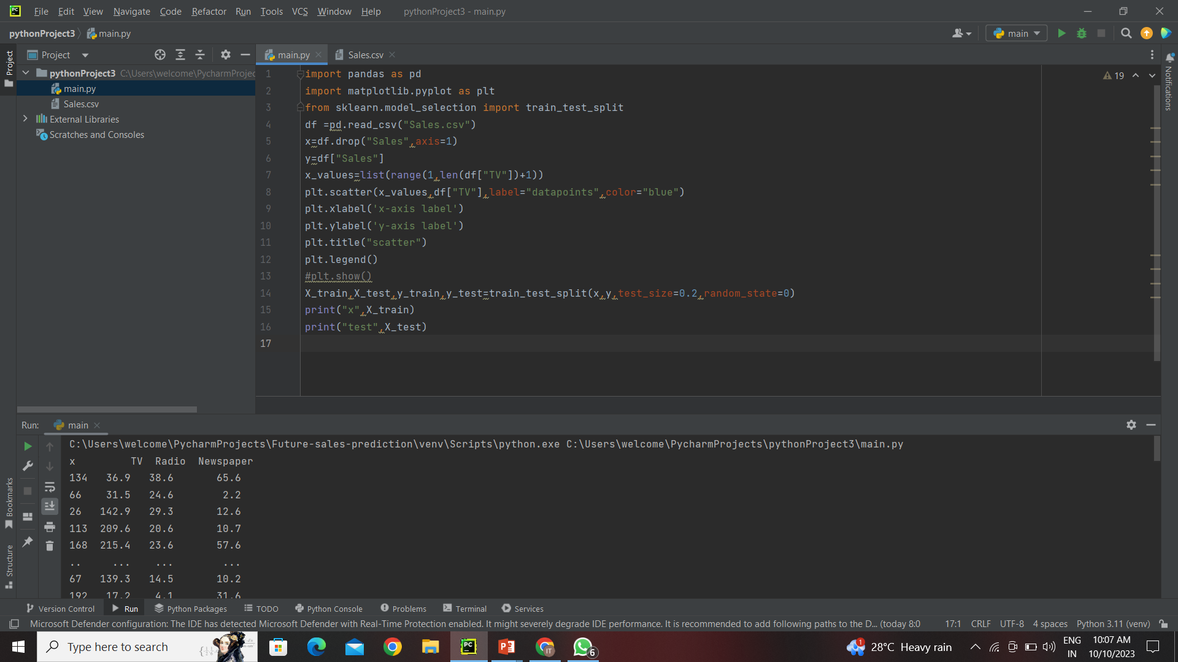
Training and testing dataset

Slide 22
Model selection and training
Choose a machine learning algorithm or model that is appropriate for
your task.
Train the model on the training data using the fit method.
Model evaluation
Evaluate the model's performance on the testing data using appropriate metrics (e.g., accuracy, mean squared error, etc.). This step helps you understand how well your model is likely to perform on new, unseen data

Slide 23
Regression Metrics
Mean Absolute Error (MAE)
Measures the average absolute differences between actual and predicted values. It gives you an idea of how far off your predictions are on average.
Mean Squared Error (MSE):
Similar to MAE, but squares the differences, which can amplify the impact of large errors.
Root Mean Squared Error (RMSE):
The square root of MSE. It gives you an interpretable measure in the same units as the target variable

