Slide 1
PGDATA
PGUSER
PGPORT
PGDATABASE
PGHOST

Slide 2

Used by command like pg_ctl and initdb
If –D option is not specified in the command . It will pickup the value set in PGDATA environment variable.
Example:
pg_ctl start
the cluster path mentioned in the PGDATA variable is started.

Slide 3


PGUSER
PGPORT
PGDATABASE
PGHOST
Above environment variables are used by tools like psql and other utilities. If the port , user , database , host are not explicitly mentioned during command , then it will pickup the values set in above environment variables.

Slide 4

After the installation, make sure bin, doc, include, lib, man and share directories are created under the default /opt/PostgreSQL/10.6 directory as shown below.
# ls -l /opt/PostgreSQL/10.6
total 12
drwxr-xr-x 2 root root 4096 Nov 11 23:25 bin
drwxr-xr-x 3 root root 4096 Nov 11 23:25 doc
drwxr-xr-x 6 root root 4096 Nov 11 23:25 include
drwxr-xr-x 3 root root 4096 Nov 11 23:25 lib
drwxr-xr-x 4 root root 4096 Nov 11 23:25 man
drwxr-xr-x 5 root root 4096 Nov 11 23:25 share

Slide 5
Terminology in Postgres(Archiecture:general:smilarities)
Oracle Postgres
1.Default tablespace:system pg_default
2.Data Dictionary pg_catalog
3.Server process – sp postgres process - pg
4.User process – up client process – cp
5.DB Writer Background writer
6.Log Writer WAL Writer
7.Archiver Archiver
8.Mmon Stats collector
9.Shared global area Shared Memory
10.DB Buffer cache Shared Buffer
11.Log buffer WAL buffer
13.Private Global area Work memory

Slide 6
Oracle Postgres 1.Table/Index Relation 2.Row Tuple 3.column Attribute 4.data block page (when block is on disk) 5.page buffer(when block is in memory)

Slide 7
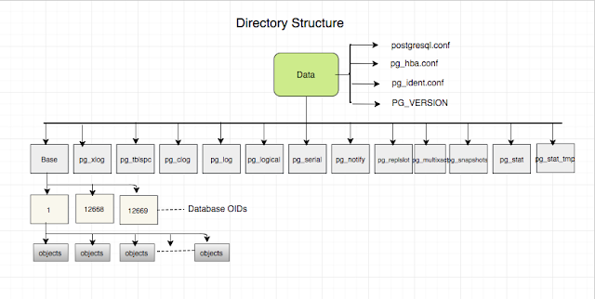
DATA DIRECTOY structure

