Slide 1
Terminology in Postgres(Archiecture:general:smilarities)
COMPARISION BETWEEN Postgres with Oracle
Oracle Postgres
1.Default tablespace:system pg_default
2.Data Dictionary pg_catalog
3.Server process – sp postgres process - pg
4.User process – up client process – cp
5.DB Writer Background writer
6.Log Writer WAL Writer
7.Archiver Archiver
8.Mmon Stats collector
9.Shared global area Shared Memory
10.DB Buffer cache Shared Buffer
11.Log buffer WAL buffer
13.Private Global area Work memory

Slide 2
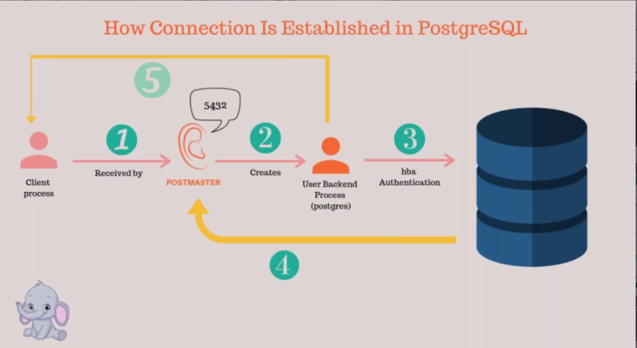
POSTMASTER

Slide 3
Postmaster
Whenever we start the postgres server database cluster the main postgres server process gets created, which were earlier known as postmaster process but the term was deprecated.
This is the main process that gets created postgres server process which will be running uniquely port number(5432).
This postmaster will be internally running some other background process for the internal activities and also when ever client makes a request access the database ,he will be first authentication by the postmaster server process by using the below configuration files.
Postgresql.conf
Pg_hba.conf
If it’s Authentication is successful postmaster process will create a new child process which is called as postgres process and this client will be making the communication through this postgres process only.
If Authentication is failed postmaster process removed backend process.
Postmaster process act as listen process.
Postnaster process will do instance recovery whenever its required.
Postmaster process will act as a parent process for all background processes.

Slide 4
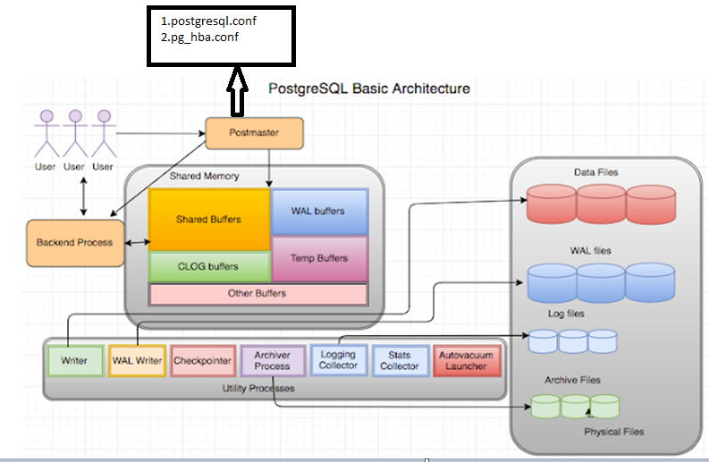
Postgresql Architecture

