Slide 1

initdb utility

Slide 2

In postgres we create cluster.
We can start and stop clusters. Each cluster listens on separate port number. The port number is mentioned in postgresql.conf file.Two clusters cannot listen on same port number
We can create any number of databases in cluster.
We cannot start or stop individual databases in a cluster.
Each cluster has a default database which is “postgres” and default super user “postgres”. Default superuser name can be changed at time of creating cluster
Each cluster has two default tablespaces “pg_default” and “pg_global”.

Slide 3
initdb utility is used to create new clusters
Create a folder/directory and pass it as input to the initdb utility using -D.
Each cluster has a default superuser. You can specify the default user name using –
U option.
Example:
initdb -D /data/as11/data –U postgres initdb -D /data/as11/data -U postgres
Linux: #mkdir /data/as11/data
#chown -R postgres:postgres /data/as11/data
Initdb -D /data/as11//data -U postgres

Slide 4
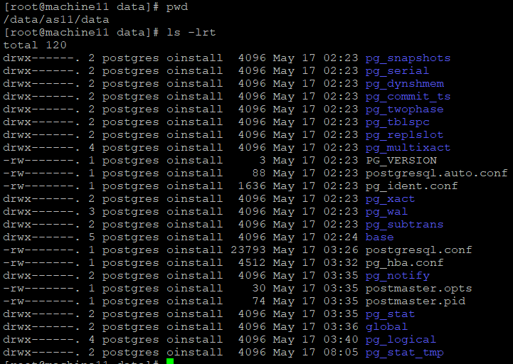
Folders and Files In Cluster

Slide 5
Directory layout inside data directory
Files Desription
PG_VERSION →A file containing the major version number of PostgreSQL.
pg_hba.conf →A file to control PosgreSQL's client authentication.
pg_ident.conf →A file to control PostgreSQL's user name mapping.
postgresql.conf →A file to set configuration parameters.
postgresql.auto.conf →A file used for storing configuration parameters that are set in ALTER SYSTEM (version 9.4 or later).
SUBDIRECTORIES DIRECTORIES
base/ → Subdirectory containing per-database subdirectories.
Global/ →Subdirectory containing cluster-wide tables, such as pg_database and pg_control.
pg_commit_ts/Subdirectory containing transaction commit timestamp data. Version 9.5 or later.
pg_clog/→ (Version 9.6 or earlier)Subdirectory containing transaction commit state data. It is renamed to pg_xact in Version 10. CLOG will be described in
Postmaster.opts/→ opts is a file in the data directory written after startup which contains the options used to start the postmaster process
pg_logical/→Subdirectory containing status data for logical decoding
pg_multixact/→Subdirectory containing multitransaction status data (used for shared row locks).
pg_notify/→Subdirectory containing LISTEN/NOTIFY status data.
postmaster.pid: it will store the cluster PID.

Slide 6
pg_repslot/Subdirectory containing replication slot data.
pg_serial/Subdirectory containing information about committed serializable transactions.
pg_snapshots/Subdirectory containing exported snapshots (version 9.2 or later). The PostgreSQL's function pg_export_snapshot creates a snapshot information file in this subdirectory.
pg_stat/→Subdirectory containing permanent files for the statistics subsystem.
pg_stat_tmp/→Subdirectory containing temporary files for the statistics subsystem.
pg_tblspc/→Subdirectory containing symbolic links to tablespaces.
pg_twophase/Subdirectory containing state files for prepared transactions.
pg_wal/ →(Version 10 or later)Subdirectory containing WAL (Write Ahead Logging) segment files. It is renamed from pg_xlog in Version 10.
pg_xact/ →(Version 10 or later)Subdirectory containing transaction commit state data. It is renamed from pg_clog in Version 10. CLOG will be described.

Slide 7
Cluster details
Cluster when up, we call it a postgres instance. It will be listening on port for incoming connections .This port details are mentioned in postgresql.conf file.
When cluster is created , it will consist of
Databases
Postgres
Users/Roles
Postgres ( specified during creation of cluster)
Tablespaces
pg_default
Pg_gloabl

Slide 8


Slide 9
PG_CTL Utility
Pg_ctl utility is used to start/stop the cluster.
To start a cluster → pg_ctl -D $PGDATA start
To stop a cluster → pg_ctl -D $PGDATA stop
To check status of cluster → pg_ctl -D $PGDATA status

Slide 10
Directory structure
pg_version: It contains database version information.
Base: Containing database subdirectories.
Global: Containing cluster wise tables such as pg_user.
pg_clog: Containing transaction commits status data.
pg_multixact: Containing multi transaction status data (used for shared row locks).
pg_notify: Containing LISTEN/NOTIFY status data.
pg_serial: Containing information about committed serializable transactions.
pg_snapshots: Containing exported snapshots.
pg_stat_tmp: Containing temporary files for the statistics subsystem.
pg_subtrans: Containing sub-transaction status data.
pg_tblspc: Containing symbolic links to tablespaces.
pg_twophase: Containing state files for prepared transactions.
pg_xlog: Containing WAL (Write Ahead Log) files.
pid: This file containing the current postmaster process ID (PID).

