Slide 1
CLUSTER HIERARCHY
Cluster having below hierarchy.
Cluster > Catalog > Schema > Table > Columns & Rows
A computer may have one cluster or multiple.
A database server is a cluster.
A cluster has catalogs. ( Catalog = Database )
Catalogs have schemas. (Schema = namespace of tables, and security boundary)
Schemas have tables.
Tables have rows.
Rows have values, defined by columns.

Slide 2
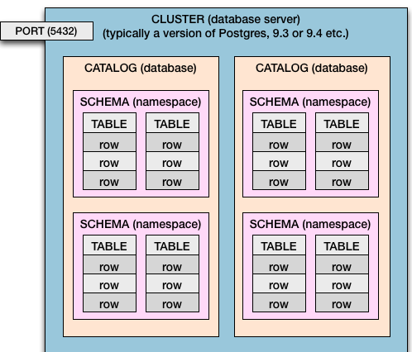
CLUSTER HIERARCHY

Slide 3
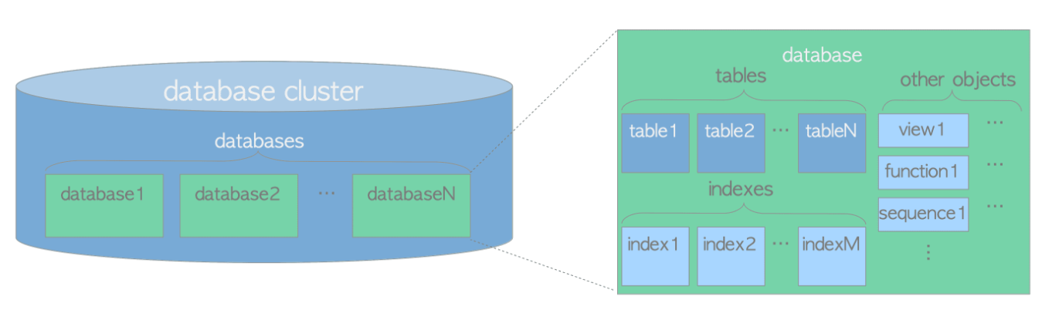
CLUSTER ARCHITECTURE
Cluster has 2 types of architectures.
1.Logical Architecture
2.Physical Architecture.
1.Logical architecture:

Slide 4
A database cluster is a collection of databases managed by a PostgreSQL server.
In oracle cluster means a group of database servers.
A PostgreSQL server runs on a single host and manages a single database cluster.
The above d iagram shows the logical structure of a database cluster. A database is a collection of database objects.
All the database objects in PostgreSQL are internally managed by respective object identifiers (OIDs).
The relations between database objects and the respective OIDs are stored in appropriate system catalogs, depending on the type of objects.
For example, OIDs of databases and heap tables are stored in pg_database and pg_class respectively, so you can find out the OIDs you want to know by issuing the queries such as the following
SELECT datname, oid FROM pg_database WHERE datname = 'sampledb‘;
SELECT relname, oid FROM pg_class WHERE relname = 'sampletbl';

Slide 5
2.Physical architecture
A database cluster basically is one directory referred to as base directory, and it contains some subdirectories and lots of files.
If you execute the initdb utility to initialize a new database cluster, a base directory will be created under the specified directory.
Though it is not compulsory, the path of the base directory is usually set to the environment variable PGDATA.
A database is a subdirectory under the base subdirectory. and each of the tables and indexes is (at least) one file stored under the subdirectory of the database to which it belongs.
Also there are several subdirectories containing particular data, and configuration files
While PostgreSQL supports tablespaces.
A tablespace in PostgreSQL is one directory that contains some data outside of the base directory

Slide 6
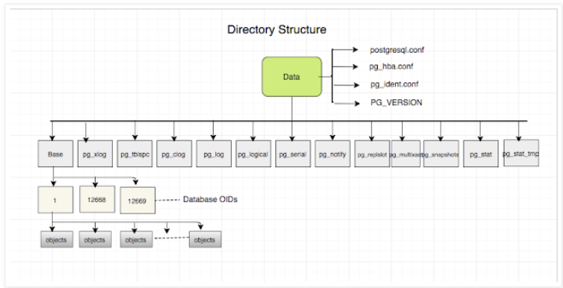
Physical architecture

Slide 7
Cluster level objects
1. role, database, and tablespace names, are defined at the cluster level and stored in the pg_global tablespace.
If you want find the databases use the below statement.
SELECT datname FROM pg_database; or
\l
If you want find the users use below statement.
Select * from pg_users;
\du
For tablespaces.
Select * from pg_tablespaces.
\db+

Slide 8
Psql usage
Psql uasage:psql –d dbname –U username –h hostname –p port
Where –d=dbname
-U=username
-h=host where cluster is running.
-p=port where cluster is running.
\! -→ to print current pwd at postgres d b level.
To print the pwd at postgres db level.
postgres=# \! pwd
/home/postgres

Slide 9
META COMMANDS
\? -→it will give the meta commands.
\l-→list of databases.
\l+ →list of database sizes.
\du→list of users
\dn-→ list of schema
\dt →List of relations.
\du+→ give more details for users.

