Slide 1
Iteration statements
While, for – Break, continue and pass statements

Slide 2
Iteration Statements
Iteration repeats the execution of a sequence of code.
Iteration is useful for solving many programming problems.
Iteration and conditional execution form the basis for algorithm construction.
Python supports different iterative/looping statements. They are:
while
for

Slide 3
while
Syntax:
The general form/syntax of while is
while expression:
statements #block of statements

Slide 4
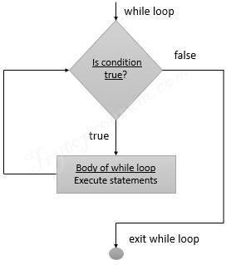
Flowchart for while statement
The reserved word while begins the while statement.
The condition determines whether the body will be (or will continue to be) executed.
A colon (:) must follow the condition.
block is a block of one or more statements to be executed as long as the condition is true.

Slide 5
Example:
Output:
1
2
3
4
5
#printing numbers from 1 to 5 using while
i = 1
while i < 6:
print(i) i = i+1

Slide 6
Example:
#factorial of a number in using while
n = int(input("enter a number: "))
f = 1
while n>0:
f = f * n
n = n – 1
print("factorial is ", f)
Output:
enter a number: 5 factorial is 120

Slide 7
for
Syntax:
The general form/syntax of for is
for var in sequence:
loop body

Slide 8
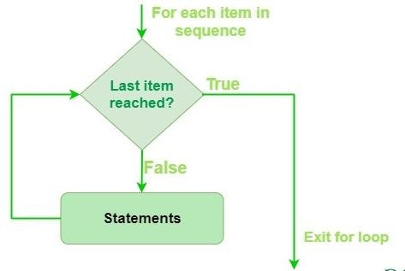
Flowchart
The for statement iterates over a sequence of values.
It can be used to execute a group of statements repeatedly depending upon the number of elements in the sequence.
It can be used to work with sequence like string, list and tuple.
Here, the variable takes the value of the item inside the sequence for each iteration.
Loop continues until the last item in the sequence is reached.
The body of for loop is separated from the rest of the code using indentation.

Slide 9
Example:
Output:
p y t h o n
#Iterating a string using for loop
str = "python"
for i in str:
print(i)

Slide 10
range( )
It is a built-in function of Python that generates a sequence of numbers.
The general form of the range expression is range( begin,end,step )

Slide 11
range( )
where
begin is the first value in the range; if omitted, the default value is 0
end is one past the last value in the range; the end value is always required and may not be omitted
step is the amount to increment or decrement; if the step parameter is omitted, it defaults to 1 (countsup by ones).
begin, end, and step must all be integer expressions; floating-point expressions and other types are not allowed.

Slide 12
Example
for n in range(21, 0, -3):
print(n, end=‘ ‘)
Output:
21 18 15 12 9 6 3

Slide 13
Example:
Output:
Enter the number 5 5 * 1 = 5
5 * 2 = 10
5 * 3 = 15
5 * 4 = 20
5 * 5 = 25
5 * 6 = 30
5 * 7 = 35
5 * 8 = 40
5 * 9 = 45
5 * 10 = 50
n = int(input("Enter the number "))
for i in range(1,11):
c = n*i
print(n,"*",i,"=",c)

Slide 14
nested for
One loop within another loop is known as “nested loop”. Python allows us to nest any number of for loops inside a for loop.
When a series of decision are involved, we may have to use more than one if-else statement in the nested form.

Slide 15
nested for
Syntax:
The general form/syntax of nested for is
for var1 in sequence: #outer loop
for var2 in sequence: #inner loop
block of statements

Slide 16
Example:
Output:
Enter the number of rows:5
1
22
333
4444
55555
n = int(input("Enter the number of rows:"))
for i in range(0,n+1):
for j in range(i):
print(i,end = ‘’)
print()

Slide 17
Loop Control Statements
Loop control statements change execution from its normal sequence. Python supports different loop control statements. They are:
break
continue
pass

Slide 18
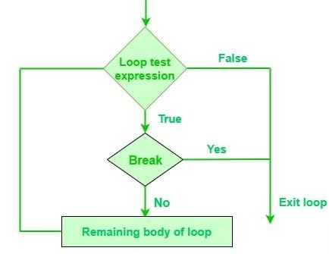
break
Break statement in Python is used to bring the control out of the loop and transfers execution to the statement immediately following the loop.
Syntax
break

Slide 19
Example
count = 0
while count <= 100:
print (count)
count += 1
if count >= 3:
break
Output:
0
1
2

Slide 20
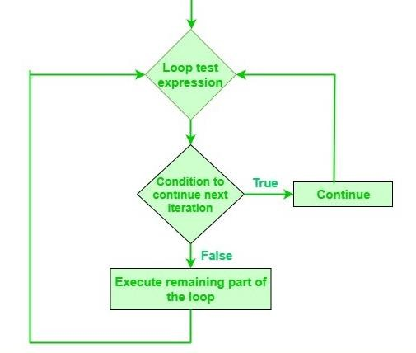
Continue:
When the continue statement is executed in the loop, the code inside the loop following the continue statement will be skipped for the current iteration and the next iteration of the loop will begin.
Unlike break, continue statement continues the loop.

Slide 21
Continue
Syntax
Continue
#Sample example for continue
for x in range(10):
if x % 2 == 0:
continue
print (x)
Output:
1
3
5
7
9

Slide 22
Pass statement:
Python has a special statement called pass, which means do nothing.
We may use the pass statement in our code in places where the language requires a statement to appear but we wish the program to take no action whatsoever.
pass statement is a no-operation placeholder that is used when the syntax requires a statement, but have nothing useful to say.
It is often used to code an empty body for a compound statement.

Slide 23
Example:
Output:
Enter any value:5
5
Enter any value:-5
#Sample example for pass
x = int(input(“Enter any value”))
if x < 0:
pass # Do nothing
else:
print(x)

