Slide 1
Modules and Packages
Built-in modules, User-Defined modules, itertools module

Slide 2
What is a module?
A module in Python is a file containing Python code, such as functions, classes, variables, and executable statements, that can be imported and reused in another Python program.
A Python module usually has the .py extension.
calculator.py
This file can contain functions such as addition, subtraction, multiplication, and division.

Slide 3
Example
Consider a college with different departments:
Computer Science and Engineering Department
Mechanical Engineering Department
Civil Engineering Department
Each department performs its own tasks but can share resources with other departments.
Similarly, a Python program can be divided into modules, where each module handles a particular task and can be reused by other programs.

Slide 4
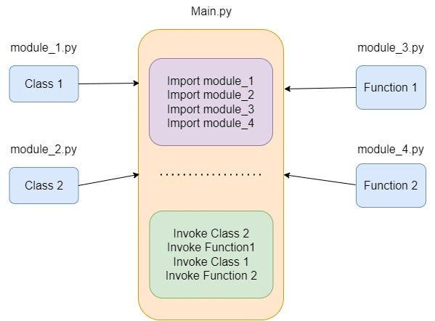

Slide 5
Why do we need modules?
Modules provide several advantages:
Advantage | Explanation
Code reusability | Write a function once and use it in multiple programs.
Modularity | Divide a large program into smaller, manageable files.
Maintainability | Update one module without rewriting the entire application.
Readability | Organize related functions and classes together.
Namespace management | Keep names organized under a module instead of placing everything in one global namespace.
Collaboration | Different developers can work on separate modules.

Slide 6
Example without modules
Suppose we write a calculator program containing all operations in one file.
def add(a, b):
return a + b
def subtract(a, b):
return a - b
def multiply(a, b):
return a * b
print(add(10, 5))
print(subtract(10, 5))
print(multiply(10, 5))

Slide 7
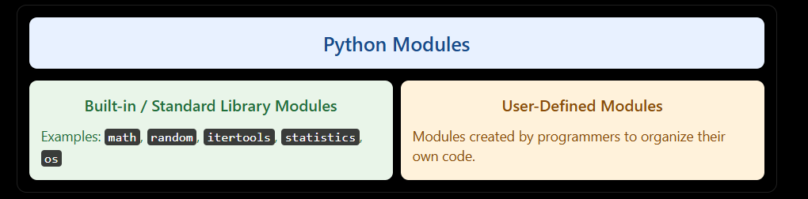
Types of Python modules

Slide 8
Importing modules in Python
The import statement makes names defined in a module available to the importing program.
Import the complete module
import module_name

Slide 9
Example:
import math
print(math.sqrt(25))
print(math.factorial(5))
5.0
120

Slide 10
Import a specific function
Syntax
from module_name import function_name

Slide 11
Example
from math import sqrt, factorial
print(sqrt(36))
print(factorial(4))
6.0
24

Slide 12
Import a module using an alias
Syntax:
import module_name as alias
Example:
import math as m
print(m.pi)
print(m.sqrt(49))
An alias provides a shorter name for referring to a module.
3.141592653589793
7.0

Slide 13
Import all names
Syntax:
from module_name import *
Example:
from math import *
print(sqrt(64))
print(factorial(6))
8.0
720

Slide 14
Built-in and standard-library modules
Python provides a collection of modules that offer ready-made functionality.
These modules are distributed with Python and are documented in the Python Standard Library.
They help programmers avoid implementing common operations from scratch.

Slide 15
Important standard-library modules
Module | Purpose | Examples
math | Mathematical operations | sqrt(), factorial()
random | Random number generation | randint(), choice()
statistics | Statistical calculations | mean(), median()
itertools | Efficient iterator operations | count(), cycle(), permutations()
os | Operating-system interaction | getcwd(), listdir()
datetime | Date and time operations | date.today(), datetime.now()
sys | Python runtime information | sys.version, sys.path
collections | Specialized container types | Counter, deque
json | JSON encoding and decoding | json.dumps(), json.loads()

Slide 16
The math module
The math module provides mathematical functions and constants.

Slide 17
Example 1: Square root
import math
number = 81
result = math.sqrt(number)
print("Square root:", result)
Square root: 9.0

Slide 18
Example 2: Factorial
import math
print(math.factorial(5))
120

Slide 19
Example 3: Mathematical constants
import math
print("Pi:", math.pi)
print("Euler's number:", math.e)

Slide 20
The random module
The random module provides pseudorandom number generation.

Slide 21
Example 1: Generate a random integer
import random
number = random.randint(1, 10)
print(number)

Slide 22
Example 2: Select a random item
import random
subjects = ["Python", "Java", "C++", "Data Science"]
print(random.choice(subjects))

Slide 23
The statistics module
This module provides functions for common statistical calculations.
import statistics
marks = [70, 80, 90, 85, 75]
print("Mean:", statistics.mean(marks))
print("Median:", statistics.median(marks))

Slide 24
User-defined modules
Definition
A user-defined module is a Python file created by a programmer to store reusable functions, classes, variables, or related code.
For example, a programmer can create a module named calculator.py and use its functions in another Python file.

Slide 25
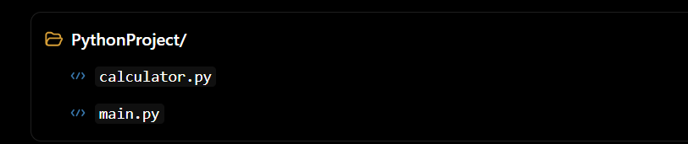
Creating a user-defined module
Suppose we create two files in the same directory.

Slide 26
File 1: calculator.py
# User-defined module
def add(a, b):
return a + b
def subtract(a, b):
return a - b
def multiply(a, b):
return a * b
def divide(a, b):
if b == 0:
raise ValueError("Cannot divide by zero")
return a / b

Slide 27
File 2: main.py
import calculator
print(calculator.add(10, 5))
print(calculator.subtract(10, 5))
print(calculator.multiply(10, 5))
print(calculator.divide(10, 5))

Slide 28
Importing selected functions from a user-defined module
from calculator import add, multiply
print(add(20, 30))
print(multiply(20, 30))

Slide 29
The Special variable __name__ :
For every Python program , a special variable name will be added internally.
This variable stores information regarding whether the program is executed as an individual program or as a module.

Slide 30
The Special variable __name__ :
__name__ is a special built-in variable in Python. It tells us how a Python file is being used.
Its value depends on whether the file is:
Run directly
Imported as a module

Slide 31
The Special variable __name__ :
When a Python file is run directly
Consider a file named demo.py:
print(__name__)
python demo.py
__main__

Slide 32
Using if __name__ == "__main__":
demo.py
def add(a, b):
return a + b
def main():
x = 10
y = 20
print("Sum =", add(x, y))
if __name__ == "__main__":
main()
python demo.py
Sum = 30

Slide 33
What happens when the file is imported?
Suppose we have two files.
calculator.py
def add(a, b):
return a + b
if __name__ == "__main__":
print(add(10, 20))

Slide 34
What happens when the file is imported?
test.py
import calculator
print(calculator.add(5, 3))
python test.py
8

