Slide 1
Python Packages
UNIT - III

Slide 2
Python Packages
Suppose you have developed a very large application that includes many modules.
As the number of modules grows, it becomes difficult to keep track of them all if they are dumped into one location.
This is particularly so if they have similar names or functionality. You might wish for a means of grouping and organizing them.

Slide 3
Python Packages
Packages allow for a hierarchical structuring of the module namespace using dot notation.
In the same way that modules help avoid collisions between global variable names, packages help avoid collisions between module names.

Slide 4
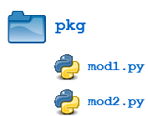
Python Packages
Creating a package is quite straightforward, since it makes use of the operating system’s inherent hierarchical file structure. Consider the following arrangement:

Slide 5
Python Packages
Python packages are a way to organize and structure code by grouping related modules into directories.
A package is essentially a folder that contains an __init__.py file and one or more Python files (modules).
Allows modules to be easily shared and distributed across different applications.

Slide 6
Key Components of a Python Package
Module: A single Python file containing reusable code (e.g., math.py).
Package: A directory containing modules and a special __init__.py file.
Sub-Packages: Packages nested within other packages for deeper organization.

Slide 7
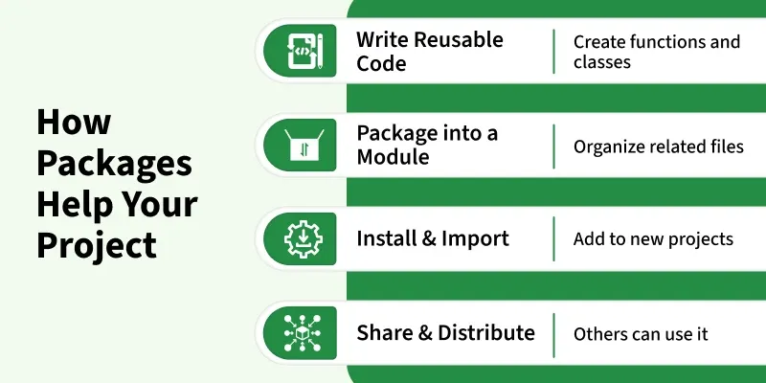
Why do we need packages

Slide 8
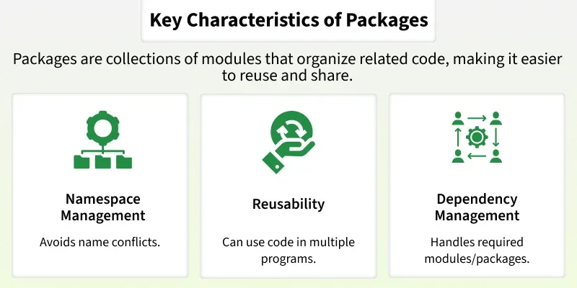
Why do we need packages

Slide 9
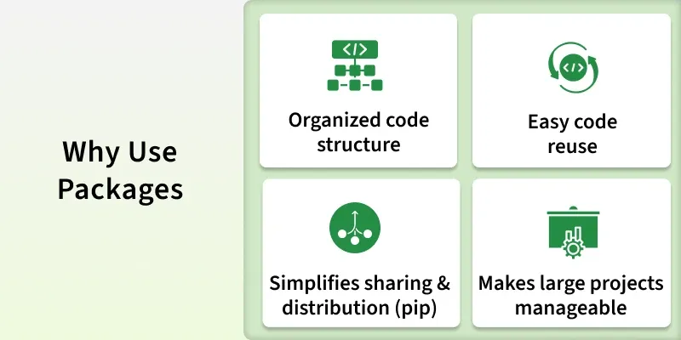
Why do we need packages

Slide 10
Creating and Accessing Packages
Create a Directory: create a folder that will act as the package root.
Add Modules: Inside the directory, add Python files (modules). Each module can contain related functions or classes.
Add __init__.py: add an __init__.py file to the directory. This file tells Python that the directory should be treated as a package.
Create Sub-packages (Optional): One can organize code further by creating subdirectories with their own __init__.py files.
Import Modules: Modules or functions inside the package can be imported using dot notation, for example:

Slide 11
Creating and Accessing Packages
from mypackage.module1 import greet
Example
In this example, we create a package called math_operations to organize mathematical functions. The package contains two sub-packages:
basic: addition and subtraction
advanced: multiplication and division

Slide 12
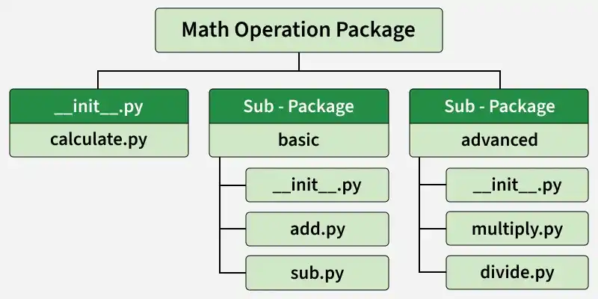
Creating and Accessing Packages

Slide 13
Creating and Accessing Packages
math_operations/__init__.py - This file initializes the main package and exposes commonly used functions so they can be imported directly from the package.
from .calculate import calculate
from .basic import add, subtract
from .advanced import multiply, divide

Slide 14
Creating and Accessing Packages
math_operations/calculate.py - This module contains a simple function that prints a message indicating that a calculation is being performed.
def calculate():
print("Performing calculation...")

Slide 15
Creating and Accessing Packages
math_operations/basic/__init__.py - This file initializes the basic sub-package and makes the add and subtract functions available when the sub-package is imported.
from .add import add
from .sub import subtract

Slide 16
Creating and Accessing Packages
math_operations/basic/add.py - This module contains the function for performing addition.
def add(a, b):
return a + b

Slide 17
Creating and Accessing Packages
math_operations/basic/sub.py - This module contains the function for performing subtraction.
def subtract(a, b):
return a - b

Slide 18
Creating and Accessing Packages
math_operations/advanced/__init__.py - This file initializes the advanced sub-package and exposes the multiply and divide functions from their respective modules.
from .mul import multiply
from .div import divide

Slide 19
Using the Package
Now we can import functions from the package and use them in our program.
from math_operations import calculate, add, subtract, multiply, divide
# Using the placeholder calculate function
calculate()
# Perform basic operations
print("Addition:", add(5, 3))
print("Subtraction:", subtract(10, 4))
# Perform advanced operations
print("Multiplication:", multiply(4, 2))
print("Division:", divide(10, 2))

Slide 20
Python Packages for Web Frameworks
Flask
Django
FastAPI
Pyramid
Tornado
Falcon
CherryPy
Bottle

Slide 21
Python Packages for AI & Machine Learning
NumPy
Pandas
SciPy
XGBoost
Matplotlib
Seaborn
Plotly

Slide 22
Python Packages for Game Development
PyGame
Pyglet
Arcade

