Slide 1
UNIT - I
History and Need of Python Programming

Slide 2
Comparison
Python | C
Easy syntax | More complex syntax
Focus on problem solving | Focus on how the computer works
Automatic memory management | Manual memory management
Interpreted | Compiled
Faster to develop | Faster execution

Slide 3
Why Learn C?
C teaches the fundamentals of programming.
1. How Memory Works
In C, you manage memory yourself.
int a = 10;
Variables
Memory addresses
Pointers
Stack and Heap

Slide 4
Python:
a = 10
Python hides all these details.

Slide 5
2. How Data is Stored
C helps you understand that:
int = 4 bytes
char = 1 byte
float = 4 bytes
Python simply lets you write:
x = 10
without worrying about storage.

Slide 6
Compilation Process
C Programming Language
Python Programming Langiage
Source Code
↓
Compiler
↓
Machine Code
↓
Program Executes
Source Code
↓
Python Interpreter
↓
Bytecode
↓
Python Virtual Machine
↓
Output

Slide 7
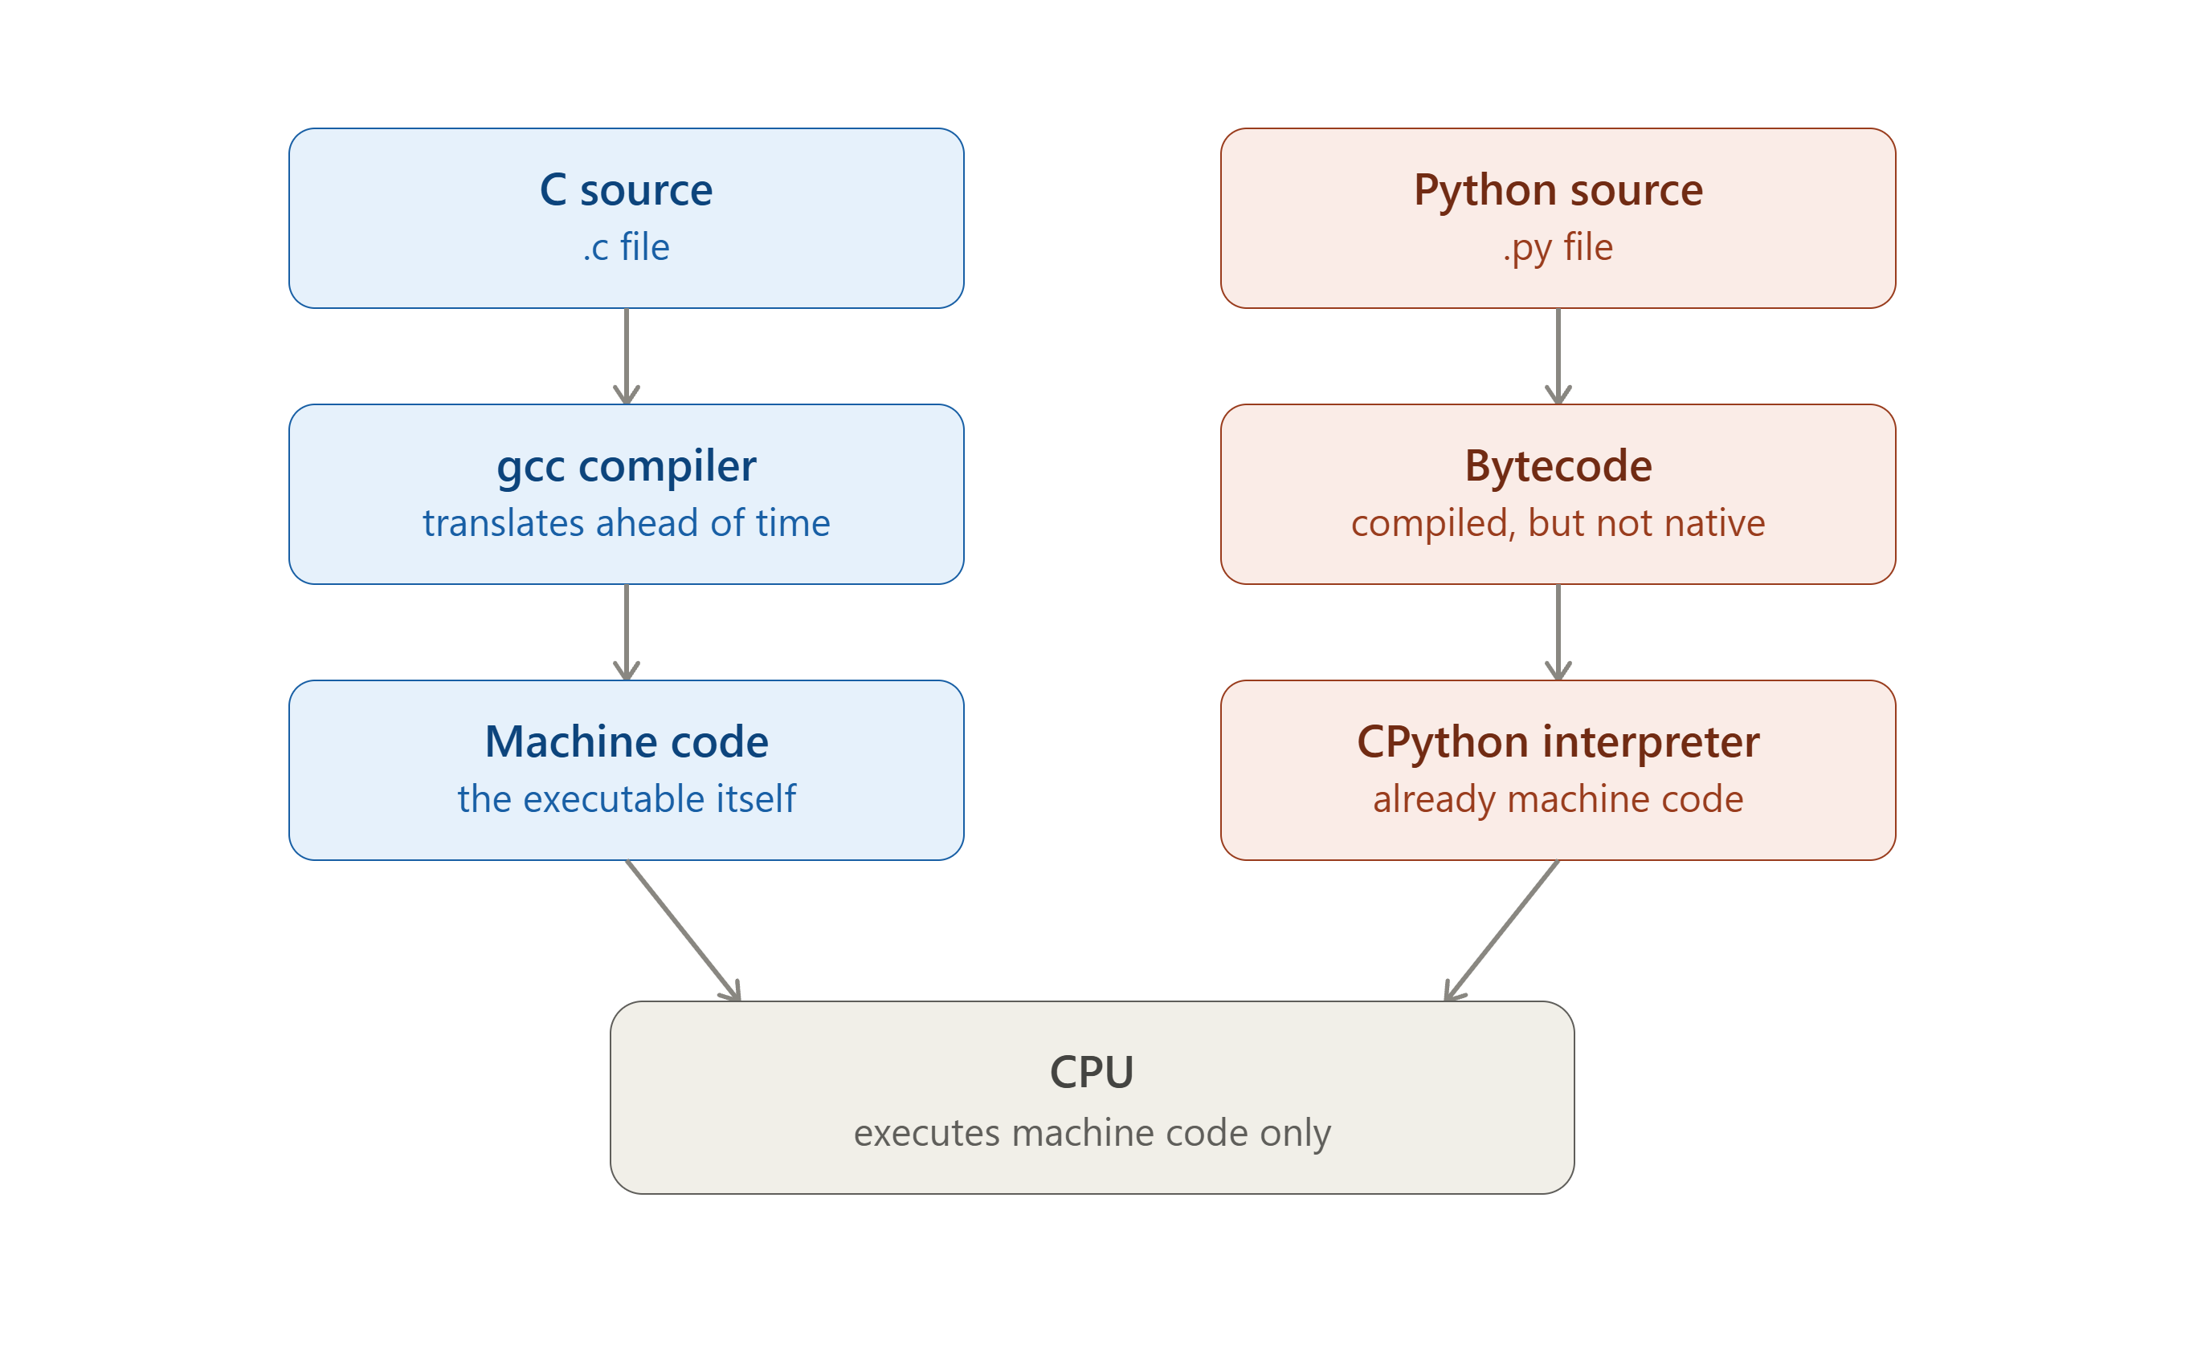
Compilation Process

