Slide 1

Think Like a Programmer
Mastering the Logic Behind the Code

Slide 2
What You Will Learn Today
Understanding the essence of a "Problem"
Defining Algorithms and Programming
Why humans outshine AI in problem-solving
Learning through interactive logic challenges
Developing a systematic "Programmer Mindset"

Slide 3
The Foundation
Defining Problems, Solutions, and Steps

Slide 4
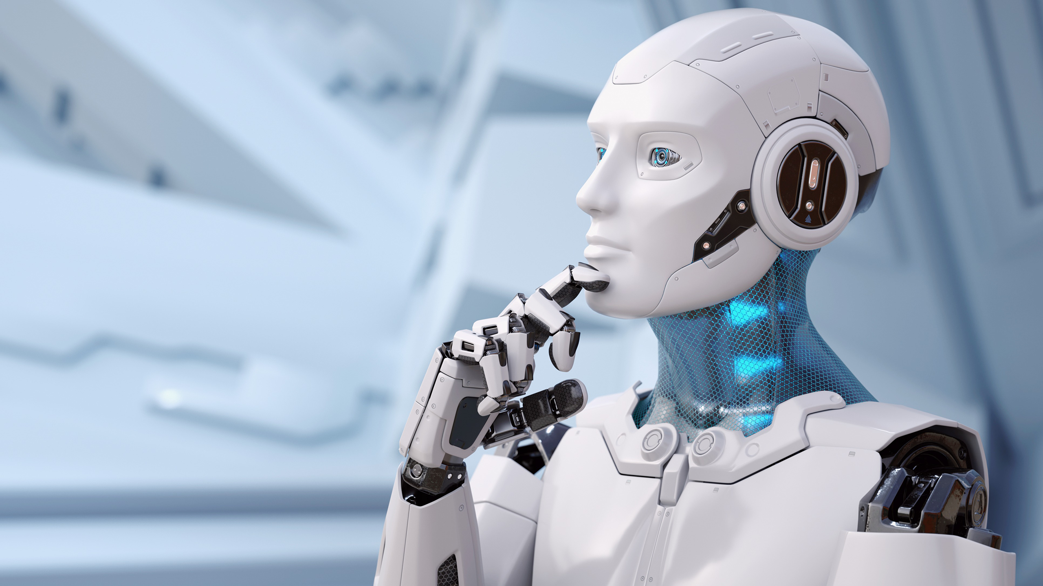

Game 1: The Human Robot
Computers Follow, Not Guess
Computers are incredibly intelligent at following instructions, but very poor at guessing intentions.
Vague: "Pick up the bottle."
Precise: "Raise right hand, open fingers, move 5cm forward."
Insight: Programming requires absolute precision.

Slide 5




Strategy and Precision
Guess the Number
Build a Sandwich
Using Binary Search to find answers faster. Good programmers think efficiently, not just quickly.
Missing a step like "Open the bag" stops the whole process. Coding is about ordering steps correctly.

Slide 6

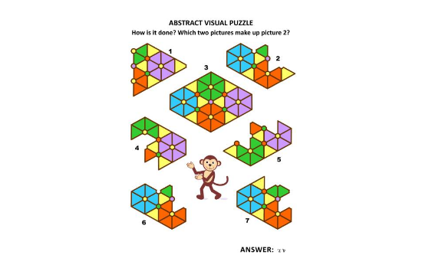

Patterns and Algorithms
Finding the Rule
Programming is essentially recognizing patterns in data. Once you find the rule, you can automate it.
Game: Treasure Hunt
"Take 5 steps, Turn left, Look under chair." This simple sequence is an Algorithm.

Slide 7

The Paper Cup Challenge
Building a Solution
Goal: Build the tallest tower in 3 minutes using only 8 paper cups.
The Programmer Lesson: There are many solutions to every problem. Some are more stable, some are taller, and some are more efficient.
Problem-solving is about choosing the best design.

Slide 8




Debugging and the AI Era
Debug the Teacher
The AI Challenge
Identifying mistakes like "Wearing shoes before socks." Finding errors in logic is Debugging.
AI can calculate instantly, but can it Think? Programming is about Logic and Creativity, not just math.

Slide 9






Coding Without a Computer
Sequence
Decision
Clues
The order of operations. Steps happen one after another.
Using If-Else logic to choose different paths based on conditions.
Using deductive reasoning to solve puzzles like an Escape Room.

Slide 10
Real-Life Problem Solving
The Problem | Programmer's Strategy
Crossing a river dry | Evaluate constraints, find edge-case solutions.
Sorting by height | Implement a Sorting Algorithm (Bubble, Quick).
Bridge crossing puzzle | Resource management and optimization.
Robot making tea | Breaking down tasks into atomic instructions.

Slide 11


The Key Insight
"Companies don't hire people who can copy code from AI. They hire people who can Understand Problems, design solutions, and think logically."
Programming is the tool; Problem-Solving is the skill.

Slide 12
Questions?
Ready to think like a programmer?
// End of Session

Slide 13




Image Sources
https://lh3.googleusercontent.com/8r34mIJBYp8N8Kto_T3Q3zzlIqt4jAmbkpcYuHB0-4Zor11Do1sifDcmCmsPZfC0sh-9PEnDOgOoSUo0jEG8sKtgsr3Dj2O-P-OUtqg94JKkSb2NeYo=w1440-h810-n-nu
Source: deepmind.google
https://media.istockphoto.com/id/2175611611/vector/abstract-visual-puzzle-educational-mathematics-spatial-reasoning-skills-training-answer.jpg?s=612x612&w=0&k=20&c=jjks1QSIR3XBbR-xdDk3ynOsxUd2GxlD8oWcuWEj4gw=
Source: www.istockphoto.com
http://www.imthecheftoo.com/cdn/shop/articles/mastering_the_stem_cup_tower_challenge.webp?v=1760645899
Source: www.imthecheftoo.com
https://cdn.prod.website-files.com/61bb26fe53aeb2a18bbd17e4/6729c62b8db7a1173848db0d_Hero%20Image%201.webp
Source: www.phaedrasolutions.com

