Slide 1
Conditional Statements
UNIT - I

Slide 2
Conditional Statements
Also known as Decision making / Selection statements.
Decision making is the most important aspect of almost all the programming languages.
These statements have the ability to compare values (make decisions) and allows to run a particular block of code depending on the outcome of the condition i.e., either TRUE or FALSE.

Slide 3
Conditional Statements
Python supports different decision making statements. They are:
Simple if
if-else
nested if
Elif statement
NOTE: Python requires the block to be indented.

Slide 4
Simple if
Syntax:
The general form/syntax of if statement is
if condition:
statement(s) #if block

Slide 5
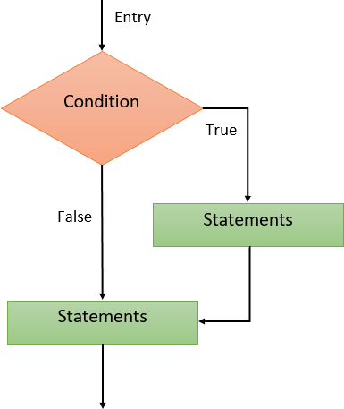
Flowchart for if statement is shown in figure:
Above syntax started with the reserved word if.
The condition is a Boolean expression that determines whether or not the body will be executed.
A colon (:) must follow the condition.
If the condition is true, then it the block of statement(s) known as “if-block (or) body of if” gets executed.
If the condition is false, then control doesn’t enter into if block and executes the statements followed by if block.
In Python, the body of if statement is indicated by the indentation.
The statements within the block must all be indented the same number of spaces from the left. The body starts with an indentation and the first unintented line marks the end.

Slide 6
Example
num = int(input("enter the number: "))
if num%2 == 0:
print("Number is even")
Output:
enter the number: 10 Number is even

Slide 7
if-else
Syntax:
The general form/syntax of if-else statement is
if condition:
statement(s) # if block
else:
statement(s) #else block

Slide 8
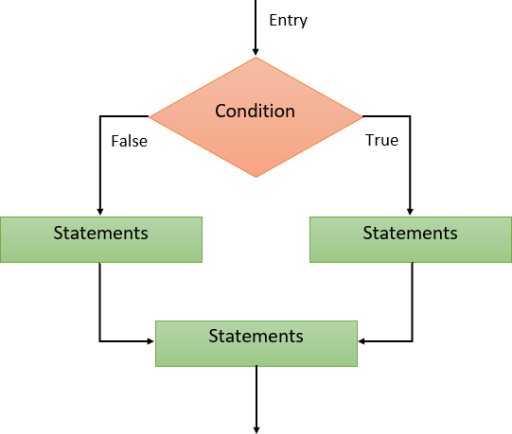
Flowchart for if-else statement is shown in figure:
If the condition is true, then the if-block is executed. Otherwise, the else-block is executed.
The if-else statement provides an else block combined with the if statement which is executed in the false case of the condition.
Here, the keywords used are if and else.

Slide 9
Example:
num = int(input("enter the number:"))
if num%2 == 0:
print("Number is even")
else:
print("Number is odd")
Output
enter the number: 11 Number is odd
enter the number: 12 Number is even

Slide 10
nested if:
When a series of decision are involved, we may have to use more than one if-else statement in the nested form.
Syntax:
The general form/syntax of nested if is
if condition1:
if condition2:
statement1 # block1
else:
statement2 # block2
else:
if condition3:
statement3 # block3
else:
statement4 # block4
Next statement

Slide 11
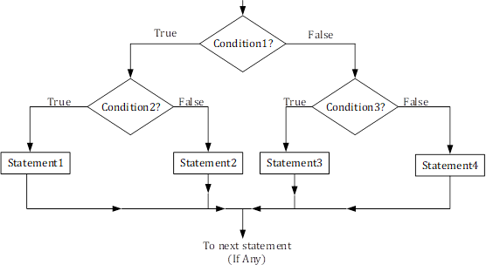
nested if:
Flowchart for nested if is as shown in figure:

Slide 12
Example:
a=int(input("Enter A: "))
b=int(input("Enter B: "))
c=int(input("Enter C: "))
If a > b:
if a>c:
g = a
else
g = c
Else:
if b > c:
g = b
else
g = c
Print(“Greater =”, g)
Output
Enter A: 10
Enter B: 20
Enter C: 5
Greater = 20

Slide 13
elif statement:

Slide 14
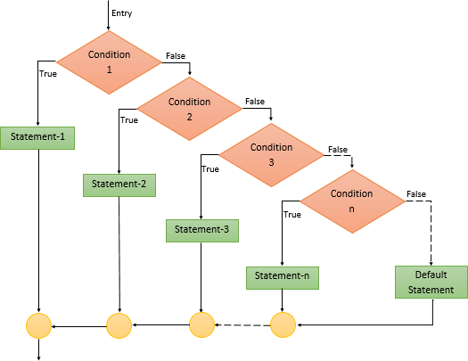
Flowchart for elif is as shown in figure:

Slide 15
Example:
Output:
Enter your age: 4
amount to pay for ticket is 5 rupees Enter your age: 7
amount to pay for ticket is 10 rupees Enter your age: 20
amount to pay for ticket is 18 rupees
age = int( input('Enter your age:’))
if age < 5:
ticket_price = 5
elif age < 16:
ticket_price = 10
else:
ticket_price = 18
print("amount to pay for ticket is",ticket_price,"rupees")

