Slide 1
Identifiers, Statements, Variables, Keywords
UNIT - I

Slide 2
Python Keywords
Keywords are the reserved words in Python where the meaning cannot be changed.

Slide 3
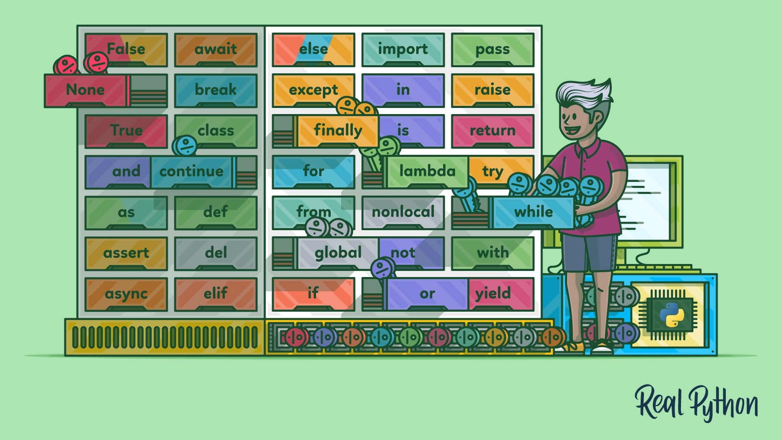
Python Keywords

Slide 4
Python Identifiers
An identifier is a name given to entities(objects) like class, functions, variables, etc.
It helps to differentiate one entity from another.

Slide 5
Rules for writing identifiers
Identifiers can be a combination of letters in lowercase (a to z) or uppercase (A to Z) or digits (0 to 9) or an underscore _.
Example: myClass
var_1
print_this_to_screen, all are valid example.
2. An identifier cannot start with a digit.
Example: 1variable is invalid, but variable1 is a valid name.
3. Keywords cannot be used as identifiers.
Example: global = 1

Slide 6
Rules for writing identifiers
4. We cannot use special symbols like !, @, #, $, % etc. in our identifier.
Example: a@ = 0
5. An identifier can be of any length.
6. Python is case sensitive
Example: Rohith and rohith, both are not same
7. Multiple name in a variable could be underscore
Example: R G Sharma ( Not Valid )
R_G_Sharma( Valid )

Slide 7
Python Variables
A variable is a named location used to store data in the memory.
Example: number = 10
Created a variable named number and assigned the value 10 to the variable.
Numbers and variables can be replaced as and when needed
Example:
number = 10
number = 1.1
Initially, the value of number was 10. Later, it was changed to 1.1

Slide 8
Assigning values to Variables in Python
As you can see from the above example, you can use the assignment operator = to assign a value to a variable.
Example:
Declaring and assigning value to a variable
website = “chatgpt.com"
print(website)
Note: Python is a type-inferred language, so you don't have to explicitly define the variable type.
It automatically knows that apple.com is a string and declares the website variable as a string.

Slide 9
Changing the value of a variable
website = “chatgpt.com"
print(website)
# assigning a new value to website
website = “claude.com"
print(website)
Output:
chatgpt.com
claude.com

Slide 10
Assigning multiple values to multiple variables
a, b, c = 5, 3.2, "Hello"
print (a)
print (b)
print (c)

Slide 11
Assign the same value to multiple variables
x = y = z = "same"
print (x)
print (y)
print (z)

Slide 12
Statement
A statement is an instruction that a Python interpreter can execute. Python statement ends with the token NEWLINE character.
It means each line in a Python script is a statement.
Example: a = 10 is an assignment statement. where a is a variable name and 10 is its value. There are other kinds of statements such as if statement, for statement, while statement, etc.,

Slide 13
Statement
There are mainly four types of statements in Python,
Print statements,
Assignment statements,
Conditional statements,
Looping statements.

Slide 14
Statement
Python Program for Statement Executions
# statement 1
print('Hello’)
# statement 2
x = 20
# statement 3
print(x)
Output: Hello
20

Slide 15
Add multiple statements on a single line separated by semicolons, as follows
# two statements in a single
l = 10; b = 5
# statement 3
print('Area of rectangle:', l * b)
# Output Area of rectangle: 50

Slide 16
Multi-Line Statements
Python statement ends with the token NEWLINE character.
But we can extend the statement over multiple lines using line continuation character (\). This is known as an explicit continuation.

Slide 17
Multi-Line Statements
addition = 10 + 20 + \
30 + 40 + \
50 + 60 + 70
print(addition) # Output: 280

Slide 18
More Python Statements in Brief
Multi-Line Statements
Python Compound Statements
Simple Statements
Expression statements
The pass statement
The del statement
The return statement
The import statement
The continue and break statement

Slide 19
Exercise Questions?
We’ve seen that n = 42 is legal. What about 42 = n?
How about x = y = 1?
In some languages every statement ends with a semicolon, ;. What happens if you put a semicolon at the end of a Python statement?
What if you put a period at the end of a statement?
In math notation you can multiply x and y like this: XY. What happens if you try that in Python

Slide 20
Exercise Questions?
The volume of a sphere with radius r is . What is the volume of a sphere with radius 5?
Suppose the cover price of a book is $24.95, but bookstores get a 40% discount. Shipping costs $3 for the first copy and 75 cents for each additional copy. What is the total wholesale cost for 60 copies?
If I leave my house at 6:52 am and run 1 mile at an easy pace (8:15 per mile), then 3 miles at tempo (7:12 per mile) and 1 mile at an easy pace again, what time do I get home for breakfast?

