Slide 1
Lists
UNIT - II

Slide 2
Lists
A list is a sequence of data values called items or elements. An item can be of any type.
The logical structure of a list resembles the structure of a string. Each of the items in a list is ordered by position.
Like a character in a string, each item in a list has a unique index that specifies its position.
The index of the first item is 0, and the index of the last item is the length of the list minus 1.
As sequences, lists and strings share many of the same operators, but they include different sets of methods.

Slide 3
Lists
Here are some real-world examples of lists:
A shopping list for the grocery store
A guest list for a wedding
A recipe, which is a list of instructions
A text document, which is a list of lines
The names in a phone

Slide 4
List Literals and Basic Operators
Literal string values are written as sequences of characters enclosed in quote marks.
In Python, a list literal is written as a sequence of data values separated by commas.
The entire sequence is enclosed in square brackets ([ and ]).

Slide 5
Example list literals
>>>integers = [1951, 1969, 1984] # A list of integers
>>>fruits = ["apples", "oranges", "cherries"] # A list of strings
>>> empty = [] # An empty list
>>> colours = [“red”, “green”, “blue”] #A list of colours

Slide 6
Example list literals
A Python list may hold different types of values.
>>> days=['Monday','Tuesday','Wednesday',4,5,6,7.0]
>>> languages=[['English'],['Gujarati'],['Hindi'],'Romanian','Spanish']

Slide 7
List Traversals
Python range () method
Example:
# Python3 code to iterate over a list
list = [2, 4, 6, 8, 10]
# getting length of list
length = len(list)

Slide 8
List Traversals
# Iterating the index
# same as 'for i in range(len(list))’
for i in range(length):
print(list[i])

Slide 9
List Traversals
Python enumerate () method
Example:
# Python3 code to iterate over a list
list = [1, 3, 5, 7, 9]
# Using enumerate()
for i, val in enumerate(list):
print (i, ",",val)

Slide 10
By using a for Loop
Example:
# Python3 code to iterate over a list
list = [2, 4, 6, 8, 10]
# Using for loop
for i in list:
print(i)

Slide 11
By using a while Loop
# Python3 code to iterate over a list
list = [2, 4, 6, 8, 10]
# Getting length of list
length = len(list)
i = 0
# Iterating using while loop
while i < length:
print(list[i])
i += 1

Slide 12
Lists
List Comprehension
Lambda function
Python NumPy module

Slide 13
Example 1
>>> days=['Monday','Tuesday','Wednesday',4,5,6,7.0]
>>> days
Output:
[‘Monday’, ‘Tuesday’, ‘Wednesday’, 4, 5, 6, 7.0]

Slide 14
Example 2
>>> languages=[['English'],['Gujarati'],['Hindi'],'Romanian','Spanish']
>>> print(languages)
Output:
[[‘English’], [‘Gujarati’], [‘Hindi’], ‘Romanian’, ‘Spanish’]

Slide 15
Example 2
To access a single element, use its index in square brackets after the list’s name. Indexing begins at 0.
>>> languages[0]
Output:
[‘English’]

Slide 16
Example 2
An index cannot be a float value.
>>> languages[1.0]
Output:
Traceback (most recent call last):File “<pyshell#70>”, line 1, in <module> languages[1.0]
TypeError: list indices must be integers or slices, not float

Slide 17
Slicing
When you want only a part of a Python list, you can use the slicing operator [].
>>> indices=['zero','one','two','three','four','five']
>>> indices[2:4]
Output
[‘two’, ‘three’]
This returns items from index 2 to index 4-1 (i.e., 3)

Slide 18
Slicing
>>> indices[:4]
Output
[‘zero’, ‘one’, ‘two’, ‘three’]
This returns items from the beginning of the list to index 3.

Slide 19
Slicing
>>> indices[4:]
Output
[‘four’, ‘five’]
It returns items from index 4 to the end of the list in Python.

Slide 20
Slicing
>>> indices[:]
Output
[‘zero’, ‘one’, ‘two’, ‘three’, ‘four’, ‘five’] This returns the whole list.

Slide 21
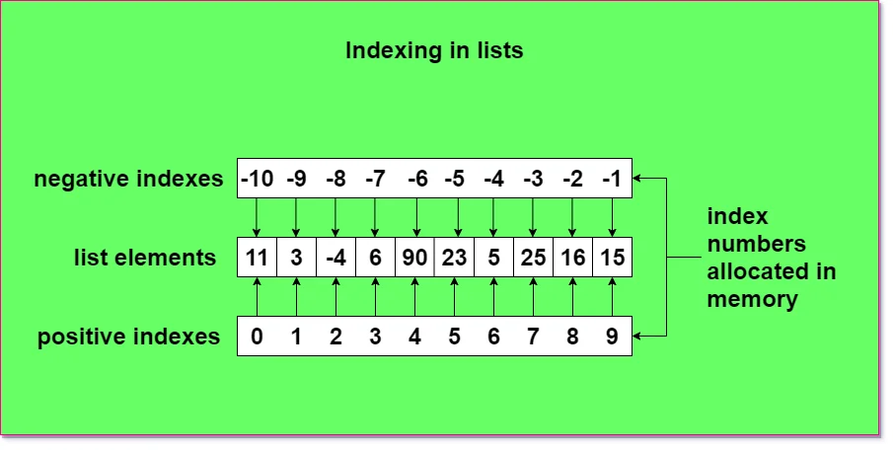
Slicing

Slide 22
Slicing
Negative indices- The indices we mention can be negative as well. A negative index means traversal from the end of the list.
>>> indices[:-2]
Output
[‘zero’, ‘one’, ‘two’, ‘three’]
This returns item from the list’s beginning to two items from the end.

Slide 23
Slicing
>>> indices[1:-2]
Output
[‘one’, ‘two’, ‘three’]
It returns items from the item at index 1 to two items from the end.

Slide 24
Slicing
>>> indices[-2:-1]
Output
[‘four’]
This returns items from two from the end to one from the end.
>>> indices[-1:-2]
Output
[]
This returns an empty Python list, because the start is ahead of the stop for the traversal.

Slide 25
Method | Description | Example
append(x) | Adds an element to the end of the list | lst.append(10)
extend(iterable) | Adds all elements of an iterable | lst.extend([4, 5])
insert(index, x) | Inserts an element at a specified position | lst.insert(1, "A")
remove(x) | Removes the first occurrence of the specified value | lst.remove(5)
pop([index]) | Removes and returns an element (last by default) | lst.pop()
clear() | Removes all elements from the list | lst.clear()
index(x) | Returns the index of the first occurrence | lst.index(20)
count(x) | Counts how many times an element appears | lst.count(5)
sort() | Sorts the list in ascending order | lst.sort()
reverse() | Reverses the order of the list | lst.reverse()
copy() | Returns a shallow copy of the list | new_lst = lst.copy()

Slide 26
List Methods
A method is what you can do to it and change it. To call a method on a construct, you use the dot-operator(.).
Python supports some built-in methods to alter a Python list.

Slide 27
List Methods
append()
It adds an item to the end of the list.
>>> a
Output
[2, 1, 3]
>>> a.append(4)
>>> a
Output
[2, 1, 3, 4]

Slide 28
List Methods
insert()
It inserts an item at a specified position.
>>> a.insert(3,5)
>>> a
Output
[2, 1, 3, 5, 4]
This inserted the element 5 at index 3.

Slide 29
List Methods
remove()
It removes the first instance of an item from the Python list.
>>> a=[2,1,3,5,2,4]
>>> a.remove(2)
>>> a
Output
[1, 3, 5, 2, 4]

Slide 30
List Methods
pop()
It removes the element at the specified index, and prints it to the screen.
>>> a.pop(3)
Output
2
>>> a
Output
[1, 3, 5, 4]

Slide 31
List Methods
clear()
It empties the Python list.
>>> a.clear()
>>> a
Output
[]
It now has a False value.
>>> bool(a)
Output
False

Slide 32
List Methods
index()
It returns the first matching index of the item specified.
>>> a=[1,3,5,3,4]
>>> a.index(3)
Output
1

Slide 33
List Methods
count()
It returns the count of the item specified.
>>> a.count(3)
Output
2

Slide 34
List Methods
sort()
It sorts the list in an ascending order.
>>> a.sort()
>>> a
Output
[1, 3, 3, 4, 5]

Slide 35
List Methods
reverse()
It reverses the order of elements in the Python lists.
>>> a.reverse()
>>> a
Output
[5, 4, 3, 3, 1]

Slide 36
List Comprehension
Creation of a new list just like you would do in mathematics.
To do so, type an expression followed by a for statement, all inside square brackets. You may assign it to a variable.
Let’s make a list for all even numbers from 1 to 20.
>>> even=[2*i for i in range(1,11)]
>>> even
Output
[2, 4, 6, 8, 10, 12, 14, 16, 18, 20]

Slide 37
List Comprehension
Optionally, you can add an if-statement to filter out items.
If we want to change this list to hold only those items from 1 to 20 that are even and are divisible by 3, we write the following code.
>>> even=[2*i for i in range(1,11) if i%3==0]
>>> even
Output
[6, 12, 18]

Slide 38
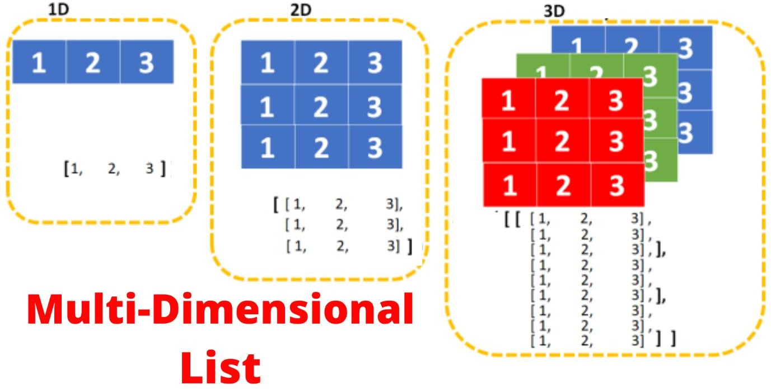
Multidimensional Lists in Python

Slide 39
Multidimensional Lists in Python
A one-dimensional list is a simple list without any sublists.
A two-dimensional list is a list that solely contains many single-dimensional lists.
A three-dimensional list solely contains many two-dimensional lists that solely contains many single-dimensional lists.
This concludes that Multi-dimensional lists are the lists within the lists within the lists within the lists and so on.

Slide 40
Multidimensional Lists in Python
Example 1:
>>>grocery_list=[['caramel','P&B','Jelly'],['onions','potatoes'],['flour','oil']]
>>> grocery_list
Output
[[‘caramel’, ‘P&B’, ‘Jelly’], [‘onions’, ‘potatoes’], [‘flour’, ‘oil’]]
This is a grocery Python list with lists in it, where the lists are according to a category. Or, you can choose to go deeper.

Slide 41
Multidimensional Lists in Python
Example 2:
>>> a=[[[1,2],[3,4],5],[6,7]]
>>> a
Output
[[[1, 2], [3, 4], 5], [6, 7]]

Slide 42
Multidimensional Lists in Python
To access the element 4 here, we type the following code into the shell.
Example 3:
>>> a[0][1][1]
>>> a[0][1][1]
Output
4

Slide 43
Multidimensional Lists in Python
Example 4:
rows=[] columns=[]
for i in range(3):
for j in range(3):
columns.append(1)
rows.append(columns)
Output: [[1, 1, 1], [1, 1, 1], [1, 1, 1]]

Slide 44
Multidimensional Lists in Python
Example 5:
rows = [1, 1, 1]
columns = [1, 1, 1]
for i in range(len(rows)):
for j in range(len(columns)):
print(rows[i], end=" ")
print()
Output:
1 1 1
1 1 1
1 1 1

