Slide 1
Regular Expressions
Matching, Search and replace, Patterns.

Slide 2
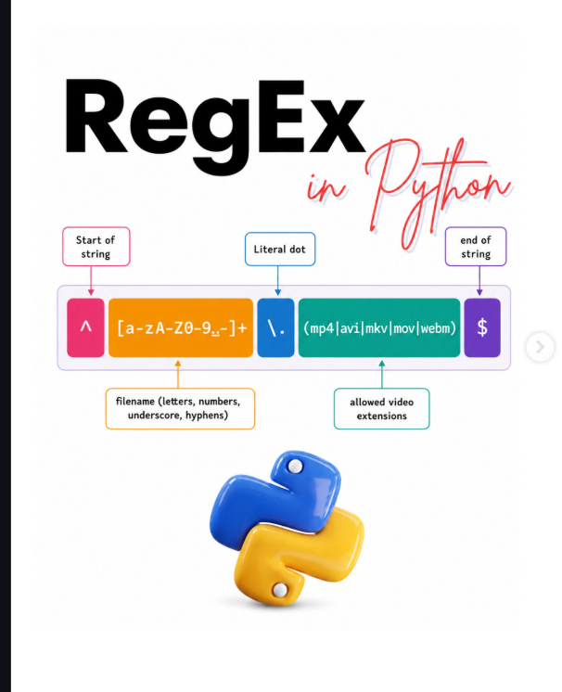

Slide 3
What is Regex?
Regex(Regular Expression) is a pattern used to search, match, extract, replace, or validate text.
Instead of checking every character manually, we can describe the text we are looking for using a compact pattern.
Regex is especially useful when the text follows a recognizable structures such as numbers, words, email-like strings, dates, or specific character combinations.

Slide 4
Why do we Use Regex?
Regex makes many text-processing tasks easier. It can be used to:
Search for a particular pattern
Extract useful information form text
Replace matching text
Validate user input
Find numbers, words, spaces, or symbols
Common applications include checking emails and phone numbers, validating passowrds, finding dates, extacting IDs, and cleaning text.

Slide 5
Importing the re module
Python provides the built-in re module for working with the regular expressions. No external installation is required.
We import it before using Regex functions.
Import re

Slide 6
Pattern | Meaning | Example
\d | Digit 0–9 | 123
\D | Not a digit | abc
\w | Word character | A, 7, _
\W | Not a word character | @, #
\s | Whitespace | space, tab
\S | Non-whitespace
. | Any character | a, 1, @
^ | Beginning of string | ^Hello
$ | End of string | world$
* | 0 or more | a*
+ | 1 or more | a+
? | 0 or 1 | a?
{n} | Exactly n | \d{10}
{n,m} | n to m | \d{2,4}
[] | Character set | [abc]
[^] | Not in set | [^0-9]
() | Group | (abc)
` | ` | OR

Slide 7
Example
text = "My phone number is 9876543210“
To find the 10-digit number:
import re
text = "My phone number is 9876543210"
result = re.search(r"\d{10}", text)
print(result.group())
\d → digit
{10} → exactly 10 occurrences
r"" → raw string, recommended for regex patterns

Slide 8
re.match()
Checks only from the beginning of the string.
import re
text = "Python is powerful"
result = re.match("Python", text)
print(result.group())
Python

Slide 9
re.match()
import re
text = "Python is powerful"
result = re.match("powerful", text)
print(result)
None

Slide 10
re.findall()
One of the most useful functions.
It finds all matches.
import re
text = "Python 123, Java 456, C++ 789"
numbers = re.findall(r"\d+", text)
print(numbers)
['123', '456', '789']

Slide 11
re.findall()
text = "cat dog cat bird cat"
words = re.findall(r"cat", text)
print(words)
['cat', 'cat', 'cat']

Slide 12
re.sub()
Used to replace text.
import re
text = "Python is difficult"
new_text = re.sub("difficult", "easy", text)
print(new_text)
Python is easy

Slide 13
Remove numbers
Python is powerful
text = "Python123 is456 powerful789"
result = re.sub(r"\d+", "", text)
print(result)

Slide 14
Character Sets []
Find vowels
text = "Hello Python"
result = re.findall(r"[aeiou]", text)
print(result)
['e', 'o', 'o']

Slide 15
Find lowercase letters
result = re.findall(r"[a-z]", text)

Slide 16
Find uppercase letters
result = re.findall(r"[A-Z]", text)

Slide 17
Find digits
result = re.findall(r"[0-9]", text)

Slide 18
Quantifiers
Quantifiers tell Python how many times something should occur.
* — zero or more
re.findall(r"ab*", "a ab abb abbb")
a
ab
abb
abbb

Slide 19
Quantifiers
+ — one or more
re.findall(r"ab+", "a ab abb abbb")
Matches:
ab
abb
abbb

Slide 20
Quantifiers
? — zero or one
re.findall(r"colou?r", "color colour")
Matches:
color
colour

Slide 21
Quantifiers
{n}
Exactly n.
re.findall(r"\d{4}", "2024 2025 123")
['2024', '2025']

Slide 22
Quantifiers
{n,m}
Between n and m.
re.findall(r"\d{2,4}", "1 12 123 1234 12345")

Slide 23
Email Validation
Valid email
A simple email regex:
import re
email = "student@example.com"
pattern = r"^[\w.-]+@[\w.-]+\.\w+$"
if re.match(pattern, email):
print("Valid email")
else:
print("Invalid email")

Slide 24
Phone Number Extraction
For Indian 10-digit mobile numbers:
import re
text = """
Contact Ravi: 9876543210
Contact Kumar: 9123456789
"""
numbers = re.findall(r"\b[6-9]\d{9}\b", text)
print(numbers)
['9876543210', '9123456789']

