Slide 1
Types: Integer and String Values, Boolean
UNIT - I

Slide 2
Types: Integer and String Values, Boolean
Python supports a number of numeric and nonnumeric values.
In particular, Python programs can use integer values. The Python statement “print(4)” prints the value 4. The value 4 is an example of an integer expression.
Python supports other types of expressions besides integer expressions.

Slide 3
Types: Integer and String Values, Boolean
An expression is a basic building block of a Python statement.
The number 4 by itself is not a complete Python statement and, therefore, cannot be a program.
The interpreter, however, can evaluate a Python expression.

Slide 4
Types: Integer and String Values, Boolean
You may type the enter 4 directly into the interactive interpreter shell:

Slide 5
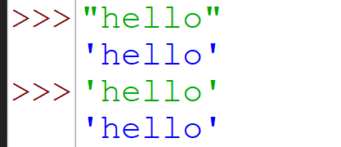
Types: Integer and String Values, Boolean
The expression "19" is an example of a string value. A string is a sequence of characters. Strings most often contain nonnumeric characters:

Slide 6
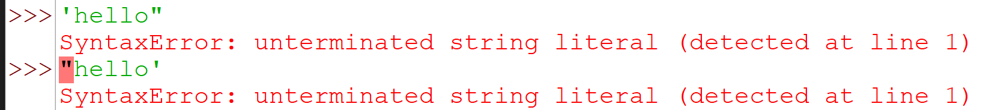
Types: Integer and String Values, Boolean
You may not mix the two kinds of quotation marks when used to delimit a particular string, as the following interactive sequence shows:

Slide 7
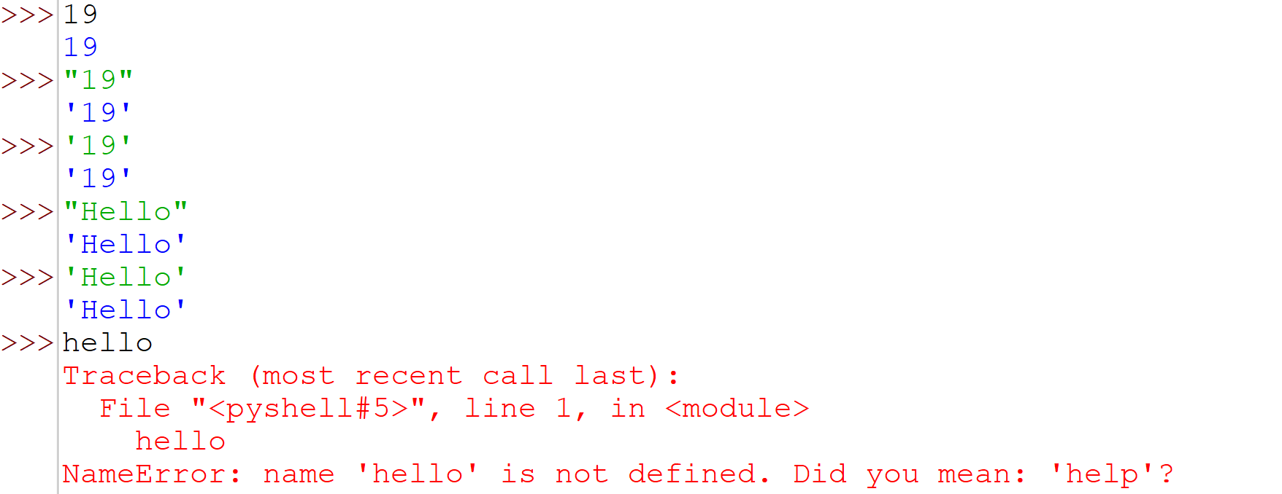
The interpreter’s output always uses single quotes, but it accepts either single or double quotes as valid input. Consider the following interaction sequence:

Slide 8
Types: Integer and String Values, Boolean
It is important to note that the expressions 4 and '4' are different. One is an integer expression and the other is a string expression.
All expressions in Python have a type.
The type of an expression indicates the kind of expression it is. An expression’s type is sometimes denoted as its class. At this point we have considered only integers and strings.

Slide 9
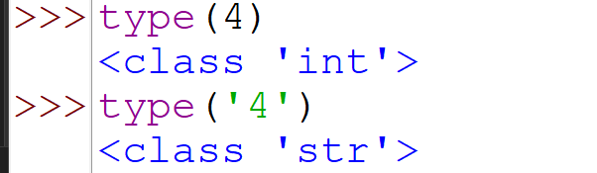
Types: Integer and String Values, Boolean
The built in type function reveals the type of any Python expression:

Slide 10
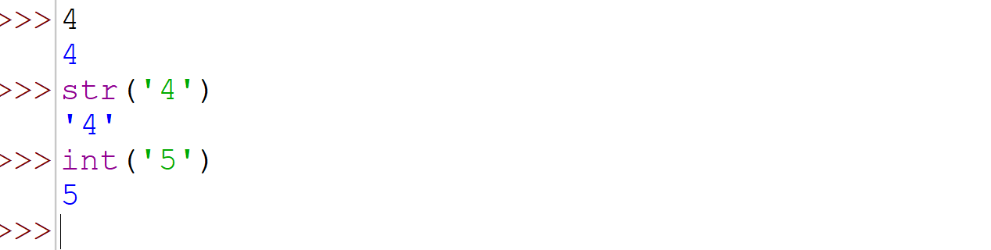
Types: Integer and String Values, Boolean
Python associates the type name int with integer expressions and str with string expressions.
The built-in int function creates an actual integer object from a string that looks like an integer, and the str function creates a string object from the digits that make up an integer:

Slide 11
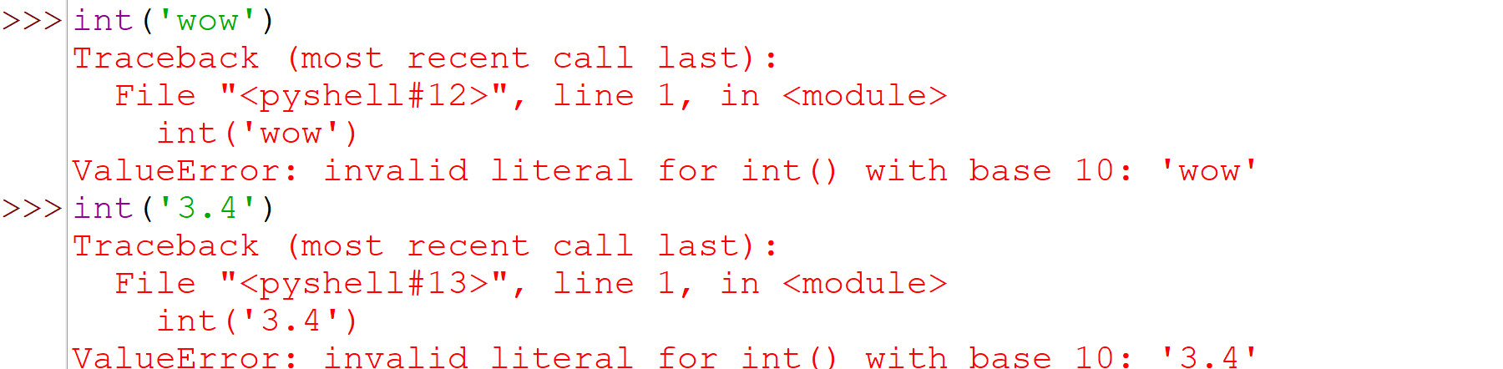

Slide 12
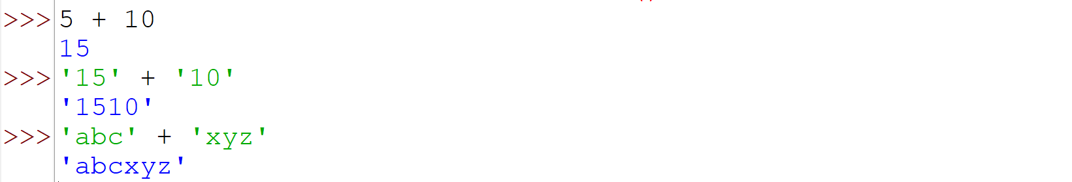
The plus operator (+) works differently for strings; consider:

Slide 13
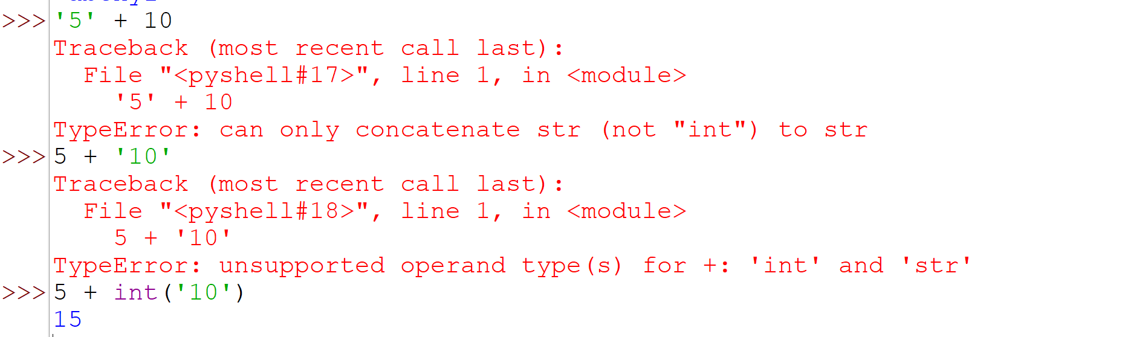
The plus operator splices two strings together in a process known as concatenation. Mixing the two types directly is not allowed:

Slide 14
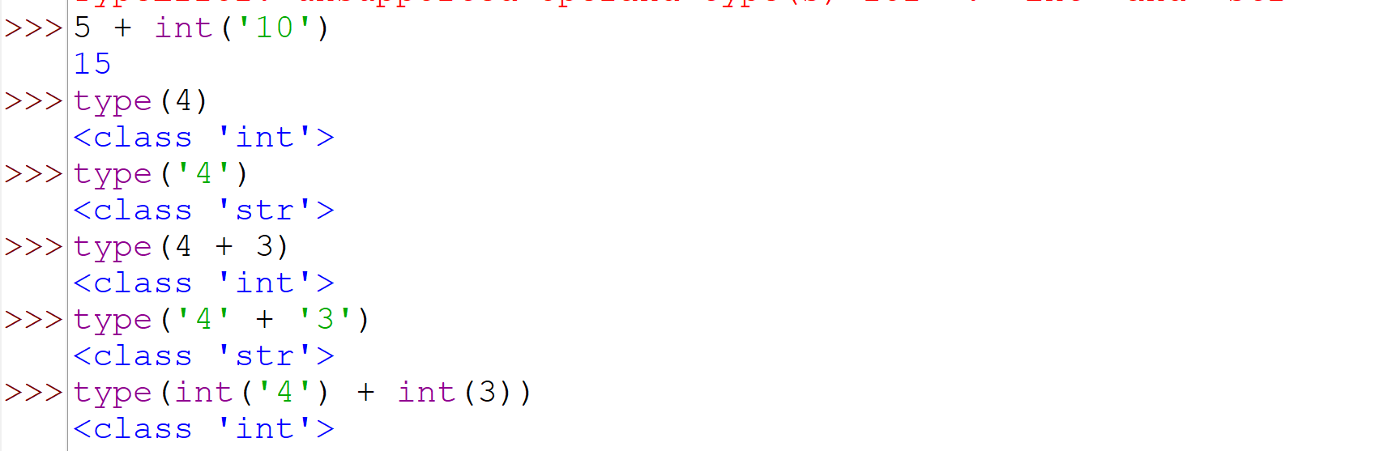
The type function can determine the type of the most complicated expressions:

Slide 15
Boolean Expressions
Arithmetic expressions evaluate to numeric values; a Boolean expression, sometimes called a predicate, may have only one of two possible values: false or true.
The term Boolean comes from the name of the British mathematician George Boole. A branch of discrete mathematics called Boolean algebra is dedicated to the study of the properties and the manipulation of logical expressions.

Slide 16
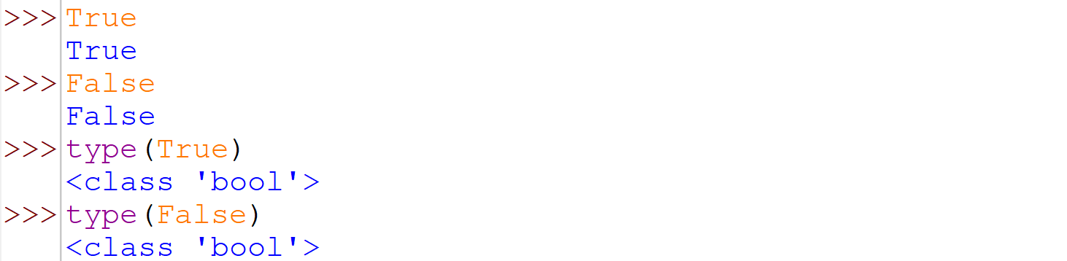

Slide 17
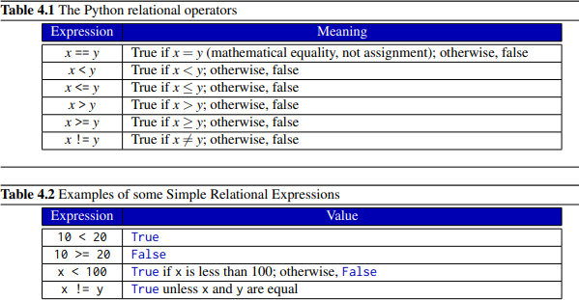

Slide 18
