Slide 1
Operators
UNIT - I

Slide 2
Operators
Python language supports the following types of operators.
Arithmetic Operators
Comparison (Relational) Operators
Assignment Operators
Logical Operators
Bitwise Operators
Membership Operators
Identity Operators

Slide 3
Arithmetic Operators
Arithmetic Operators some basic arithmetic operators are +,-,*,/,%,**, and //.
You can apply these operators on numbers as well as variables to perform corresponding operations.

Slide 4
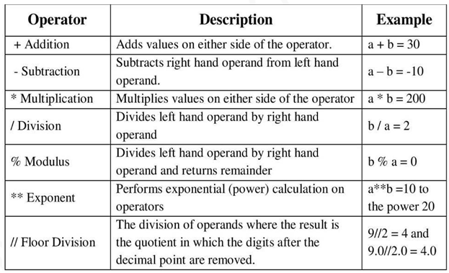

Slide 5
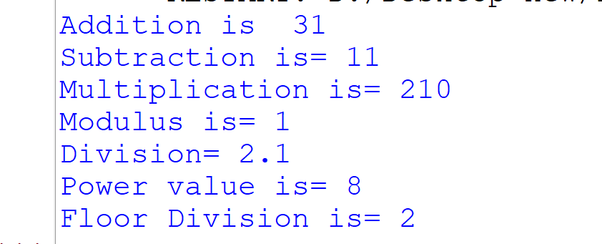
Arithmetic Operators
a=21
b=10
print("Addition is ",a+b)
print("Subtraction is=",a-b)
print("Multiplication is=",a*b)
print("Modulus is=",a%b)
print("Division=",a/b)
a=2
b=3
print("Power value is=",a**b)
a=10
b=4
print("Floor Division is=",a//b)

Slide 6
Comparison (Relational) Operators:
These operators compare the values on either sides of them and decide the relation among them.
They are also called Relational operators.

Slide 7
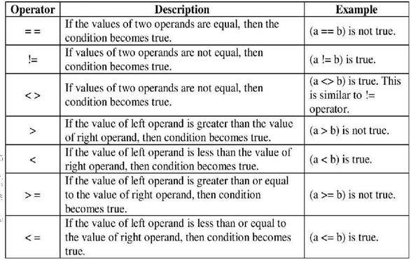

Slide 8
Comparison (Relational) Operators:
a=10 b=30
if a<b:
print("b is big") elif a>b:
print("a is big") else:
print("both are equal")
b is big

Slide 9
Assignment Operators:
Python Assignment operator is used for assigning the value of right operand to the left operand.

Slide 10
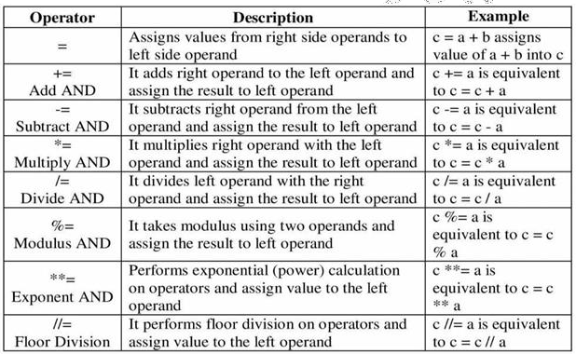

Slide 11
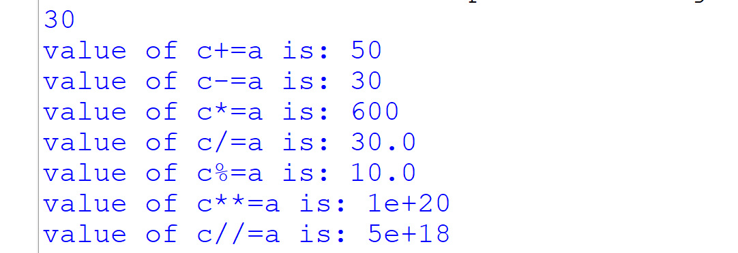
Assignment Operators:
a=20
b=10
c = 3
c=a+b
print(c)
c+=a
print("value of c+=a is:",c)
c-=a
print("value of c-=a is:",c)
c*=a
print("value of c*=a is:",c)
c/=a
print("value of c/=a is:",c)
c%=a
print("value of c%=a is:",c)
c**=a
print("value of c**=a is:",c)
c//=a
print("value of c//=a is:",c)
Assignment Operators

Slide 12
Logical operator
Logical operators in Python are used for conditional statements are true or false. Logical operators in Python are AND, OR and NOT.
For logical operators following condition are applied.
For AND operator – It returns TRUE if both the operands (right side and left side) are true.
For OR operator- It returns TRUE if either of the operand (right side or left side) is true.
For NOT operator- returns TRUE if operand is false.

Slide 13
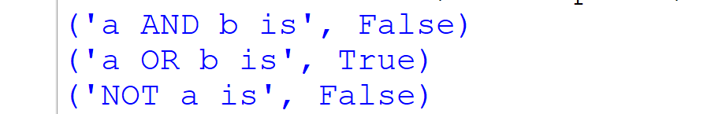
Logical operator
a = True
b = False
print(('a AND b is',a and b))
print(('a OR b is',a or b))
print(('NOT a is',not a))

Slide 14
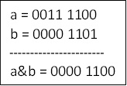
Bitwise Operators
Bitwise operator works on bits and performs bit by bit operation. Assume if a = 60; and b = 13;
Now in binary format they will be as follows:

Slide 15
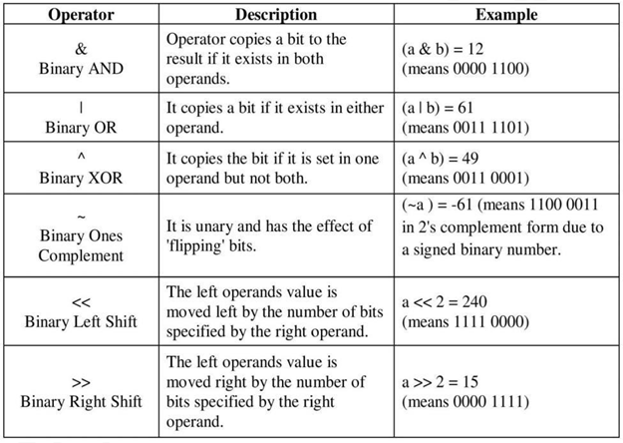

Slide 16
Membership Operators
Membership operators are operators used to validate the membership of a value.
It tests for membership in a sequence, such as strings, lists, or tuples. There are two membership operators.
In Operator
Not in Operator

Slide 17
in operator
The ‘in’ operator is used to check if a value exists in a sequence or not. Evaluates to true if it finds a variable in the specified sequence and false otherwise.

Slide 18
In operator
numbers = [10, 20, 30, 40]
print(20 in numbers)
print(50 in numbers)
True
False

Slide 19
‘not in’ operator:
Evaluates to true if it does not finds a variable in the specified sequence and false otherwise.

Slide 20
‘not in’ operator:
fruits = ["Apple", "Banana", "Mango"]
print("Orange" not in fruits)
print("Banana" not in fruits)
False
True

Slide 21
Identity Operators
Identity operators compare the memory locations of two objects. There are two Identity operators.
Is Operator
Not is Operator

Slide 22
Identity Operators
a = [10, 20, 30]
b = a
print(a is b)
print(a is not b)
True
False

