Slide 1
Hackathon Project
Find the Interest Amount for current year
Group – 2
Group name: Pirates of the CTS

Slide 2
Project done by:
Pola Ramana (2230163)
Arpitha S (2230357)
Siripi Praveena (2230103)
Vinod K(2230226)
Akash G K(2230651)
Tarange Vishal Pandurang(2230531)

Slide 3
Problem Statement :
1. Buying a car of 15 Lac
2. Interest rate of 9.5%
3. Tenure should be 1 year.
Display the interest amount & principal amount of first month.
(Suggested Site: emicalculator.net / HDFCbank.com etc. however you are free to use any other legitimate site)

Slide 4
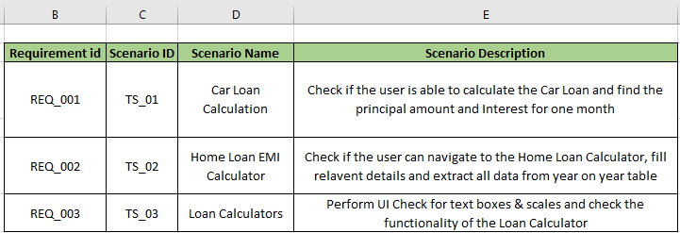
Test Scenarios:

Slide 5
APPROACH :
The Hackathon problem that is given is automated by Selenium.
Maven Plugin used for Architectural Design & Dependencies.
TestNG framework for Test Execution using TestNG Annotations.
Extent for Reports and analysis.

Slide 6
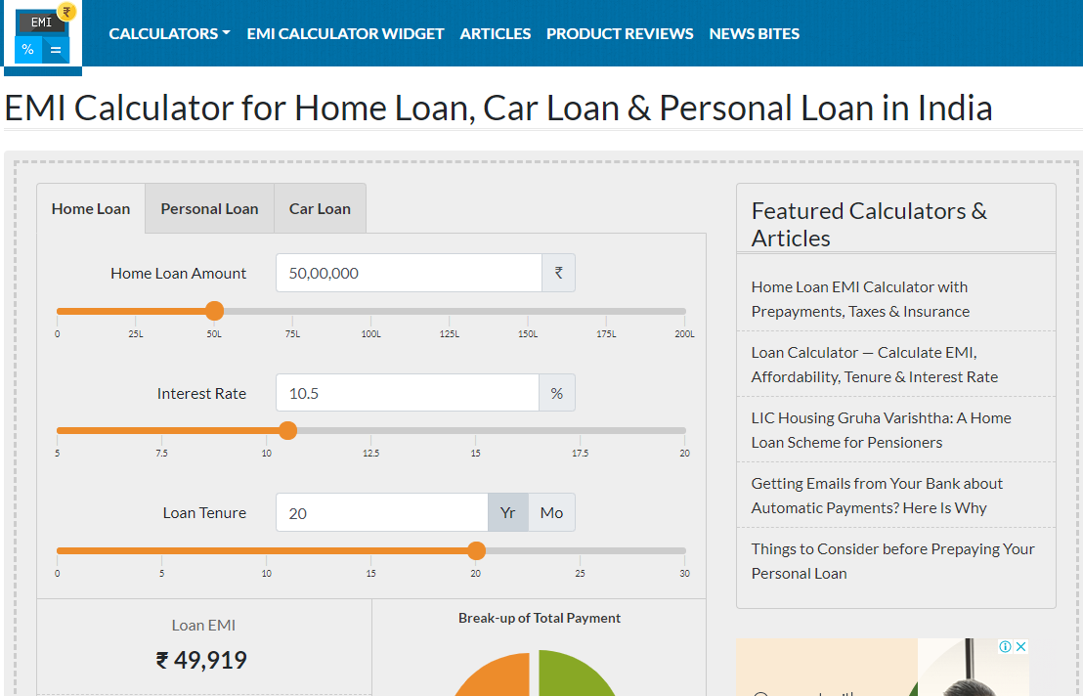
Home page of EMI calculator.net :

Slide 7
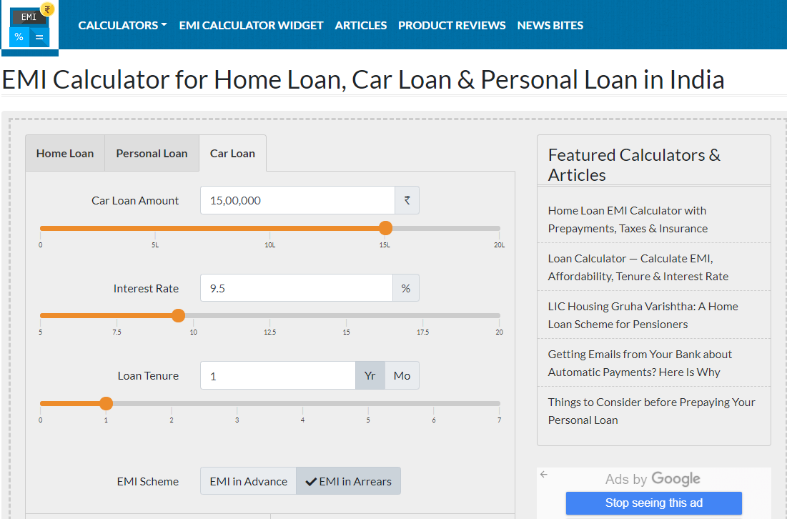
Scenario 1 : Find the EMI for car with price of 15 lacs, interest rate of 9.5% & Tenure 1 year ; Display the interest amount and principal amount for one month

Slide 8
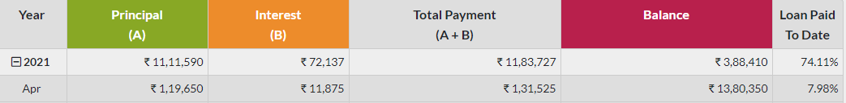
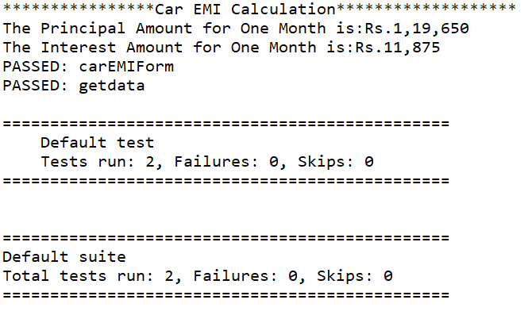
Scenario 1:
Extracting and displaying the Principal Amount and Interest Amount for one month with the given data on to the console.

Slide 9
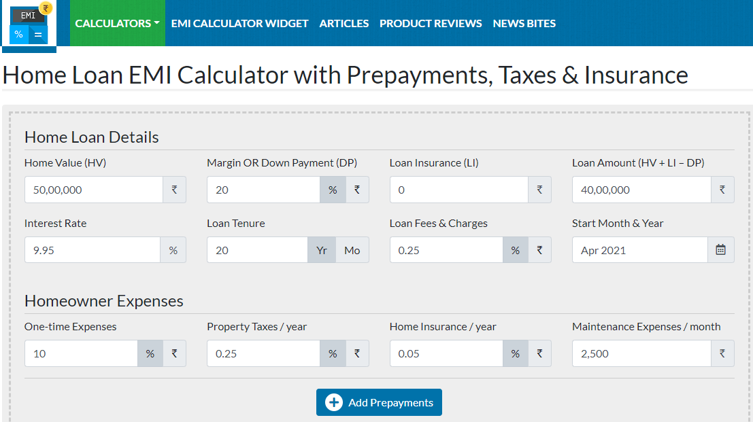
Scenario 2:From Menu, pick Home Loan EMI Calculator, fill relevant details & extract all the data from year on year table & store in excel.

Slide 10
Scenario 2:
Navigating to required fields using relative xpaths and filling required data
To extract the output into the excel sheet we created workbook.
After creation of the workbook and sheet we obtain the row and cell to read the data(String/Numeric) present in it.

Slide 11
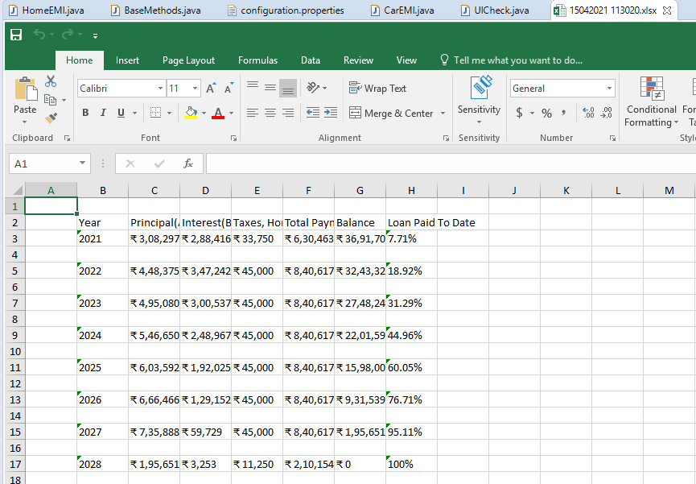
A new excel sheet is created with the data that generated after filling required data

Slide 12
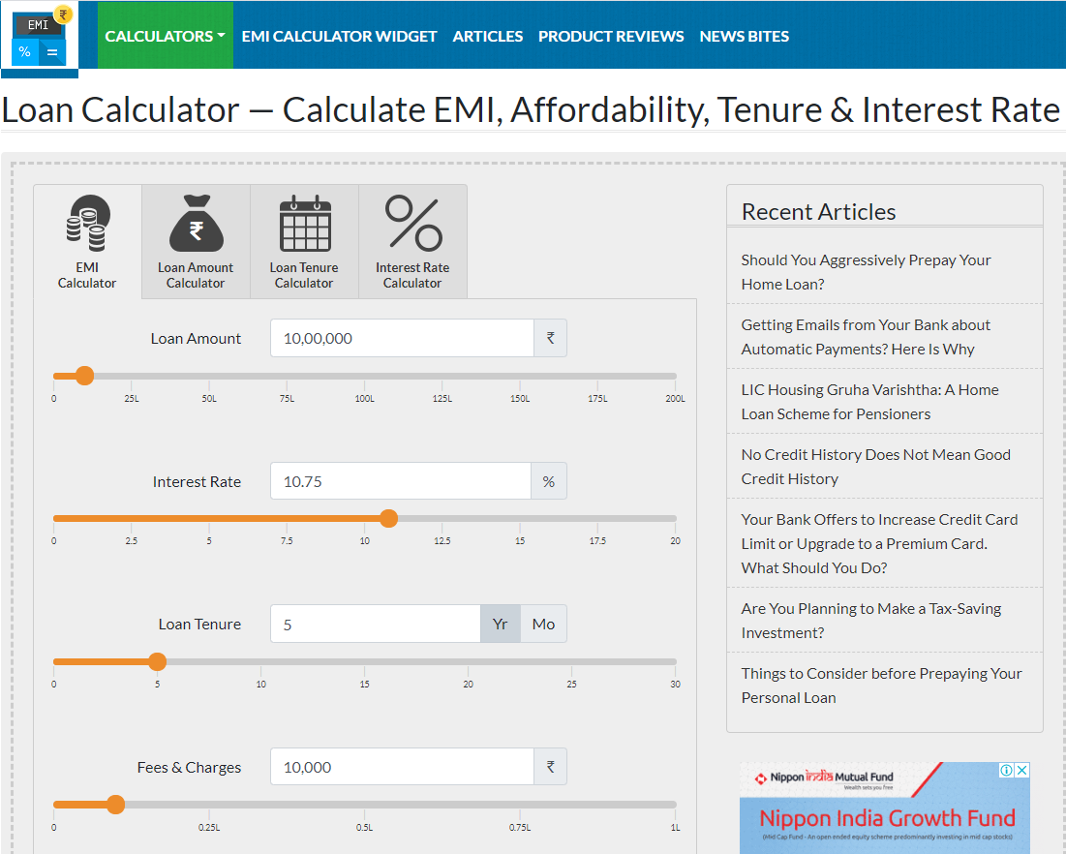
Scenario 3: From Menu, pick Loan Calculator and under EMI calculator, do all UI check for text box & scales; change the Loan tenure for year ,check the change in scale; Re-use the same validation for Loan Amount Calculator & Loan Tenure Calculator

Slide 13
Scenario 3: EMI Calculator
For “EMI Calculator” , we have done UI checking of all the text boxes and scales by locating the fields with findElement(By) method and applying Action class to handle “drag and drop” mouse event to change the scales to our desired values.
We have done UI check of the “Loan Amount” , “Loan Tenure” , “Interest Rate” , “Fees & Charges” fields.Switching and validating all checks for Loan Tenure Calculator and Loan Amount Calculator

Slide 14
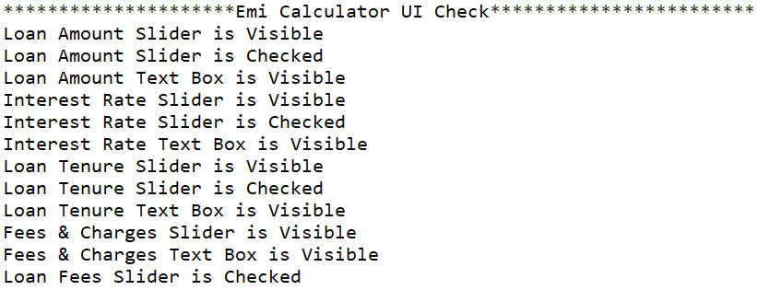
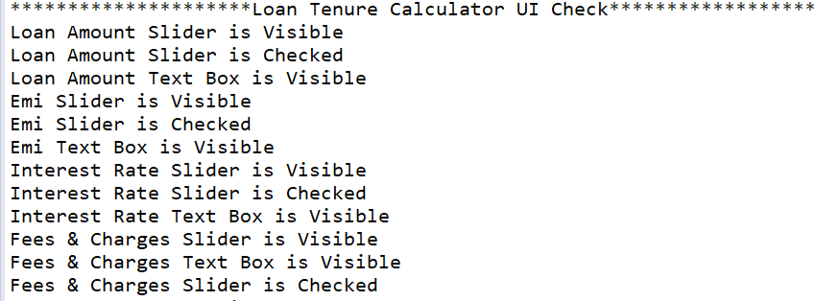
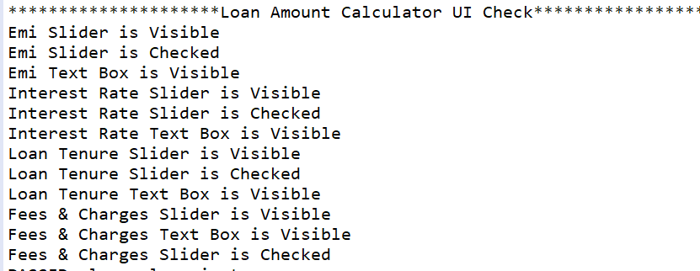
Checking and Validating the fields of Loan Calculator:

Slide 15
Key Automation Scope
Validation of transactions & calculations;
Extract table values & store in excel
Filling data in screen & multiple UI validations
Navigation from Menus
Reusable methods
Scrolling down in web page

Slide 16
THANK YOU

