Slide 2
This chart is not a standard MS Excel chart, but specially made for the house style of Radboud University. You can change the data, but can not choose another chart style.
Right click with the mouse on the chart and choose ‘edit data’.

Slide 3
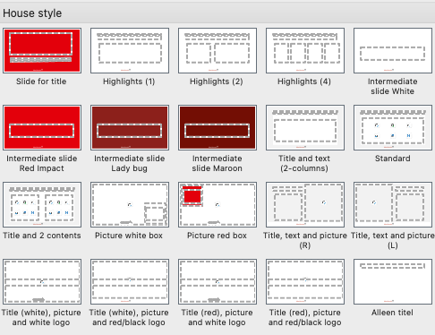
Available Slide Layouts
This template includes several predefined layouts to help you present your information clearly and consistently.
You can select a layout in two ways:
New Slide ▼ → click the arrow next to New Slide to choose a design when adding a new slide
Home > Layout → change the design of an existing slide
Pick the layout that best fits your content.

Slide 4

List of available text styles
List 1st level
  List 2nd level
    List 3rd level
      List number 1st level
        List number 2nd level
          List number 3rd level
            Heading
              Plain text
                Indent 1st level
              Text styles can be applied by the formatting menu
              (see special Ribbon Radboud Universiteit).
        In case this ribbon is not installed please use the buttons for Decrease and Increase List Level (see picture below) to change text styles. You can find these buttons on tab Home, group Paragraph. Do not use the buttons for bullets and numbering.

Slide 5
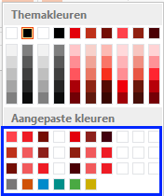
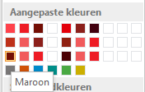
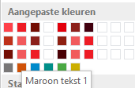
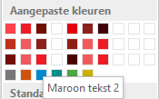
How to apply colors
              This template contains additional colors.
              There are groups of colors. The first are basic colors, which also are theme
              colors. The 2 colors next to a basic color can be combined with this basic color.
              Example:
              You can hover with the mouse pointer above the boxes and than the
              name of the color appears.
              The colors below are for charts or tables. Slide 2 shows an example of a chart.
Poppy -->
a
<--Red Impact
Lady bug -->
<--Berry
Maroon-->
<--Mahogany

Slide 6
icons
              This template includes a collection of icons in the official brand style.
              You can copy and paste these icons into your slides to visually support your content and keep the presentation consistent.
1
2
3
4
5
For more icons, please visit our website

