Slide 1

Department of Computer Science and Engineering
Movie Data Engineering Pipeline using Python and SQLite
Batch Members: 2320030224 – R. Akshaya 2320030231 – Harshitha 2320030493 – A. Vinod | Domain Data Engineering Under the Guidance of Dr. N. Shirisha, Assoc.Prof.

Slide 2

Abstract
Movie Dataset Analysis has been showed as a pipeline throughout this project.
The dataset collected consist of various movies and their info along with their credits.
We divided our project into multiple phases — similar to a real-world data pipeline.
We started with raw datasets, then moved through stages of ingestion, cleaning, transformation, loading, and analysis.
Each of these stages was implemented in a separate Python script to keep our code modular and maintainable.

Slide 3
Objectives
To simulate a real-world data engineering workflow by building an end-to-end movie data pipeline.
To ingest raw movie datasets (TMDB Movies and Credits) using Python and Pandas.
To analyze the data by running SQL queries to extract insights such as top genres and revenue trends.
To visualize insights using graphs and charts for better understanding of movie performance patterns.
To document and version control the entire pipeline using Git and GitHub for reproducibility.

Slide 4
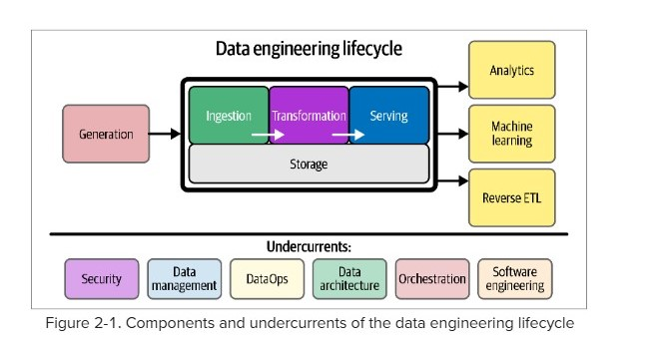
Life Cycle

Slide 5
Modules
Phase 1:
The first phase is Data Ingestion, where we load our datasets – ‘tmdb_5000_movies.csv’ and ‘tmdb_5000_credits.csv’
We used Python’s Pandas library to read these CSV files and perform some basic exploration like checking their size, column names, and missing values
Phase 2:
The second phase is Data cleaning and integration – in this phase we have merged both the datasets using the common movie_id column
Handled missing values, calculated metrics like profit, revenue, etc…

Slide 6
Cont…
Phase 3:
Data Loading – Storing final dataset into a database for analysis.
Used SQLite – a lightweight relational database, and SQLAlchemy, which acts as a bridge between Python and SQL.
Phase 4:
Finally, we performed Data Analysis using SQL queries and visualizations.

Slide 7
Tools and Technology
Python:
Python is the primary programming language used for building the data pipeline. Its rich ecosystem of libraries makes tasks like data ingestion, cleaning, and transformation easier. It is highly readable and widely used in data engineering and analytics. Python scripts handle reading CSV/Excel files, processing movie and credit datasets, and preparing them for analysis.
Pandas:
Pandas is a Python library for data manipulation and analysis. It allows efficient handling of structured data, such as CSVs, and provides tools for filtering, grouping, and aggregating data. In the pipeline, Pandas is used to clean, merge, and transform movie and credit datasets. Its DataFrame structure simplifies data operations and analysis.

Slide 8
Cont…
SQLite:
SQLite is a lightweight relational database used for storing processed data. It allows querying using SQL and is easy to integrate with Python. In the pipeline, it stores the cleaned movie and credit data, making it easy to retrieve and analyze efficiently.
SQLAlchemy:
SQLAlchemy is a Python library for working with databases using an ORM (Object Relational Mapping) approach. It helps Python interact with SQLite without writing raw SQL for every operation. In the project, it is used to insert, update, and query movie and credit data programmatically.
Git and GitHub:
Git is a version control system that tracks changes in the project code. GitHub is a cloud-based platform for hosting repositories and collaborating with team members. Together, they help manage code versions, collaborate efficiently, and maintain a backup of the pipeline scripts.

Slide 9
Existing System vs Proposed System
Existing System: Raw TMDB datasets are unstructured, contain missing values, and are difficult to merge or analyze directly. No centralized database — data analysts manually clean and process data each time.
Proposed System: We built an automated data pipeline that ingests, cleans, transforms, and loads movie data into a structured SQLite database. Enables easy querying, reusability, and visualization that is converting static CSV files into a dynamic, analysis-ready system.

Slide 10
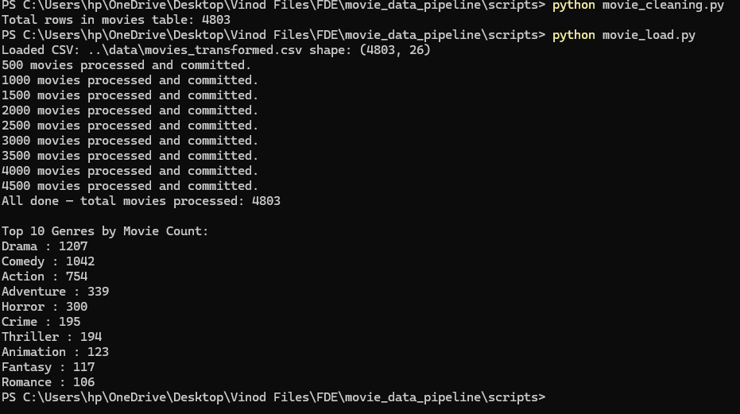
Module Implementation and Result

Slide 11
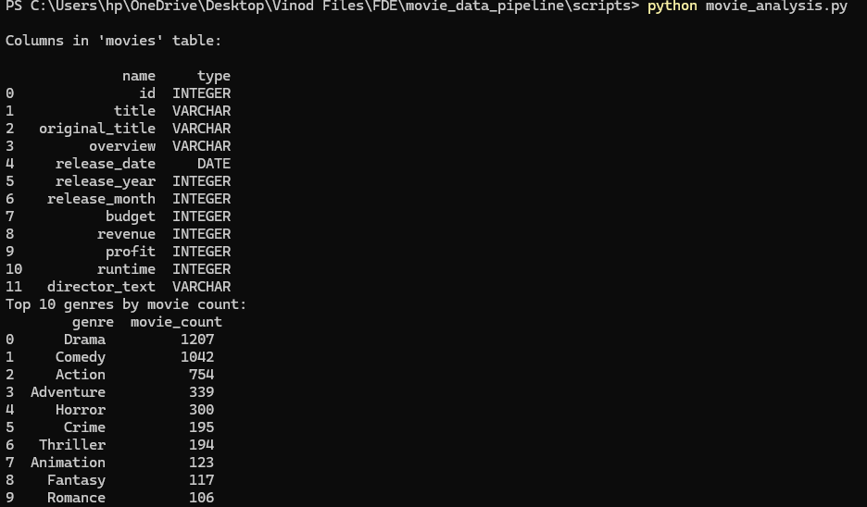
Implementation

Slide 12
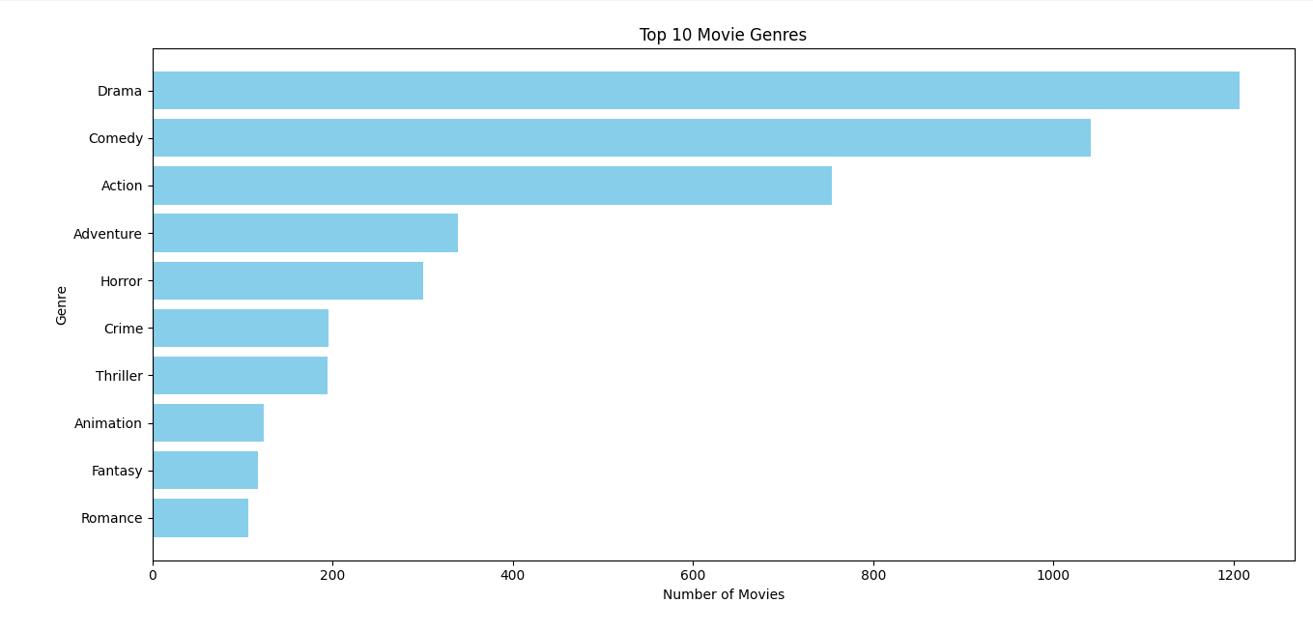

Slide 13
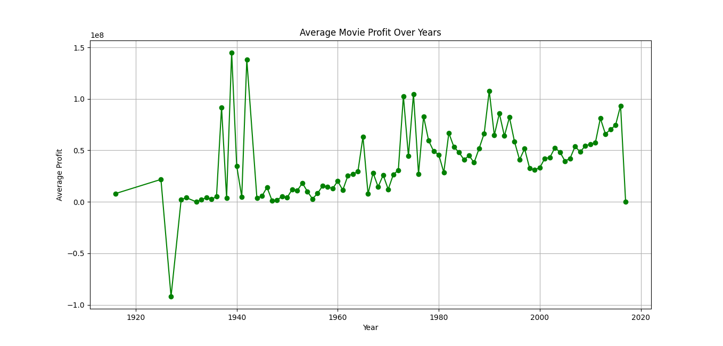

Slide 14
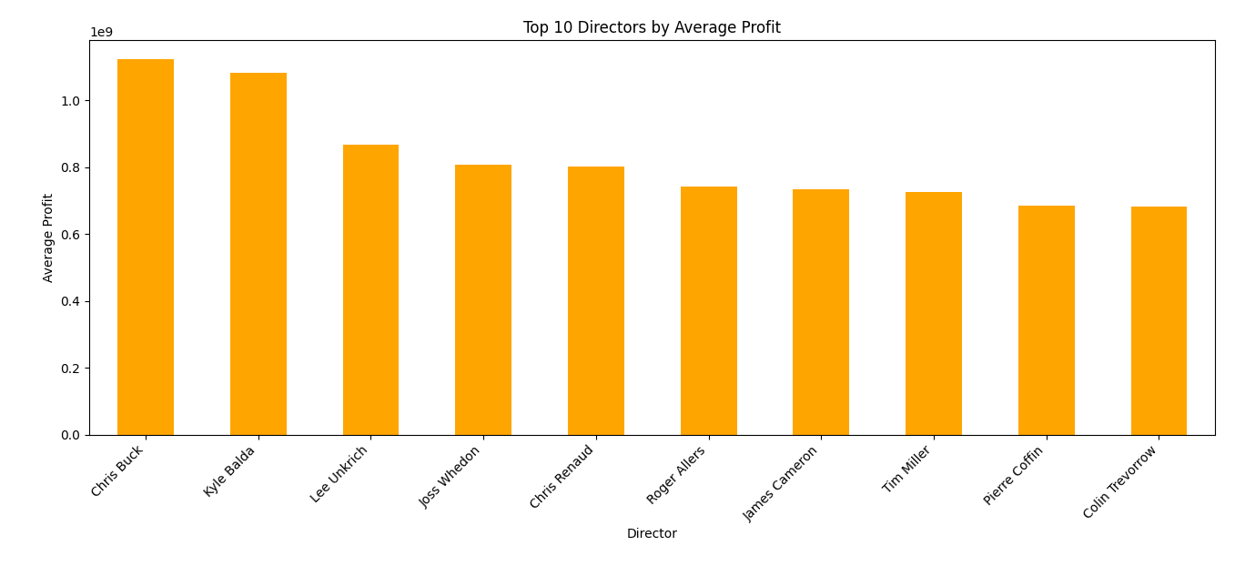

Slide 15
Expected Outcomes
The pipeline successfully ingests, cleans, and merges movie and credit datasets for analysis.
Queries on movies, actors, directors, genres, and revenue give accurate, meaningful results.
The processed data is stored in SQLite, enabling fast and easy retrieval for further analysis.
Insights such as top-grossing movies, popular actors, and genre trends can be generated.
The pipeline demonstrates a clear, reproducible workflow for movie data analysis.

Slide 16
References
Python
Pandas
SQLite
SQLAlchemy
Version Control : Git & GitHub guides
ChatGPT (OpenAI) – Assistance in pipeline design, coding, and problem solving
TMDb Datasets (tmdb_5000_movies.csv and tmdb_5000_credits.csv, accessed October 2025)

Slide 17
Thank You
Notes:
nhghggffghh

