Slide 1

DEPARTMENT OF ARTIFICIAL INTELLIGENCE AND DATA SCIENCE
Project name : Air Quality Monitoring
Team name:Proj_224787 Team_1
Team members:
1)Tharun raj R S (113321243056)
2)Vetrivelan S (113321243059)
3)Vinod A (113321243060)
4)Yedla Sasidhar (113321243062)
5)Yathesh kumar P (113321243061)

Slide 2
PROBLEM DEFINITION
▶ AIR POLLUTION CONCERNS: Rising levels of air pollution in metropolitan areas represent a serious concern to human health and the environment.
▶ ABSENCE OF REAL-TIME DATA: Current air quality monitoring systems frequently produce delayed data, which impedes prompt actions.
▶ LIMITED ACCESSIBILITY: The public's ability to make educated judgements is hampered by the limited access to data on air quality.

Slide 3

OBJECTIVES
Real-time monitoring: Give the public and appropriate agencies access to the most recent air quality data.
Enable data-driven decision-making for pollution
management and health alerts by doing data analysis. Cost-Efficiency: Monitor air quality for less money than you would with conventional techniques.

Slide 4
PROJECT
This project uses a Raspberry Pi and a MQ135 sensor to track air quality. The goal is to gather data on current air quality and transfer it to a distant server for analysis. Sensor calibration, data transfer, and server configuration are prerequisites.

Slide 5


REQUIREMENTS
Raspberry Pi and MQ135 sensor setup. Python script for data collection.
Calibration for accurate air quality readings.
Data transmission to a remote server. Remote server for data storage and analysis.

Slide 6
PYTHON CODE
import RPi.GPIO as GPIO import time
import json
# GPIO pin connected to the analog output of the sensor ANALOG_PIN = 0
# API endpoint to send data to a remote server REMOTE_API_URL = "https://your-api-endpoint.com/data" # Set the mode to BCM
GPIO.setmode(GPIO.BCM) def read air_ quality():
try:
# Create a data dictionary
air_quality_data = {"timestamp": int(time.time()),"analog_value": analog_value }

Slide 7
# Send data to a remote server (you'll need to set up the server)
send_ data_ to_ remote_ server (air_quality_data)
print("Analog Value:", analog_value)
# Sleep for a few seconds (you can adjust the interval) except KeyboardInterrupt:
GPIO.cleanup()
# Reset GPIO settings on Ctrl+C exit
def send_data_to_remote_server(data):
try:
# Send the data as JSON to the remote server
response = requests.post(REMOTE_API_URL, json=data

Slide 8
# Check if the request was successful if response.status_code == 200:
print("Data sent successfully")
else:
print("Error sending data to the server") except Exception as e:
print(f"Error sending data to the server: {str(e)}")
if __name__ == '__main__': read_air_quality()

Slide 9
PROPOSED SYSTEM
▶ IoT Sensors and Devices:
Set up an IoT sensor and device network over the whole water distribution network, including water treatment facilities, reservoirs, pipelines, and customer locations.
These sensors will continually check for pollutants and characteristics including water flow rate, pressure, temperature, pH levels, and turbidity.
▶ Real-time Data Collection:
Real-time data collection will provide you a thorough picture of the state of the complete water system by gathering data in real-time from the sensors and gadgets.
Use wireless communication technologies (such NB-IoT and LoRaWAN) to send data effectively and securely.

Slide 10
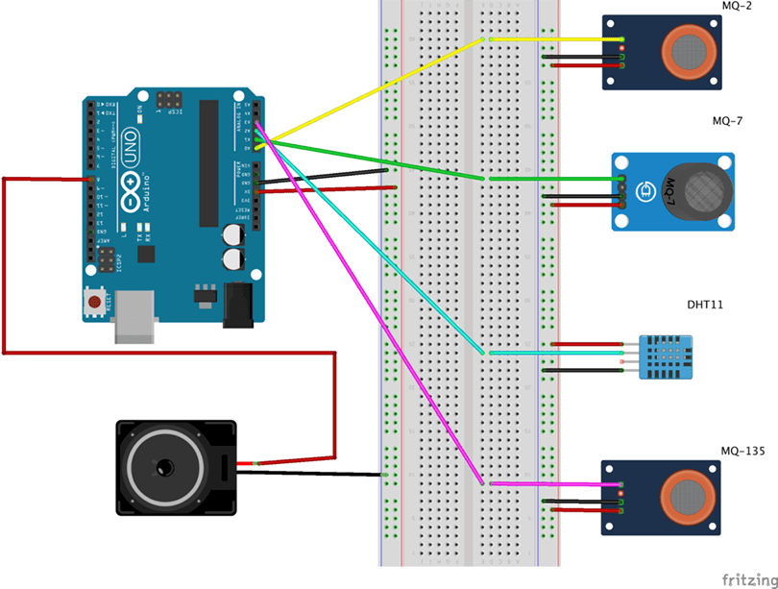
DIAGRAM:

Slide 11
CONCLUSION
This code now includes a method called send_data_to_remote_server that transmits the air quality data that has been gathered to a remote API endpoint. To save data on your server or in the cloud, you would need to replace "https://your-api-endpoint.com/data" with the actual URL of the server or service.

Slide 12
THANK YOU

