Slide 1

Department Of
ARTIFICIAL INTELLIGENCE & DATA SCIENCE
Air Quality Monitoring
Team name : proj_224787 team_1
Team members:-
1.Tharun Raj RS(113321243056)
2.Vetrivelan S(113321243059)
3.Vinod A (113321243060)
4.Yedla Sasidhar(113321243062)
5.Yathesh kumar P(113321243061)

Slide 2
__OBJECTIVES__
The objectives for an air quality monitoring project should be specific, measurable, achievable, relevant, and time-bound (SMART).
Here are some potential objectives for an air quality monitoring project:
Measure Particulate Matter (PM) Concentrations
Monitor Gas Emissions
Assess Air Quality Index (AQI)
Identify Pollution Sources
Provide Real-time Data
Public Awareness and Education
Early Warning System
Compliance Monitoring
Long-term Trend Analysis

Slide 3
__PROBLEM DEFINITION__
Air quality management encompasses the complex set of practices, policies, and measures aimed at monitoring, regulating, and mitigating the levels of pollutants and contaminants present in the Earth's atmosphere.
This critical endeavor arises from recognition of several interrelated challenges:
High Pollution Levels
Public Health Risks
Environmental Impact
Compliance with Regulatory Standards
Source Identification and Control
Global and Transboundary Effects
Technological Advancements and Innovation
Data Availability and Accuracy

Slide 4
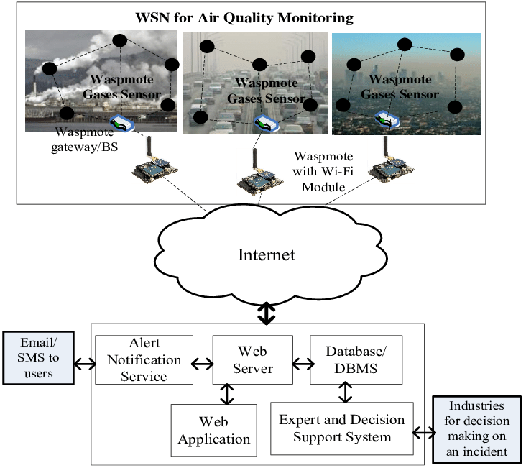
__IOT DEVICES DESIGN__

Slide 5
__IOT DEVICES DESIGN__
Designing an IoT (Internet of Things) sensor for air quality monitoring involves selecting appropriate sensors, data transmission methods, power management, and data visualization
Determine the specific parameters you want to monitor, such as particulate matter (PM2.5, PM10), gases (CO, CO2, NO2, SO2), temperature, humidity, and VOCs (Volatile Organic Compounds).
We are Choosing appropriate sensors for each parameter you intend to monitor. Common air quality sensors include particulate matter sensors, gas sensors, temperature and humidity sensors, and VOC sensors.
Develop a circuit board that integrates the selected sensors, a microcontroller (e.g., Arduino, Raspberry Pi), power supply (battery or mains), and connectivity options (Wi-Fi, cellular, LoRa, or Bluetooth).
Program the microcontroller to read data from sensors and process it.
Implement data storage mechanisms, such as onboard storage (SD card) or cloud-based storage (e.g., AWS, Azure, Google Cloud).
Create data visualization dashboards to present air quality information in a user-friendly way. Tools like D3.js, Plotly, or Tableau can be useful.
Allow users to customize charts, maps, and reports based on their preferences.

Slide 6
__DATA SHARING PLATFORM__
Designing a data sharing platform for air quality monitoring involves creating a user-friendly interface
Define the purpose of your data sharing platform. Consider stakeholders such as environmental agencies, researchers, policymakers, and the general public.
Choose an appropriate database system to store air quality data.
Options include relational databases (e.g., PostgreSQL, MySQL), NoSQL databases (e.g., MongoDB, Cassandra), or cloud-based solutions (e.g., AWS DynamoDB, Azure Cosmos DB).
Develop APIs or data connectors to ingest data from IoT devices and sensors. Support common data formats such as JSON or CSV.
Implement data validation and cleaning processes to ensure data quality

Slide 7
__INTEGRATION APPROACH__
The integration approach for air quality monitoring involves combining various technologies
Step 1: Define Integration Objectives
Step 2: Select Data Sources and Sensors
Step 3: Data Collection and Aggregation
Step 4: Data Processing and Quality Assurance
Step 5: Integration Platform Selection
Step 6: Data Storage and Management
Step 7: Real-time Data Handling
Step 8: Geographic Information System (GIS) Integration
Step 9: Reporting and Visualization
Step 10: Compliance and Regulatory Integration
Step 11: Testing and Validation

Slide 8

t

