Slide 1
Dissection of World Happiness Report
-Vinod Babu Palani

Slide 2
Dataset: World Happiness Report
Variables In Dataset: GDP Per Capita, Family, Life Expectancy ,Freedom , Trust On Government , Generosity, Urban Population %, Overweight Female %, Overweight Male %.
Each observation represents a country.
Bullseye:
To identify factors which distinguishes happiest countries from the other countries
To identify factors that contributes more for happiness of a country
Data Refining:
Merging Datasets.
Checking and imputing missing values.
Dropping countries that has more than 50% NA values in its observation.

Slide 3
Method Used:
Principle Component Analysis
Why PCA?
Dimensionality reduction technique
To uncover relationship among variables and to find relative importance of them
Can be Visually represented in the form of Biplot for easier interpretation.

Slide 4
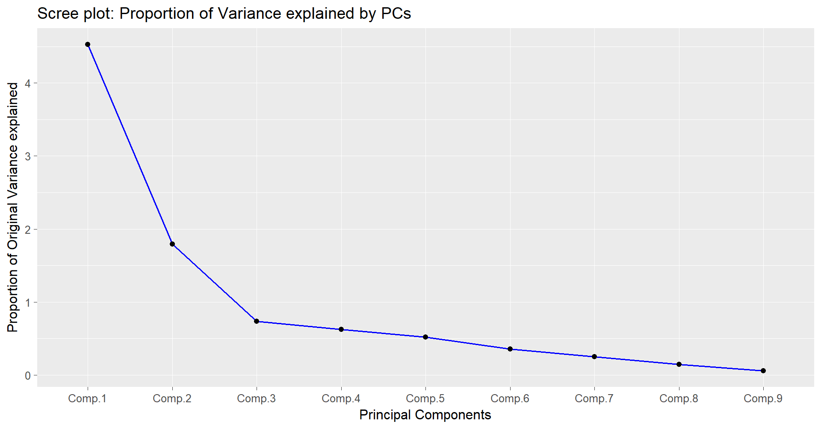
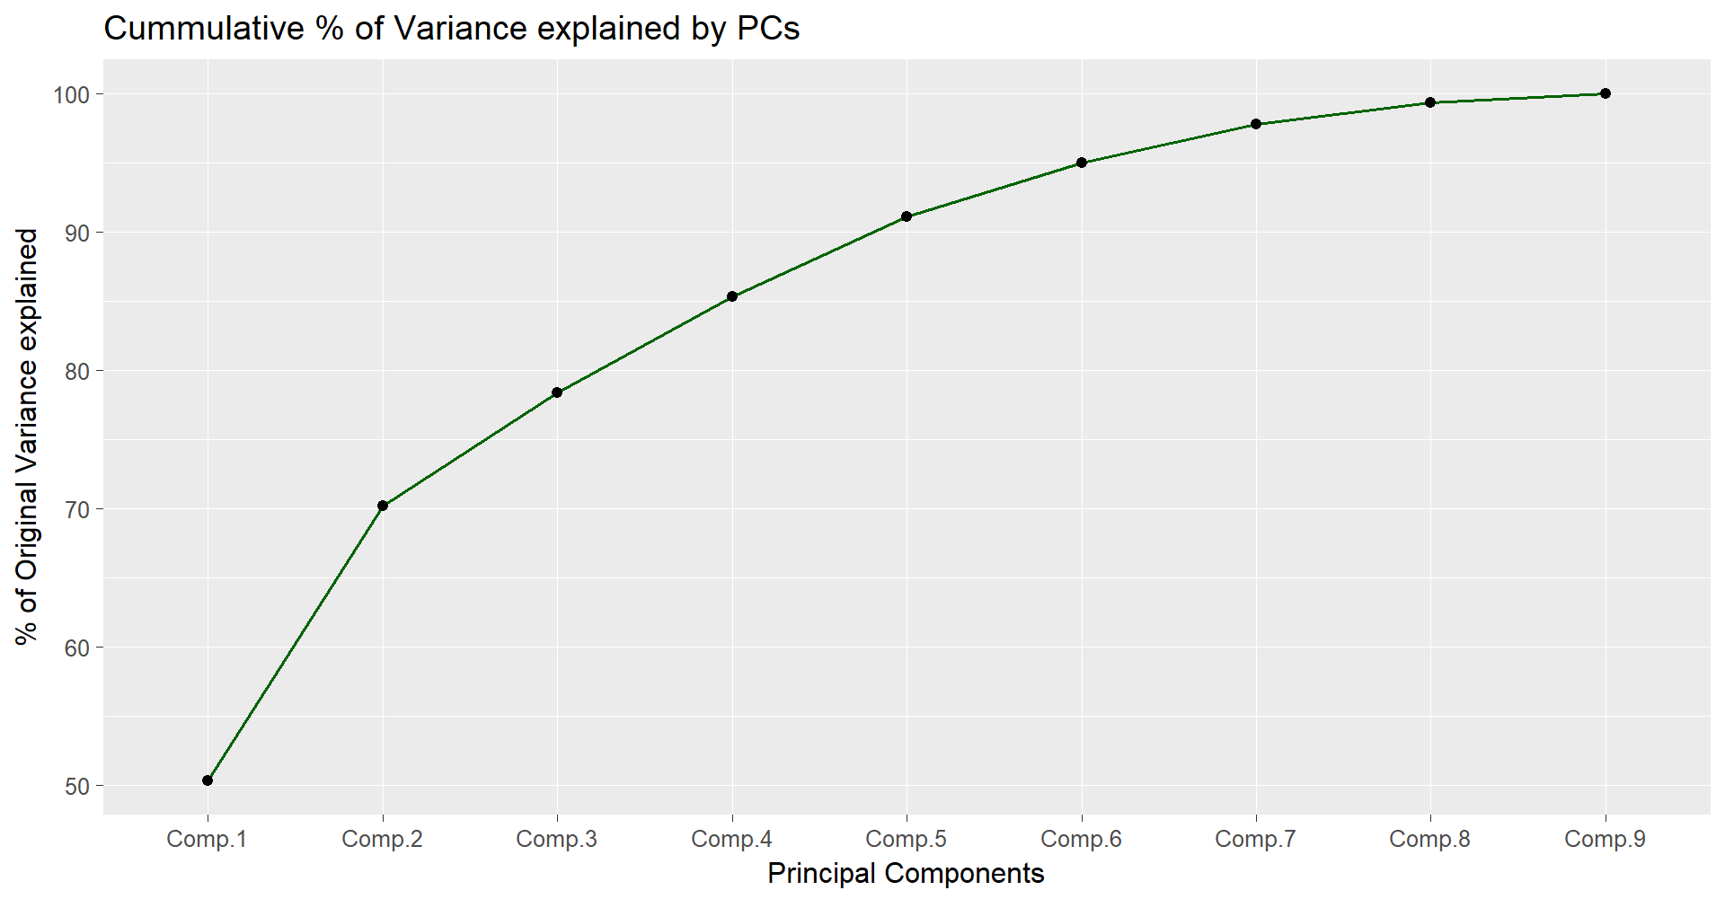
How High it can get?

Slide 5

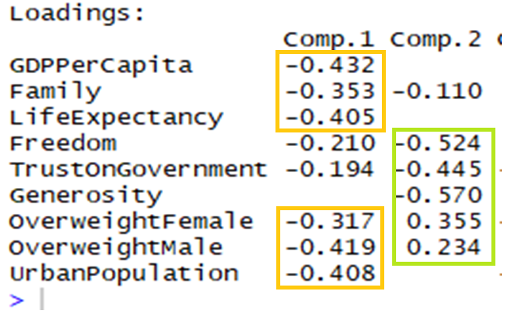
PC1 and PC2 confessions!!!
Selecting first 2 PCs that explains 70% of original variance in data.
PC1 indicates the overall happiness of a country with per-Capita income score dominating the contribution of overall happiness. It should be noted that income and obese population moves in same direction implying high earning people tend to be overweight.
PC2 indicates countries with more trust on Government and more generous as vital factors for being happy. It can also be noted that obese factor moves in opposite direction implying that these countries with high PC2 are more health-conscious.

Slide 6
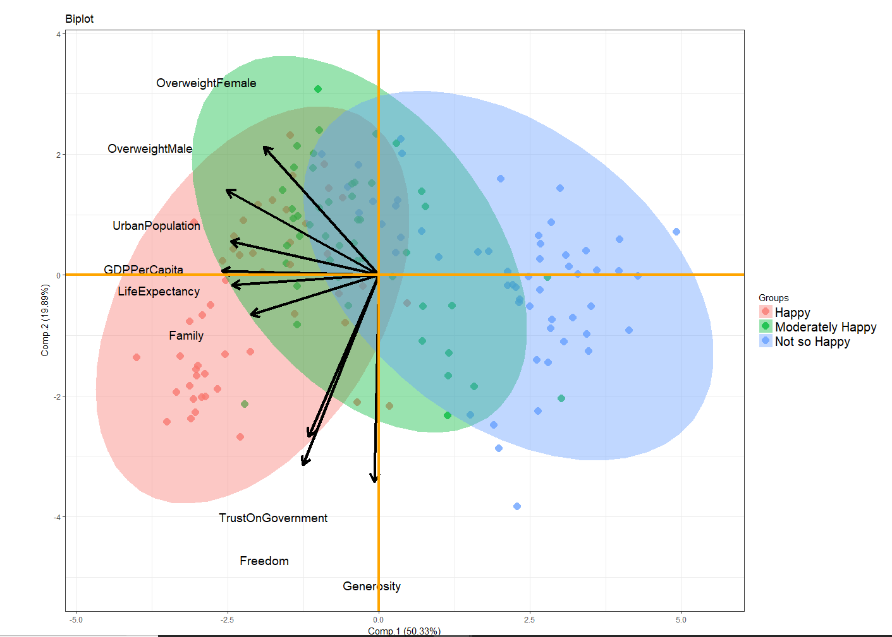
So what’s our point?

Slide 7
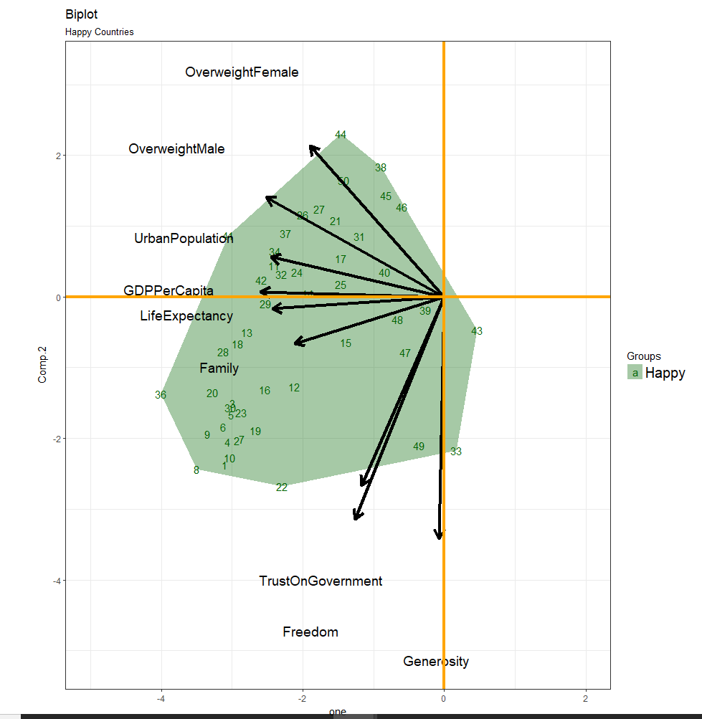
I am happy
Top 50 countries in the happiest countries list
All of these countries have good PC1 value implying they have good per capita income , life expectancy and family relations.

Slide 8
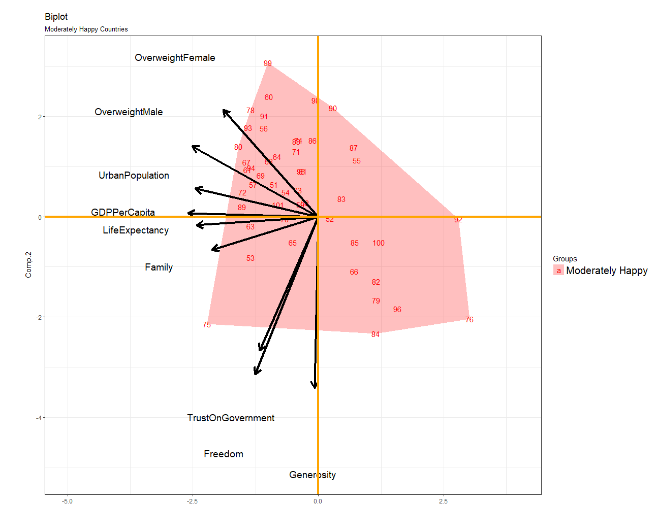
I am happy with 50% CI
Countries ranked 51 to 100 in happiness report
These countries are good in either PC1 value or PC2 value but not both which means these countries either have good economy or have high trust on their government but not both.

Slide 9
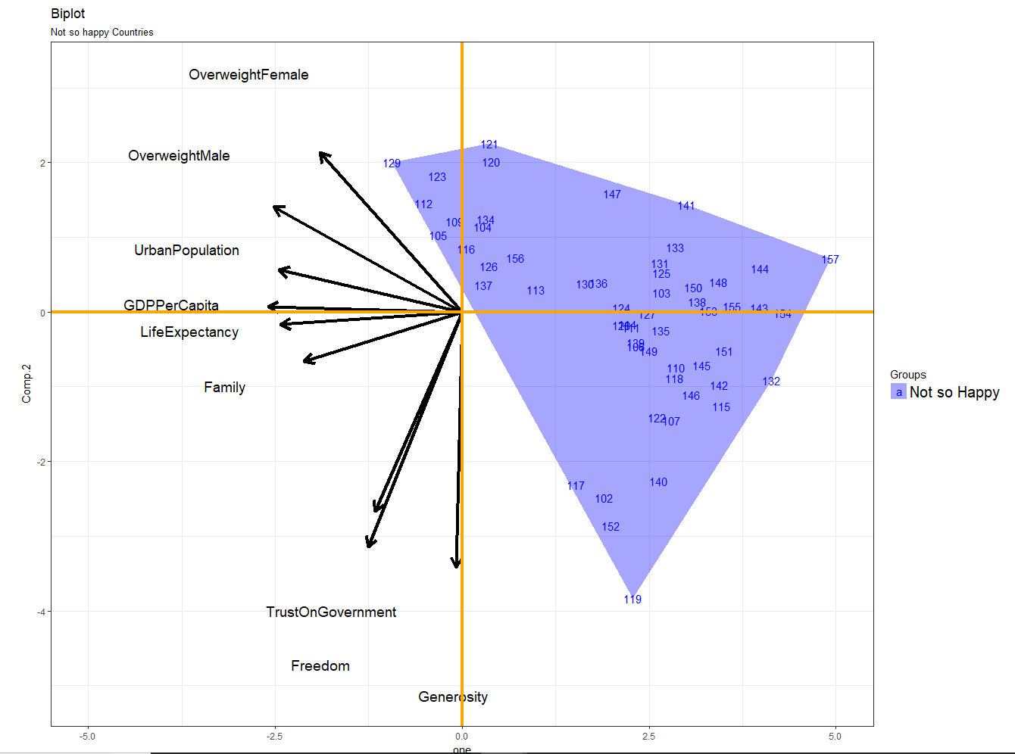
Happiness: Coming Soon!!!
Least ranked countries in happiness report
All of these countries perform low in both PC1 and PC2 indicating they lack both good economy as well the trust on their government

Slide 10
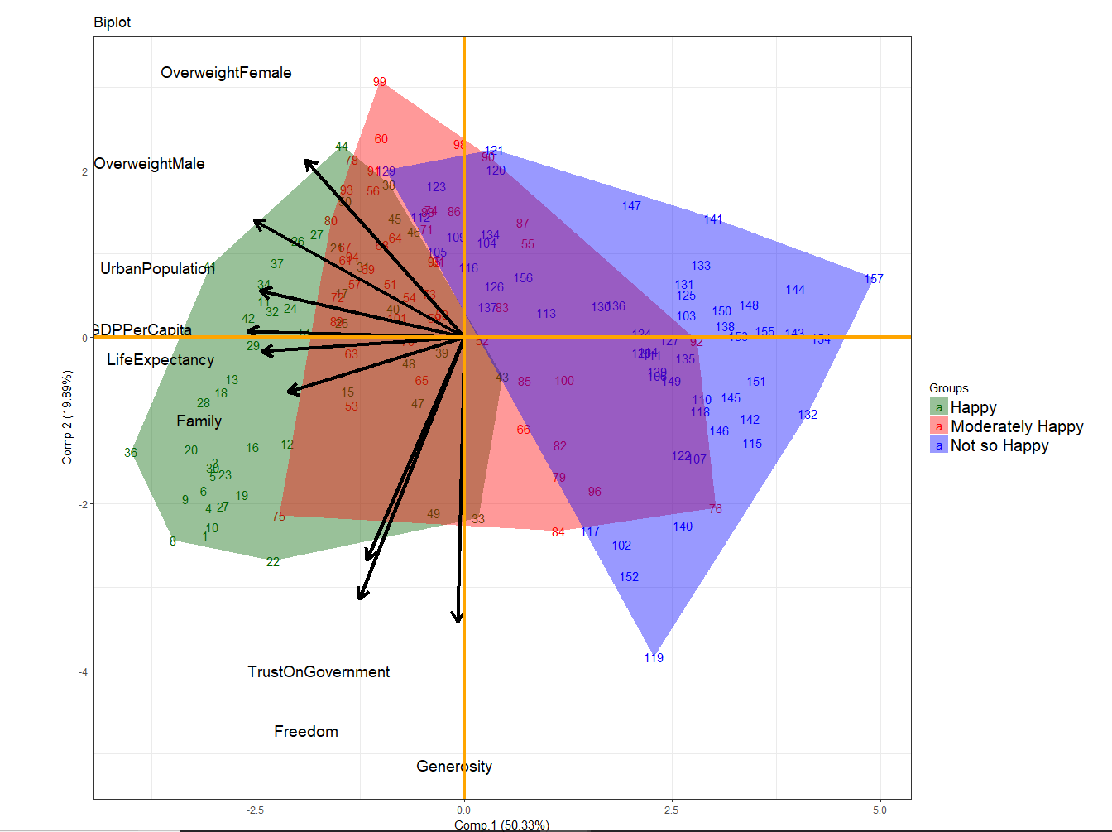
3 in 1

Slide 11
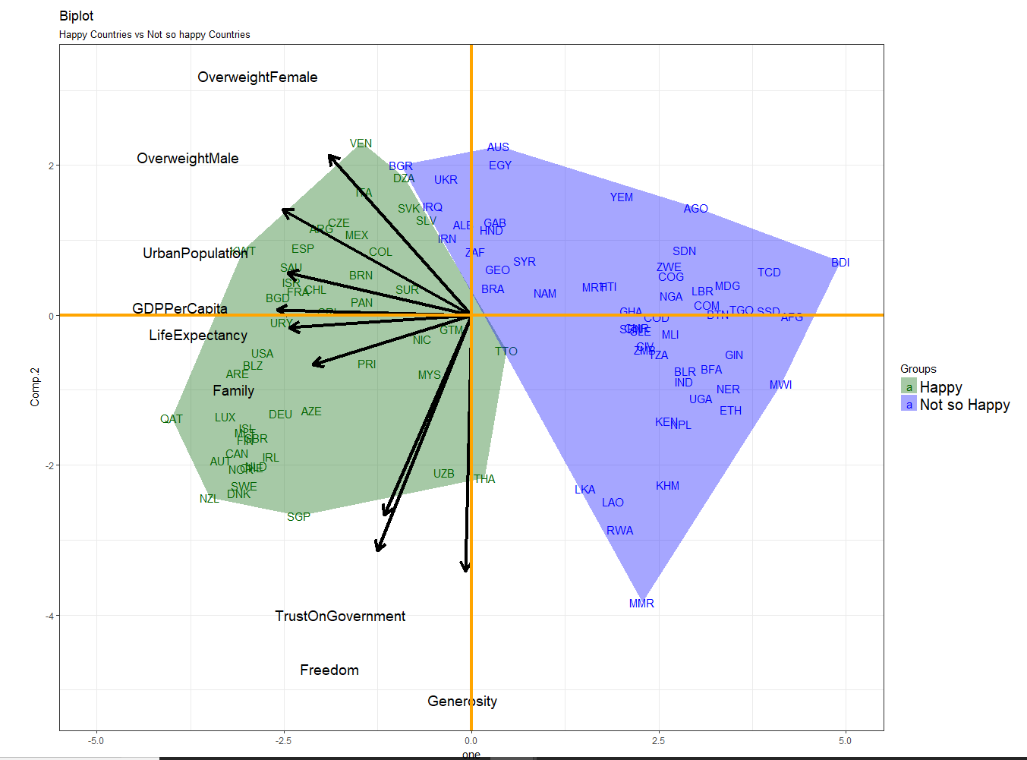
Contrast between most happiest and least happiest countries

Slide 12
Conclusion
Economy(per capita income) is most important factor in deciding happiness of a people
More urbanized the country more happy it is
Most of the Under-developed countries lack trust on their Government
Being Generous is independent of how much a person earns.

