Slide 1
Performance Test Results
AI-Assisted Performance Testing & Quality Engineering
• Current run: Current (50 samples)
• Baseline run: Baseline
• Transactions in current run: 5
• Average response time across transaction averages: 93.96 ms
• Overall throughput estimate: 10.598 req/s
• Estimated run duration: 4.72 seconds
• Average transaction error rate: 0.00%
• Quality gate: PASS

Slide 2
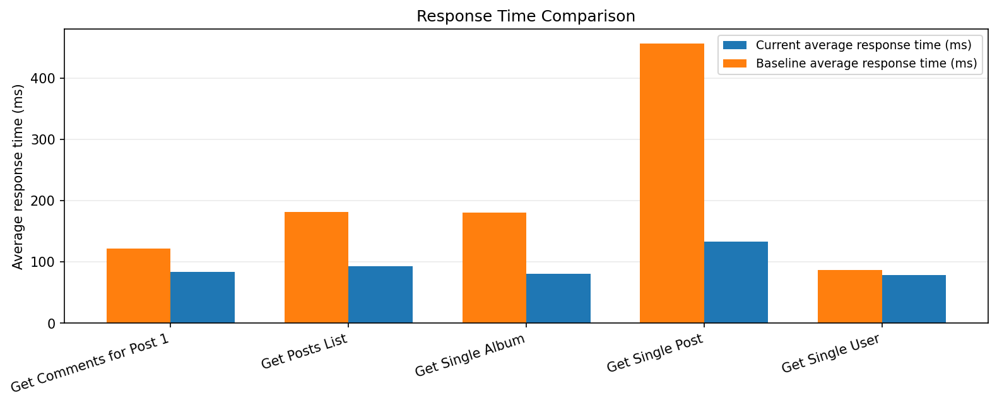
Response Time Comparison
Grouped bars compare average response time by transaction

Slide 3
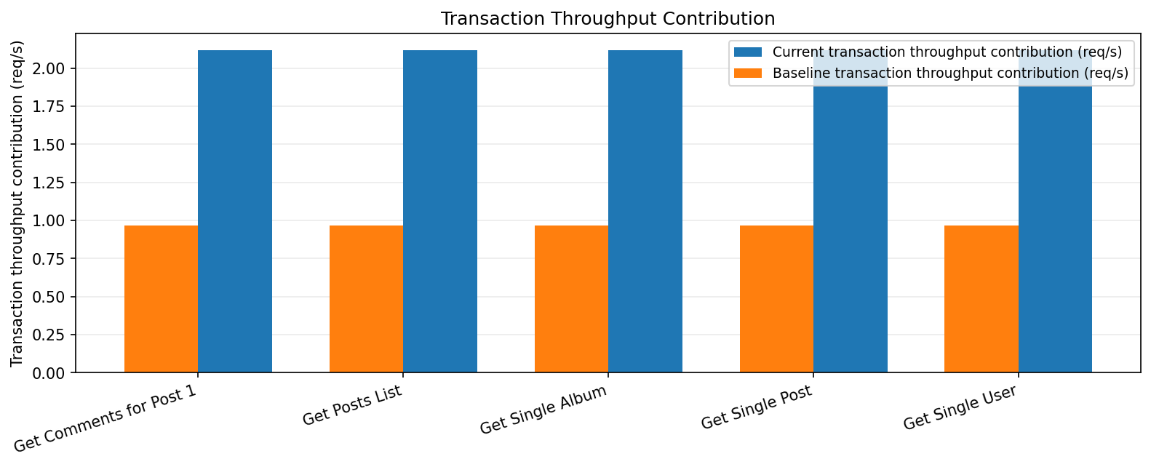
Transaction Throughput Contribution
Grouped bars show each transaction sample count divided by the estimated full run duration

Slide 4
Baseline Comparison
Selected metrics; full comparison remains available in the Excel export
test name | response time ms | baseline response time ms | response time change pct | throughput rps | baseline throughput rps | error rate pct
Get Comments for Post 1 | 83.90 | 122.00 | -31.23 | 2.12 | 0.97 | 0.00
Get Posts List | 93.60 | 182.00 | -48.57 | 2.12 | 0.97 | 0.00
Get Single Album | 80.60 | 181.00 | -55.47 | 2.12 | 0.97 | 0.00
Get Single Post | 133.10 | 457.00 | -70.88 | 2.12 | 0.97 | 0.00
Get Single User | 78.60 | 87.00 | -9.66 | 2.12 | 0.97 | 0.00

Slide 5
Errors & Failed Transactions
Failed samples from uploaded JMeter results and transaction-level error rates
• No errors recorded in the uploaded current-run results.
• Current-run transaction error rates are all 0.00%.

Slide 6
Quality Gate & Investigation Notes
Rule-based triage guidance; not an automated root-cause diagnosis
• Overall quality gate: PASS
• Response-time threshold: 500.0 ms; transactions breaching it: 0
• Error-rate threshold: 2.00%; transactions breaching it: 0
• Baseline regression threshold: 10.0%; transactions flagged: 0
• No transactions breached the configured response-time or error-rate thresholds, and no response-time regression exceeded the warning limit.
• Recommended follow-up: validate the load profile and repeat the run; correlate any flagged transaction with CPU, memory, database waits, downstream latency, connection pools, and application logs.

