Slide 1
Next WORD Prediction Model
Vinod Gaitonde
Manchinasetti Sai Srihari
Sai Kiran Velishala
Hardik Kamaleshkumar Parekh
Prudhvi Sanaboyina
Piyush Jain
Deebak V S Vijay

Slide 2
Problem Statement
Next Word Prediction is a widely used feature in smartphone keyboards, messaging applications, and search engines such as Google. It enhances user experience by predicting and suggesting the next word in a sentence based on the previous input.
Use Case: A Next Word Prediction Model trained based on an organization’s domain, emails & chat messages can be eventually integrated in respective applications e.g. chat, email text editor, which can help with efficiency.
This project presents a deep learning approach to building a Next Word Prediction model using Python, leveraging the TensorFlow and Keras libraries. We train a Recurrent Neural Network (RNN), specifically a Long Short-Term Memory (LSTM) network, which is well-suited for handling sequential data and long-term dependencies, making it ideal for this task.

Slide 3

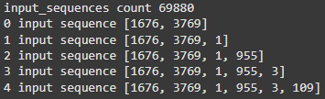
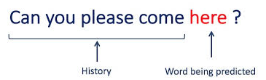
Data Clean Up & Processing
Data Set Info
Source:
https://www.gutenberg.org/
The Adventures of Sherlock Holmes, by Arthur Conan Doyle
* Due to Compute & RAM limitations, we could only use one book for training.
Vocabulary from the Book
UTF-8 encoded “.txt” file of the novel is used.
Tokenize & create unique word dictionary.
Create n-gram.
Pad sequences to make them of same length.
Prepare features(n-gram) against label.
Convert output array into suitable format for training
N-gram preparation
N-Gram segregated in features(X) & Label(y)
Group10

Slide 4
ML Methodologies USED
Recurrent Neural Network (RNN)
RNN model is built using Keras library.
The Sequential model is created which is a linear stack of layers in Keras.
Layer | Nodes | Dropout
Embedding | 100 | 0.2 | Converts words from their raw categorical representation into dense vectors that capture semantic relationships between words, making it significantly easier for the LSTM to learn complex
LSTM | 150 | 0.2 | Capture long-term dependencies between words and phrases in a sentence
Dense |  |  | Transforms the complex, high-dimensional representation produced by the LSTM into a final output probability distribution over the vocabulary
Other Hyperparameters
Activation Function | SoftMax
Loss Function | Categorical Cross Entropy
Optimizer | Adam
Epochs | 60
Batch Size | 128
Notes:
Embedding: Embeddings are methods for learning vector representations of categorical data. it converts words from their raw categorical representation into dense vectors that capture semantic relationships between words, making it significantly easier for the LSTM to learn complex patterns and dependencies within a sequence, leading to better prediction accuracy in tasks like next word prediction.
When using a Keras Embedding layer before an LSTM, it can represent either a pre-trained word embedding like Word2Vec or GloVe, or it can learn its own word embeddings from scratch depending on how you configure the layer.
Function:
It takes a sequence of word indices as input and outputs a corresponding sequence of embedding vectors.
Pre-trained embeddings:
You can load pre-trained word embeddings like Word2Vec or GloVe into the Embedding layer by specifying the appropriate weight matrix.
Learning embeddings:
If you don't provide a pre-trained weight matrix, the Embedding layer will randomly initialize weights and learn word representations during the training process
Dense Layer:
It acts as a fully connected layer to transform the complex, high-dimensional representation produced by the LSTM into a final output probability distribution over the vocabulary, allowing the model to predict the most likely next word based on the context learned by the LSTM
While LSTMs can capture long-range dependencies, the output from an LSTM layer is still a high-dimensional vector. The dense layer helps to reduce this dimensionality to the size of the vocabulary, making it suitable for predicting the next word.
Linear Combination:
The dense layer performs a weighted sum of the LSTM output, allowing the model to combine information from the context effectively to generate the final prediction

Slide 5
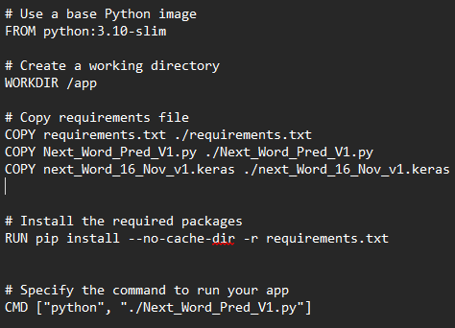
Docker Container
Docker
A Docker container image is a standalone, executable package of software that includes everything needed to run an application.
In this case, includes the pre-trained model and the python program
Can be ported to another computer easily
Docker Container uploaded at: https://drive.google.com/file/d/1TH4YPALstGicy1AeoPx8uY5L0s08j1_4/view?usp=sharing

Slide 6
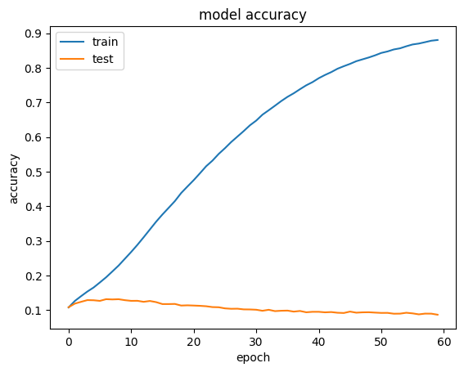
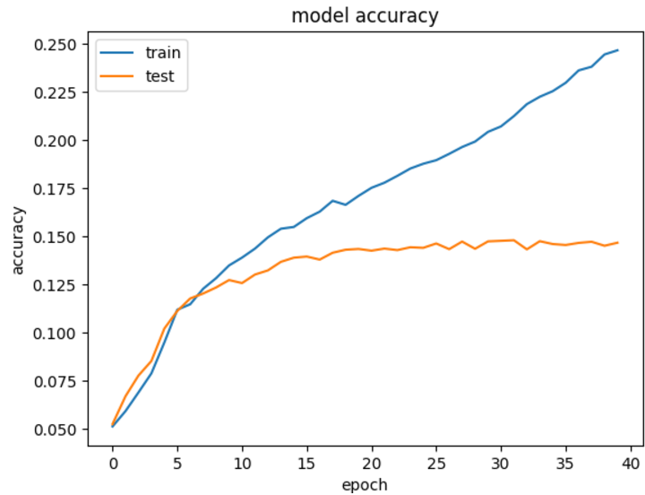
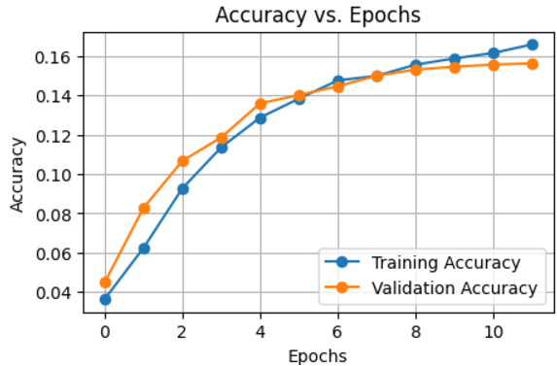
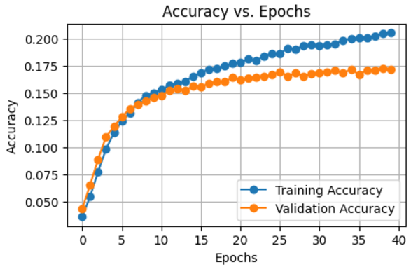
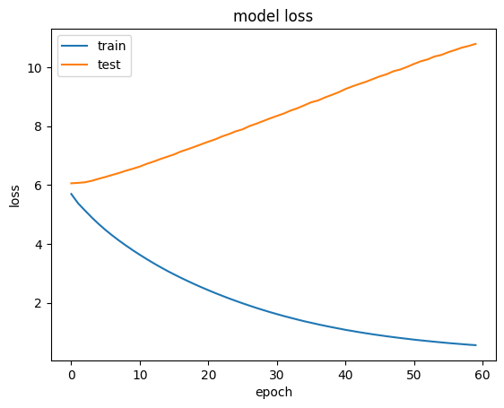
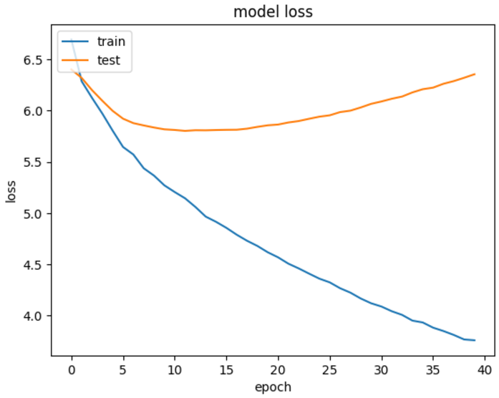
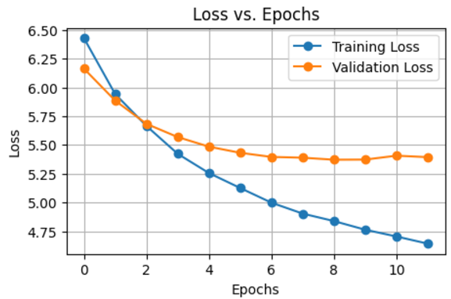
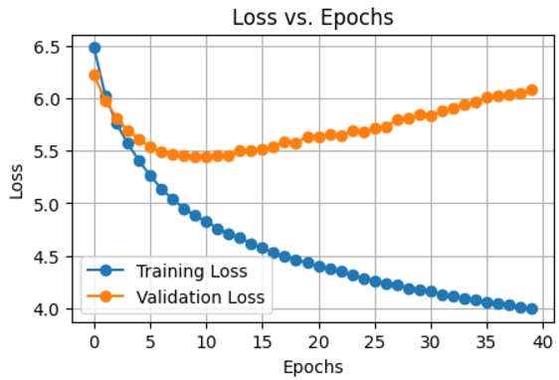
Model Tuning
Without cross-validation
Embedding: 100
LSTM: 150
Dense
activation='softmax’
optimizer='adam'
validation_split=0.2 batch_size=128
epochs=60
With 5x cross-validation
Embedding: 100
LSTM: 150
Dense
activation='softmax’
optimizer='adam'
validation_split=0.2 batch_size=128
epochs=60
With Early Stopping
Embedding: 100
LSTM: 256, Dropout: 0.2
LSTM: 128, Dropout: 0.2
Dense
activation='softmax’
optimizer='adam'
validation_split=0.2 batch_size=128
epochs=40
Without Early Stopping
Embedding: 100
LSTM: 256, Dropout: 0.2
LSTM: 128, Dropout: 0.2
Dense
activation='softmax’
optimizer='adam'
validation_split=0.2 batch_size=128
epochs=40

Slide 7
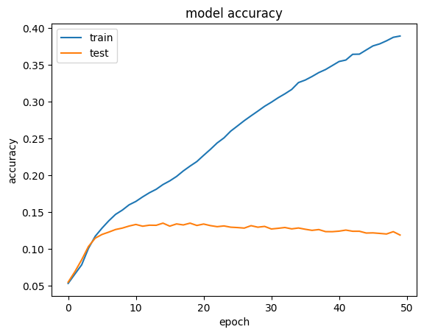
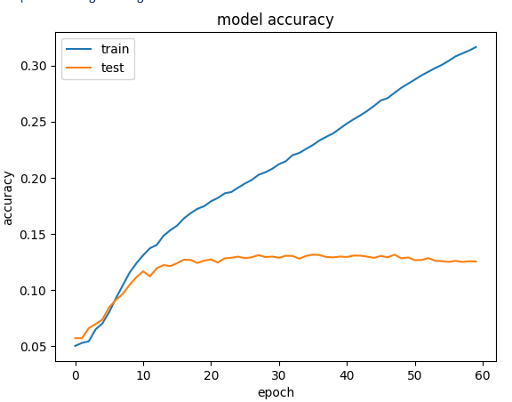
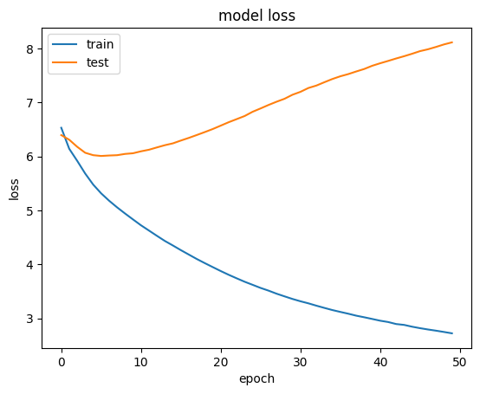
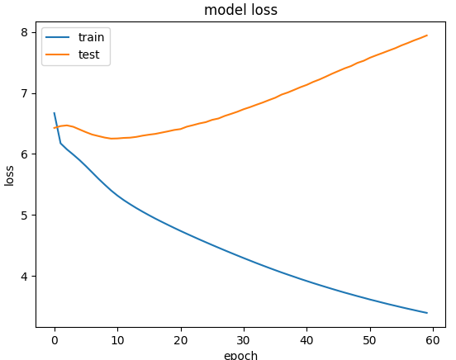
Model Tuning
Embedding: 100, Dropout: 0.2
LSTM: 150 , Dropout: 0.2
Dense
activation='softmax’
optimizer='adam'
validation_split=0.2 batch_size=128
epochs=60
Embedding: 100
LSTM: 50
Dense
activation='softmax’
optimizer='adam'
validation_split=0.2 batch_size=128
epochs=60
2024

Slide 8
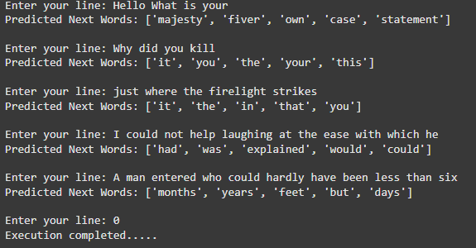
Prediction Results

Slide 9
CONTRIBUTION
 | Vinod Gaitonde | Manchinasetti Sai Srihari | Sai Kiran Velishala | Hardik K Parekh | Prudhvi Sanaboyina | Piyush Jain | Deebak V S Vijay
Data Cleanup & acquisition | 25 |  |  | 25 |  | 25 | 25
ML Model Selection Training |  | 20 | 20 | 20 | 20 | 20
Hyper Parameter Tuning |  | 25 | 25 |  | 25 | 25
Metrics | 25 | 20 | 20 |  | 20 | 15
Presentation | 10 | 10 | 10 | 35 | 10 |  | 25
Documentation | 25 | 10 | 10 | 10 | 10 |  | 35

Slide 10
Conclusion
Fair prediction of the Next Word with selected Model [Accuracy: 40%]
We achieved accuracy of ~90%; however, observed the model to have overfitting and did not generalize well beyond the data set.
RNN/LSTM is well suited for use cases of complex sequential data like language
Embedding layer helps translate the vocabulary in a dense vector and very helpful for language
Following parameters are helpful to avoid “overfitting” of the model
Drop out (20%) helped very well with achieving better prediction & validation accuracy
In this particular case, L2 regularization did not help as accuracy didn’t improve
Cross validation did not show improvement in the training & validation accuracy balance
Early stop was tried however, considering limited data, most of the cases, the training stopped after 10 epochs
Added two layers of LSTM with drop out which helped with validation accuracy but only up to 20 epochs after which it was observed to be plateaued
Similar observation with bi-directional LSTM as well
Training using “limited amount of data set” leads towards overfitting or lack of accuracy
Due to limited compute & RAM resources, we could not try with larger data set to train the model

Slide 11
Future Enhancements
Link to source code & Docker
Project Git hub link: https://github.com/vinodgaitonde/Capstone_Group10
Docker Container location: https://drive.google.com/file/d/1TH4YPALstGicy1AeoPx8uY5L0s08j1_4/view?usp=sharing
ML Ops to be setup for continuous collection of data , retraining & deployment using DVC & ML Flow
Experiment with Pre-trained tokenizer models like GPT 2.0 for this purpose
Transfer learning (TL) technique that uses a pre-trained model on required set of data set
Optimize the size of the docker container
Integrate the container with a chat application

Slide 12
Q & A Thank You!

