Slide 1
GeoPath Route Planner
Shortest Path Finder using Dijkstra's Algorithm
Team Lead: K. Rakesh (23AK1A3237)
Team Members:
K. Prashanth (23AK1A3233)
Vinodh Kumar S (23AK1A3257)

Slide 2
Problem Statement
To find the shortest route between two locations using Dijkstra's Algorithm and display the result graphically.

Slide 3
Technologies Used
• Python
• Flask
• NetworkX
• Matplotlib
• HTML & CSS

Slide 4
Dijkstra's Algorithm
1. Start from source node.
2. Assign distance values.
3. Update neighboring nodes.
4. Repeat until destination is reached.
5. Return shortest path.

Slide 5
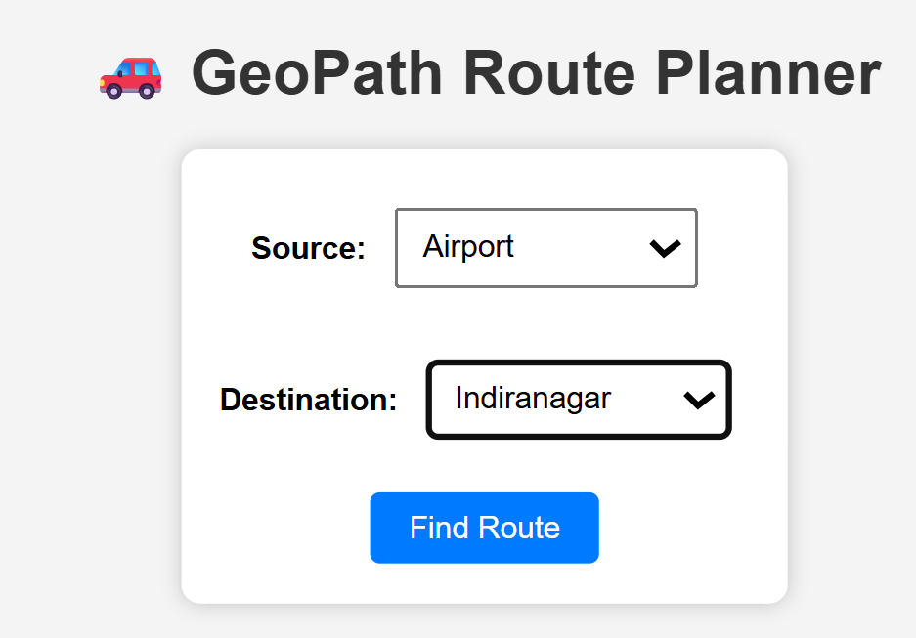
Input Page

Slide 6
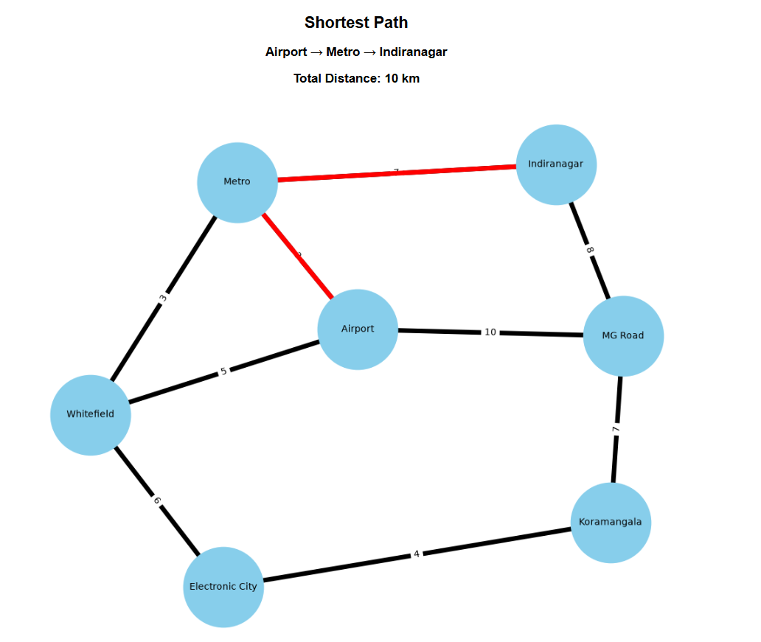
Output Page

Slide 7
Advantages
• Fast shortest path calculation.
• Interactive user interface.
• Easy to extend with more locations.
• Useful for route planning applications.

Slide 8
Conclusion
GeoPath Route Planner successfully finds the shortest path using Dijkstra's Algorithm and visually highlights the route.

Slide 9
Thank You

