Slide 1
Monochrome: Black pixel – 0
Colored: Yellow - 0

Slide 2
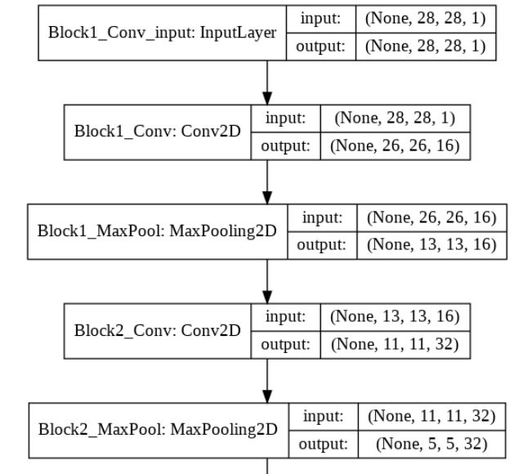
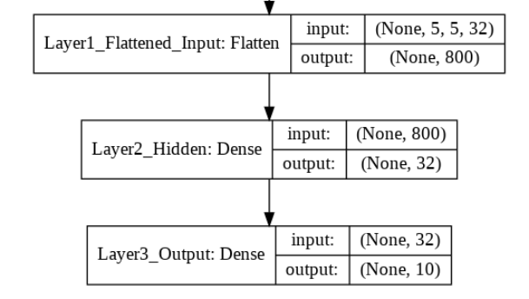

Slide 3
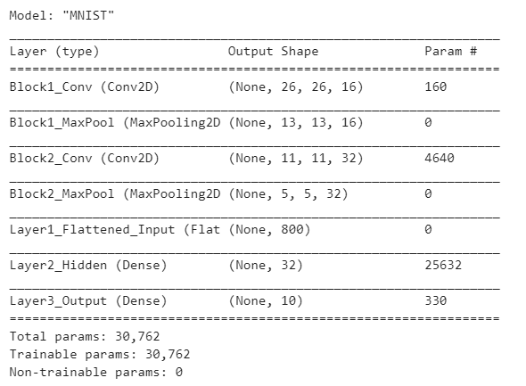

Slide 4
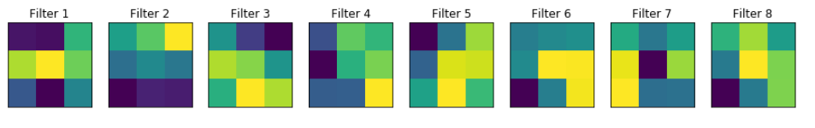
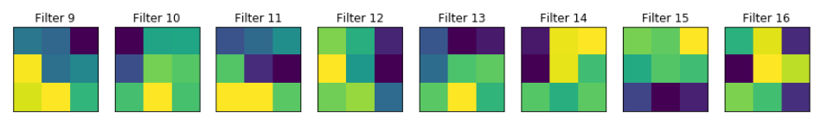
CNN Filters Visualization

Slide 5
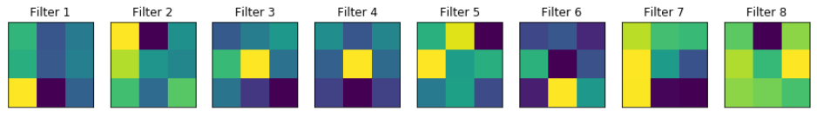
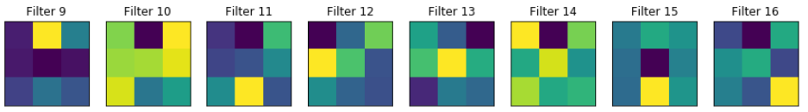
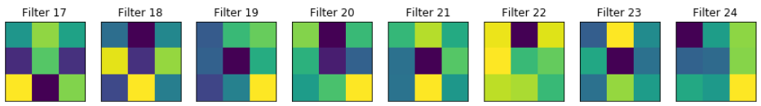
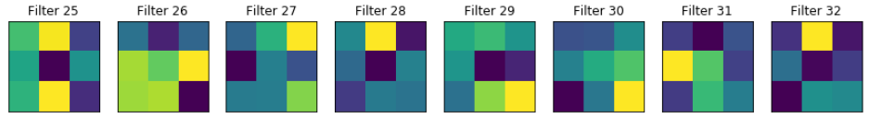

Slide 6

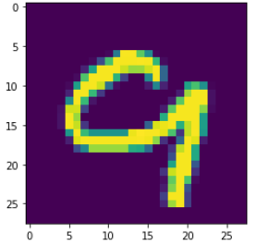

Slide 7

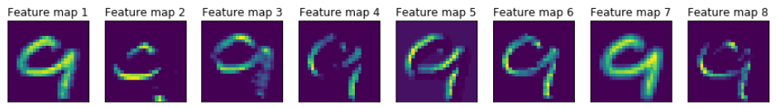
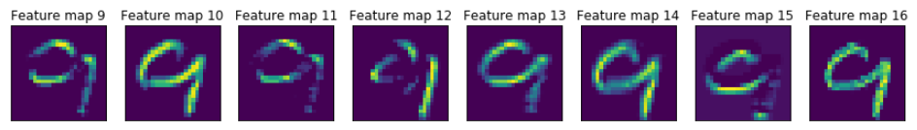

Slide 8

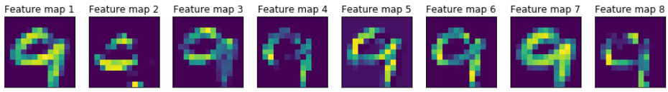
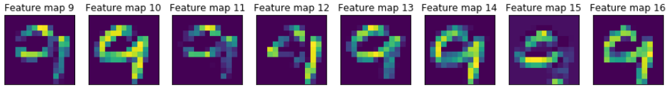

Slide 9

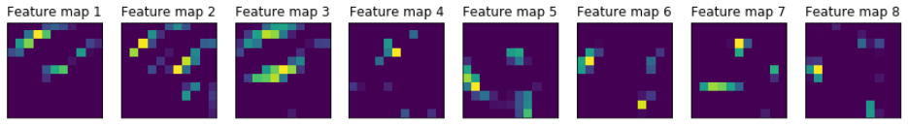
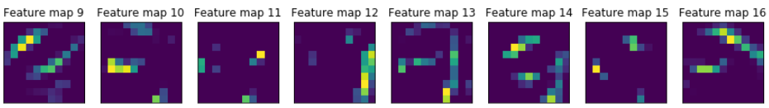
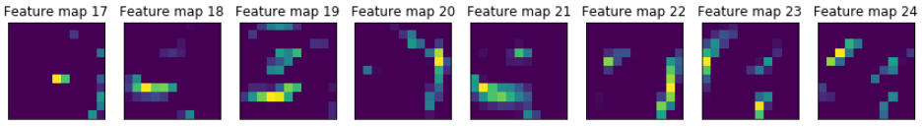
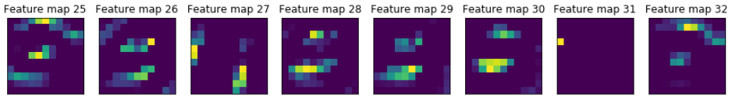

Slide 10

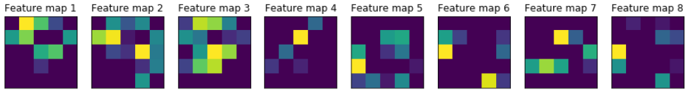
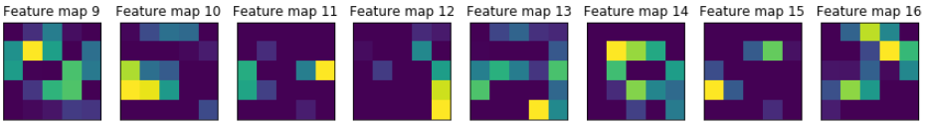
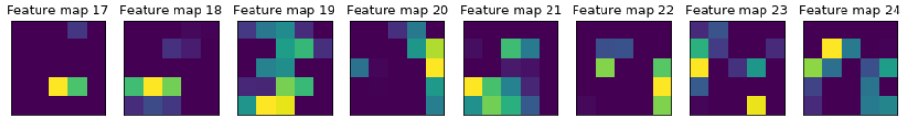
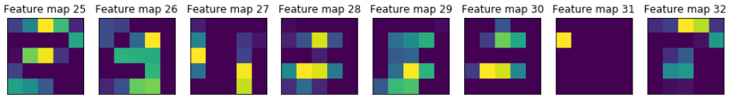

Slide 11

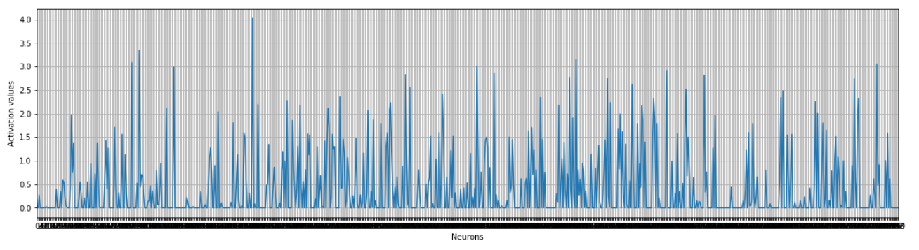

Slide 12

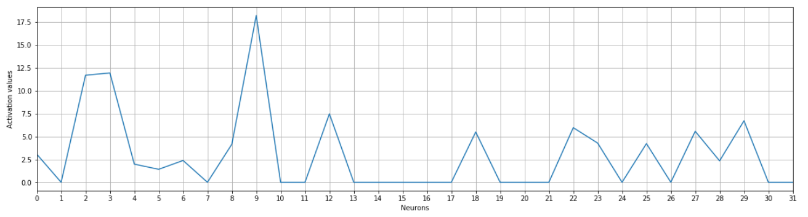

Slide 13

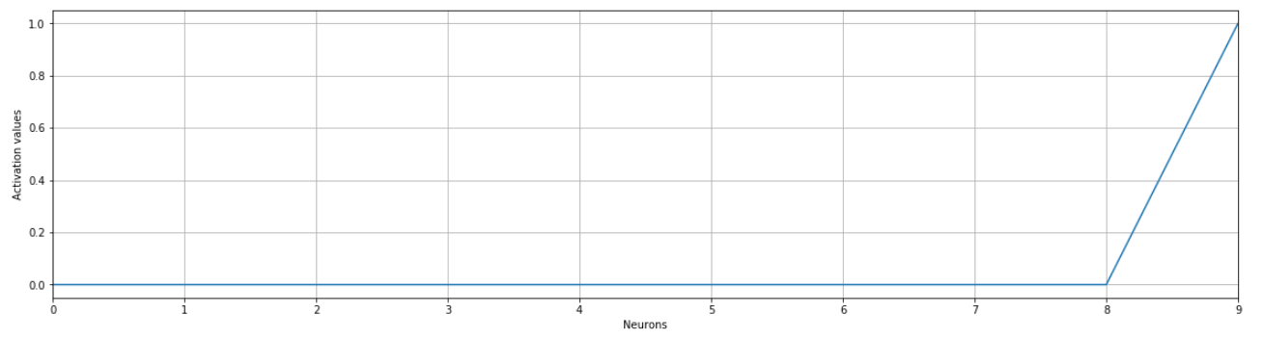

Slide 14
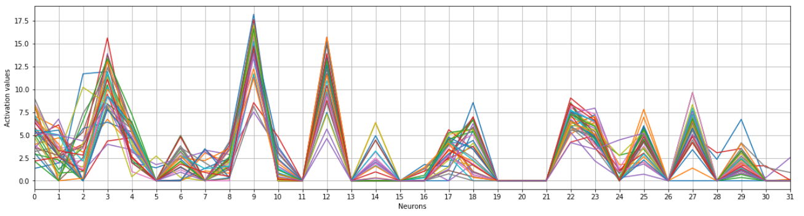
Intermediate Activations – Layer 6 (32 neurons)
Input : 35 images of digit 9 from MNIST test data
Prominently active neurons : 9, 3, 12, 0, 22, 23

Slide 15
0
0
3
1
.
.
2
9
3
4
12
5
.
.
6
7
22
8
9
23

Slide 16
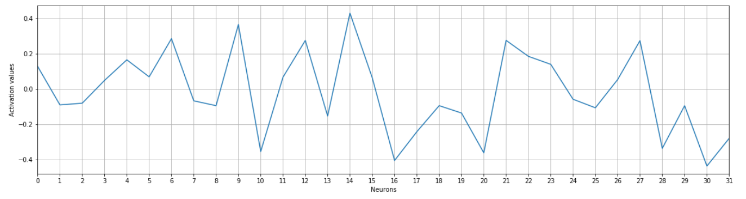

Slide 17
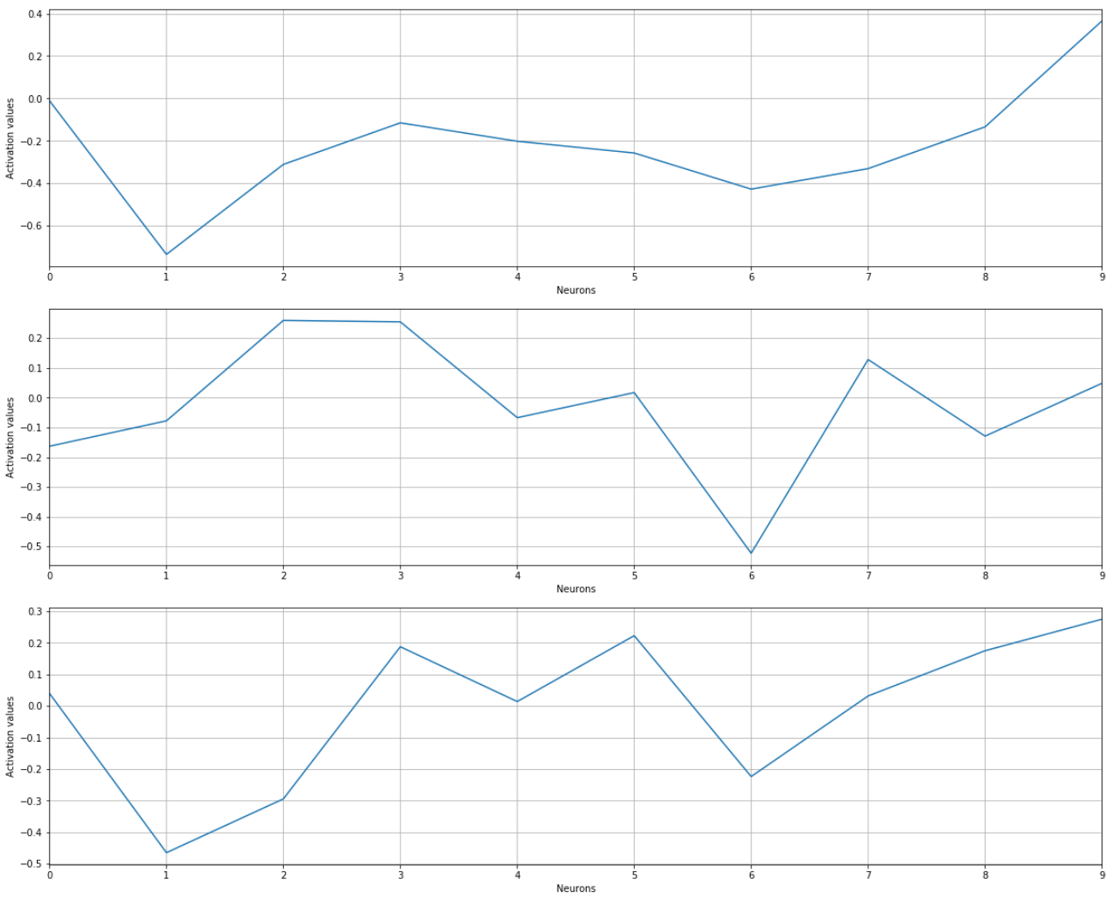
Prominently active neurons in 6th layer for Digit 9 : 9, 3, 12, 0, 22, 23
Neuron 9 fires only for digit 9
Neuron 3:
To some extent, our 35 input images of 9 resemble the features of digits 2, 3 or 7.
Thus neuron 3 fires for an input 9
Neuron 12:

Slide 18
What Next?
Activation Maximization at 6th Layer
For neurons 3,9 and 12, perform activation maximization to synthesize input images and see what patterns make those neurons fire.
Remember according to our observation, the synthesized image for neuron 3 should have patterns like 2,3 and 7. Verify the hypothesis.

Slide 19
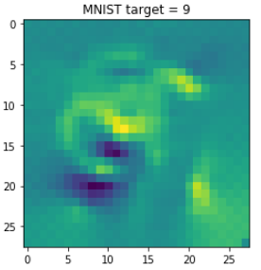
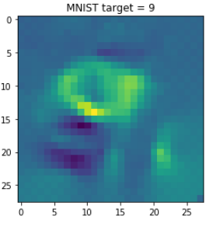
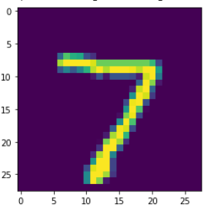
Activation Maximization (Starting with layer 7)
For neuron 9
Synthesized image with no seed input
Seed input
Synthesized image
P(9) = 0.93
P(9) = 0.94

Slide 20
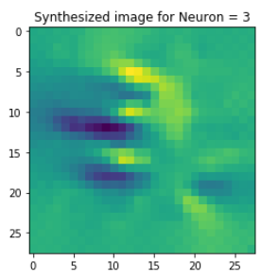
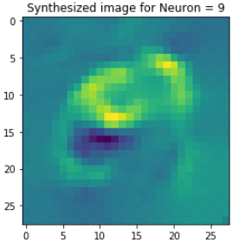
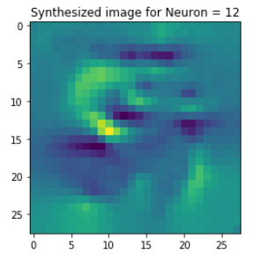
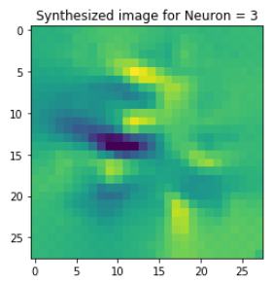
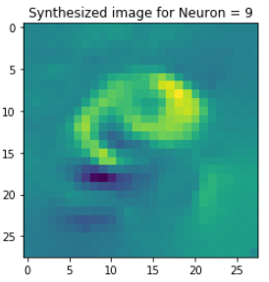
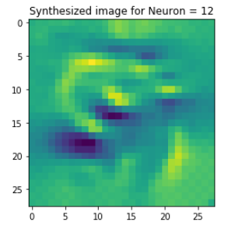
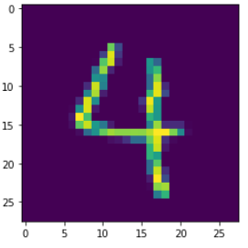
Activation Maximization (Layer 6)
Neuron 3 fires for
digits 2, 3, 7 and 9
Neuron 9 fires only
for digit 9
Neuron 12 fires for
digits 3, 5, 8 and 9
No Input Image – Initial Pixel values are randomly
initialized
P(2) = 0.32 P(3) = 0.31
P(7) = 0.22
P(9) = 0.95
P(3) = 0.1 P(5) = 0.1
P(9) = 0.65

