Slide 1
Web Frame Work Using JavaScript
Vivek Sharma
Notes:
This template can be used as a starter file for presenting training materials in a group setting.
Sections
Sections can help to organize your slides or facilitate collaboration between multiple authors. On the Home tab under Slides, click Section, and then click Add Section.
Notes
Use the Notes pane for delivery notes or to provide additional details for the audience. You can see these notes in Presenter View during your presentation.
Keep in mind the font size (important for accessibility, visibility, videotaping, and online production)
Coordinated colors
Pay particular attention to the graphs, charts, and text boxes.
Consider that attendees will print in black and white or grayscale. Run a test print to make sure your colors work when printed in pure black and white and grayscale.
Graphics, tables, and graphs
Keep it simple: If possible, use consistent, non-distracting styles and colors.
Label all graphs and tables.

Slide 2
The Course Break Down:
Class 1: Mean Stack Fundamentals.
Class 2: Learning Node.js
Class 3: Implementing HTTP Services in Node.js
Class 4: Scaling the Applications Using Node.js
Class 5: Understanding NoSql and MongoDB
Class 6: Understanding Express and Implementation.
Class 7: Understanding Angular
Class 8: Understanding the Angular Directives and Angular Web Application.
Class 9: Creating a Shopping Cart.
Class 10: Creating another project.
Notes:
Give a brief overview of the presentation. Describe the major focus of the presentation and why it is important.
Introduce each of the major topics.
To provide a road map for the audience, you can repeat this Overview slide throughout the presentation, highlighting the particular topic you will discuss next.

Slide 3
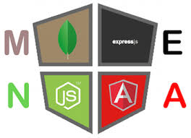
Welcome

Slide 4
Today’s Overview
1
2
How to leverage scope in Custom Directives
3
Discussing Transclusion in Custom Directives
Discussing Scope in Custom Directives
4
Discussing Controllers in Custom Directives
Notes:
This is another option for an overview slide.

Slide 5
Angular Working With Complex Directive
Notes:
Use a section header for each of the topics, so there is a clear transition to the audience.

Slide 6
Directive Scopes
Recap: What is the default scope of the directive applied on an element?
In the demonstration we would create a simple directive which is so simple that it does not even require link function.
Only a link function would be enough.
Let us open the file: AngularJS/Basics_AngularDirective/Directives_Custom/ConfigurationExaplanations/Scope/File_1_Default_Scope.html.
If you watch closely, the same directive is applied to two similar elements and in the template, we have bound the directive two way on the scope property : name.
The effect is both the directives would now be in synch since they are technically working on the same scope property.
This behavior can be useful, and it is a nice demonstration of how the scope can be used to keep elements coordinated and capture or display the same data. But you will often want to reuse a directive to capture or display different data, and that’s where the management of scopes comes in.
Since the management of the directives can be a little hard to grasp, we would try to look at a diagram to have a better understanding.
Notes:
By default, the link function is passed the scope of the controller that manages the view that contains the element to which the directive has been applied.

Slide 7
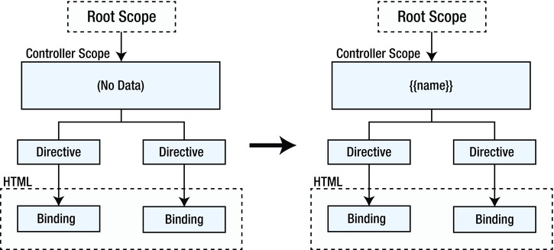
Scope Configuration Options:
Notes:
There is no scope data in this example when the application first starts, but the ng-model directive that is included in the directive template means that AngularJS will dynamically create a name property when the contents of either input element are changed.
Since there is only one scope in this example—well, aside from the root—both directives bind to the same property, and that’s why they are synchronized.

Slide 8
Creating Multiple Controllers
The simplest but at the same time the least elegant solution for creating the independent scopes for the directive is: Creating Individual Controllers for the Directives.
IMO it should only be used when you don’t have the control over the source code of the directive you are using.
Let us open the file: AngularJS/Basics_AngularDirective/Directives_Custom/ConfigurationExaplanations/Scope/File_2_Defining_Multiple_Controllers_For_Scope_Management.html
The effect of using two individual controllers over the directives:
Two individual scopes.
Within those scopes we have independent values : name.
This allows the directives which have input elements to behave independently.
Let us see how does it translate in the form of a diagram.

Slide 9
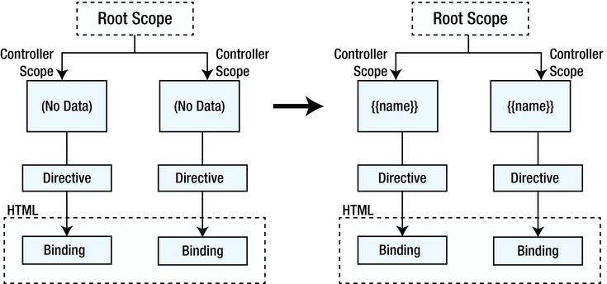
Scope Configuration with Individual Controllers:
Notes:
There are two controllers, each of which contains no data when the application starts.
Editing the input elements dynamically creates a name property in the scope of the controller that contains the directive instance the input element is managed by, but these properties are completely separate from one another.

Slide 10
Individual Scope to the Directives:
Elegant approach is to ask AngularJS to create a scope for each instance of the directive by setting the scope definition object property to true.
Let us look at the file : AngularJS/Basics_AngularDirective/Directives_Custom/ConfigurationExaplanations/Scope/File_3_Individual_Scope_Directives.html
Setting the scope property true allows us to reuse the directive within the same controller.
In large projects which are complex enough, without having to create endless controllers just to stop your directives from sharing data values can be very useful.
Sharing scopes between the parent controller and the directives underneath:
The scopes that are created when the scope property is set to true are part of the regular scope hierarchy which is : if the property is attached to the object and then attached to the scope, that would be shared across the directives, but the properties which are attached to scope directly, the directives would manage their own copies.
Let us see that in action : AngularJS/Basics_AngularDirective/Directives_Custom/ConfigurationExaplanations/Scope/File_4_Sharing_Scope_Directives.html

Slide 11
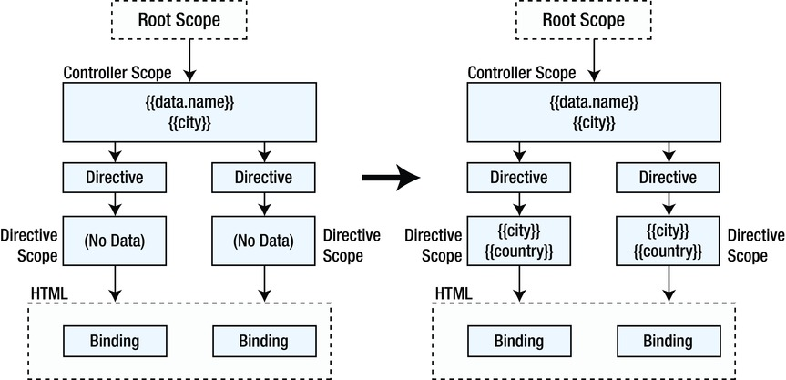
Scope Configuration

Slide 12
Scope Configuration: Isolated
Isolated scope is where AngularJS creates a separate scope for each instance of the directive but the scope doesn’t inherit from the controller scope.
This is useful if you are creating a directive that you intend to reuse in a range of different situations and don’t want any interference caused by the data objects and properties defined on by the controller or elsewhere in the scope hierarchy.
An isolated scope is created when the scope definition property is set to an object. The most basic kind of isolated scope is represented by an object with no properties.
Let us modify the example that we were building initially: AngularJS/Basics_AngularDirective/Directives_Custom/ConfigurationExaplanations/Scope/File_5_Isolated_Scope.html
As you might have observed, all six input elements are empty.
This is the consequence of the isolated scope; because there is no inheritance from the controller’s scope, there are no values defined for any of the properties specified by the ng-model directive.
AngularJS will dynamically create these properties if you edit the input elements, but the properties will only be part of the isolated scope of the directive that the modified input element is associated with.

Slide 13
Binding through an Attribute Value
Isolated scope are very useful for very generic directives.
But completely isolating the scope can make it very difficult to inject the data back and forth form the directive.
Angular JS provides two mechanisms through which you can have expected interactions between the controller and the directive.
Isolated scopes allow you to bind to data values in the controller scope using attributes applied to the element alongside the directive:
Let us see that in action : AngularJS/Basics_AngularDirective/Directives_Custom/ConfigurationExaplanations/Scope/File_6_Isolated_Scope_Binding_Via_Attribute.html
Why is this example so relevant is because have used an isolated scope so that our directive doesn’t inherit the data in the controller’s scope and end up working with data that it wasn’t expecting—something that can happen because there is no way to selectively control how a regular nonisolated scope inherits data values from its parent.
But my directive does need to access a data value in the controller’s scope, so I told AngularJS to create a one-way binding between an expression I specified as an attribute value and a property on the local scope.
This gives us the selective control over the scope inheritance that I need and, as a bonus, allows that selection to be configured when the directive is applied, which is key to allowing a single directive to be reused in different ways without needing any code or markup changes.

Slide 14
Two way binding and reusing the directives.
AngularJS/Basics_AngularDirective/Directives_Custom/ConfigurationExaplanations/Scope/File_8_Isolated_Scope_Two_Way_Binding.html
AngularJS/Basics_AngularDirective/Directives_Custom/ConfigurationExaplanations/Scope/File_7_Isolated_Scope_Binding_Via_Attribute_Reuse.html

Slide 15
Summary
Define your challenges
Technological as well as personal
Set realistic expectation
Mastery is not achieved overnight
Keep your eye on the goal
Mentorship programs
Notes:
Summarize presentation content by restating the important points from the lessons.
What do you want the audience to remember when they leave your presentation?

Slide 16
Resources
<Intranet site text here> <hyperlink here>
<Additional reading material text here> <hyperlink here>
This slide deck and related resources: <hyperlink here>

Slide 17
Questions?

Slide 18
Appendix
Notes:
Is your presentation as crisp as possible? Consider moving extra content to the appendix.
Use appendix slides to store content that you might want to refer to during the Question slide or that may be useful for attendees to investigate deeper in the future.

