Slide 1
Core Java
Java String

Slide 2

Enabling Objectives
After completing this chapter, in the next 120 minutes you will be able to :
Demonstrate on different types of string classes and their related API’s.

Slide 3
Key Topics
String Class and its API’s
StringBuffer Class and its API’s
StringBuilder Class and its API’s
String Vs StringBuffer Vs StringBuilder
StringTokenizer Class and its API’s
StringJoiner Class and its API’s

Slide 4
String Class and its API’s

Slide 5
String Class
Strings are the sequence of characters.
Java provides String class to create and process strings.
Strings are objects.

Slide 6
How to create a String?
Option 1:
String greeting = "Hello world!";
// Create a string literal and assign it to a String reference.
(OR)
Option 2:
String greeting = new String("Hello world!“);
// Using the String constructor.

Slide 7
What does String class contain?
String is available in java.lang package.
String class contains the API’s used for creating and processing strings.
Example:
Comparing Strings
Searching strings.
Extracting substrings.
Also constructors for creating Strings in different ways.

Slide 8
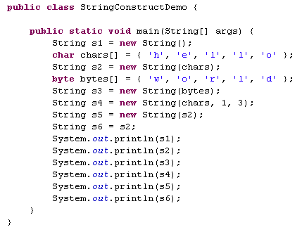
Lend a hand - String Constructors
Creating string objects from a character array.
From byte array.
From other char objects.
From other string objects.

Slide 9
Some commonly used API’s inside String Class
Result | Method | Description
char | charAt(int index) | Returns the character at the specified index.
int | compareTo(String anotherString) | Compares two strings lexicographically.
boolean | equalsIgnoreCase(String anotherString) | Compares this String to another String, ignoring case considerations.
int | indexOf(int ch) | Returns the index within this string of the first occurrence of the specified character.
int | length() | Returns the length of this string.

Slide 10
String Class Api’s
Result | Method | Description
String | concat(String str) | Concatenates the specified string to the end of this string.
String | replace(char oldChar, char newChar) | Returns a new string resulting from replacing all occurrences of oldChar in this string with newChar.
String | substring(int beginIndex, int endIndex) | Returns a new string that is a substring of this string.
String | trim() | Returns a copy of the string, with leading and trailing whitespace omitted.

Slide 11
Key points on String Class
Strings are immutable
If a string reference is assigned to a new string, the old string will be lost.
Example:
String str1="Hello";
str1="World"; // Now, str1 contains "World".
Notes:
Immutable means once it is created a String object cannot be changed.

Slide 12
Key points on String Class (Contd.)
All string operations (concatenate, trim, replace, substring) construct and return new strings.
String class is final.

Slide 13
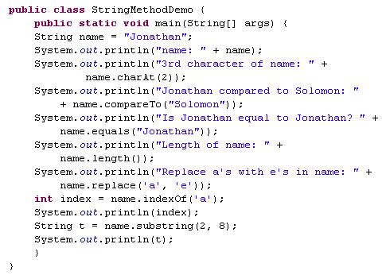
Lend a hand - String API’s
Prints the character at second index
This compares t oStrings.
This equates two string and returns true/false.
Prints the String length.
This returns “Jonethen”.
This the returns the index of the character ‘a’ in the String.
This returns substring between index 2 & 8.
Notes:
Lets develop a program to explore the few API’s of String class, namely,
print a specific character of a string, compare, print length of string, replace a string etc.

Slide 14
StringBuffer Class and its API’s

Slide 15
What is StringBuffer?
Unlike Strings, StringBuffer objects are mutable.
Using StringBuffer API, the content and the length of the string can be changed without creating a new object.
The API's of StringBuffer are synchronized.
Notes:
Mutable means string value can be modified

Slide 16
Why StringBuffer Class?
Preferred when modification of strings are needed.
Efficient in memory utilization.
Examples:
Appending String
Inserting characters in string.
Deleting characters from a string

Slide 17
StringBuffer Class
StringBuffer is a final class.
StringBuffer objects can be created empty,
StringBuffer strBuf = new StringBuffer();
StringBuffer can be created from a String.
StringBuffer strBuf = new StringBuffer(“Bob”);
StringBuffer can be created with a capacity.
StringBuffer strBuf = new StringBuffer(100);

Slide 18
StringBuffer Class
StringBuffers are used to concatenate String.
Example:
String str="Stanford";
str = str+ "University";
Can be developed as
str = new StringBuffer().append("Standford").append("University").toString();
Step 2: Appends the string representation of each operand to the string buffer in turn.
Step 1: Compiler creates a new string buffer initially empty.
Step 3: Converts the contents of the string buffer to a string as ‘str’ is a string object.
Notes:
Instead of using concatenation operator "+" on string objects. StringBuffer use append() function which is more efficient than "+" concatenation.

Slide 19
StringBuffer API’s
Result | Method | Description
void | setCharAt(int index, char ch) | The character at the specified index of this string buffer is set to the character ch.
StringBuffer | insert(int offset, String str) | Inserts the string argument into this string buffer.
StringBuffer | delete(int start, int end) | Removes the characters in a substring of this StringBuffer.
StringBuffer | replace(int start, int end, String str) | Replaces the characters in a substring of this StringBuffer with characters in the specified String.

Slide 20
StringBuffer API’s
Result | Method | Description
StringBuffer | reverse() | The character sequence contained in this string buffer is replaced by the reverse of the sequence.
StringBuffer | append(String str) | Appends the string to this string buffer.
void | setLength(int newLength) | Sets the length of this String buffer.
String | substring(int start, int end) | Returns a new String that contains a subsequence of characters currently contained in this StringBuffer.

Slide 21
Lend a Hand – StringBuffer API
Lets develop a program to explore the few API’s of String Buffer class.
Append two Strings “Hello” & “World” . Output: “Hello World”
Insert a string “_Java” in the String after “Hello”. Output: “Hello_Java World”
Replace _ with space. Output: “Hello Java World”.

Slide 22
Lend a Hand – StringBuffer API
4. Print the character at the 6’th position . Output: J
5. Delete the character in the third position. Output: “Helo World”
6. Print the capacity of the buffer.
7. Reverse the string and print the string. Output: “dlroW avaJ oleH”

Slide 23
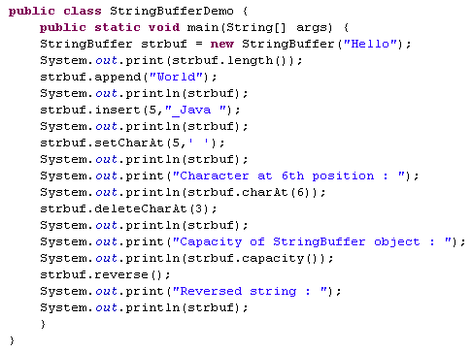
Lend a hand Solution -StringBuffer API’s
This returns 5.
This returns “HelloWorld” .
This returns “Hello_Java World”.
This returns “Hello Java World”.
This returns ‘J ‘ .
This returns “Helo Java World”.
This returns ‘21 ‘.
This returns “dlroW avaJ oleH“ .

Slide 24
StringBuilder Class and its API’s

Slide 25
What is StringBuilder?
All the methods available on StringBuffer are also available on StringBuilder.
StringBuilder is considered as a replacement for StringBuffer as it offers faster performance.
StringBuilder is not synchronized. Hence, it is not thread-safe.

Slide 26
Lend a Hand – StringBuilder API
Lets develop a program to explore the few API’s of String Builder class.
Append two Strings “Hello” & “World” . Output: “HelloWorld”
Insert a string “_Java” in the String after “Hello”. Output: “Hello_Java World”
Replace _ with space. Output: “Hello Java World”.

Slide 27
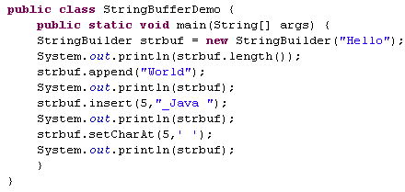
Lend a hand-StringBuilder Methods
This returns 5
This returns “HelloWorld”
This returns “Hello_Java World”
This returns “Hello Java World”

Slide 28
String vs StringBuilder vs StringBuffer

Slide 29
String Vs StringBuilder Vs StringBuffer
String | StringBuilder | StringBuffer
Strings are immutable | Strings are mutable | Strings are mutable
 | Can be accessed in single threaded environment. Not thread-safe but faster than StringBuffer | Can be accessed in multi-threaded environment. Hence Synchronous and thread-safe.
Notes:
When to use which one :
If a string is going to remain constant throughout the program, then use String class object because a String object is immutable.
If a string can change (example: lots of logic and operations in the construction of the string) and will only be accessed from a single thread, using a StringBuilder is good enough.
If a string can change, and will be accessed from multiple threads, use a StringBuffer because StringBuffer is synchronous so you have thread-safety.

Slide 30
Conversion from String to StringBuffer and StringBuilder
As String class is immutable, so for editing a string, we can perform by converting it to StringBuffer or StringBuilder class objects.
Example:
String str = "Cognizant";
// conversion from String object to StringBuffer
StringBuffer sbr = new StringBuffer(str);
sbr.reverse();
System.out.println(sbr);
// conversion from String object to StringBuilder
StringBuilder sbl = new StringBuilder(str);
sbl.append("Technology Solution");
System.out.println(sbl);
Notes:
Example:
public class Test
{
public static void main(String[] args)
{
String str = "Cognizant";
// conversion from String object to StringBuffer
StringBuffer sbr = new StringBuffer(str);
sbr.reverse();
System.out.println(sbr);
// conversion from String object to StringBuilder
StringBuilder sbl = new StringBuilder(str);
sbl.append("Technology Solution");
System.out.println(sbl);
}
}

Slide 31
Conversion from StringBuffer and StringBuilder to String
Using toString() method which is available in both StringBuffer and StringBuilder classes.
Example:
StringBuffer sbr = new StringBuffer("Cognizant");
// conversion from StringBuffer object to String
String str = sbr.toString();
// conversion from StringBuilder object to String
String str1 = sbdr.toString();
Notes:
For example:
public class Test
{
public static void main(String[] args)
{
StringBuffer sbr = new StringBuffer("Cognizant");
StringBuilder sbdr = new StringBuilder("Technology");
// conversion from StringBuffer object to String
String str = sbr.toString();
System.out.println("StringBuffer object to String : ");
System.out.println(str);
// conversion from StringBuilder object to String
String str1 = sbdr.toString();
System.out.println("StringBuilder object to String : ");
System.out.println(str1);
// changing StringBuffer object sbr
// but String object(str) doesn't change
sbr.append("Technology");
System.out.println(sbr);
System.out.println(str);
}
}
Note that while we use toString() method, a new String object(in Heap area) is allocated and initialized to character sequence currently represented by StringBuffer object, that means the subsequent changes to the StringBuffer object do not affect the contents of the String object.

Slide 32
Conversion from StringBuffer to StringBuilder or vice-versa
There is no direct way.
String class object can be used as a mediator of conversion.
Example:
StringBuffer sbr = new StringBuffer("Cognizant");
// conversion from StringBuffer object to StringBuilder
String str = sbr.toString();
StringBuilder sbl = new StringBuilder(str);
Notes:
public class Test
{
public static void main(String[] args)
{
StringBuffer sbr = new StringBuffer("Cognizant");
// conversion from StringBuffer object to StringBuilder
String str = sbr.toString();
StringBuilder sbl = new StringBuilder(str);
System.out.println(sbl);
}
}

Slide 33
StringTokenizer Class and its API’s

Slide 34
StringTokenizer Class
Used to break a string into tokens based on delimiters.
It is available in java.util package
StringTokenizer implements the Enumeration interface.
Example:
India, USA, UK, Russia
– This string can be split based on the delimiter “,”
Notes:
Tokens from the String:
Token 1- India Token 2- USA Token 3- UK Token 4- Russia

Slide 35
StringTokenizer API’s
The default delimiters are whitespace characters. space, tab, newline, and carriage return.
Result | Method | Description
boolean | hasMoreTokens() | Tests if there are more tokens available from this tokenizer's string.
String | nextToken() | Returns the next token in this string tokenizer's string.

Slide 36
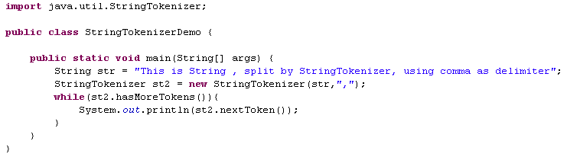
Lend a hand - StringTokenizer
Lets develop a program to explore the StringTokenizer.
Run the program and check the output.
Now Execute the same program without using delimiter and see the output.
StringTokenizer st = new StringTokenizer(str);

Slide 37
StringJoiner Class and it’s API

Slide 38
StringJoiner Class
Available in Java.util package.
Used to construct a sequence of characters separated by a delimiter.
Example:
StringJoiner joinNames = new StringJoiner(",");
// passing comma(,) as delimiter
// Adding values to StringJoiner
joinNames.add(“Alice");
joinNames.add(“Bob");

Slide 39
StringJoiner Constructors
Constructor | Description
Public StringJoiner(CharSequence delimiter) | Constructs a StringJoiner with no characters in it, with no prefix or suffix, and a copy of the supplied delimiter. It throws NullPointerException if delimiter is null.
Public StringJoiner(CharSequence delimiter,CharSequence prefix,CharSequence suffix) | Constructs a StringJoiner with no characters in it using copies of the supplied prefix, delimiter and suffix. It throws NullPointerException if prefix, delimiter, or suffix is null.

Slide 40
StringJoiner Methods
Result | Method | Description
StringJoiner | add(charSequence newElement) | Adds a copy of the given CharSequence value as the next element of the StringJoiner value.
int | length() | Returns the length of the String representation of this StringJoiner.
StringJoiner | merge(StringJoiner other) | Adds the contents of the given StringJoiner without prefix & suffix as the next element if it is non-empty.
StringJoiner | setEmptyValue(CharSequence emptyValue) | Sets the sequence of characters to be used when determining the string representation of this StringJoiner and no elements have been added yet, that is, when it is empty.

Slide 41
Lend a Hand – StringJoiner Class
Lets develop a program to explore StringJoiner class
Create a Employee object with instance variable age and name.
Add employee name: Alice, Bob, Cameron, Dev
Output should display in
[Alice, Bob, Cameron, Dev]

Slide 42
hashCode() method
Is part of java.lang.Object.
Can be overridden and implemented with the object specific logic
Notes:
What is a Hash code?
Hash code is an unique id number allocated to an object by JVM. This number is maintain throughout the lifecycle of the Object.
hashCode():
This method by default returns the hash code integer value of the object on which this method is invoked.
You can develop your own logic of generating hash code.

Slide 43
equals() method
Is used for comparing two objects for equality.
Override the equals() with a logic which needs to be used for comparing for equivalence.
Notes:
equals():
equals() refers to equivalence relation i.e. you say that two objects are equivalent they satisfy the “equals()” condition.
Example: Assume we have a object Employee with the following instance variables, EmployeeId, EmployeeName.
The developer can override the equals method and compare the employee Id for checking equivalence.

Slide 44
Lend a Hand – Equals and Hash Code
Lets develop a program to explore how equals and hash code works.
Create a Employee object with instance variable age and name. Override the hash code and equals method as mentioned below,
Equals – The method overridden to compare the age of the employees if same they should return a true else return false.
hashCode – Should return the age as hash code.

Slide 45
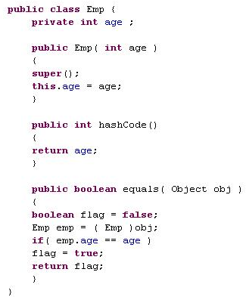
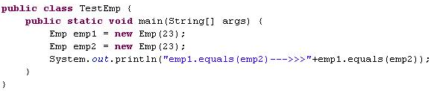
Lend a hand Solution
This returns true.
Overriding hashCode().
Overriding equals()

Slide 46
Key points on equals method
Reflexive: x.equals(x) is true.
Symmetric: if x.equals(y) is true, then y.equals(x) must be true.
Transitive: if x.equals(y) is true, and y.equals(z) is true, then z.equals(x) is true.
Consistent: Multiple calls to x.equals(y) will return the same result.
Null: If x.equals(y) is true, then x.hashCode() == y.hashCode() is true.

Slide 47
Key points on hash code method
Consistent: Multiple calls to x.hashCode() return the same integer.
If x.equals(y) is true, x.hashCode() == y.hashCode() is true.
However, a.hashCode() == b.hashCode() does not have to mean a.equals(b).
Transient variables are not appropriate for equals() and hashCode().

Slide 48
Test your understanding
What is String?
What is the use of StringBuffer class?
What is the use of StringBuilder class?
When to use String, StringBuffer & StringBuilder?
What is the use of StringTokenizer class?
What is the use of StringJoiner class?
What is the significance of hashcode() and equals() mehods?

Slide 49

Recap
In this chapter we have learnt to:
Demonstrate on different types of string classes and their related API’s.

Slide 50
You have successfully completed - String session in Java.

