Slide 1




Github copilot
Vinodh Srinivasan & Mohamed ismail
Digital excellence center

Slide 2

I’m powered by AI, so surprises and mistakes are possible. Make sure to verify any generated code or suggestions, and share feedback so that we can learn and improve.

Slide 3
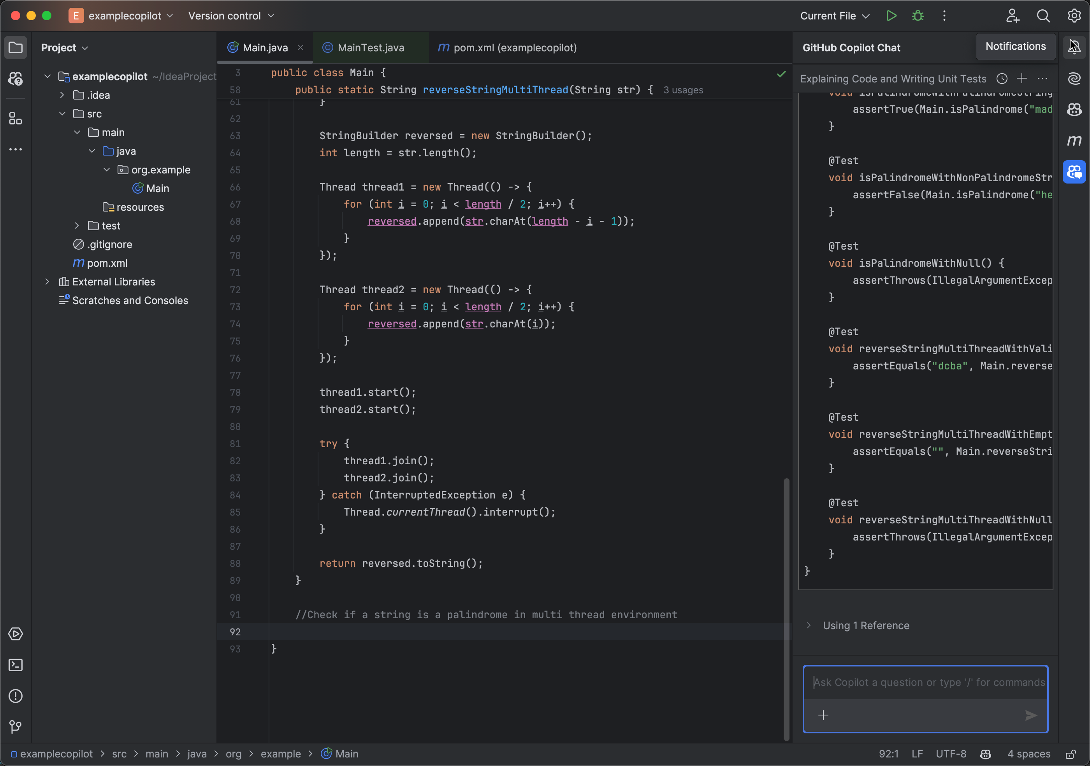



introduction
GPT4o
Public repo
Internal Training
Context
Suggestions
SSO Enabled
OpenAI Codex
Inline Suggestions
Chat

Slide 4
features
Code Auto Completion
Understand the context
Suggest code
Generate Docs
Create documentation by understanding code
Generate test
Will create test for the give code
Fix this
Review existing code and provide suggestions
Explain This
Understand existing code and provide explanation
Simply this
Provide minimalize version

Slide 5
usage
Auto code completion and inline suggestions
Unit test creation
Learn new features of language/ ide
Refactor the core or translate into a different language
Understand existing code
Generate comments
Details of Role / Job description and other generic information
Simplify / fix
Vulnerability suggestions / fix

Slide 6
Life cycle of code suggestion in the ide
GitHub Copilot in the IDE
Data is held in memory, not written to disk
Copilot Proxy
1
Developer enters text into code editor. Copilot gathers context from:
Code before and after cursor
File name and type
Other open tabs in the editor
3
Terminate requests containing:
Toxic language
Requests unrelated to code
Hacking attempts
Copilot LLM
2
4
Code suggestion formulated
Prompt constructed from context
5
Test code suggestions for obvious bugs and common security vulnerabilities
Truncate responses that contain unique identifiers
Filter responses matching public ode.
6
Code suggestion presented to user to accept or reject
Reference: https://resources.github.com/learn/pathways/copilot/essentials/how-github-copilot-handles-data/

Slide 7
Prompt crafting
Context
Information provided in the prompt that helps Copilot understand the task better.
Intent
The level of detail and precision in a prompt.
Clarify
Specificity
The quality of being unambiguous and easy to understand.
The specific goal or purpose you have in mind when creating a prompt.

Slide 8
/slash commands
/explain
Explains how the selected code works
/tests
Ask a questions about the files in your current workspace
/fix
/workspace
Proposes a fix for the problems in the selected code
Generates unit tests for the selected code
/help
Learn how to use Copilot Chat

Slide 9
Prompt crafting
The process of giving clear natural language instructions to computer programs, such as the large language models(LLMs) that drive GitHub Copilot functionalities.
It can be a questions, statement or description of what you want Copilot to do
Accepted in the form of comments in your file or inputs in Copilot Chat
Copilot’s LLMs are sophisticated probability engines, so you might not get the same results for the exact same prompts every time

Slide 10
references
https://github.com/enterprises/<sso>/sso
https://github.com/login/device
https://resources.github.com/learn/pathways/copilot/essentials/how-github-copilot-handles-data/

Slide 11
Languages supported
Java
JavaScript
Python
C#
C++
Ruby
PHP
Swift
Kotlin
TypeScript
Go
Rust
SQL
HTML/CSS
R
MATLAB
Perl
Scala
Groovy
Objective-C
As of my training data up to October 2023, here are some of the programming languages commonly supported by various development tools and platforms:
This list is not exhaustive, and support for additional languages may be available depending on the specific development environment or tool you are using.

