Slide 1
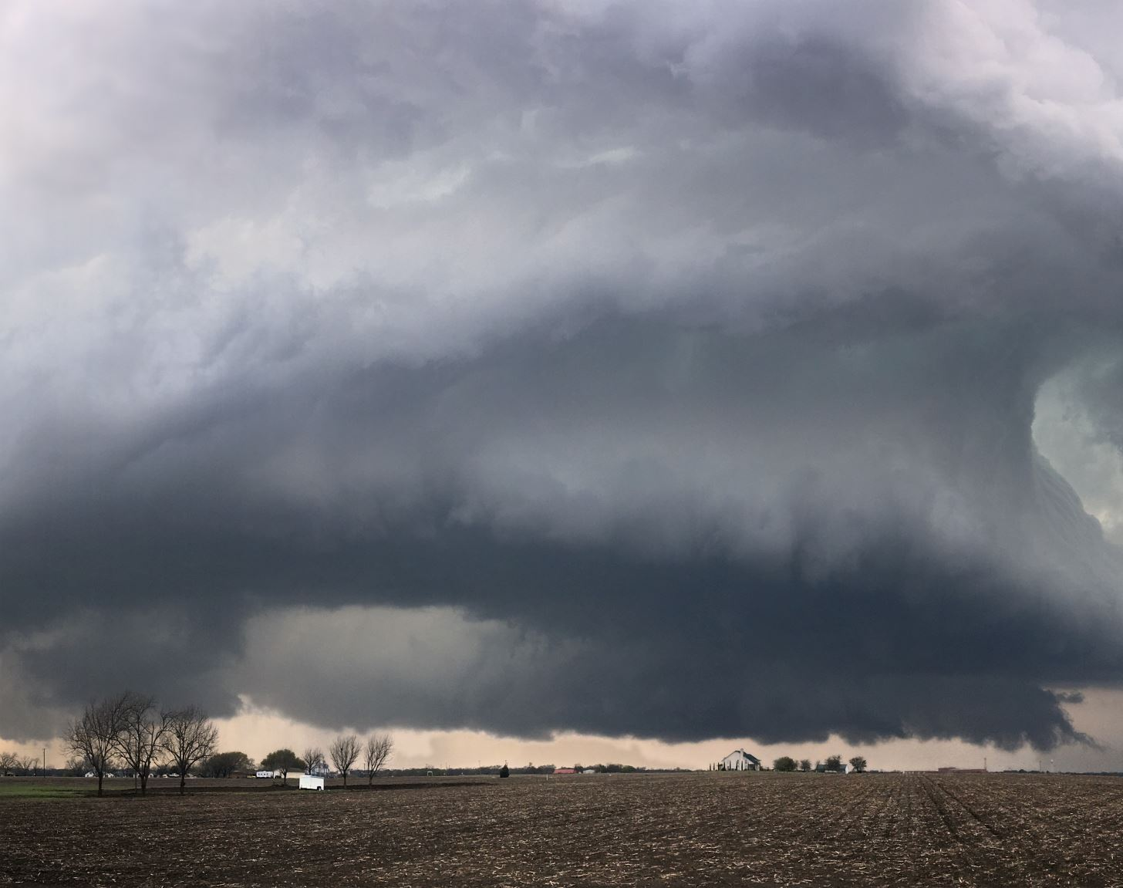
Rainfall Prediction Using Machine Learning
Team-12

Slide 2




TEAM MEMBERS
Vinodh Kumar Chimpiri
Machine Learning Engineer
Snithika Patel Talasani
Data Engineer
Sneha Vangala
Data Scientist
Anwar Rashid Shaik
Bigdata Engineer

Slide 3

Objective
Developing an Accurate and Scalable Machine Learning Model for Rainfall Prediction to Enhance Water Resource Management.

Slide 4
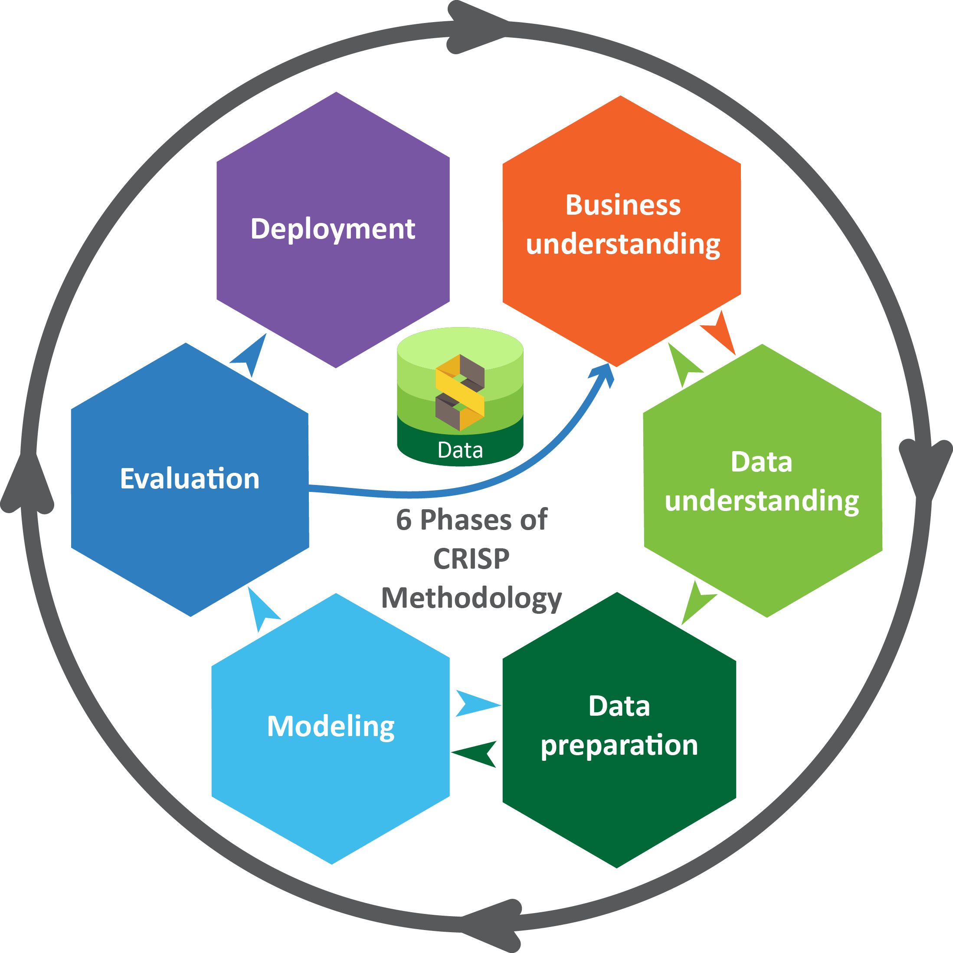
Crisp Methodology
CRISP methodology involves systematically defining the problem, collecting and comprehending the data, preprocessing to ensure data quality, selecting relevant features, choosing appropriate models, developing and fine-tuning these models, evaluating their performance, and optimizing hyper parameters for increased accuracy.

Slide 5
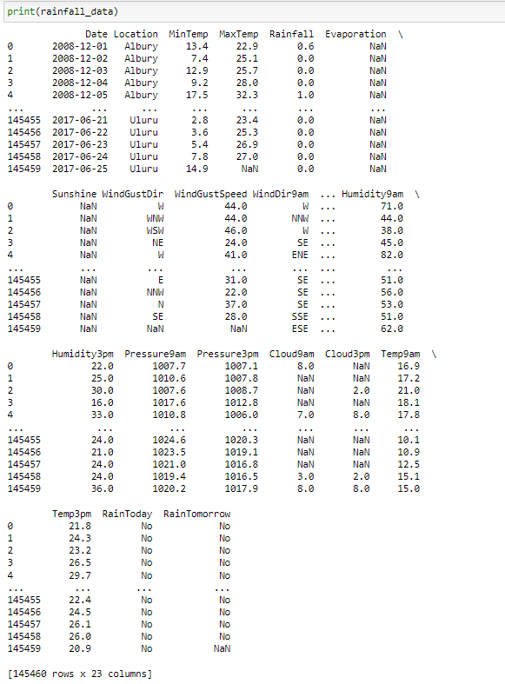
Data Acquisition
The dataset is acquired from kaggle.
Our dataset contains 145460 rows and 23 columns.

Slide 6
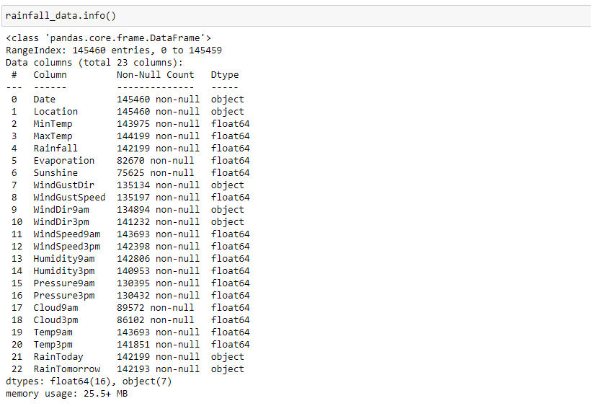
Data Exploration

Slide 7

Model Selection
Logistic Regression
Decision Tree
Random Forest Classifier
XG-Boost

Slide 8
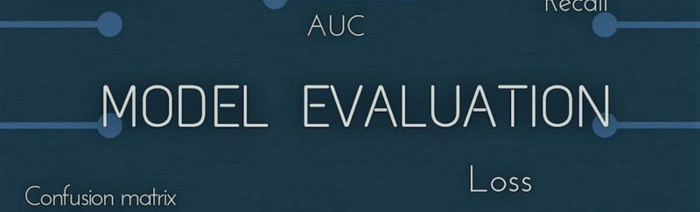
Evaluation Metrics
Accuracy
Precision
Recall
F1-score
Confusion Matrix

Slide 9
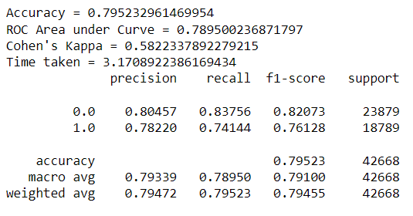
Logistic Regression
Logistic Regression serves as a valuable tool, especially when the task is framed as a binary classification problem, distinguishing between the occurrence and non-occurrence of rainfall within a specific timeframe.

Slide 10
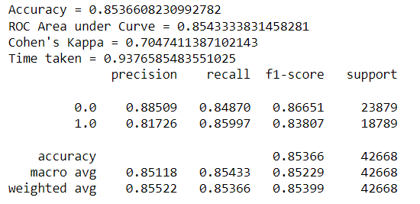
Decision Tree
Decision trees are a powerful tool in the realm of rainfall prediction, providing a transparent and intuitive framework for understanding and interpreting complex relationships within meteorological data.

Slide 11
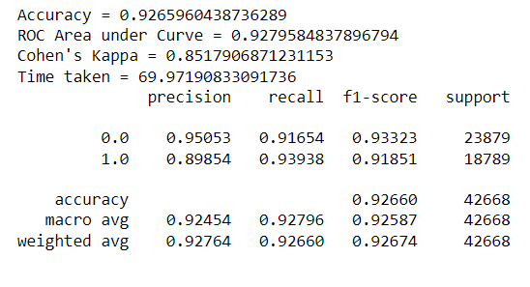
Random Forest Classifier
The Random Forest classifier proves instrumental in rainfall prediction by leveraging an ensemble of decision trees to enhance accuracy and robustness. Through the aggregation of predictions from multiple trees, each trained on different subsets of the data, Random Forest mitigates overfitting and captures complex relationships within meteorological features.

Slide 12
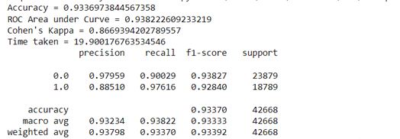
XG-Boost
XG-Boost, an advanced implementation of gradient boosting, proves invaluable in rainfall prediction by enhancing predictive accuracy and handling complex relationships within meteorological data.

Slide 13
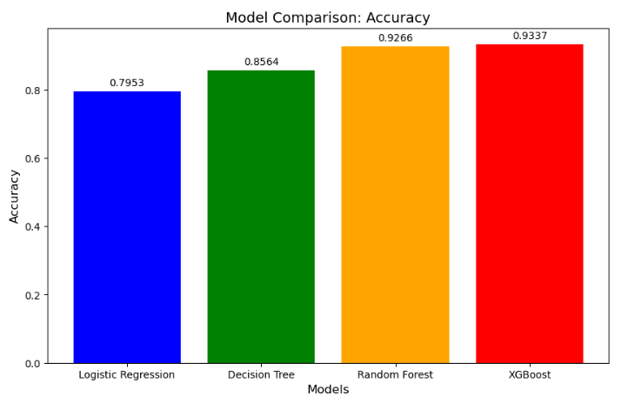

Model Comparison

Slide 14

Our project links
https://github.com/vinodhvinu438/DSDE-TEAM12#dsde-team12

Slide 15
Thank you

