Slide 1

Testing APIs with Postman

Slide 2
Topics
Postman Introduction
Postman Collections
Writing Automated Tests using Postman
Automated Testing with Newman
Demo
References & Learning

Slide 3







Postman Introduction
What Is Postman?
Features
Is a Google Chrome app for interacting with HTTP APIs. It presents you with a friendly GUI for constructing requests and reading responses. There is also a native app available for windows, mac and linux platforms.
Supports grouping of requests into collections
Supports REST and SOAP protocols
Command line execution
Data Driven testing using csv & json
Import postman collections into SOAP UI
CI/CD support
Publish
Design & Mock
Onboard developers to your API faster with Postman collections and documentation
Design in Postman & use Postman’s mock service
Monitor
Debug
Create automated tests to monitor APIs for uptime, responsiveness, and correctness
Test APIs, examine responses, add tests and scripts
Document
Automated
Testing
Create beautiful web-viewable documentation
Run automated tests using the Postman collection runner

Slide 4


Postman Collections
A Postman Collection is an Executable API Description
It is the core of Postman API Development Environment
Collections allow us to :
Group a set of requests into an API suite
Organize requests into folders
Send requests individually, or use collection runner to send all the requests in the collection
Document the collection with description, tests and more
Examine responses and view results
What we can do with collections?
Share Collection
Export Collection
Add Folder to a Collection
Duplicate the Collection
Remove the collection from workspace
Delete the collection
Leave a comment on the collection

Slide 5
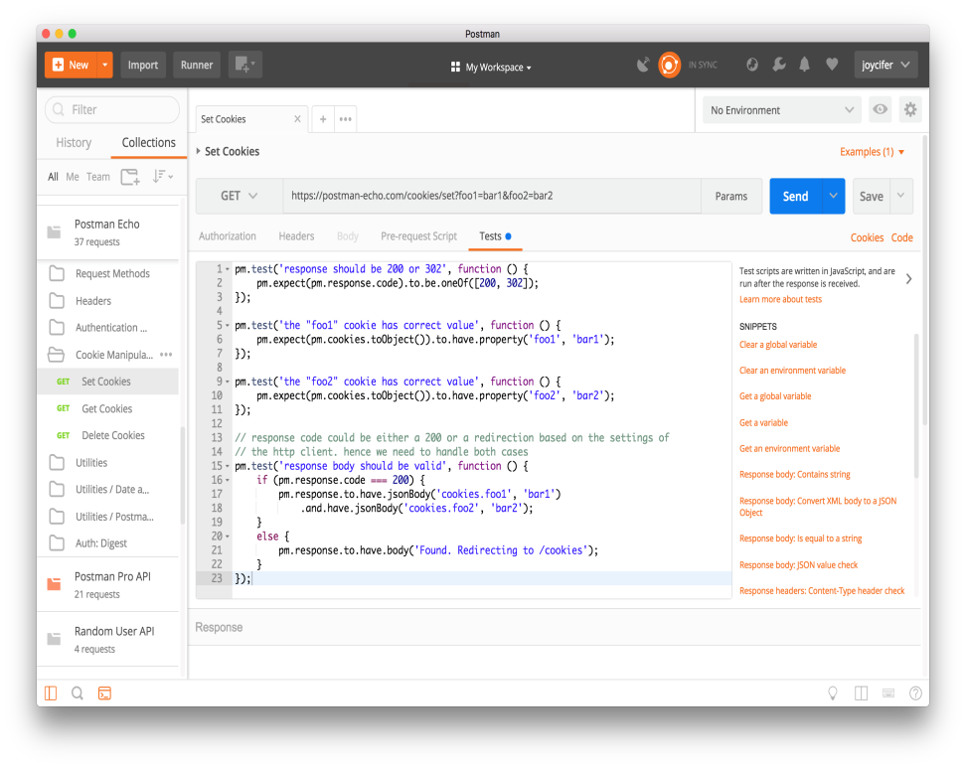
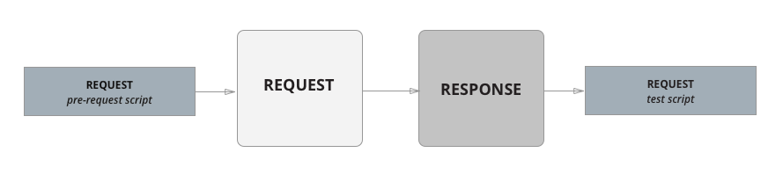
Writing Automated Tests using Postman
Postman contains a powerful runtime based on Node.js that allows you to add dynamic behavior to requests and collections. This allows you to write test suites, build requests that can contain dynamic parameters, pass data between requests etc. You can add JavaScript code to execute during 2 events in the flow:
Before a request is sent to the server, as a pre-request script under the Pre-request Script tab
After a response is received, as a test script under the Tests tab
Execution order of scripts
A pre-request script associated with a request will execute before the request is sent
A test script associated with a request will execute after the request is sent

Slide 6
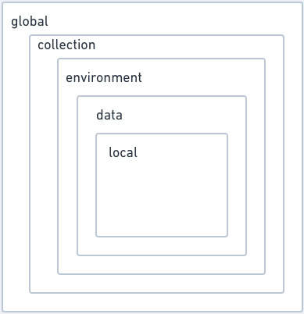
Environment and Variables
Environments
An environment is a set of key-value pairs. The key represents the name of the variable.
Lets us to customize requests using variables so you can easily switch between different setups without changing your requests
We can create, share, duplicate, export, and delete an environment. Also lets us import an environment as a single JSON file
Variables
Variables can be used in request url, headers, pre-requisite script and tests.
Supports data variables in csv and json formats. In this way tests can be parameterized with different sets of data using external files
Variable scopes
Accessing variables
Variable Scopes
Global
Collection
Environment
Data
Local
Request Builder
Through Script
Data Variables
In pre-script
and tests
Data Variables
In Requests
Global
Collection
Environment
Data
Local
{% raw %} {{variableName}} {% endraw %}
pm.environment.set() or pm.global.set()
pm.environment.get() or pm.global.get()
pm.iterationData.get(“username”)
{% raw %} {{variableName}} {% endraw %}

Slide 7
Automated Testing with Newman
// TODO

Slide 8
References & Learning
https://learning.getpostman.com/docs/postman/launching_postman/installation_and_updates/
http://blog.getpostman.com/2014/10/28/using-csv-and-json-files-in-the-postman-collection-runner/?_ga=2.123063947.1206661868.1546906314-1179543638.1546679075
https://www.qasymphony.com/blog/automated-api-testing-tutorial/
https://www.npmjs.com/package/newman

