Slide 1
FinPilot
FinPilot is an agentic AI financial assistant that handles education, market, news, portfolio, planning, and tax questions, by routing each request to a specialized agent, with scoped tool access and guardrails.
10-minute MVP demonstration
FinPilot 1 / 10
Notes:
00:00–00:40 | 40 seconds
FinPilot is an agentic AI financial assistant that handles education, market, news, portfolio, planning, and tax questions, by routing each request to a specialized agent, with scoped tool access and guardrails. Each task needs a different approach. Finance and Tax need reliable evidence, Portfolio needs scoped customer records, and Goals needs accurate calculations. This MVP connects six specialists within one application. Let me show you how they work together. Synthetic portfolios and simulated identity are used for the MVP.
Sources: docs/finpilot-mvp-overview.md; docs/evaluation.md; docs/cost-optimization.md. UI images: actual local captures in docs/architecture/assets/ui/. Synthetic portfolios and provider snapshots illustrate application behavior. No evaluation scores are claimed.

Slide 2
Application architecture
Streamlit UI
FastAPI
Input guardrails
Intent router
PII redaction, regex checks
Moderation, injection screening
Finance
Tax
Portfolio
Market
Goals
News
Qdrant RAG
PDF + cache
Qdrant RAG
Tax corpus
SQLite
Scoped data
Twelve Data
MCP + cache
Local Python
Calculators
Tavily API
Direct HTTPS
Human clarification
SQLite checkpoints + resume
Output checks
Validated response to UI
LangSmith
Request and tool tracing
OpenAI: routing, agent reasoning and dense embeddings
FinPilot 2 / 10
Notes:
00:40–01:35 | 55 seconds
Read this architecture in three groups. On the left, Streamlit sends questions through FastAPI. In the middle, LangGraph runs input checks and an intent router, then selects one specialist. Finance and Tax use Qdrant RAG. Portfolio uses scoped SQLite tools. Goals uses local calculators. Market connects through a Twelve Data MCP subprocess. News calls Tavily directly. On the right are providers, stores and LangSmith. Human-in-the-loop clarification uses SQLite checkpoints and the same thread on resume. The UI shows session chat history. A fresh question does not automatically send that visible history to the agent. Output redaction and API validation precede the response. Point out the main groups, without reading every box. Diagram source: docs/architecture/assets/finpilot-architecture-v2.svg.
Sources: docs/finpilot-mvp-overview.md; docs/evaluation.md; docs/cost-optimization.md. UI images: actual local captures in docs/architecture/assets/ui/. Synthetic portfolios and provider snapshots illustrate application behavior. No evaluation scores are claimed.

Slide 3
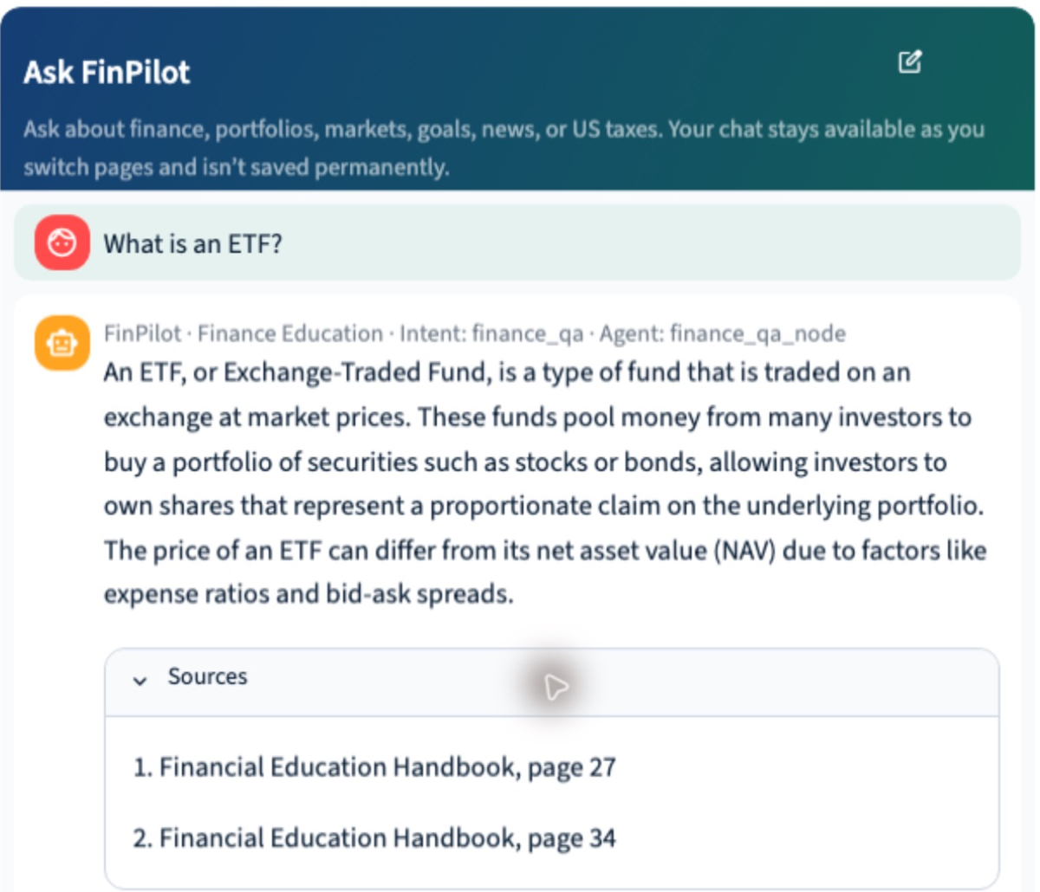
Finance Education
RAG from a curated finance handbook
OFFLINE INGESTION
PDF, recursive splitting, OpenAI embeddings
HYBRID SEARCH
Qdrant dense + sparse BM25, RRF
EVIDENCE RECOVERY
Evidence Expansion, Targeted Query Rewrite
REUSE AND BOUNDS
Semantic cache, 3 retrieval actions
Tools: RAG query, expand evidence, targeted search
Simple and compound interest calculators
ETF answer with handbook citations
Example: “What is an ETF?”
FinPilot 3 / 10
Notes:
01:35–02:30 | 55 seconds
The Finance specialist starts with a curated handbook. Offline ingestion creates LangChain Documents, then recursive splitting creates 800-character chunks with 120-character overlap. OpenAI dense embeddings and FastEmbed Qdrant/bm25 sparse vectors go into finance_education_hybrid. Online, eligible definition questions first check a semantic answer cache. Otherwise Qdrant hybrid search combines dense and sparse rankings using Reciprocal Rank Fusion. Evidence coverage can trigger Evidence Expansion or a Targeted Query Rewrite for missing facts. The total limit is three retrieval actions, with a shared cap of 15 passages and 30,000 characters. Baseline exposes up to three passages. Explicit supported metadata can filter retrieval. The optional cross-encoder reranker is disabled by default. Retrieval timeout is 15 seconds. Point to the ETF answer and its source. If using the app, show the preloaded answer rather than waiting for a fresh request.
Sources: docs/finpilot-mvp-overview.md; docs/evaluation.md; docs/cost-optimization.md. UI images: actual local captures in docs/architecture/assets/ui/. Synthetic portfolios and provider snapshots illustrate application behavior. No evaluation scores are claimed.

Slide 4
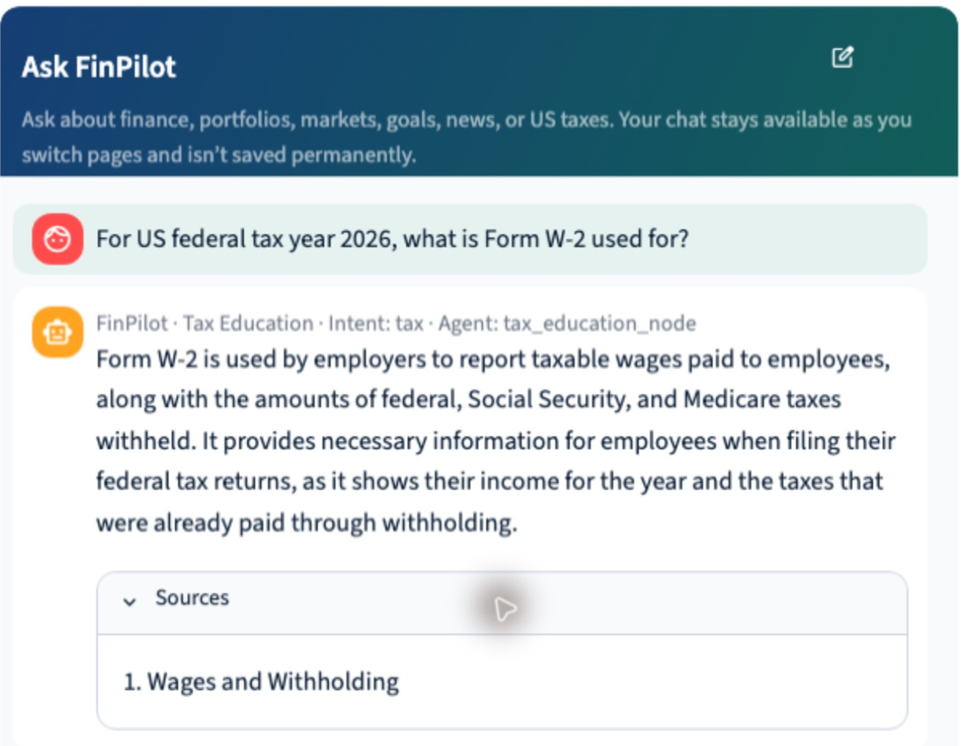
Tax Education
Year-specific explanations grounded in curated tax evidence
OFFLINE INGESTION
JSONL, recursive splitting, Qdrant
QUERY CONSTRAINTS
Tax year, filing year, forms and topic metadata
SHARED RAG FLOW
Hybrid search, RRF, Expansion, Targeted Rewrite
ANSWER CONTROLS
Separate semantic cache, sources, clarification
Tools: tax RAG query, expansion, targeted search
Limited federal ordinary-income-tax calculator
Form W-2 explanation with retrieved evidence
Example: “For tax year 2026, what does Form W-2 report?”
FinPilot 4 / 10
Notes:
02:30–03:15 | 45 seconds
Tax reuses the Finance retrieval pipeline with a separate tax_education_hybrid collection and semantic answer cache. Curated JSONL records are split and indexed. The important difference is constraint preservation: a requested tax year stays attached to retrieval and recovery, alongside supported metadata such as forms and topic. Baseline exposes up to five passages. Expansion exposes up to ten, subject to the shared three-action limit and evidence caps. The specialist cites available evidence and reports missing support. Its calculator covers limited 2026 federal ordinary income tax before credits and payments. It is not a full tax return. Point to the W-2 answer and citation in the screenshot.
Sources: docs/finpilot-mvp-overview.md; docs/evaluation.md; docs/cost-optimization.md. UI images: actual local captures in docs/architecture/assets/ui/. Synthetic portfolios and provider snapshots illustrate application behavior. No evaluation scores are claimed.

Slide 5
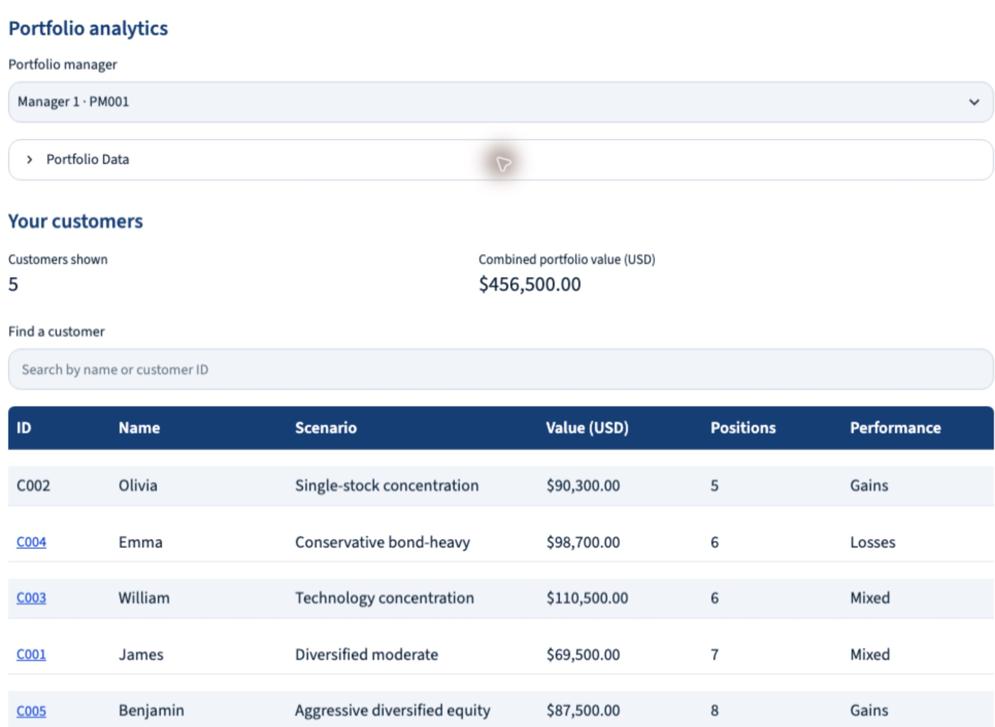
Portfolio Analysis
Manager and customer scope enforced by deterministic tools
DATA
Synthetic customers, in-memory SQLite
ACCESS SCOPE
Assigned customers or own portfolio
CUSTOMER ANALYSIS
Holdings, allocation, concentration, gains/losses
MANAGER OPERATIONS
Screen portfolios and compare customers
Tools: resolve customer, portfolio, investment profile
Manager screening, comparison, clarification
PM001’s five assigned synthetic customers
Example: “List all portfolio customers assigned to me.”
FinPilot 5 / 10
Notes:
03:15–04:10 | 55 seconds
Here the source is relational data rather than RAG. In-memory SQLite holds synthetic managers, assignments, holdings, profiles and frozen prices. The model chooses an operation. Python tools enforce scope and compute values, unrealized gains and losses, allocation and concentration. A manager can screen and compare assigned customers. A customer is scoped to their own record. Stored goals and risk tolerance are synthetic onboarding attributes. They are not inferred from holdings. Real authentication is deferred. Show PM001 and the customer list, then open Emma if the app is ready. No trades or brokerage actions occur.
Sources: docs/finpilot-mvp-overview.md; docs/evaluation.md; docs/cost-optimization.md. UI images: actual local captures in docs/architecture/assets/ui/. Synthetic portfolios and provider snapshots illustrate application behavior. No evaluation scores are claimed.

Slide 6
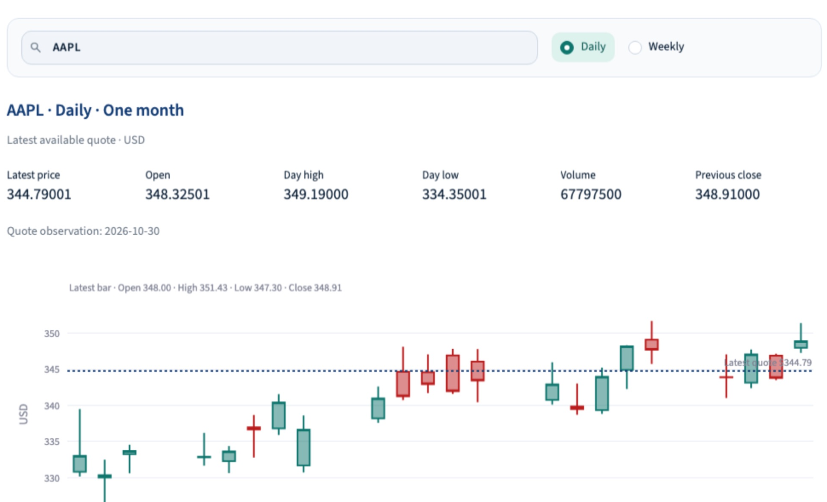
Market Intelligence
Twelve Data through an MCP server
PROVIDER CONNECTION
MCP client, local stdio server, Twelve Data API
PROVIDER TOOLS
Symbol lookup, quote, time series
LOCAL ANALYSIS
Price growth, minimum/maximum, two-stock views
RELIABILITY
TTL/LRU cache, shared requests, transient retries
MCP: search_symbol, get_quote, get_time_series
Local: calculate_price_growth, calculate_price_extrema
Available quote and daily candlestick observations
Example: “What was NVDA’s lowest observed price in the last two months?”
FinPilot 6 / 10
Notes:
04:10–05:10 | 60 seconds
Market uses observations from Twelve Data, reached through a local MCP subprocess. It can resolve symbols, get quotes and retrieve time series. Local deterministic tools compute growth and observed extrema. The UI supports daily or weekly charts and two-stock comparison. Provider metadata, observation timestamps and coverage caveats accompany results. An in-process TTL/LRU cache reuses responses and shares identical requests already in flight. Only eligible transient failures get retries, with three attempts total. The overall agent timeout is 30 seconds. Per-MCP-attempt timeout and jitter remain deferred. Historical output is capped at 100 observations, with extrema windows capped at 100 calendar days. Show AAPL’s chart and observation time without reading provider prices as independently verified facts.
Sources: docs/finpilot-mvp-overview.md; docs/evaluation.md; docs/cost-optimization.md. UI images: actual local captures in docs/architecture/assets/ui/. Synthetic portfolios and provider snapshots illustrate application behavior. No evaluation scores are claimed.

Slide 7
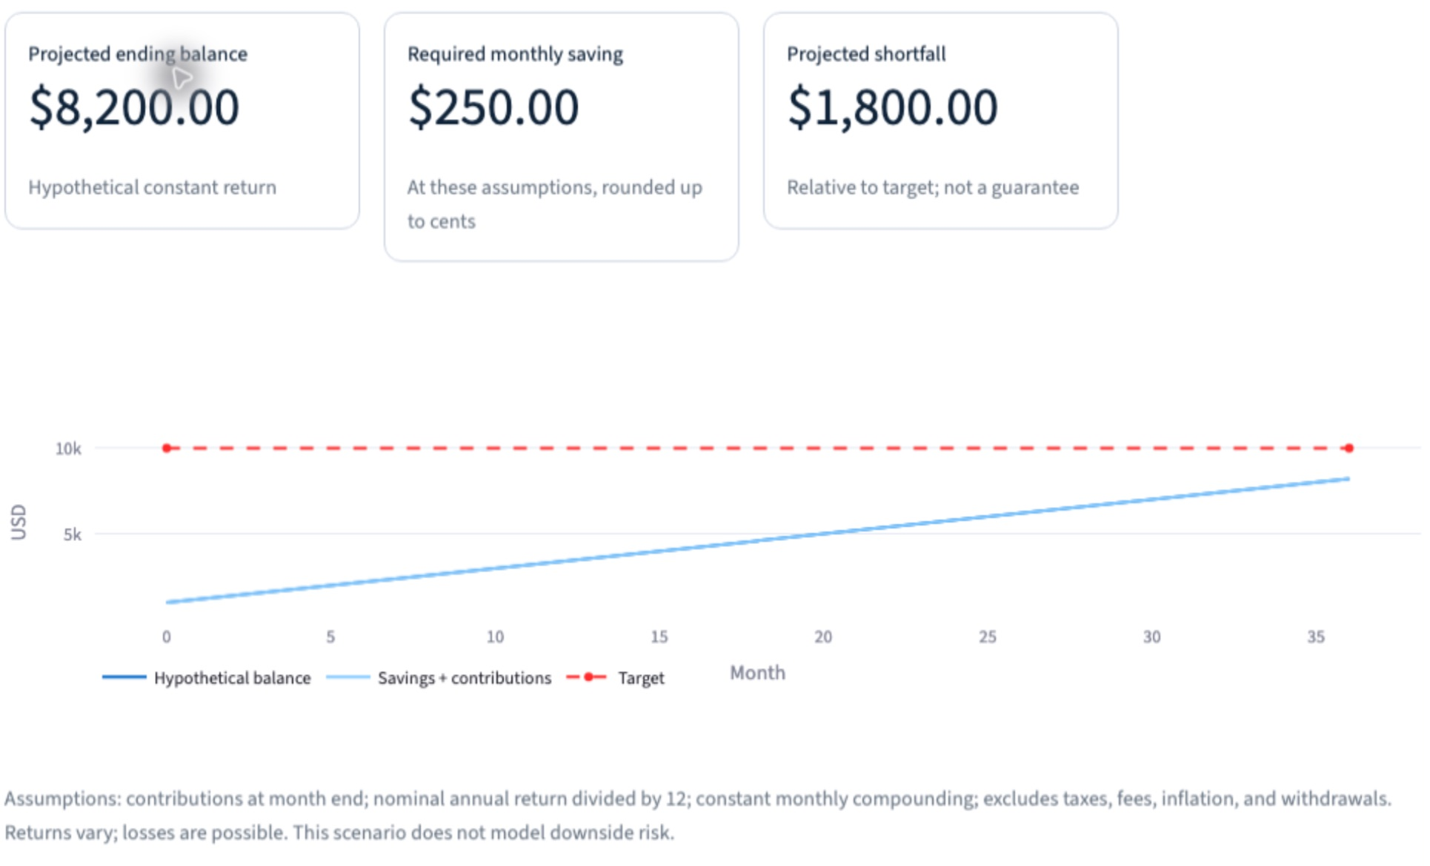
Goal Planning
Deterministic savings calculations with explicit assumptions
FOUR CALCULATORS
Contribution, future value, timeline, feasibility
INPUTS
Target, horizon, starting savings, assumed return
HUMAN CLARIFICATION
Ask for essential missing details and resume
OUTPUT
Projection, required contribution and shortfall
Tools: required contribution, future value
Time to goal, feasibility, clarification
Local scenario calculator with a projected shortfall
Example: “How much monthly to reach USD 20,000 in five years at 0%?”
FinPilot 7 / 10
Notes:
05:10–05:55 | 45 seconds
Goals turns a target or contribution into a deterministic calculation. Four tools answer how much to contribute, what savings could become, how long a target takes and whether a deadline is feasible. Essential missing inputs can trigger checkpointed clarification. Defaults for starting savings and assumed return are zero when omitted. Results disclose assumptions and shortfalls. No external provider or RAG is involved. The screenshot is the separate local UI scenario calculator, which does not run through the chat agent. If showing the app, change a contribution and show the recalculated balance.
Sources: docs/finpilot-mvp-overview.md; docs/evaluation.md; docs/cost-optimization.md. UI images: actual local captures in docs/architecture/assets/ui/. Synthetic portfolios and provider snapshots illustrate application behavior. No evaluation scores are claimed.

Slide 8
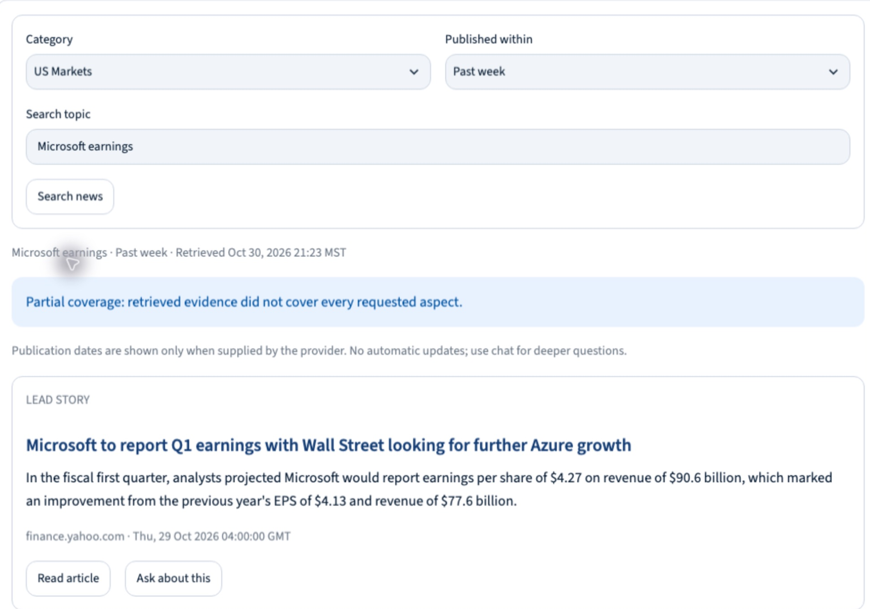
News Synthesis
Tavily supplies articles, FinPilot assesses and summarizes
SEARCH SCOPE
Financial category, custom topic, date window
ACQUISITION
Tavily HTTPS, include_answer=False
EVIDENCE COVERAGE
Assess missing aspects and focus another search
RESPONSE
Supported summary, original links, available dates
Tools: search_financial_news, clarification
Up to 3 searches, stopping early when sufficient
Sourced news card with a partial-coverage notice
Example: “Summarize this week’s technology earnings news with sources.”
FinPilot 8 / 10
Notes:
05:55–06:45 | 50 seconds
News calls Tavily directly over HTTPS rather than MCP. The selected category, custom topic and requested period establish search scope. Tavily’s generated answer is disabled. It supplies article evidence, while FinPilot checks coverage and writes the summary. A missing aspect can trigger a focused follow-up search within the three-search total. Original URLs are attached, and missing dates are not invented. Out-of-domain questions use unsupported handling. There is no Qdrant news index or persistent response cache. The provider defaults to a rolling week when no dates are supplied. Returned dates are not strictly post-filtered, so do not promise a hard publication cutoff. Show the preloaded result, source and partial-coverage notice.
Sources: docs/finpilot-mvp-overview.md; docs/evaluation.md; docs/cost-optimization.md. UI images: actual local captures in docs/architecture/assets/ui/. Synthetic portfolios and provider snapshots illustrate application behavior. No evaluation scores are claimed.

Slide 9
Guardrails, state and cost controls
Input checks
Presidio PII redaction, regex, moderation, injection detection
Output checks
PII redaction, empty-answer fallback, API validation
Human in the loop
LangGraph interrupt, SQLite checkpoint, same-thread resume
Execution controls
Timeouts, bounded tool work, caches, selective retries
FinPilot 9 / 10
Notes:
06:45–07:40 | 55 seconds
These controls span all agent workflows. Input checks redact PII and examine supported policy rules, injection and moderation. Availability and configuration govern external checks. Output handling redacts PII, supplies an empty-answer fallback and validates API responses. A specialist can pause using a LangGraph interrupt. SQLite checkpoints preserve execution, and the user’s reply resumes the same thread. This is execution memory. The UI keeps session chat history, while long-term user memory is not implemented. Timeouts, iteration limits, semantic caching and provider caching control latency and cost. Most reasoning uses gpt-4o-mini. The diagram’s identity is simulated for this MVP. Do not describe the output as a Guardrails AI toxicity pipeline, because that is not implemented.
Sources: docs/finpilot-mvp-overview.md; docs/evaluation.md; docs/cost-optimization.md. UI images: actual local captures in docs/architecture/assets/ui/. Synthetic portfolios and provider snapshots illustrate application behavior. No evaluation scores are claimed.

Slide 10
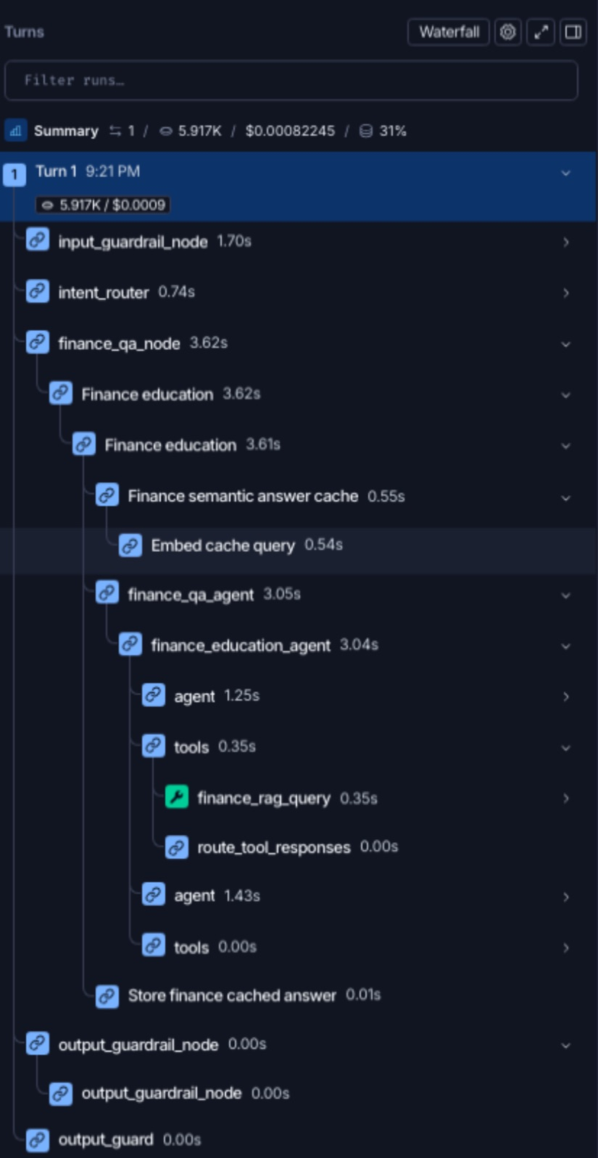
Evaluation and execution tracing
Evaluation
Router cases and prompt A/B variants
Intent, handler and route correctness
LangSmith tracing
One request with nested agent/tool spans
Latency, tokens, cache activity and cost
Next: broader answer-quality evaluation
and production identity integration
FinPilot 10 / 10
Notes:
07:40–09:10 | 90 seconds. Leave 50 seconds of buffer before 10:00.
Evaluation and tracing answer different questions. Evaluation checks expected behavior against cases. The repository includes router JSONL cases, prompt variants A and B, and evaluators for intent, handler and route correctness. Experiments can be published to LangSmith. No measured score or completed experiment result is asserted in this deck. Tracing shows what happened in a particular request. This ETF trace links guardrails, routing, the Finance specialist, semantic cache activity and RAG execution under one request. Inside retrieval we can inspect dense embeddings, sparse encoding and Qdrant RRF. Timings, tokens and cost describe that run. The shown trace follows baseline retrieval, so it does not prove expansion or targeted rewrite ran. If the prepared LangSmith tab is ready, spend up to 30 seconds expanding finance_rag_query. Otherwise use this screenshot. Conclude: FinPilot separates financial tasks into six specialists, connects each to the appropriate evidence or calculator, and makes the execution inspectable. Broader answer-quality evaluation and real identity are next steps.
Sources: docs/finpilot-mvp-overview.md; docs/evaluation.md; docs/cost-optimization.md. UI images: actual local captures in docs/architecture/assets/ui/. Synthetic portfolios and provider snapshots illustrate application behavior. No evaluation scores are claimed.

