Slide 1
Parallel Matrix Multiplication
&
Cache Performance
Prabha - 013785759
Nrupa - 012483276
Vinod - 012420642

Slide 2
Initialization comparison: GNU
Matrix Dimension (n x n) | Serial Initialization Timing (ms) | Parallel Initialization Timing (OpenMP #pragma parallel for)(ms)
3 | 0.028000 | 4.054000
400 | 4.944 | 3.606
600 | 9.061 | 6.995

Slide 3
Initialization comparison: XCODE (LLVM)
Matrix Dimension (n x n) | Serial Initialization Timing (ms) | Parallel Initialization Timing (OpenMP #pragma parallel for)(ms)
3 | 0.040676 | 4.970905
400 | 5.183 | 4.312
600 | 8.163554 | 5.240300

Slide 4
Multiplication comparison: GNU
Matrix Dimension | Serial Multiplication Timing (ms) | Parallel Multiplication Timing in milliseconds
 |  | SP | PT | PC | PN | PS
3 | 0.000000 | 0.060000 | 0.029000 | 0.068000 | 0.084000 | 0.002000
400 | 552.74 | 269.72 | 1078.06 | 592.352 | 284.14 | 754.93
600 | 1796.28 | 980.13 | 3740.38 | 1905.21 | 953.52 | 2453.40
SP: Simple Parallel
PT: Parallel Multiplication with 4 threads
PC: Parallel Multiplication with chunks, 3 for each thread
PN: Parallel Multiplication with Nested Loops
PS: Parallel Multiplication with SIMD Multiple Loops

Slide 5
Multiplication comparison: XCODE (LLVM)
Matrix Dimension | Serial Multiplication Timing (ms) | Parallel Multiplication Timing in milliseconds
 |  | SP | PT | PC | PN | PS
3 | 0.000491 | 0.090990 | 0.042960 | 0.017270 | 0.012837 | 0.002002
400 | 440.815 | 280.772 | 1033.602 | 515.954 | 1736.251 | 3742.258
600 | 1068.834432 | 321.412146 | 1362.600991 | 1052.573001 | 1918.711792 | 10146.961673
SP: Simple Parallel
PT: Parallel Multiplication with 4 threads
PC: Parallel Multiplication with chunks, 3 for each thread
PN: Parallel Multiplication with Nested Loops
PS: Parallel Multiplication with SIMD Multiple Loops

Slide 6
Cache performance with l1, l2, l3 cache
Laptop 1
Laptop 2
Laptop 3
Without __builtin_prefetch
Matrix Dimension | Timing (ms)
32*32 ~ 32 Kb | 0.005000
64*64~ 128 Kb | 0.017000
128*128 ~ 512 Kb | 0.078000
256*256 ~ 2 Mb | 0.228000
512 * 512 ~ 8 Mb | 0.915000
1024*1024 ~ 32 Mb | 3.324000
2048*2048 ~128 Mb | 9.646000
Timing (ms)
0.006000
0.025000
0.105000
0.367000
1.165000
4.08000
14.783000
Timing (ms)
0.009612
0.054631
0.136106
0.522645
2.056201
3.210601
12.530276
Timing (ms)
0.013000
0.043000
0.170000
0.369000
1.164000
3.507000
16.518000
L1
L2
L3
L3
RAM
RAM
RAM

Slide 7
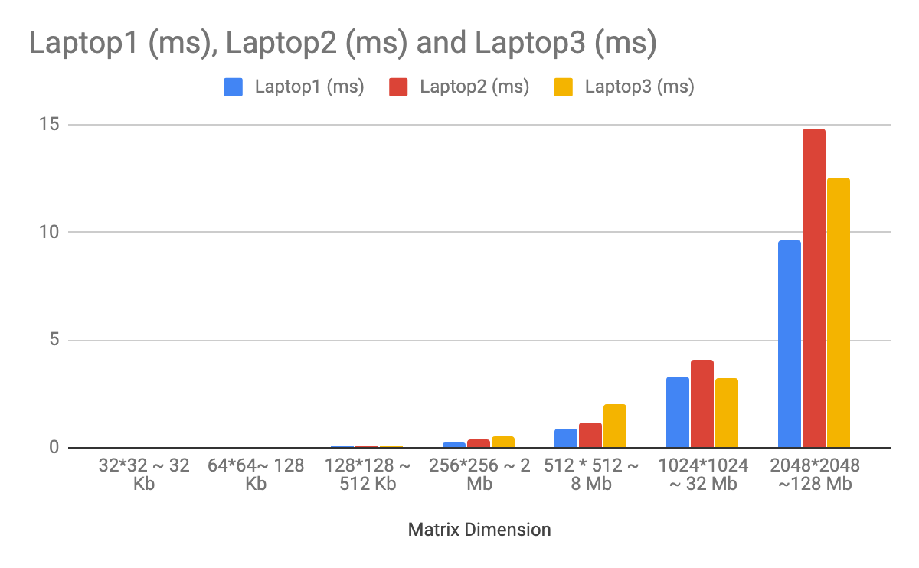
Cache Performance: GCC

Slide 8
Thank You

