Slide 1

PENTAGON (Team - 5)
Hari Krishna Pariveda
Manvitha Challagundla
Radhika Srinivasan
Sanjay Raghavendra karnati
Vinod Katta

Slide 2
Design Patterns Implemented:
Factory Pattern
Observer Pattern
Command Pattern
Strategy Pattern
State Pattern

Slide 3
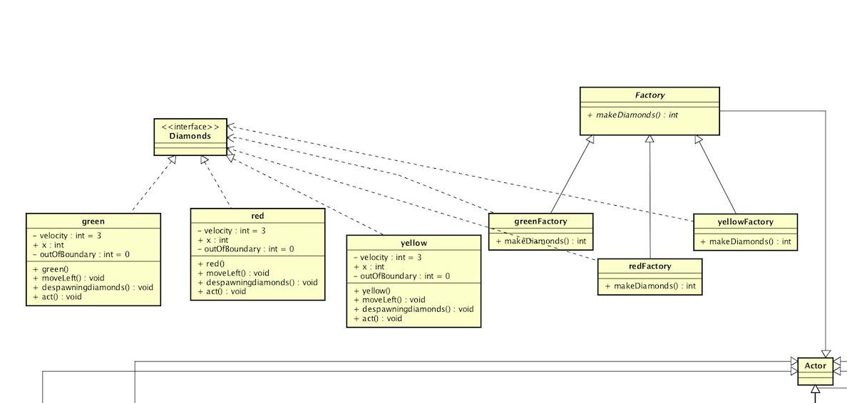
Factory Pattern

Slide 4
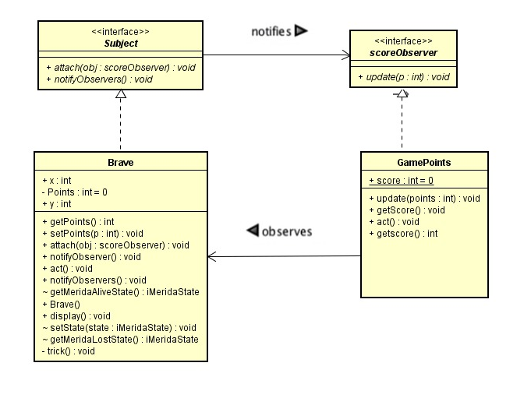
Observer Pattern

Slide 5
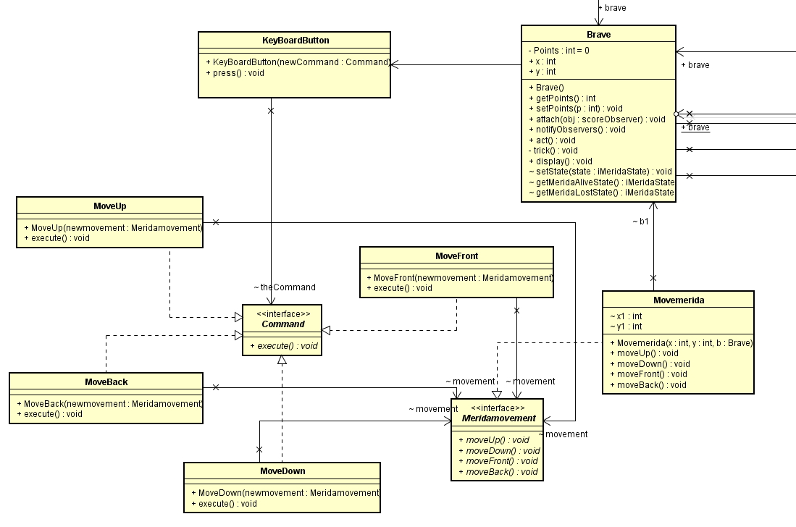
Command Pattern

Slide 6
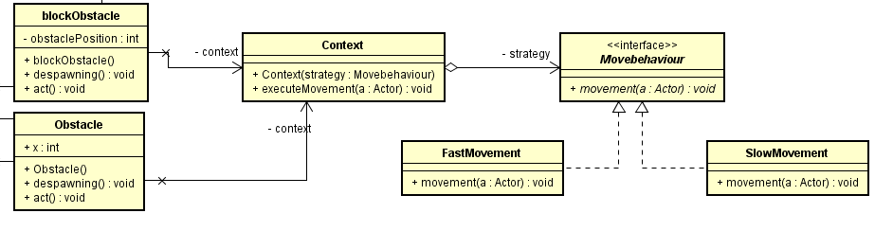
Strategy Pattern

Slide 7
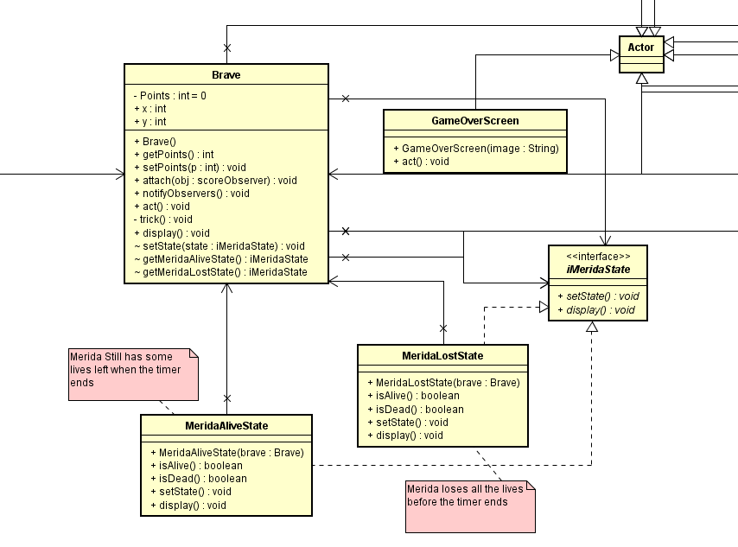
State Pattern

Slide 8

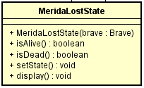

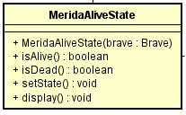
State Pattern

Slide 9
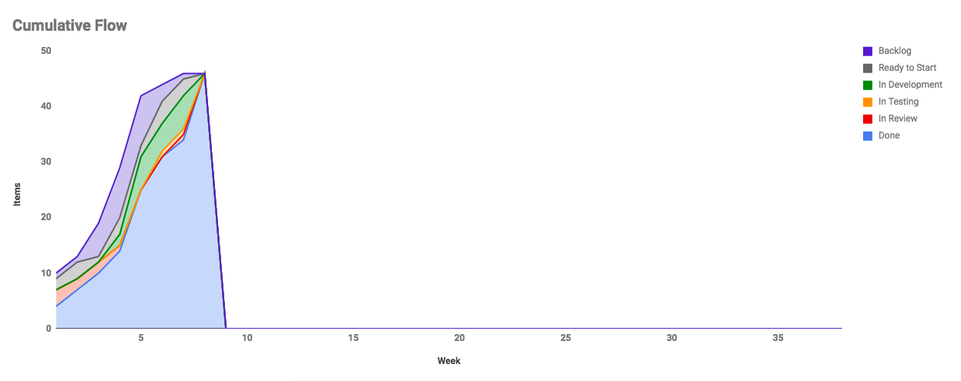

Slide 10
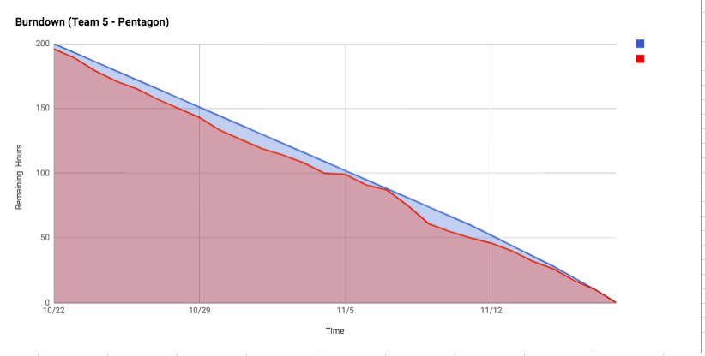

Slide 11
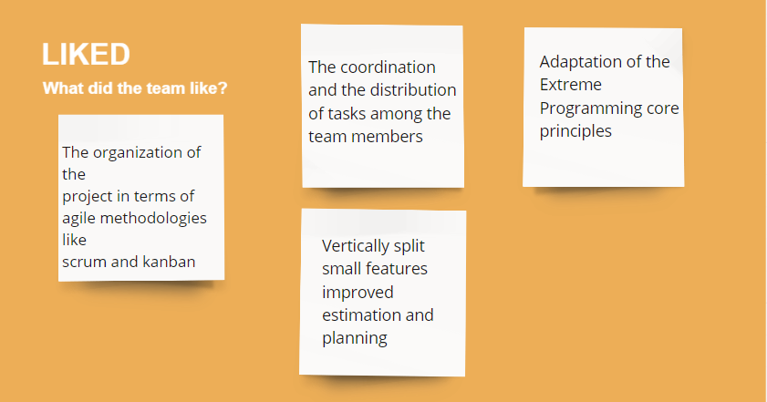

Slide 12
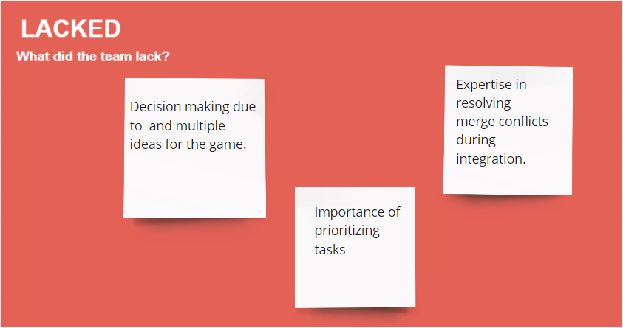

Slide 13
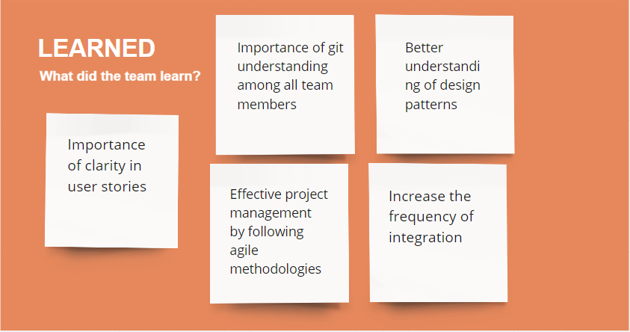

Slide 14
THANK YOU !

