Slide 1
MIN-400B
DEVELOPMENT OF A DEEP LEARNING ALGORITHM TO PREDICT THE FATIGUE LIFE
VINOD KHOJA
16117098
Supervisor:
Prof. VIDIT GAUR
MIED, IIT Roorkee

Slide 2
Introduction
This project is a work on machine learning based algorithms for fatigue growth calculation.
We aim to design a neural network to predict the crack growth rate and attempt to create a framework for calculating the fatigue life.
Validation of the results shall be done on our own experimental data.

Slide 3
Work Flow chart
Preparing the dataset required for training
Creating a framework to predict the fatigue life using the designed neural network
Designing a neural network for crack growth rate prediction
Experimental test in laboratory and validation of result from NNs
A comparison study among NN and state-of –the-art methods in practice

Slide 4
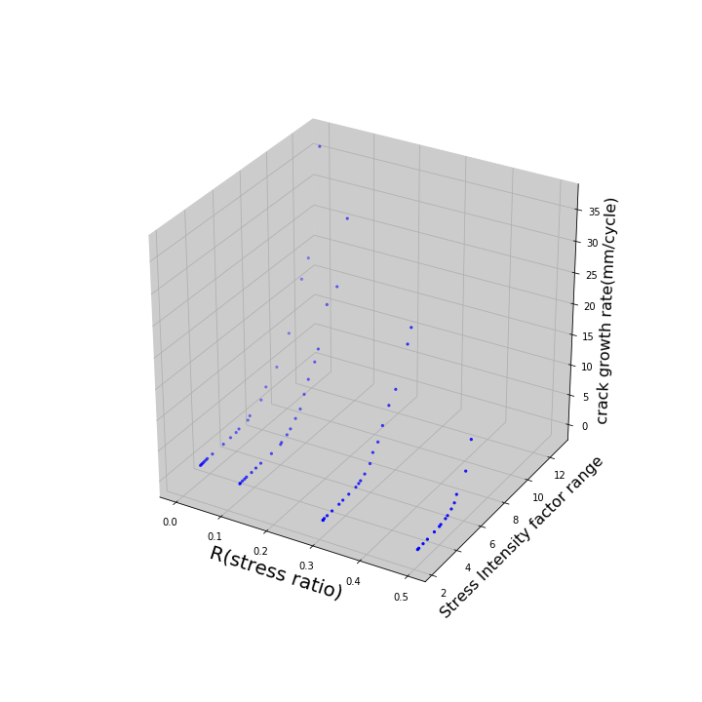
Data being used for training the Neural Network
Experimental Data Available:
Material of Specimen : 2024- T351 Aluminum.
Data available for 4 different stress ratios. (source ref. 1)
Training Dataset size – 77
NN trained on two features, first being stress ratio(R) and second stress intensity factor range(delta K).

Slide 5
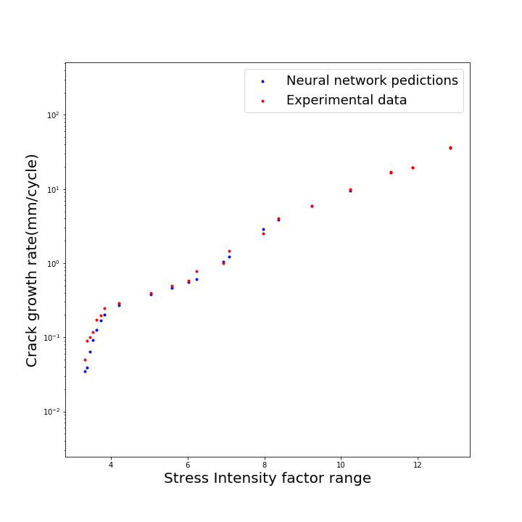
Performance comparison
NN Network with experimental data

Slide 6
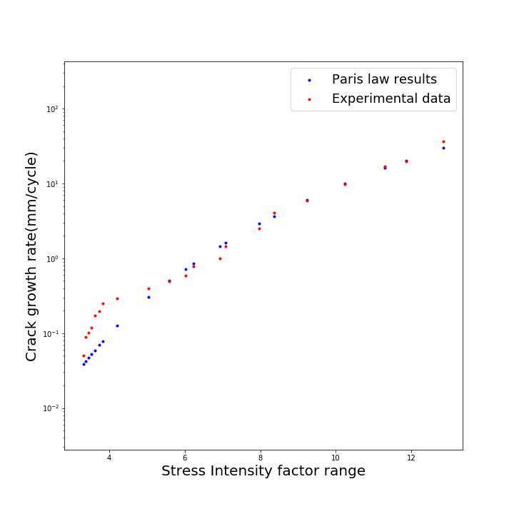
Performance comparison
Paris law with experimental data

Slide 7
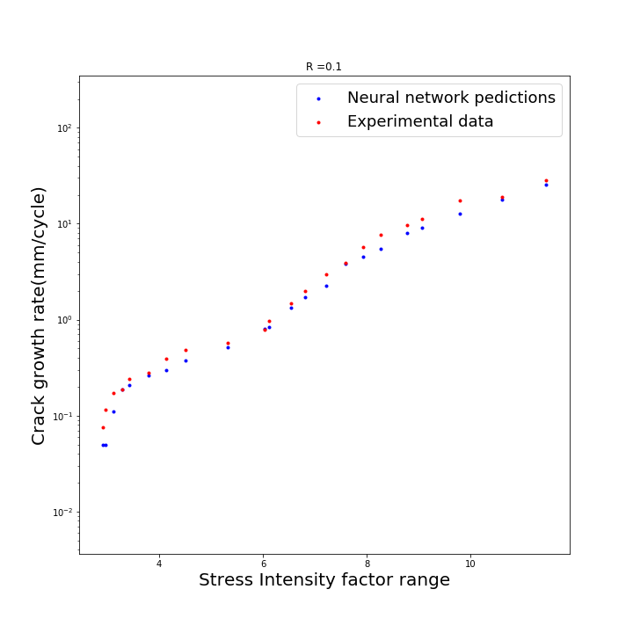
How well does neural network perform for a R value that it has never seen?

Slide 8
Conclusions so far:
Developed neural network(NN) has shown excellent prediction power when compared with the experimental data.
Algorithm is able to predict the crack growth rate over all stress intensity factor range values in comparison to the Paris Law.
This NN can be used to calculate the crack growth rate at any stress ratio(R) values, i.e. Experimental data on every R value is not required.

Slide 9
Future work:
Results from the learning algorithm shall be validated from conducting experiments in lab.
Neural network has comparatively bad results than the Paris Law at high R values, so the improvement needs to be done for the same.
Results from our developed raw NN can be compared with pre- developed deep learning methods in

Slide 10
References:
Wang, Hongxun & Zhang, Weifang & Sun, Fuqiang. (2017). A Comparison Study of Machine Learning Based Algorithms for Fatigue Crack Growth Calculation. Materials. 10. 10.3390/ma10050543.
T. Anderson-Fracture Mechanics - Fundamentals and Applications.

