Slide 1
Industrial Project
In this project, we have to stop Application/database on a server and after that Application/DB team will perform some activity and then we have to again start the DB/Application sequentially on the server using Ansible playbook and also we need to make sure, if any issues come while performing the activity then the scripts should not move further and provide all the failure logs.
There would be two playbooks for this Stop/Start Scripts
Stop playbook (ctm_stop.sh, aptm_dev_DB_stop.sh, Agents_stop.sh)
Start playbook (pem_maint.sh start, aptm_devHA_DB_start.sh, ctm_devHA_DB_start.sh & Active_Agents_start.sh)
1

Slide 2
Stop playbook (ctm_stop.sh, aptm_dev_DB_stop.sh, Agents_stop.sh)
First playbook will stop the mentioned scripts in sequence one by one and also debug the scripts logs while playbook runs and moreover we have to make sure that if any of the scripts got failed then it should throw the failed logs and playbook should not run move further.
Start playbook (pem_maint.sh start, aptm_devHA_DB_start.sh, ctm_devHA_DB_start.sh & Active_Agents_start.sh)
Second playbook will start the mentioned scripts in sequence one by one and also debug the scripts logs while playbook runs and moreover we have to make sure that if any of the scripts got failed then it should throw the failed logs and playbook should not run move further.

Slide 3
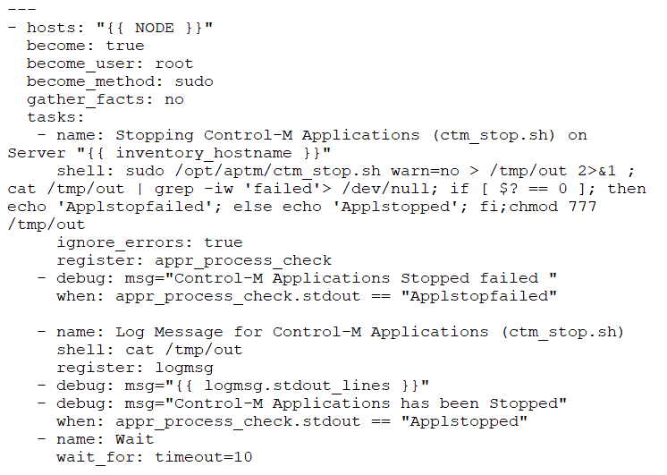
Stop playbook (ctm_stop.sh, aptm_dev_DB_stop.sh, Agents_stop.sh)

Slide 4
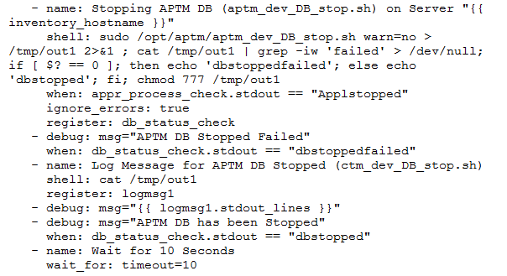
Stop playbook (ctm_stop.sh, aptm_dev_DB_stop.sh, Agents_stop.sh)

Slide 5
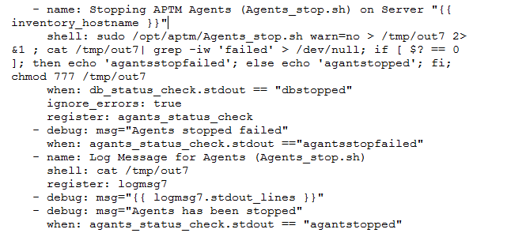
Stop playbook (ctm_stop.sh, aptm_dev_DB_stop.sh, Agents_stop.sh)

Slide 6
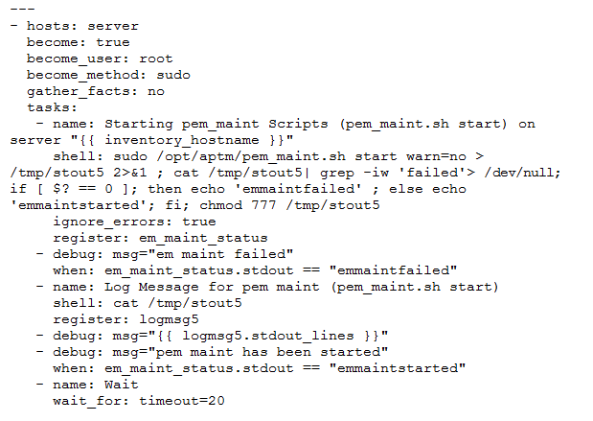
Start playbook (pem_maint.sh start, aptm_devHA_DB_start.sh, Active_Agents_start.sh)

Slide 7
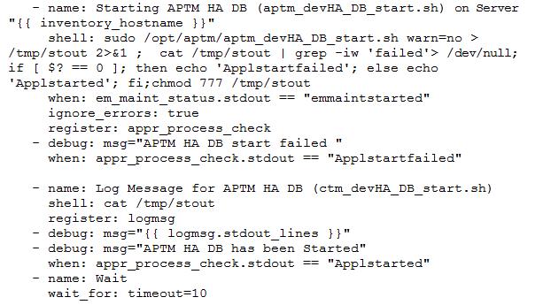
Start playbook (pem_maint.sh start, aptm_devHA_DB_start.sh, Active_Agents_start.sh)

Slide 8
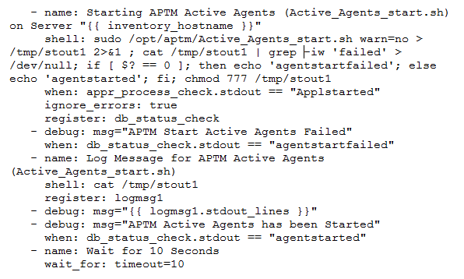
Start playbook (pem_maint.sh start, aptm_devHA_DB_start.sh, Active_Agents_start.sh)

Slide 9
Ansible Roles
You've been exposed to how Ansible can interact with configured clients from the command line with the ansible command, and how you can automate configuration with playbooks run through the ansible-playbook command. Where do roles fit into this scheme?
Simply put, roles are a further level of abstraction that can be useful for organizing playbooks. As you add more and more functionality and flexibility to your playbooks, they can become unwieldy and difficult to maintain as a single file. Roles allow you to create very minimal playbooks that then look to a directory structure to determine the actual configuration steps they need to perform.
Organizing things into roles also allows you to reuse common configuration steps between different types of servers. This is already possible by "including" other files within a playbook, but with roles, these types of links between files are automatic based on a specific directory hierarchy.

Slide 10
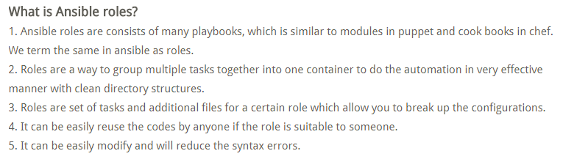
Ansible Roles

Slide 11
How do we create Ansible Roles?
To create a Ansible roles, use ansible-galaxy command which has the template to create it. This will create it under default directory /etc/ansible/roles
# ansible-galaxy init /etc/ansible/roles/apache –offline
--apache was created successfully
Where, ansible-galaxy is the command to create the roles using the template
Init is to initialize the role
apache is the name of the role
Offline – create offline mode rather than getting from online repository.

Slide 12
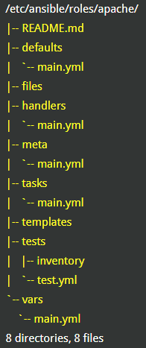
tree /etc/ansible/roles/apache

Slide 13
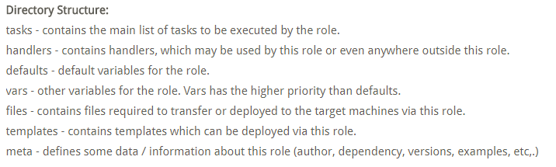

Slide 14
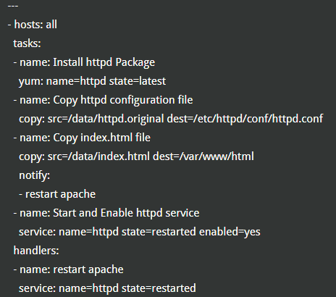
Lets take an example to create a role for Apache Web Server

Slide 15
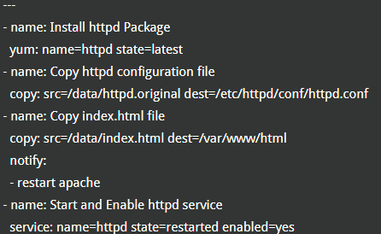
First move on to the Ansible roles directory and starting editing yml file
cd /etc/ansible/roles/apache
Tasks
Edit the main.yml as shown
#vi tasks/main.yml

Slide 16
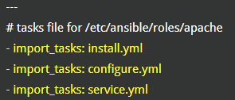
Tasks
You can add all your tasks in this file or just break the codes even more as below using “import_tasks” statements
Edit the main.yml as shown
#vi tasks/main.yml

Slide 17
Tasks
You can add all your tasks in this file or just break the codes even more as below using “import_tasks” statements
Edit the main.yml as shown
#vi tasks/main.yml

Slide 18

Tasks
Lets create install.yml, configure.yml, service.yml included in the main.yml
install.yml
cat tasks/install.yml

Slide 19
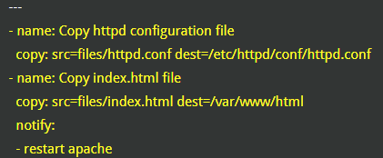
Tasks
Lets create install.yml, configure.yml, service.yml included in the main.yml
Configure.yml
cat tasks/configure.yml

Slide 20

Tasks
Lets create install.yml, configure.yml, service.yml included in the main.yml
service.yml
cat tasks/service.yml

Slide 21
Files
Copy the required files (httpd.conf and index.html) to the files directory
cd /etc/ansible/roles/apache/files
ls –ltr

Slide 22
Handlers
Edit handlers main.yml to restart the server when there is a change.
# cat /etc/ansible/roles/apache/handlers/main.yml
#Handlers file for /etc/ansible/roles/apache
- name: restart apache
service: name=httpd state=restarted

Slide 23
Meta
Edit main.yml to add the information about the roles like author, descriptions, licence, platform supported

Slide 24
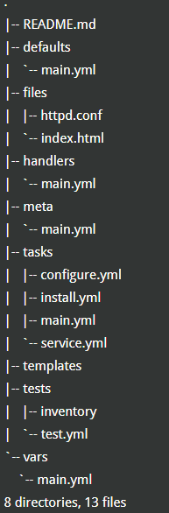

Slide 25
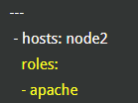
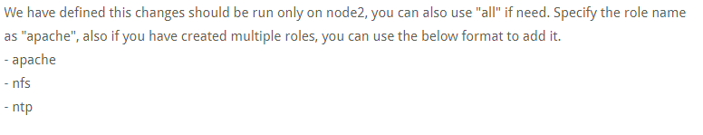
We have got all the required files for Apache roles. Lets apply this role into the ansible playbook “apachesetup.yml”
cat /etc/ansible/apachesetup.yml

Slide 26
Verify the syntax error
Ansible-playbook /etc/ansible/apachesetup.yml --syntax-check

Slide 27
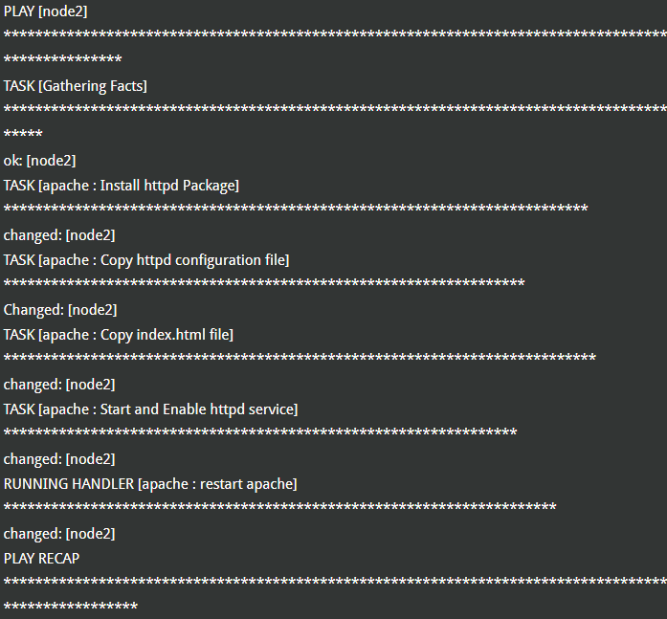

Slide 28
