Slide 1
Waterfall Model
PRESENTED BY:
MADHAN.R
NITESH
PRABHJOT
SUSHANTA.N
VINOD KUMAR

Slide 2
SOFTWARE DEVELOPMENT LIFE CYCLE(SDLC)
Software Development Life Cycle (SDLC) is a process used by the software industry to design, develop and test high quality softwares. The SDLC aims to produce a high-quality software that meets or exceeds customer expectations, reaches completion within times and cost estimates.
It consists of a detailed plan describing how to develop, maintain, replace and alter or enhance specific software.

Slide 3
INTRODUCTION TO WATERFALL.
The Waterfall approach was established in 1970 by Winston w. Royce.
The Waterfall Model was the first Process Model to be introduced. It is also referred to as a linear-sequential life cycle model
In a waterfall model, each phase must be completed before the next phase can begin and there is no overlapping in the phases.
The waterfall Model illustrates the software development process in a linear sequential flow. This means that any phase in the development process begins only if the previous phase is complete. In this waterfall model, the phases do not overlap

Slide 4
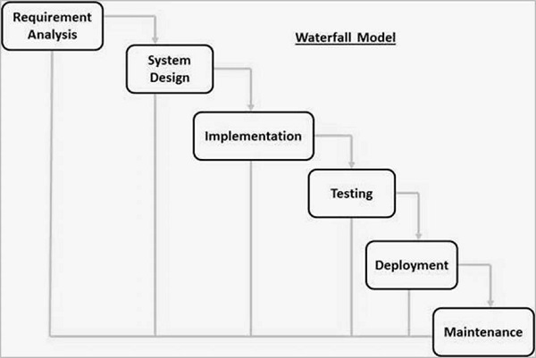

Slide 5
The sequential phases in Waterfall model are −
Requirement Gathering and analysis − All possible requirements of the system to be developed are captured in this phase and documented in a requirement specification document.
System Design − The requirement specifications from first phase are studied in this phase and the system design is prepared. This system design helps in specifying hardware and system requirements and helps in defining the overall system architecture.
Implementation − With inputs from the system design, the system is first developed in small programs called units, which are integrated in the next phase. Each unit is developed and tested for its functionality, which is referred to as Unit Testing.
Integration and Testing − All the units developed in the implementation phase are integrated into a system after testing of each unit. Post integration the entire system is tested for any faults and failures.
Deployment of system − Once the functional and non-functional testing is done; the product is deployed in the customer environment or released into the market.
Maintenance − There are some issues which come up in the client environment. To fix those issues, patches are released. Also to enhance the product some better versions are released. Maintenance is done to deliver these changes in the customer environment.

Slide 6
Advantages of waterfall model

Slide 7
Advantages:-
1. The water fall is the simplest and classical model of all the models we have.
2. In this model each and every phase must be completed before moving to the next phase.
3. This model is very suitable also for the small projects where the technical issues are very clear.
4. In this model there is no any case of overlapping.
5. Each phase has a well defined task and a review process

Slide 8
Disadvantages of waterfall model

Slide 9
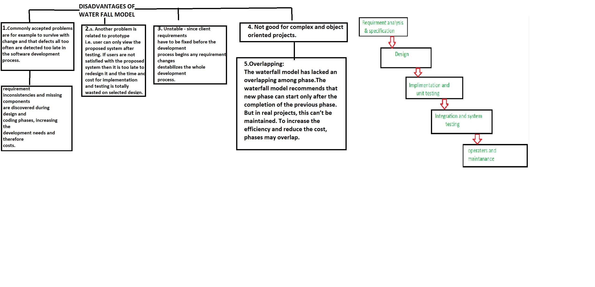

Slide 10
Project Implementation of Waterfall model

Slide 11
Waterfall model is Used in -
developing a simple application
for short term projects
whenever we are sure that the requirements will not change

Slide 12
Example -
waterfall model can be used in developing a simple calculator.
as the functions of addition, subtraction etc and the numbers will not change for a long time.

