Slide 1

SharePoint 2010 Overview
C3: Protected

Slide 2

About the Author
Created By: | NS, Jenkins (188281)
Credential Information: | 8+ Years Exp, HealthCare
Version and Date: | 1.0, 15-Aug-2011
Cognizant Certified Official Curriculum

Slide 3







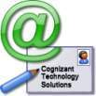

Icons Used
Hands on Exercise
Questions
Tools
Coding Standards
Test Your Understanding
Reference
A Welcome Break
Contacts
Demonstration

Slide 4
SharePoint 2010 : Overview
Introduction
This module provides a general overview about Microsoft SharePoint Server is all about, New Features in 2010 and History available. It also covers System Requirements, functional and architectural overview.
Notes:
Discuss SharePoint 2010 Overview

Slide 5
Objectives
Objective:
After completing this chapter you will be able to:
What is SharePoint
SharePoint History
SharePoint 2010 System Requirements
What’s New in SharePoint 2010
SharePoint 2010 Development Primer
New Developer Tools for SharePoint 2010

Slide 6
What is SharePoint
Microsoft SharePoint makes it easier for people to work together. Using SharePoint, your people can set up Web sites to share information with others, manage documents from start to finish, and publish reports to help everyone make better decisions.

Slide 7
SharePoint History
Before SharePoint
1997 – Site Server with SQL Server 6.5
1999 - Digital Dashboard Starter Kit with SQL server 6.5
2000 – Digital Dashboard Resource Kit 2000 with SQL server 6.5 and Portal look
SharePoint Versions
V1 – Early in 2001 - MS SharePoint Portal Server 2001, WSS 1.0 and Office XP
V2 – October 2003 - MS Office SharePoint Server 2003, WSS 2.0 and Office 2003
V3 – Nov 2006- MOSS 2007, WSS 3.0 and Office 2007
V4 – May 12th 2010 - MS SharePoint Server 2010, MS SharePoint 2010 Foundation(WSS 4.0) and Office 2010
Notes:
Refer for more details http://sharepoint.microsoft.com/blog/Pages/BlogPost.aspx?PageType=4&ListId={72C1C85B-1D2D-4A4A-90DE-CA74A7808184}&pID=467
http://www.quicklearn.us/library/sps.Sharepoint%20History.ashx
http://www.joiningdots.net/blog/2006/08/sharepoint-history.html

Slide 8
SharePoint 2010 System Requirements
Hardware Requirements
Processor - 64-bit, four cores
RAM SharePoint Server
4 GB for developer or evaluation use
8 GB for production use in a single server or multiple server farm
RAM for Database Server
8 GB for small deployments
16 GB for medium deployments
Hard disk - 80 GB for system drive
Notes:
http://technet.microsoft.com/en-us/library/cc262485.aspx

Slide 9
SharePoint 2010 System Requirements
Software Requirements
Server Box
Windows 2008 Server
IIS7
Microsoft SQL Server 2008 R2
Windows PowerShell 2.0
Developer Box
Windows 7 / Vista
MS Visual Studio 2010
MS SharePoint Designer 2010
MS Office 2010
MS Office InfoPath 2010
IE 8.0 / FireBox Latest Version
Notes:
http://technet.microsoft.com/en-us/library/cc262485.aspx

Slide 10
MOSS 2007
Windows SharePoint Services (WSS v3)
Site and Workspace Provisioning Engine
Out-of-the-box Collaboration Services
Microsoft Office SharePoint Server (MOSS)
User Profiles, Search, Workflows, WCM
BDC, Excel Services, Forms Services, ECM
Browser Clients
Microsoft Office SharePoint Server 2007 (MOSS)
MS Office Clients
Windows SharePoint Services 3.0 (WSS v3)
.NET Framework 3.0
Internet Information Services 6.0 or 7.0
Windows Server 2003 or 2008 (32-bit or x64)
Notes:
Many student will be familiar with WSS 3.0 and MOSS. Here are some questions that each student should answer.
Are you familiar with MOSS 2007 and WSS 3.0
as a user?
as a site administrator?
as a farm administrator?
as a developer?
What types of components have you developed for SharePoint?
Features and Solution packages
Web Parts and Event Handlers
ListDefs and SiteDefs
What Tools and utilities have you used?
Visual Studio Extensions for WSS 3.0
CodePlex utilities

Slide 11
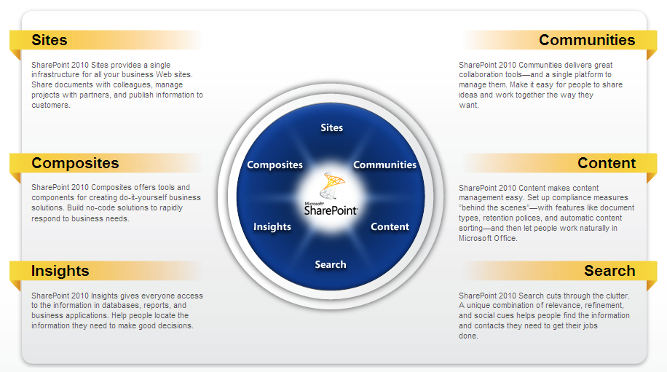
MS SharePoint 2010
Notes:
Discuss about 6 pillors
SharePoint 2010 Review: The New 6 Pillars of SharePoint
1. Sites
Essentially, everything you do in SharePoint is site-based. These sites can be accessible through your intranet, extranet or internet. They can be collaboration workspaces, business dasboards, portals, your public web presence. You also have personalization via MySites, content targeting and tagging.
Perhaps the point here is that whether you are building an intranet, an extranet or an Internet site, the tools you need are similar. Personalization, collaboration, communities, social networking, content management — these things can be leveraged across any type of site you create.
Another important point to make here is that SharePoint 2010 is a platform that can support the growing number of mobile workers across an organization. This new virtual cube experience is supported through collaboration, content management and community capabilities. And SharePoint Workspace has arrived to support offline access (sometimes we do disconnect from the network).
2. Communities
It was called Facebook for the Enterprise during a Microsoft demonstration, and while I sort of dislike that term, the thinking behind it made sense. Microsoft has taken the social aspects of SharePoint 2007 and made them a lot better. MySites actually becomes a very useful component, Profiles are rich, there's a newsfeed — or activity feed — to keep you in the loop.
Communities are really special collaboration sites, if that helps you envision them better. They are not exactly like the communities you may be use to in solutions like Telligent, NewsGator or Jive, but the social computing capabilities are much better than 2007.
3. Content
In many ways, this pillar should really just be renamed Document and Records Management, but there's two many words to fit on the new SharePoint wheel. Maybe this is where the enhancements have really taken SharePoint from a departmental, or SMB solution to a real enterprise option.
There have been massive improvements to metadata creation and management, and taxonomy. You can set retention policies on content types, which can, by the way, be created globally. The amount of documents that can be added to SharePoint 2010 has increased significantly and the support for external data storage makes it that much better. You've got in place records management, a record management center, auditing and version control, and much more.
Important to note here that all these capabilities support not only document-based content, but web pages and social content as well.
DoD5015 certification is still not available, but likely in the works, as is support for the newly official CMIS standard.
4. Search
With the acquisition of FAST and its integration into SharePoint 2010, search has improved a great deal. Of course FAST Search for SharePoint is not the default search option. That, too, however has seen a number of improvements.
5. Insights
SQL Server 2008 R2 has added a number of self-service business intelligence capabilities, including some new functionality that works for SharePoint 2010. This is business intelligence for the information worker including dashboards, scorecards, reports and more.
You now have PowerPivot for SharePoint and Reporting Services 3.0. To take the business intelligence capabilities to the next step, Microsoft has added Performance Point Server to the SharePoint platform, renaming it PerformancePoint Services for SharePoint
6. Composites
Remember, SharePoint is a platform. And with SharePoint 2010 comes a rich API and the new Business Connectivity Services. It has become much easier to integrate data from your line of business systems, mixing in a little collaboration, a rich security model, upcoming support for CMIS.
These composite applications can be built without diving into the world of developer code as well using tools like InfoPath, SharePoint Designer 2010 and Visio 2010. Cheers and woots just went up among the information workers, and shudders of fear among IT.

Slide 12
SharePoint Server 2010
An evolved version of MOSS and WSS v3
Microsoft SharePoint Server 2010 (SPS)
Microsoft SharePoint Foundation 2010 (SPF)
Development can now be done on client OS
Significant enhancement for many development teams
Browser Clients
Microsoft SharePoint Server 2010
MS Office Clients
Microsoft SharePoint Foundation 2010
.NET Framework and ASP.NET 3.5 SP1
Internet Information Services 7.0
Windows Server 2008 (x64 only) for Production Environments
Windows 7 or Vista (x64 only) for Development Environments only
Notes:
SharePoint Server 2010 is the next version of the SharePoint technology stack. There will be three different SKUs for SharePoint Server 2010
SharePoint 2010 Server Enterprise
SharePoint 2010 Server Standard
Microsoft SharePoint Foundation
SharePoint 2010 Server only runs on 64-bit operating systems. This is different from MOSS 2007 and WSS 3.0 which ran on either a 32-bit OS and a 64-bit OS.
SharePoint 2010 Server is the first version of the product that supports installation on a client OS for development. The supported clients Oss included 64-bit version of Windows 7 and Windows Vista.
IIS 7.0 investments – few changes for the httpmodules and httphandlers registrations in the web.config – requires changes to webconfigmodifications
Ajax & Silverlight modifications natively supported by the platform
Word services good example of the new possibilities of the Platform – transform documents for example to pdf and print them. Services provide new possibilities

Slide 13
What's New in SharePoint 2010
Improvements to UI and accessibility features
Better Tools for Developers and Designers
End-to-end Integration with Power Shell
Improvements to lists and events
New WSS integration with LINQ
New client-side object model and runtime
Enhanced support for developing workflow applications
New Extensible architecture for service applications
Evolving story for integrating SharePoint with external data
New Connector framework enhances Search architecture
Sandbox Solutions and Partially Trusted Code
The shift to claims-based security
Notes:
You can see from this list there are quite a few things for developers to get excited about when moving to SharePoint 2010. There is no need to drill into each of these bullets at this stage of the course but rather just to give students familiar with SharePoint 2007 a quick idea of the new surface area that they have to work with.

Slide 14
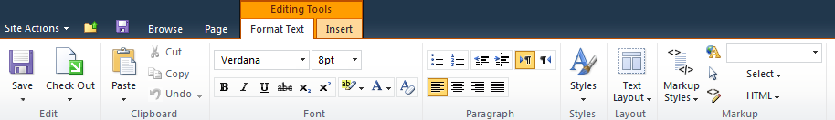
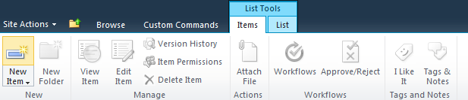
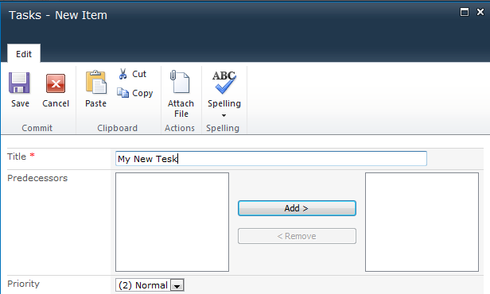


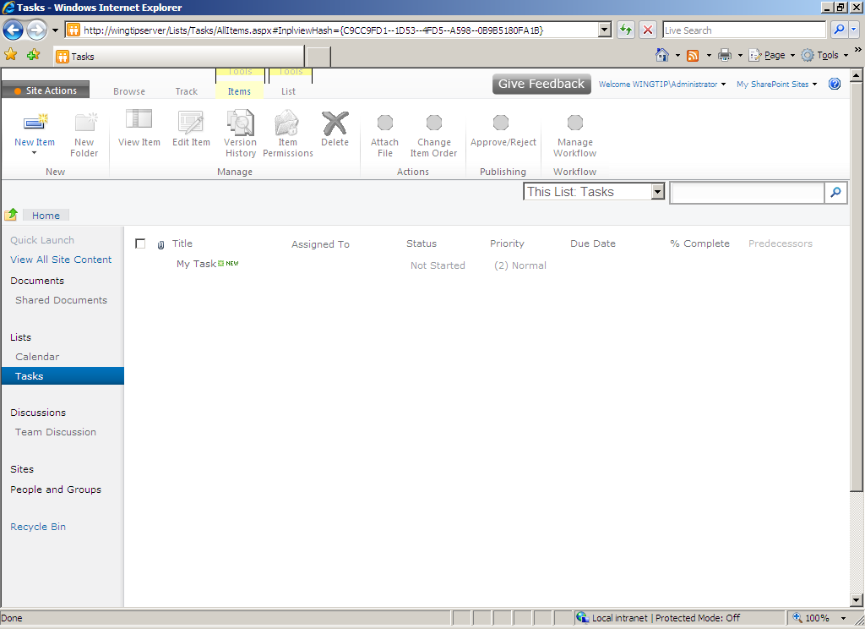
Major Shifts in SharePoint UI
Server ribbon
In-place editing
Popup dialog
AJAX refresh
Notes:
There has been a major overhaul to the most basic aspects of the SharePoint UI. Many of these changes have been designed to get rid of all the HTTP postbacks that are required when making updates in the browser. SharePoint 2010 has a new core engine for processing pages based on ASP.NET AJAX and designed to delivery a more of a Web 2.0 user experience.
SharePoint 2010 adds a new server-side ribbon to create a consistency with the client-side ribbon added to Office applications with the release of the Office 2007 system. The ribbon now provides a JavaScript-enabled paradigm where the user can move between modes (e.g. edit mode versus diisplay mode) without sending postbacks to the Web server. In-place editing is the most obvious change that users will notice when moving from SharePoint 2007.

Slide 15
SharePoint 2010 Development Primer
- Farm (SPFarm)
- Web Application (SPWebApplication)
- Site Collection (SPSite)
- Site (SPWeb)
- List (SPList)
- Item (SPListItem)
- Document Library (SPDocumentLibrary)
- File (SPFile)
- Folder (SPFolder)
Notes:
This slide is a transition slide to move into a more developer-centric topic. Ask students if they have programmed in the past using these classes which of common types in the SharePoint object model.

Slide 16
New Developer Tools for SharePoint 2010
VS 2010 SharePoint Tools – It brings new tools
Created by group within Visual Studio 2010 team
Major step forward from SharePoint 2007 development
New tools target SharePoint 2010 only
SharePoint Designer Improvements
Power Shell Support
Notes:
Discuss about SharePoint 2010 Tools and Improvements - The main thing to mention is that the Microsoft-provided developer experience is much better with these new tools than anything that have released in the past.

Slide 17
Test Your Understanding
What is SharePoint ?
Brief about SharePoint 2010 New Features?
What are the development tools new in SharePoint 2010 Server?

Slide 18
Overview: Summary
What is SharePoint
SharePoint History
SharePoint 2010 System Requirements
What’s New in SharePoint 2010
SharePoint 2010 Development Primer
New Developer Tools for SharePoint 2010

Slide 19
SharePoint 2010 Overview: Source
http://sharepoint.microsoft.com/en-us/Pages/default.aspx
Disclaimer: Parts of the content of this course is based on the materials available from the Web sites and books listed above. The materials that can be accessed from linked sites are not maintained by Cognizant Academy and we are not responsible for the contents thereof. All trademarks, service marks, and trade names in this course are the marks of the respective owner(s).

Slide 20

You have successfully completed SharePoint 2010 Overview

