Slide 1

Americana Last Mile Delivery Platform Monitoring Overview
Date: 31 Jan 2023

Slide 2
Americana Last Mile Delivery Platform
(Automated Monitoring & Alert)
Azure Cloud
(Application Insights, Azure Analytics | New Relic | Dynatrace | AppDynamics)
Confluent Kafka
(Confluent Health+ |New Relic | Grafana | Dynatrace)
ALMP Workflow
(Custom Health Check)
API Management
App Gateway
Containers
Database
Firewall
Front Door
Key Vault
Load Balancer
Redis Cache
Storage
Virtual Machine
Virtual Network
Kafka Cluster
Partitions
Kafka Brokers
Kafka Topics
Replication
Read & Write
Latency
Incoming Traffic
Outgoing Traffic
Size of Queue
Producer
Consumer
Authentication
Ingestion
Assignment
Delivery
Feedback
Notifications
Third Party API Monitoring (Weather, RouteMobile, FCM, Google Maps APIs etc.)

Slide 3
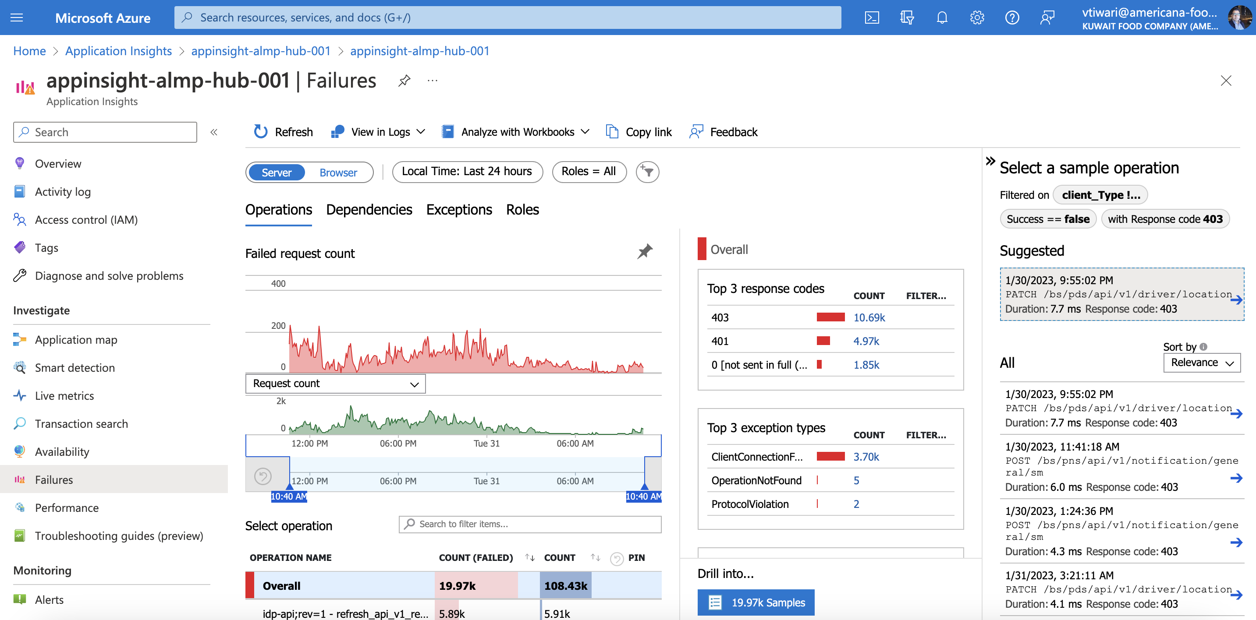
Microsoft Azure – Application Insights

Slide 4
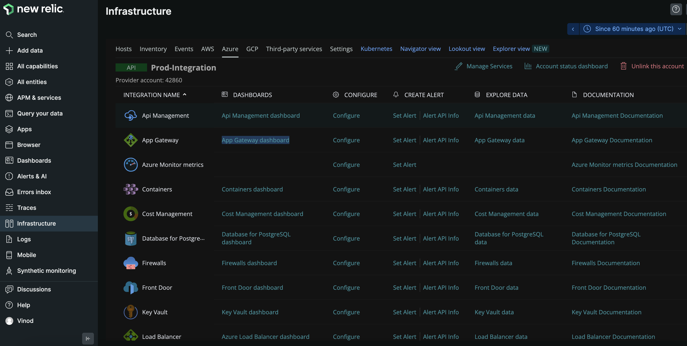
New Relic – ALMP Infrastructure Monitoring

Slide 5
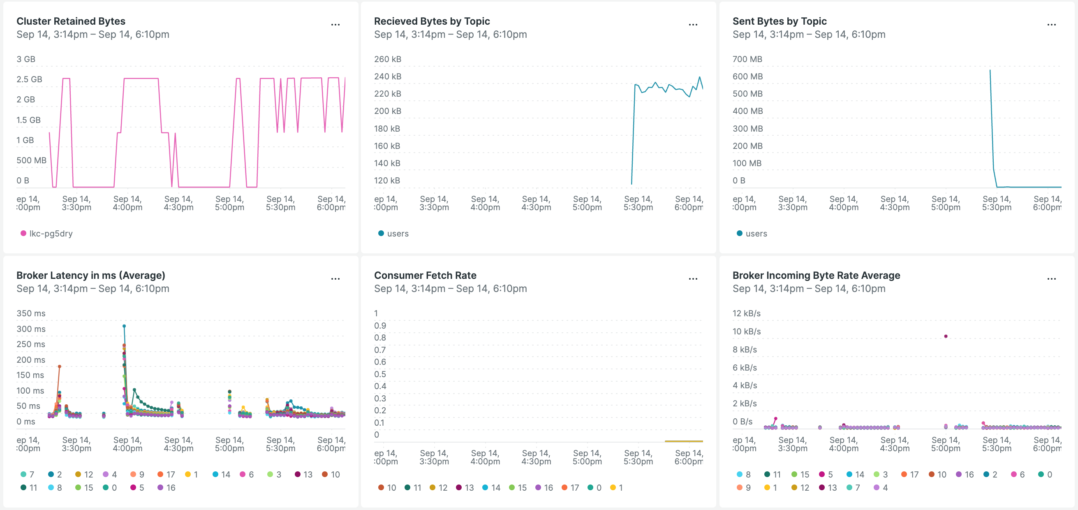
New Relic – Confluent Kafka Monitoring

Slide 6
THANK YOU

