Slide 1
Bluestock Mutual Fund Analytics
Capstone Project | Performance Analysis & Dashboard
Vinod Kumar Vasantha | August 2026

Slide 2
Problem & Objective
Problem: Fragmented mutual fund data across NAV, transactions, and industry sources makes performance comparison and investor analysis difficult
Objective 1: Build a clean ETL pipeline consolidating 10 data sources into an analyzable structure
Objective 2: Compute risk-adjusted performance metrics (Sharpe, Sortino, Alpha, Beta) across 40 schemes
Objective 3: Deliver an interactive dashboard for fund comparison and investor behavior analysis

Slide 3
Data Sources
10 structured datasets covering the full mutual fund ecosystem
Fund Master — scheme metadata for 40 funds (Equity & Debt)
NAV History — daily NAVs, Jan 2022 to May 2026 (~46,000 records)
Industry data — AUM, SIP inflows, category inflows, folio counts
Investor Transactions — 32,778 records across 12 states, 5 age groups
Benchmark Indices — Nifty 50, Nifty 100, and 5 other market indices

Slide 4
Architecture
Extract: Raw CSVs + live NAV feed via mfapi.in API
Transform: Data cleaning, anomaly flagging, date-type standardization
Load: SQLite star-schema (fact/dimension tables) + Power BI data model
Analysis: Python (pandas, scipy) for statistical computations
Visualization: Power BI — 4-page interactive dashboard with drill-through

Slide 5
EDA Highlights — Fund Universe
40 schemes: 34 Equity (85%) + 6 Debt (15%)
Equity breakdown: 14 Large Cap, 7 Mid Cap, 6 Small Cap, plus Flexi Cap, ELSS, Value
Expense ratios range from 0.55% to 1.64%
No single-day return anomalies exceeding 20% — clean dataset

Slide 6
EDA Highlights — Industry & Investors
Total industry AUM: ₹62.74 lakh crore
Monthly SIP inflows: ₹31,002 crore (17.17% YoY growth)
Total investor folios: 26.12 crore
32,778 transactions analyzed across 12 states and 5 age groups

Slide 7
Performance Metrics — Top Performers
Top Fund Scorecard: UTI Mid Cap Fund (88.19), HDFC Top 100 Fund (88.13), Axis Small Cap Fund (85.25)
Best Sharpe Ratio: Mirae Asset Large Cap Fund (1.45)
Highest Alpha vs Nifty 100: SBI Small Cap Fund (+30.3% annualized)
Scorecard weights: 30% return, 25% Sharpe, 20% Alpha, 15% expense ratio, 10% max drawdown

Slide 8
Performance Metrics — Risk Analysis
Worst Max Drawdown: SBI Small Cap Fund (Direct), -52.6% (Jan 2023–Oct 2025)
Small Cap category disproportionately represented in worst drawdowns
Tracking error vs Nifty 100 ranged 18.6%–29.3% across top 5 funds
Benchmark correlation (R²) unusually low across most funds — flagged for data validation

Slide 9
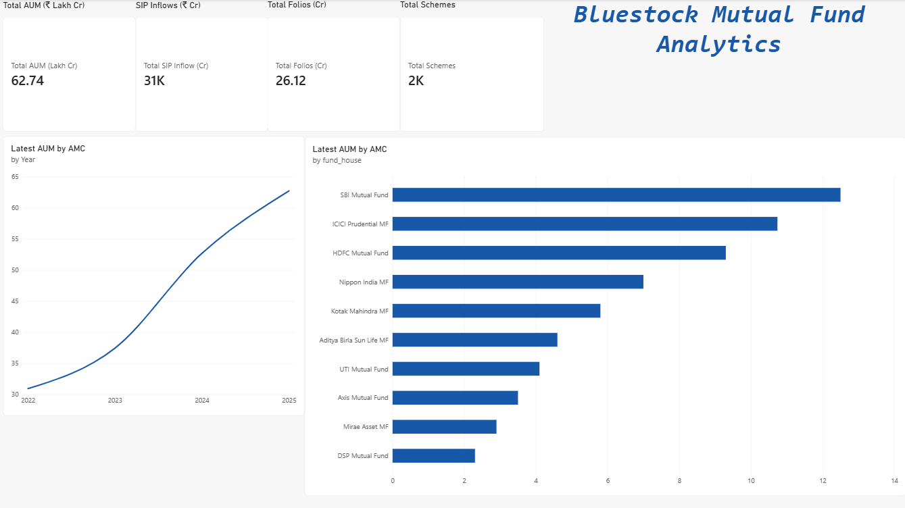
Dashboard — Industry Overview

Slide 10
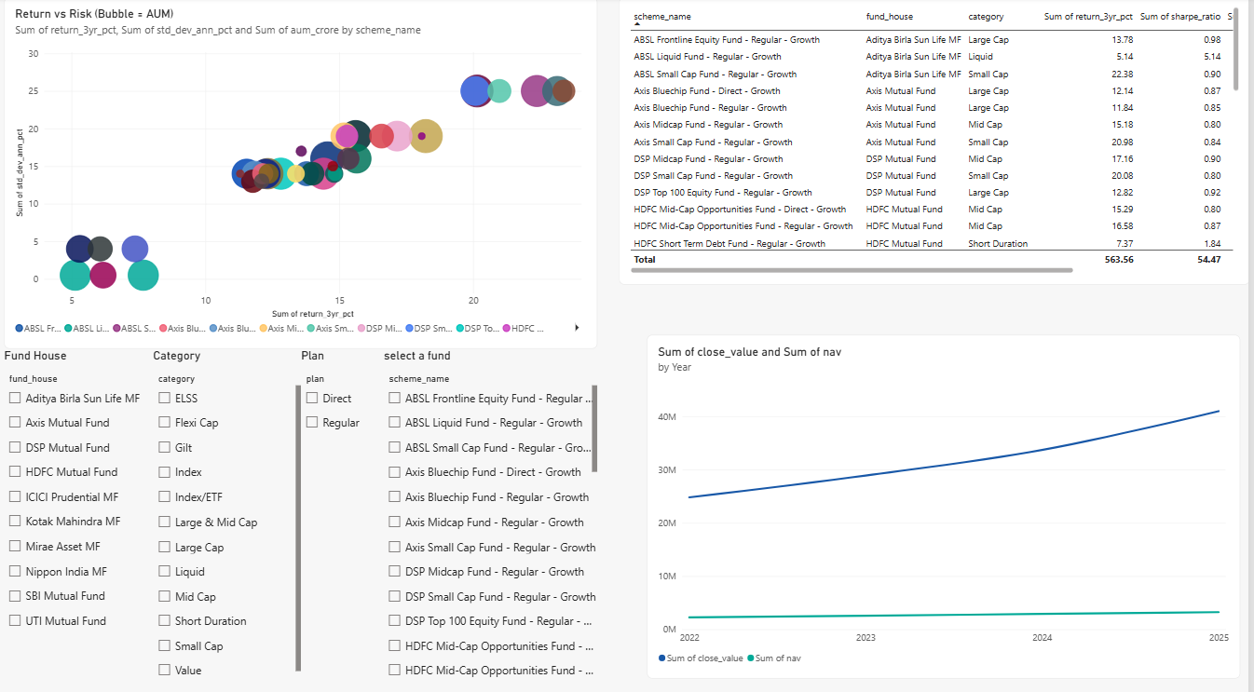
Dashboard — Fund Performance

Slide 11
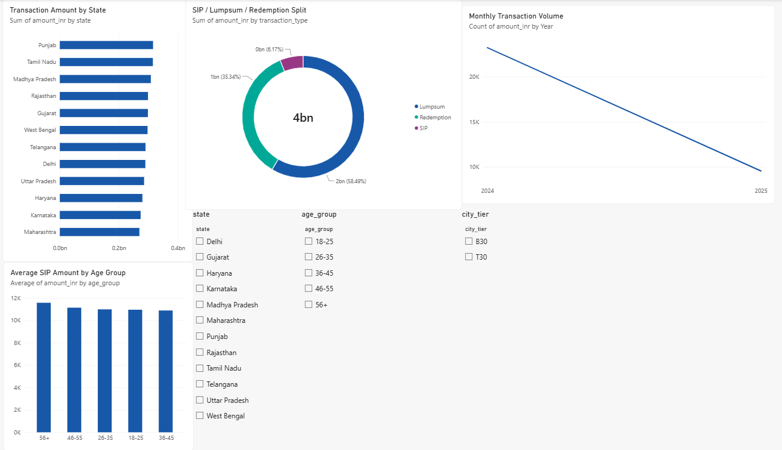
Dashboard — Investor Analytics

Slide 12
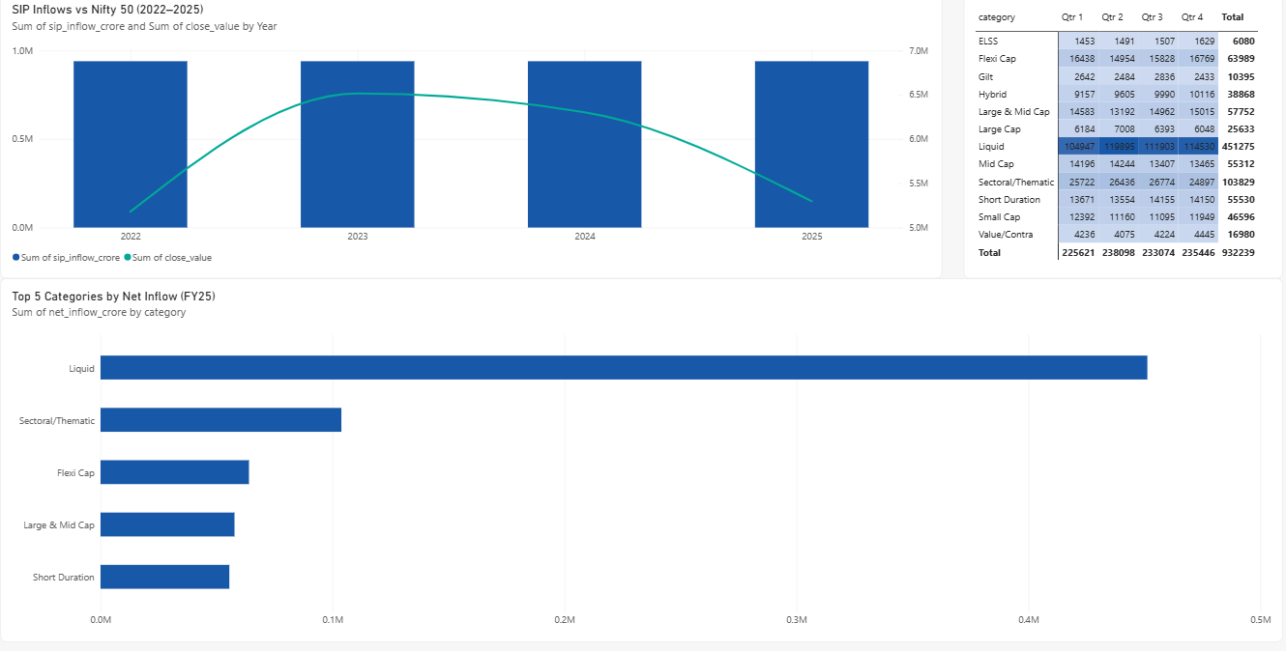
Dashboard — SIP Trends

Slide 13
Key Findings
Top-ranked funds balance strong risk-adjusted returns with cost efficiency, not just raw returns
Small Cap category shows highest return potential alongside highest drawdown risk
Industry-wide SIP growth (17.17% YoY) signals sustained retail participation
Low benchmark correlation across funds is a key data-quality flag for future validation
4-page Power BI dashboard enables self-serve exploration for non-technical stakeholders

Slide 14
Thank You
Questions & Discussion
Vinod Kumar Vasantha
GitHub: vinodkumarvasantha/Mutual-Fund-Analytics

