Slide 1
Microservices

Slide 2
What Can You Expect from This Training!
For Java developers and architects interested in developing microservices.
High-level understanding and fundamental prerequisites that should be in place to be successful with a microservice architecture.
Take a dive into a Java framework for implementing microservices.
Discuss issues around deployment, clustering, failover, and how Spring Cloud, NetflixOSS, ELK, Mesos/ Marathon, Docker, Kubernetes deliver solutions in these areas.
Notes:
Unfortunately, just using new technology doesn’t magically solve distributed systems problems. We take a look at some of the forces involved and what successful companies have done to make microservices work for them, including culture, organizational structure, and market pressures.

Slide 3
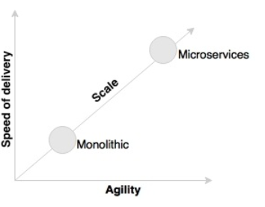
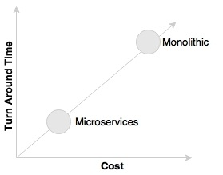
The evolution of Microservices
Microservices are not a technology-only discussion.
Business demand as a catalyst for Microservices evolution
Microservices promise more agility, speed of delivery,
and scale compared to traditional monolithic applications.
Microservices provide an approach for developing quick and agile applications, resulting in less overall cost.
Notes:
Implementations of microservices have roots in complex-adaptive theory, service design, technology evolution, domain-driven design, dependency thinking, promise theory, and other backgrounds. They all come together to allow the people of an organization to truly exhibit agile, responsive, learning behaviours to stay competitive in a fast-evolving business world.

Slide 4
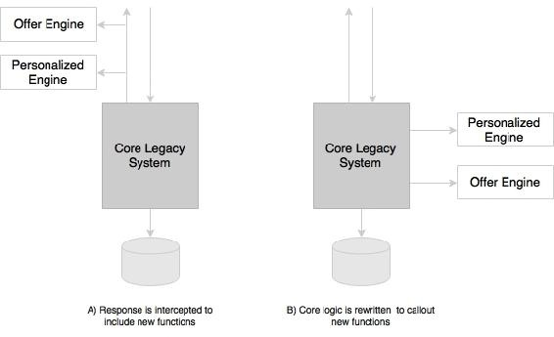
The evolution of Microservices
An example of an online retailer running with a legacy monolithic application.
If the retailer wants to innovate: rather than investing in
rebuilding the core legacy system,
Pass the responses through the new functions
By modifying the core legacy system to call out these
functions as part of the processing
These functions are typically written as microservices.
This approach gives organizations opportunities to quickly try out new functions with lesser cost in an experimental mode. Businesses can later validate key performance indicators and alter or replace these implementations if required.
Modern architectures are expected to maximize the ability to replace their parts and minimize the cost of replacing their parts. The microservices approach is a means to achieve this.
Microservices help us break the boundaries of monolithic applications and build a logically independent smaller system of systems.
Notes:
Today, for instance, banking or financial institutions do not invest in rebuilding their core mainframe systems as another monolithic monster.

Slide 5
The evolution of Microservices
Technology as a catalyst for the microservices evolution
Commoditization of Technology
Open source is leading the charge in the technology space.
This drives communities to build things like operating systems (Linux), programming languages (Go), message queues (Apache ActiveMQ), and web servers (httpd).
Open source and open ecosystems have become the norm, and we’re starting to see a lot of innovation in software technology coming directly from open source communities (e.g., Apache Spark, Docker, and Kubernetes). The container revolution created by Docker radically influenced the infrastructure space.
NoSQLs have revolutionized the databases space. We have a long list of databases: Hadoop, Cassandra, CouchDB, and Neo4j to name a few. Each of these databases addresses certain specific architectural problems.

Slide 6
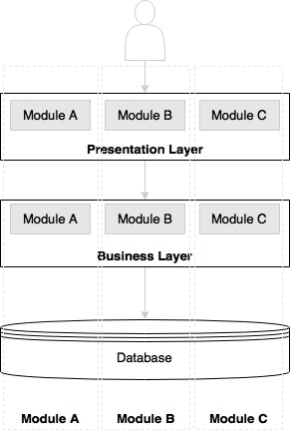
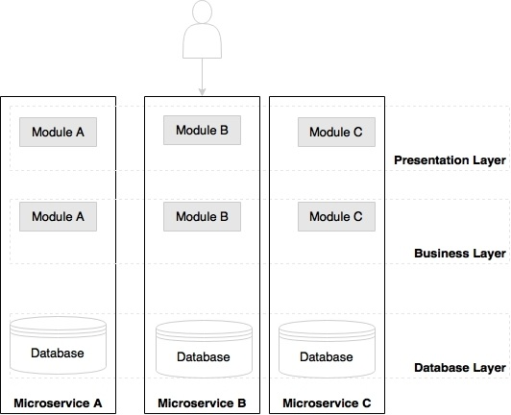
What are Microservices?
Microservice architecture (MSA) is an approach to building software systems that decomposes business domain models into smaller, consistent, bounded-contexts implemented by services.
Microservices are an architectural style or an approach to building IT systems as a set of business capabilities that are autonomous, self-contained, and loosely coupled:
Traditional N-tier application architecture
Microservices based architecture
Notes:
Many organizations such as Netflix, Amazon, and eBay successfully used the divide-and-conquer technique to functionally partition their monolithic applications into smaller atomic units, each performing a single function. These organizations solved a number of prevailing issues they were experiencing with their monolithic application. Following the success of these organizations, many other organizations started adopting this as a common pattern to refactor their monolithic applications. Later, evangelists termed this pattern as the microservices architecture.
There is no standard for communication or transport mechanisms for microservices. In general, microservices communicate with each other using widely adopted lightweight protocols, such as HTTP and REST, or messaging protocols, such as JMS or AMQP. In specific cases, one might choose more optimized communication protocols, such as Thrift, ZeroMQ, Protocol Buffers, or Avro.
Microservices originated from the idea of hexagonal architecture coined by AlistairCockburn. http://alistair.cockburn.us/Hexagonal+architecture.

Slide 7
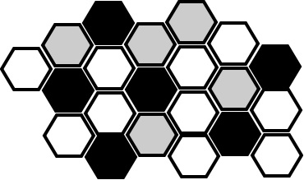
Microservices – the honeycomb analogy
In the real world, bees build a honeycomb by aligning
hexagonal wax cells. They start small, using different
materials to build the cells.
Construction is based on what is available at the time
of building.
Repetitive cells form a pattern and result in a strong fabric structure.
Each cell in the honeycomb is independent but also integrated with other cells.
By adding new cells, the honeycomb grows organically to a big, solid structure.
The content inside each cell is abstracted and not visible outside.
Damage to one cell does not damage other cells, and bees can reconstruct these cells without impacting the overall honeycomb.

Slide 8
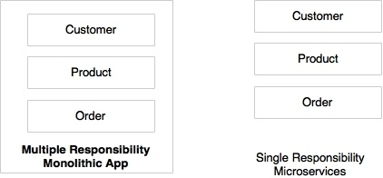
Principles of Microservices
Single responsibility per service (http://wiki.c2.com/?PrinciplesOfObjectOrientedDesign)
This implies that a unit, either a class, a function, or a service, should have only one responsibility.
At no point should two units share one responsibility or one unit have more than one responsibility.
A unit with more than one responsibility indicates tight coupling.
Notes:
Customer, Product, and Order are different functions of an ecommerce application. Rather than building all of them into one application, it is better to have three different services, each responsible for exactly one business function, so that changes to one responsibility will not impair others. In the preceding scenario, Customer, Product, and Order will be treated as three independent microservices.

Slide 9
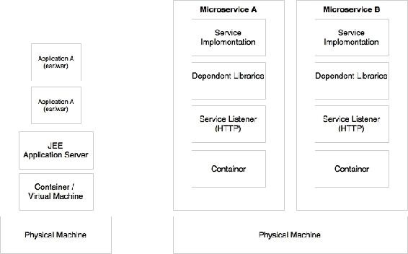
Principles of Microservices
Microservices are autonomous
Microservices are self-contained, independently deployable, and autonomous services that take full responsibility of a business capability and its execution.
They bundle all dependencies, including library dependencies, and execution environments such as web servers and containers or virtual machines that abstract physical resources.
One major difference between microservices and SOA is in their level of autonomy. While most SOA implementations provide service-level abstraction, microservices go further and abstract the realization and execution environment.

Slide 10
Characteristics of microservices
There is no single, concrete, and universally accepted definition for microservices. However, there are some common characteristics.
Services are first-class citizens
Microservices expose service endpoints as APIs and abstract all their realization details.
The internal implementation logic, architecture, and technologies (including programming language, database, quality of services mechanisms, and so on) are completely hidden behind the service API.
In the microservices architecture, there is no more application development; instead, organizations focus on service development.

Slide 11
Characteristics of microservices
Characteristics of services in a microservice
Service contract: Similar to SOA, microservices are described through well-defined service contracts. JSON and REST are universally accepted for service communication. In the case of JSON/REST, to service contracts: JSON Schema, WADL, Swagger, and RAML.
Loose coupling: Microservices are independent and loosely coupled. Messaging, HTTP, and REST are commonly used for interaction between microservices.
Service abstraction: In microservices, service abstraction is not just an abstraction of service realization, but it also provides a complete abstraction of all libraries and environment details.
Statelessness: Well-designed microservices are stateless and share nothing with no shared state or conversational state maintained by the services. In case there is a requirement to maintain state, they are maintained in a database, perhaps in memory.

Slide 12
Characteristics of microservices
Characteristics of services in a microservice
Services are discoverable : Microservices are discoverable. In a typical microservices environment, microservices self-advertise their existence and make themselves available for discovery. When services die, they automatically take themselves out from the microservices ecosystem.
Service interoperability: Services are interoperable as they use standard protocols and message exchange standards. Messaging, HTTP, and so on are used as transport mechanisms.
Service composeability: Microservices are composeable. Service composeability is achieved either through service orchestration or service choreography.

Slide 13
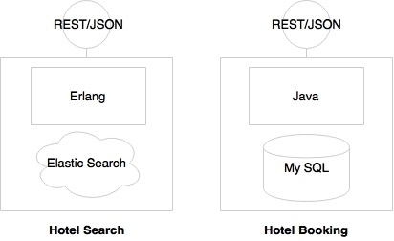

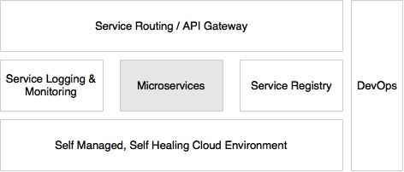
Characteristics of microservices
Microservices are lightweight
common characteristics in most of the implementations are with smaller footprints.
Microservices with polyglot architecture
Automation in a microservices environment
Microservices with a supporting ecosystem
Notes:
The development phase is automated using version control tools such as Git together with
Continuous Integration (CI) tools such as Jenkins, Travis CI, and so on.
The testing phase will be automated using testing tools such as Selenium, Cucumber, and other AB
testing strategies. As microservices are aligned to business capabilities, the number of test cases to
automate is fewer compared to monolithic applications, hence regression testing on every build also
becomes possible
Infrastructure provisioning is done through container technologies such as Docker, together with
release management tools such as Chef or Puppet, and configuration management tools such as
Ansible. Automated deployments are handled using tools such as Spring Cloud, Kubernetes, Mesos,
and Marathon.

Slide 14
Characteristics of microservices
Microservices are distributed and dynamic
Distributed data and logic and decentralized governance.
Antifragility, failfast, and self-healing
Notes:
Fail fast is a concept used to build fault-tolerant, resilient systems. This philosophy advocates systems that expect failures versus building systems that never fail. Importance should be given to how quickly the system can fail and if it fails, how quickly it can recover from this failure. With this approach, the focus is shifted from Mean Time Between Failures (MTBF) to Mean Time To Recover (MTTR). A key advantage of this approach is that if something goes wrong, it kills itself, and downstream functions aren't stressed.

Slide 15
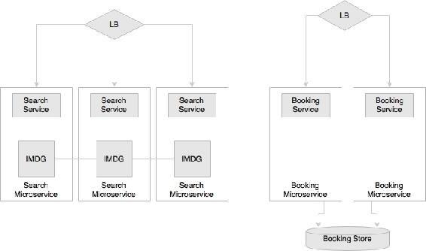
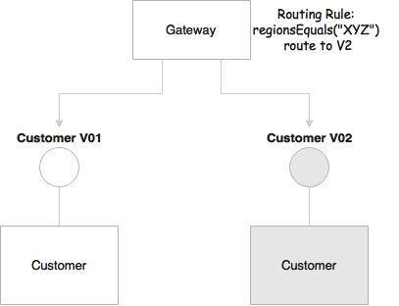
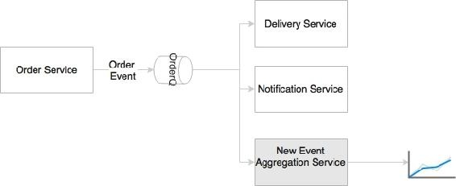
Microservices benefits
Selective scalability is also in the way in which the microservices are architected.
Supports polyglot architecture
Enables experimentation and innovation
Elastically and selectively scalable
Enable us to implement selective scalability.
Helping reducing technology debt
It is possible to change or upgrade
technology for each service individually
rather than upgrading an entire application.
Allowing the coexistence of different versions
Supporting event-driven architecture
Microservices enable us to develop
transparent software systems.
Notes:
Upgrading an application with five million lines written on EJB 1.1 and Hibernate to the Spring, JPA, and REST services is almost similar to rewriting the entire application. In the microservices world, this could be done incrementally.
Business events and system events, unless published explicitly, are hard to understand and analyze. Modern applications require data for business analysis, to understand dynamic system behaviors, and analyze market trends, and they also need to respond to real-time events. Events are useful mechanisms for data extraction.

Slide 16
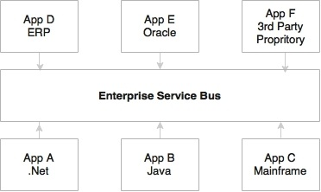
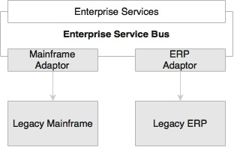
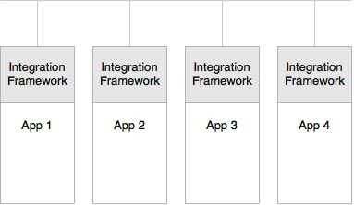
Relationship with other architecture styles
Relations with SOA
Are they same or are they different?
Service-oriented integration
Legacy modernization
Service-oriented application
Notes:
The difference between microservices and SOA is in a way based on how an organization approaches SOA.

Slide 17
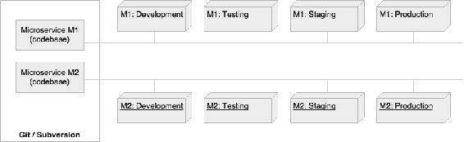
Relationship with other architecture styles
Relations with Twelve-Factorapps (https://12factor.net/)
Twelve-Factor App, forwarded by Heroku, is a methodology describing the characteristics expected from modern cloud-ready applications.
Twelve-Factor App is equally applicable for microservices as well.
A single code base
Each application has a single code base. There can be multiple instances of deployment of the same code base, such as development, testing, and production.
Notes:
Cloud native is a term used for developing applications that can work efficiently in a cloud environment, understanding and utilizing cloud behaviors such as elasticity, utilization based charging, fail aware, and so on.

Slide 18
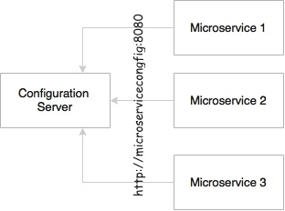
Relationship with other architecture styles
Bundling dependencies
As per this principle, all applications should bundle their dependencies along with the application bundle.
Externalizing configurations
This principle advises the externalization of all configuration parameters from the code.

Slide 19
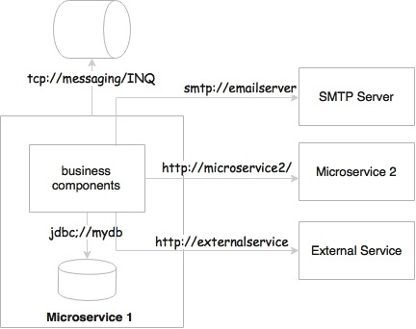
Relationship with other architecture styles
Backing services are addressable
All backing services should be accessible
through an addressable URL.
Isolation between build,release and run
Stateless, shared nothing processes
Exposing services through port bindings
Port binding is one of the fundamental requirements for microservices to be autonomous and self-contained. Microservices embed service listeners as a part of the service itself.
Notes:
The build stage refers to compiling and producing binaries by including all the assets required. The release stage refers to combining binaries with environment-specific configuration parameters. The run stage refers to running application on a specific execution environment. The pipeline is unidirectional.

Slide 20
Relationship with other architecture styles
Disposability with minimal overhead
In an automated deployment environment, we should be able bring up or bring down
instances as quick as possible.
Development and production parity
This principle states the importance of keeping development and production environments as identical as possible.
Externalizing logs
Use a centralized logging framework.
Package admin processes
Admin code should also be packaged along with the application code.
Notes:
Splunk, Greylog, Logstash, Logplex, and Loggly are some examples of log shipping and analysis tools. The recommended approach is to ship logs to a central repository by tapping the logback appenders and write to one of the shippers' endpoints

Slide 21
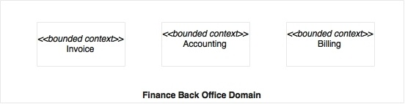
Applying microservices concepts
Establishing appropriate microservice boundaries
Domain-driven design(DDD) defines the concept of a bounded context
(http://domainlanguage.com/ddd/)
A bounded context is a good way to determine the boundaries of microservices.
Each bounded context could be mapped to a single microservice.
There is no silver bullet to establish microservices boundaries, and often, this is quite challenging.
Establishing boundaries is much easier in the scenario of monolithic application to microservices migration, as the service boundaries and dependencies are known from the existing system.
In a greenfield microservices development, the dependencies are hard to establish upfront.
Notes:
One of the most common questions relating to microservices is regarding the size of the service. How big (mini-monolithic) or how small (nano service) can a microservice be, or is there anything like right-sized services? Does size really matter? A quick answer could be "one REST endpoint per microservice", or "less than 300 lines of code", or "a component that performs a single responsibility".
A bounded context is a subdomain or a subsystem of a larger domain or system that is responsible for performing a particular function.
Even though real world organizational boundaries are the simplest mechanisms for establishing a bounded context, these may prove wrong in some cases due to inherent problems within the organization's structures. For example, a business capability may be delivered through different channels such as front offices, online, roaming agents, and so on. In many organizations, the business units may be organized based on delivery channels rather than the actual underlying business capabilities. In such cases, organization boundaries may not provide accurate service boundaries.

Slide 22
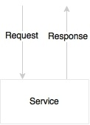

Applying microservices concepts
Designing Communication styles
Synchronous style communication
A synchronous style adds hard dependencies between microservices. If one service
in the service chain fails, then the entire service chain will fail. In order for
a service to succeed, all dependent services have to be up and running. Many of the
failure scenarios have to be handled using timeouts and loops.
Asynchronous style communication
This approach provides higher levels of scalability, because services are independent, and can internally spawn threads to handle an increase in load. When overloaded, messages will be queued in a messaging server for later processing.
The downside is that it has a dependency to an external messaging server.
Notes:
From a high availability standpoint, many active instances can be up and running, accepting traffic. Since there are no other infrastructure dependencies such as a shared messaging server, there are management fewer overheads. In case of an error at any stage, the error will be propagated back to the caller immediately, leaving the system in a consistent state, without compromising data integrity.
It is complex to handle the fault tolerance of a messaging server. Messaging typically works with an active/passive semantics. Hence, handling continuous availability of messaging systems is harder to achieve. Since messaging typically uses persistence, a higher level of I/O handling and tuning is required.

Slide 23
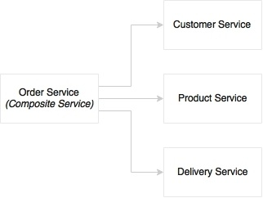
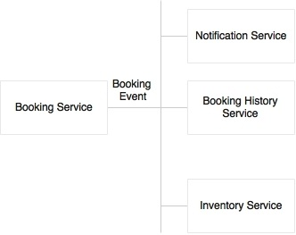
Applying microservices concepts
Orchestration of microservices
Two approaches
Orchestration
Choreography

Slide 24
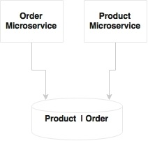
Applying microservices concepts
One microservice per VM or multiple?
This question typically arises when the services are simple, and the traffic volume is less.
Shared datasource?
Shared datamodels, sharedschema, and shared tables are recipes
for disasters when developing microservices
If the services have only a few tables, it may not be worth
investing a full instance of a database like an Oracle database instance.
In such cases, a schema level segregation is good enough to start with.

Slide 25
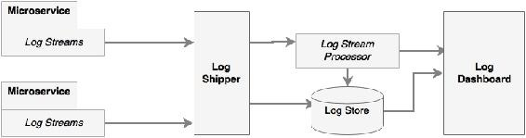
Applying microservices concepts
Logging and monitoring
The ability to collect all log messages and run analytics on top of the log messages
The ability to correlate and track transactions end to end
The ability to keep log information for longer time periods for trending and forecasting
The ability to eliminate dependency on the local disk system
The ability to aggregate log information coming from multiple sources such as network devices, operating system, microservices, and so on

Slide 26
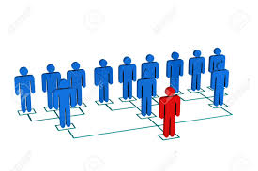
Applying microservices concepts
Embrace Organization Agility
To build agile software systems, we must start with building agile organizational structures.
This structure will facilitate the prerequisites we need for Microservices.
Conway’s law: “organizations which design systems…are constrained to produce designs which are copies of the communication structures of these organizations.”
Notes:
No discussion on microservices would be complete without quoting Conway’s law: “organizations which design systems…are constrained to produce designs which are copies of the communication structures of these organizations.”:- Fred Brooks cited the paper and the idea in his elegant classic "The Mythical Man-Month," calling it "Conway's Law." The name stuck.

Slide 27
Drawbacks?
Microservices help solve the “how do we decouple our services and teams to move quickly at scale?” problem
Drawbacks.
It can be more resource intensive.
You may end up with what looks like duplication.
Operational complexity is a lot higher.
It becomes very difficult to understand the system holistically.
It becomes significantly harder to debug problems.
In some areas you may have to relax the notion of transaction.
Teams may not have been designed to work like this.
Notes:
Think of microservices as an optimization for problems that require the ability to change things quickly at scale but with a price.

Slide 28
Challenges
Designing cloud-native applications following a Microservices approach requires thinking differently about how to build, deploy and operate them.
Design for Faults
Building distributed systems is different from building shared memory, single process, monolithic applications.
Networks are inherently unreliable.
Latent network calls can be very difficult to debug.
Design with Dependencies in Mind
Need loose coupling in our teams, in our technology, and our governance.
Notes:
In complex systems, things fail. Hard drives crash, network cables get unplugged, we do maintenance on the live database instead of the backups, and VMs disappear. Single faults can be propagated to other parts of the system and result in cascading failures that take an entire system down.
Design with dependencies in mind: This means being able to change things as quickly as the business needs without impacting those services around you or the system at large.
“One of the principles of creativity is to drop a constraint: Ganesh Prasad in Dependency Oriented Thinking.

Slide 29
Challenges
Design with the Domain in Mind
Identify and explicitly separate the different models and ensure they’re cohesive and unambiguous within their own bounded context.
A bounded context is a set of domain objects that implement a model that tries to simplify and communicate a part of the business, code, and organization.
This deep understanding of the domain takes time.
Notes:
Models have been used for centuries to simplify and understand a problem through a certain lens. For example, the GPS maps on our phones are great models for navigating a city while walking or driving. This model would be completely useless to someone flying a commercial airplane. The models they use are more appropriate to describe way points, landmarks, and jet streams. Different models make more or less sense depending on the context from which they’re viewed.
It may take a few iterations to fully understand the ambiguities that exist in business models and properly separate them out and allow them to change independently. This is at least one reason starting off building microservices is difficult. Carving up a monolith is no easy task, but a lot of the concepts are already baked into the monolith; your job is to identify and carve it up. With a greenfield project, you cannot carve up anything until you deeply understand it. In fact, all of the microservice success stories we hear about (like Amazon and Netflix) all started out going down the path of the monolith before they successfully made the transition to microservices.

Slide 30
Challenges
Design with Promises in Mind
it’s very important to keep in mind the relationship between service provider and service consumer.
In the course of trying to keep a promise, it helps to have empathy for the rest of the system and the service quality we’re trying to uphold.
Notes:
As an autonomous service team, you cannot place obligations on other teams and services because you do not own them; they’re autonomous by definition. All you can do is choose whether or not to accept their promises of functionality or behavior. As a provider of a service to others, all you can do is promise them a certain behavior. They are free to trust you or not.
Promise theory, a model first proposed by Mark Burgess in 2004 and covered in his book In Search of Certainty (O’Reilly, 2015).
In the course of trying to keep a promise, it helps to have empathy for the rest of the system and the service quality we’re trying to uphold.

Slide 31
Challenges
Distributed Systems Management
Some quick questions about the manageability of a Microservices deployment:
• How do we start and stop a fleet of services?
• How do we aggregate logs/metrics/SLAs across Microservices?
• How do we discover services in an elastic environment where they can be coming, going, moving, etc.?
• How do we do load balancing?
• How do we learn about the health of our cluster or individual services?
• How do we restart services that have fallen over?
• How do we do fine-grained API routing?
• How do we secure our services?
• How do we throttle or disconnect parts of a cluster if it starts to crash or act unexpectedly?
• How do we deploy multiple versions of a service and route to them appropriately?
• How do we make configuration changes across a large fleet of services?
• How do we make changes to our application code and configuration in a safe, auditable, repeatable manner?
Notes:
At the end of the day, managing a single system is easier than a distributed one. If there’s just one machine, and one application server, and there are problems with the system, we know where to look. If you need to make a configuration change, upgrade to a specific version, or secure it, it’s still all in one physical and logical location. Managing, debugging, and changing it is easier.
As we discussed earlier, however, Microservices are not free; the trade-off for having flexibility and scalability is having to manage a complicated system.

Slide 32
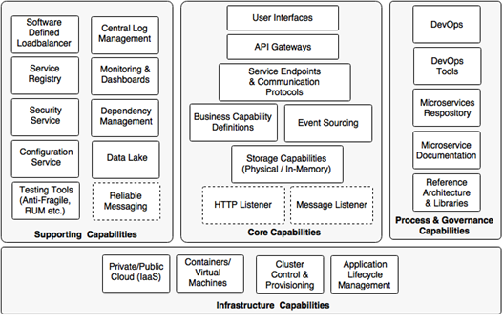
The microservices capability model
Core capabilities: These are part of the microservices themselves
Supporting capabilities: These are software solutions supporting core microservice implementations
Infrastructure capabilities: These are infrastructure level expectations for a successful microservices implementation
Governance capabilities: These are more of process, people, and reference information

Slide 33
Technology Solutions
Microservices is not just a technological problem, and getting the right organizational structure and teams in place to facilitate microservices is paramount.
Switching from SOAP to REST doesn’t make a Microservices architecture.
Introduction to some popular technology components, how they help solve some of the problems of developing and delivering software using a Microservices architecture.
Spring Boot
Spring Cloud + NetflixOSS
ELK
Docker
Mesos/ Marathon in Cloud (AWS, Azure etc)
Kubernetes
Notes:
Java frameworks: Spring Boot, DropWizard, Wildfly Swarm.
Reactive approach: Vert.x (http://vertx.io/docs/), Lagom (https://www.lagomframework.com/)
Microservices are described through well-defined service contracts: JSONSchema, WADL, Swagger, and RAML are a few examples.
Infrastructure provisioning is done through container technologies such as Docker, together with release management tools such as Chef or Puppet, and configuration management tools such as
Ansible. Automated deployments are handled using tools such as SpringCloud, Kubernetes, Mesos, and Marathon.
Centralized logging framework. Splunk, Greylog, Logstash, Logplex, and Loggly are some examples of log shipping and analysis tools.

