Slide 1

Couchbase
Presented to CASA systems | DD - MMM - YYYY

Slide 2
AGENDA

Slide 3
Agenda
Overview
Deployment
Bucket Creation
Indices Creation
XDCR Replication
Redundancy

Slide 4
Overview of Couchbase

Slide 5
Overview of Couchbase
  Couchbase Server is a distributed, open-source NoSQL database engine.
  The core architecture is designed to simplify building modern applications with a flexible data model and simpler high availability, high scalability, high performance, and advanced security.
  Couchbase Server consists of a single package that is installed on all nodes.
  Using the SDKs, you can write applications in the language of your choice (Java, node.js, .NET, or others).
  The applications connect to a Couchbase Server cluster to perform read and write operations, and run queries with low latencies (sub millisecond) and high throughput (millions of operations per second).

Slide 6
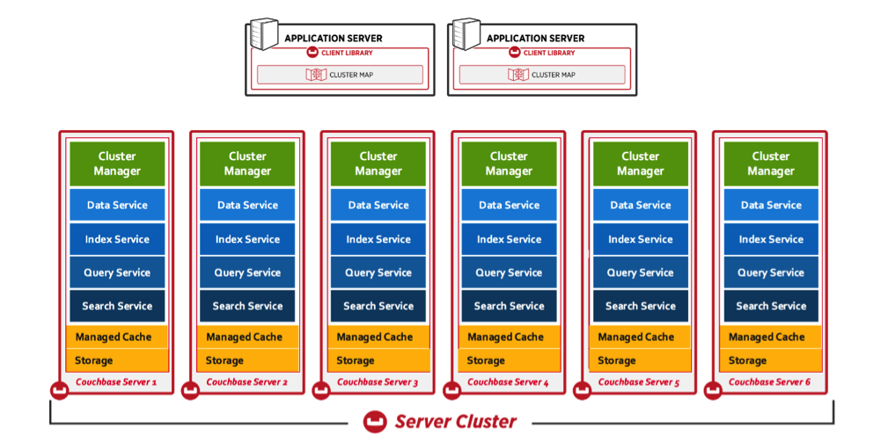
Architecture
Notes:
The following are the core runtime systems within Couchbase Server:
Connectivity architecture
Replication architecture
Storage architecture
Caching layer architecture
Security architecture
The runtimes such as replication, storage, caching, and so on can be tuned to the needs of different services within the system.
Couchbase Server also consists of the following services:
Cluster manager
Data service
Index service
Query service
Search service

Slide 7
Database Installation

Slide 8
Database Installation
This section provides instructions to the following:
  • Deploy Couchbase Database
  • Initialize Couchbase Cluster
  • Creating Buckets
  • Creating indexes
  XDCR Replication
  Redundancy

Slide 9
Deploy Couchbase Database
Deploy Couchbase on K8 cluster:
Cluster supports Dynamic PVC provision.
  Following can/should be updated as needed:
  • sidecar-image - line#39
  • couchbase-image - line#80
  • resources - line#95
  • storage - line199
  Using existing PVC .
  Following can/should be updated as needed:
  • sidecar-image - line#39
  • couchbase-image - line#80
  • resources - line#95
  • claimName - line#194

Slide 10
Initialize Couchbase Cluster
  Credentials can be changed and the same will be used to connect to database.
  Using CLI
kubectl -n <namespace> exec -it couchbase-0 -c couchbase -- couchbase-cli cluster-init --cluster-username=Administrator --cluster-password=password --cluster-ramsize=4000 --cluster-index-ramsize=1024 --cluster-fts-ramsize=1024 --cluster-name=cb-primary --services="data,index,query,fts" --cluster=localhost:8091

Slide 11
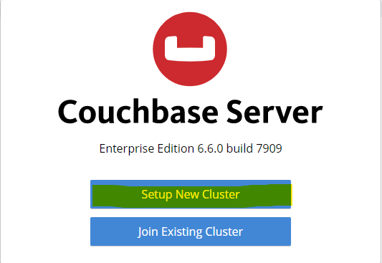
Initialize Couchbase Cluster
  Using Web-UI
  Open the Couchbase UI URL ( http://<NodeIP>:32601 ) on your browser.

Slide 12
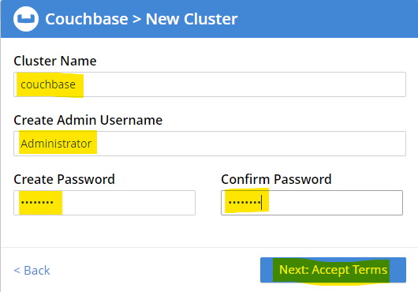
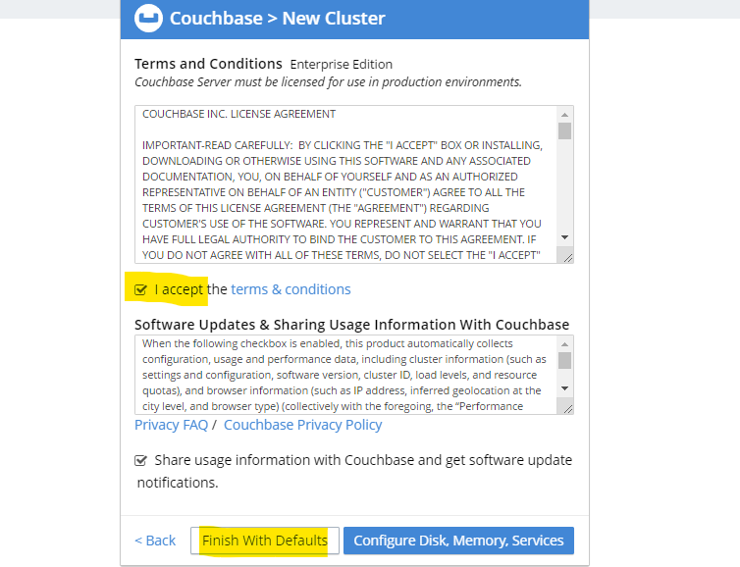
Initialize Couchbase Cluster
  .

Slide 13
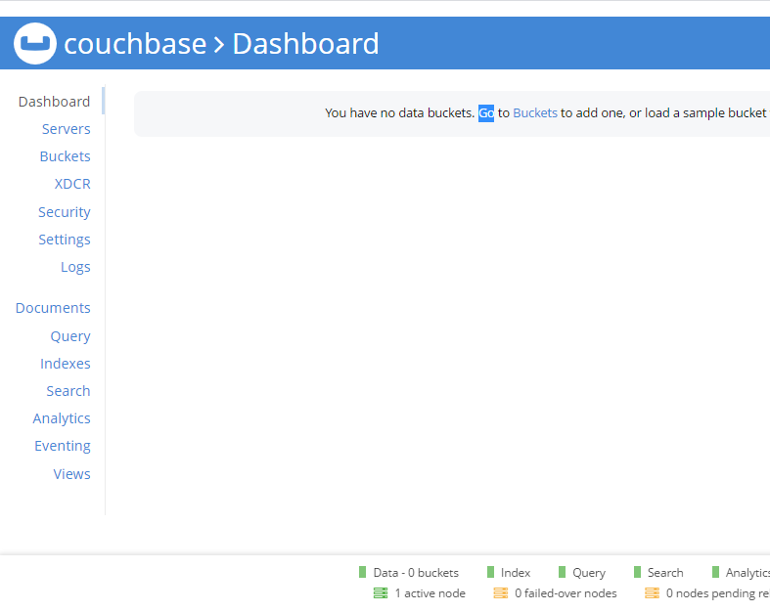
Initialize Couchbase Cluster

Slide 14
Creating Buckets
kubectl -n <namespace> exec -it couchbase-0 -c couchbase -- couchbase-cli bucket-create --cluster localhost:8091 --username Administrator --password password --bucket AuthVector --bucket-type couchbase --bucket-ramsize 500 kubectl -n <namespace> exec -it couchbase-0 -c couchbase -- couchbase-cli bucket-create --cluster localhost:8091 --username Administrator --password password --bucket BatchProcessor --bucket-type couchbase --bucket-ramsize 300 kubectl -n <namespace> exec -it couchbase-0 -c couchbase -- couchbase-cli bucket-create --cluster localhost:8091 --username Administrator --password password --bucket ContextManagement --bucket-type couchbase --bucket-ramsize 300 kubectl -n <namespace> exec -it couchbase-0 -c couchbase -- couchbase-cli bucket-create --cluster localhost:8091 --username Administrator --password password --bucket PCF --bucket-type couchbase --bucket-ramsize 800 kubectl -n <namespace> exec -it couchbase-0 -c couchbase -- couchbase-cli bucket-create --cluster localhost:8091 --username Administrator --password password --bucket portaldb --bucket-type couchbase --bucket-ramsize 100 kubectl -n <namespace> exec -it couchbase-0 -c couchbase -- couchbase-cli bucket-create --cluster localhost:8091 --username Administrator --password password --bucket pcfportaldb --bucket-type couchbase --bucket-ramsize 100 kubectl -n <namespace> exec -it couchbase-0 -c couchbase -- couchbase-cli bucket-create --cluster localhost:8091 --username Administrator --password password --bucket SubscriptionManagement --bucket-type couchbase --bucket-ramsize 800 kubectl -n <namespace> exec -it couchbase-0 -c couchbase -- couchbase-cli bucket-create --cluster localhost:8091 --username Administrator --password password --bucket SubscriptionPolicy --bucket-type couchbase --bucket-ramsize 800 kubectl -n <namespace> exec -it couchbase-0 -c couchbase -- couchbase-cli bucket-create --cluster localhost:8091 --username Administrator --password password --bucket SystemConfiguration --bucket-type couchbase --bucket-ramsize 200
  --bucket-ramsize value can be changed as required.
kubectl -n <namespace> exec -it couchbase-0 -c couchbase -- couchbase-cli bucket-create --cluster localhost:8091 --username Administrator --password password --bucket AuthVector --bucket-type couchbase --bucket-ramsize 500 kubectl -n <namespace> exec -it couchbase-0 -c couchbase -- couchbase-cli bucket-create --cluster localhost:8091 --username Administrator --password password --bucket BatchProcessor --bucket-type couchbase --bucket-ramsize 300 kubectl -n <namespace> exec -it couchbase-0 -c couchbase -- couchbase-cli bucket-create --cluster localhost:8091 --username Administrator --password password --bucket ContextManagement --bucket-type couchbase --bucket-ramsize 300 kubectl -n <namespace> exec -it couchbase-0 -c couchbase -- couchbase-cli bucket-create --cluster localhost:8091 --username Administrator --password password --bucket PCF --bucket-type couchbase --bucket-ramsize 800 kubectl -n <namespace> exec -it couchbase-0 -c couchbase -- couchbase-cli bucket-create --cluster localhost:8091 --username Administrator --password password --bucket portaldb --bucket-type couchbase --bucket-ramsize 100 kubectl -n <namespace> exec -it couchbase-0 -c couchbase -- couchbase-cli bucket-create --cluster localhost:8091 --username Administrator --password password --bucket pcfportaldb --bucket-type couchbase --bucket-ramsize 100 kubectl -n <namespace> exec -it couchbase-0 -c couchbase -- couchbase-cli bucket-create --cluster localhost:8091 --username Administrator --password password --bucket SubscriptionManagement --bucket-type couchbase --bucket-ramsize 800 kubectl -n <namespace> exec -it couchbase-0 -c couchbase -- couchbase-cli bucket-create --cluster localhost:8091 --username Administrator --password password --bucket SubscriptionPolicy --bucket-type couchbase --bucket-ramsize 800 kubectl -n <namespace> exec -it couchbase-0 -c couchbase -- couchbase-cli bucket-create --cluster localhost:8091 --username Administrator --password password --bucket SystemConfiguration --bucket-type couchbase --bucket-ramsize 200

Slide 15
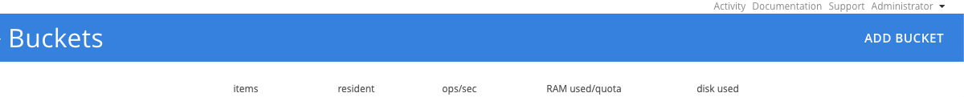
Creating Buckets
  Using Web-UI
Open the Couchbase UI URL ( http://<NodeIP>:32601 ) on your browser and login.
Navigate to the buckets tab from the left nav menu.
Click on "Add bucket" from the top right corner
  Allocate memory quota according to the deployment and subscriber base size.

Slide 16
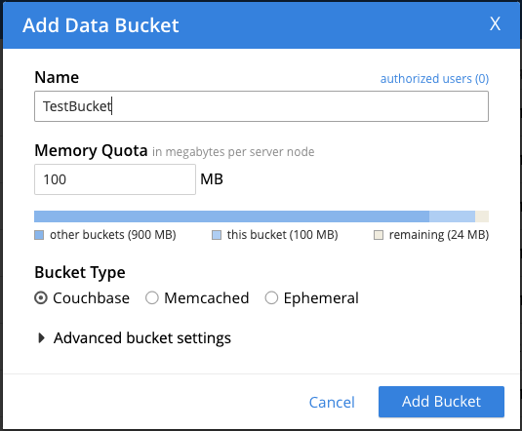
Creating Buckets

Slide 17
Creating Buckets
Follow the above process to create following buckets:
AuthVector | 500
BatchProcessor | 300
ContextManagement | 300
Pcfportaldb | 100
PCF | 800
Portaldb | 100
SubscriptionManagement | 800
SubscriptionPolicy | 800
SystemConfiguration | 200

Slide 18
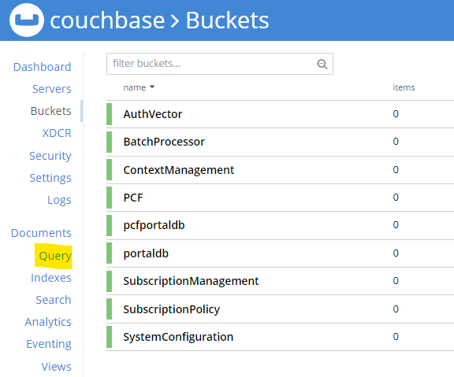
Creating Indexes
Using Web-UI
Open the Couchbase UI URL ( http://<NodeIP>:32601 ) on your browser and login.
Paste & run the query to create index in the query monitor as below.
kubectl -n <namespace> exec -it couchbase-0 -c couchbase -- couchbase-cli bucket-create --cluster localhost:8091 --username Administrator --password password --bucket AuthVector --bucket-type couchbase --bucket-ramsize 500 kubectl -n <namespace> exec -it couchbase-0 -c couchbase -- couchbase-cli bucket-create --cluster localhost:8091 --username Administrator --password password --bucket BatchProcessor --bucket-type couchbase --bucket-ramsize 300 kubectl -n <namespace> exec -it couchbase-0 -c couchbase -- couchbase-cli bucket-create --cluster localhost:8091 --username Administrator --password password --bucket ContextManagement --bucket-type couchbase --bucket-ramsize 300 kubectl -n <namespace> exec -it couchbase-0 -c couchbase -- couchbase-cli bucket-create --cluster localhost:8091 --username Administrator --password password --bucket PCF --bucket-type couchbase --bucket-ramsize 800 kubectl -n <namespace> exec -it couchbase-0 -c couchbase -- couchbase-cli bucket-create --cluster localhost:8091 --username Administrator --password password --bucket portaldb --bucket-type couchbase --bucket-ramsize 100 kubectl -n <namespace> exec -it couchbase-0 -c couchbase -- couchbase-cli bucket-create --cluster localhost:8091 --username Administrator --password password --bucket pcfportaldb --bucket-type couchbase --bucket-ramsize 100 kubectl -n <namespace> exec -it couchbase-0 -c couchbase -- couchbase-cli bucket-create --cluster localhost:8091 --username Administrator --password password --bucket SubscriptionManagement --bucket-type couchbase --bucket-ramsize 800 kubectl -n <namespace> exec -it couchbase-0 -c couchbase -- couchbase-cli bucket-create --cluster localhost:8091 --username Administrator --password password --bucket SubscriptionPolicy --bucket-type couchbase --bucket-ramsize 800 kubectl -n <namespace> exec -it couchbase-0 -c couchbase -- couchbase-cli bucket-create --cluster localhost:8091 --username Administrator --password password --bucket SystemConfiguration --bucket-type couchbase --bucket-ramsize 200

Slide 19
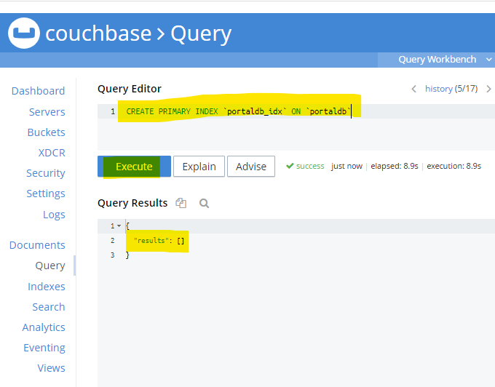
Creating Indexes
kubectl -n <namespace> exec -it couchbase-0 -c couchbase -- couchbase-cli bucket-create --cluster localhost:8091 --username Administrator --password password --bucket AuthVector --bucket-type couchbase --bucket-ramsize 500 kubectl -n <namespace> exec -it couchbase-0 -c couchbase -- couchbase-cli bucket-create --cluster localhost:8091 --username Administrator --password password --bucket BatchProcessor --bucket-type couchbase --bucket-ramsize 300 kubectl -n <namespace> exec -it couchbase-0 -c couchbase -- couchbase-cli bucket-create --cluster localhost:8091 --username Administrator --password password --bucket ContextManagement --bucket-type couchbase --bucket-ramsize 300 kubectl -n <namespace> exec -it couchbase-0 -c couchbase -- couchbase-cli bucket-create --cluster localhost:8091 --username Administrator --password password --bucket PCF --bucket-type couchbase --bucket-ramsize 800 kubectl -n <namespace> exec -it couchbase-0 -c couchbase -- couchbase-cli bucket-create --cluster localhost:8091 --username Administrator --password password --bucket portaldb --bucket-type couchbase --bucket-ramsize 100 kubectl -n <namespace> exec -it couchbase-0 -c couchbase -- couchbase-cli bucket-create --cluster localhost:8091 --username Administrator --password password --bucket pcfportaldb --bucket-type couchbase --bucket-ramsize 100 kubectl -n <namespace> exec -it couchbase-0 -c couchbase -- couchbase-cli bucket-create --cluster localhost:8091 --username Administrator --password password --bucket SubscriptionManagement --bucket-type couchbase --bucket-ramsize 800 kubectl -n <namespace> exec -it couchbase-0 -c couchbase -- couchbase-cli bucket-create --cluster localhost:8091 --username Administrator --password password --bucket SubscriptionPolicy --bucket-type couchbase --bucket-ramsize 800 kubectl -n <namespace> exec -it couchbase-0 -c couchbase -- couchbase-cli bucket-create --cluster localhost:8091 --username Administrator --password password --bucket SystemConfiguration --bucket-type couchbase --bucket-ramsize 200

Slide 20
Creating Indexes
CREATE PRIMARY INDEX `SystemConfiguration-index` ON `SystemConfiguration` USING GSI; CREATE PRIMARY INDEX `portaldb-index` ON `portaldb` USING GSI CREATE PRIMARY INDEX `SubscriptionManagement-index` ON `SubscriptionManagement` USING GSI; CREATE PRIMARY INDEX `AuthVector-index` ON `AuthVector` USING GSI; CREATE PRIMARY INDEX `BatchProcessor-index` ON `BatchProcessor` USING GSI; CREATE PRIMARY INDEX `ContextManagement-index` ON `ContextManagement` USING GSI; CREATE PRIMARY INDEX `pcfportaldb-index ` ON `pcfportaldb` USING GSI; CREATE PRIMARY INDEX `pcf-index` ON `PCF` USING GSI; CREATE PRIMARY INDEX `SubscriptionPolicy-index` ON `SubscriptionPolicy` USING GSI; CREATE INDEX `supiIndex` ON `SubscriptionManagement`(`supi`); CREATE INDEX `simStatusIndex` ON `SubscriptionManagement`(`simStatus`); CREATE INDEX `lteSubscriptionStatusIndex` ON `SubscriptionManagement`(`lteSubscriptionStatus`); CREATE INDEX `nrSubscriptionStatusIndex` ON `SubscriptionManagement`(`nrSubscriptionStatus`); CREATE INDEX `typeIndex` ON `SubscriptionManagement`(`type`) ; CREATE INDEX `pcfportaldb_companyid_type_index` ON `pcfportaldb`(`companyId`,`type`); CREATE INDEX `amf_instanceid` ON `ContextManagement`((`amf3gppAccess`.`amfInstanceId`)) WHERE ((meta(self).`id`) like "%amf") CREATE INDEX `mme_identity` ON `ContextManagement`((`mmeIdentity`)) WHERE ((meta(self).`id`) like "%mmecontext") CREATE INDEX `sdm_subdoc` ON `ContextManagement`((distinct (object_names(self)))) WHERE ((meta(self).`id`) like "%sdm") CREATE INDEX `smf_subdoc` ON `ContextManagement`((distinct (object_names(self)))) WHERE ((meta(self).`id`) like "%smf") CREATE INDEX `smf_subdoc_instanceid` ON `ContextManagement`((distinct (object_pairs(self)))) WHERE ((meta(self).`id`) like "%smf") CREATE index subscription_simStatus on SubscriptionManagement(simStatus) where type='SubscriptionData'
Run The below queries to create all indexes.
kubectl -n <namespace> exec -it couchbase-0 -c couchbase -- couchbase-cli bucket-create --cluster localhost:8091 --username Administrator --password password --bucket AuthVector --bucket-type couchbase --bucket-ramsize 500 kubectl -n <namespace> exec -it couchbase-0 -c couchbase -- couchbase-cli bucket-create --cluster localhost:8091 --username Administrator --password password --bucket BatchProcessor --bucket-type couchbase --bucket-ramsize 300 kubectl -n <namespace> exec -it couchbase-0 -c couchbase -- couchbase-cli bucket-create --cluster localhost:8091 --username Administrator --password password --bucket ContextManagement --bucket-type couchbase --bucket-ramsize 300 kubectl -n <namespace> exec -it couchbase-0 -c couchbase -- couchbase-cli bucket-create --cluster localhost:8091 --username Administrator --password password --bucket PCF --bucket-type couchbase --bucket-ramsize 800 kubectl -n <namespace> exec -it couchbase-0 -c couchbase -- couchbase-cli bucket-create --cluster localhost:8091 --username Administrator --password password --bucket portaldb --bucket-type couchbase --bucket-ramsize 100 kubectl -n <namespace> exec -it couchbase-0 -c couchbase -- couchbase-cli bucket-create --cluster localhost:8091 --username Administrator --password password --bucket pcfportaldb --bucket-type couchbase --bucket-ramsize 100 kubectl -n <namespace> exec -it couchbase-0 -c couchbase -- couchbase-cli bucket-create --cluster localhost:8091 --username Administrator --password password --bucket SubscriptionManagement --bucket-type couchbase --bucket-ramsize 800 kubectl -n <namespace> exec -it couchbase-0 -c couchbase -- couchbase-cli bucket-create --cluster localhost:8091 --username Administrator --password password --bucket SubscriptionPolicy --bucket-type couchbase --bucket-ramsize 800 kubectl -n <namespace> exec -it couchbase-0 -c couchbase -- couchbase-cli bucket-create --cluster localhost:8091 --username Administrator --password password --bucket SystemConfiguration --bucket-type couchbase --bucket-ramsize 200

Slide 21
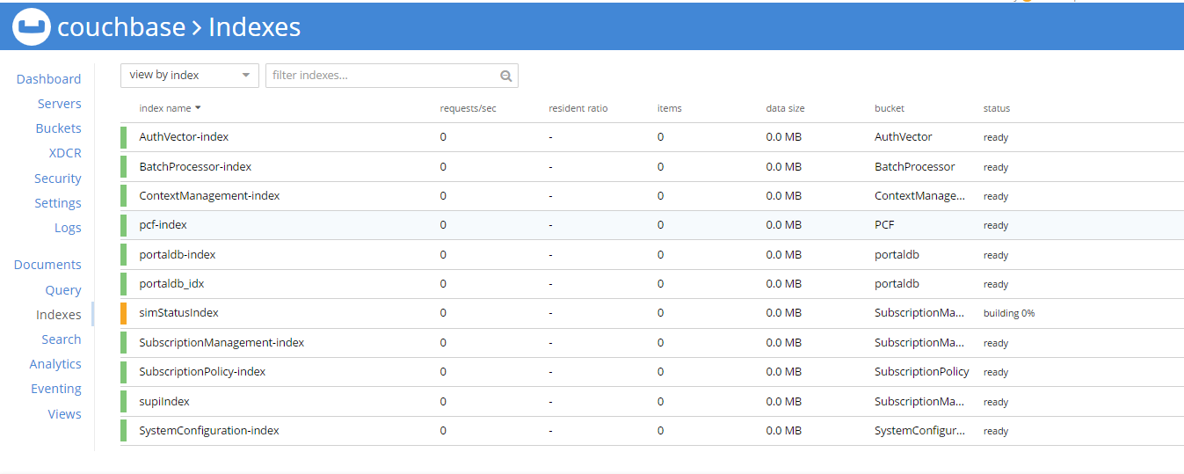
Creating Indexes
Alternate Method to Add Create index.
kubectl -n <namespace> exec -it couchbase-0 -c couchbase -- bashcurl -X POST 'http://cb-svc-ui:8093/query/service' -u '<username:password>' -H "Content-Type: text/plain" -d '<query>'
kubectl -n <namespace> exec -it couchbase-0 -c couchbase -- couchbase-cli bucket-create --cluster localhost:8091 --username Administrator --password password --bucket AuthVector --bucket-type couchbase --bucket-ramsize 500 kubectl -n <namespace> exec -it couchbase-0 -c couchbase -- couchbase-cli bucket-create --cluster localhost:8091 --username Administrator --password password --bucket BatchProcessor --bucket-type couchbase --bucket-ramsize 300 kubectl -n <namespace> exec -it couchbase-0 -c couchbase -- couchbase-cli bucket-create --cluster localhost:8091 --username Administrator --password password --bucket ContextManagement --bucket-type couchbase --bucket-ramsize 300 kubectl -n <namespace> exec -it couchbase-0 -c couchbase -- couchbase-cli bucket-create --cluster localhost:8091 --username Administrator --password password --bucket PCF --bucket-type couchbase --bucket-ramsize 800 kubectl -n <namespace> exec -it couchbase-0 -c couchbase -- couchbase-cli bucket-create --cluster localhost:8091 --username Administrator --password password --bucket portaldb --bucket-type couchbase --bucket-ramsize 100 kubectl -n <namespace> exec -it couchbase-0 -c couchbase -- couchbase-cli bucket-create --cluster localhost:8091 --username Administrator --password password --bucket pcfportaldb --bucket-type couchbase --bucket-ramsize 100 kubectl -n <namespace> exec -it couchbase-0 -c couchbase -- couchbase-cli bucket-create --cluster localhost:8091 --username Administrator --password password --bucket SubscriptionManagement --bucket-type couchbase --bucket-ramsize 800 kubectl -n <namespace> exec -it couchbase-0 -c couchbase -- couchbase-cli bucket-create --cluster localhost:8091 --username Administrator --password password --bucket SubscriptionPolicy --bucket-type couchbase --bucket-ramsize 800 kubectl -n <namespace> exec -it couchbase-0 -c couchbase -- couchbase-cli bucket-create --cluster localhost:8091 --username Administrator --password password --bucket SystemConfiguration --bucket-type couchbase --bucket-ramsize 200

Slide 22
Show & Tell Session
  • Deploy Couchbase Database
  • Initialize Couchbase Cluster
  • Creating Buckets
  • Creating indexes
Notes:
ACL Show & Tell Session to be performed on Time availability.

Slide 23
XDCR Replication
  Cross Data Center Replication (XDCR) replicates data between a source bucket and a target bucket.
  The buckets may be located on different clusters, and in different data centers.
  This provides protection against data-center failure, and provides high-performance data-access for globally distributed, mission-critical applications.
  Data from the source bucket is pushed to the target bucket by means of an XDCR agent, running on the source cluster, using the Database Change Protocol.
  Any bucket (Couchbase or Ephemeral) on any cluster can be specified as a source or a target for one or more XDCR definitions.

Slide 24
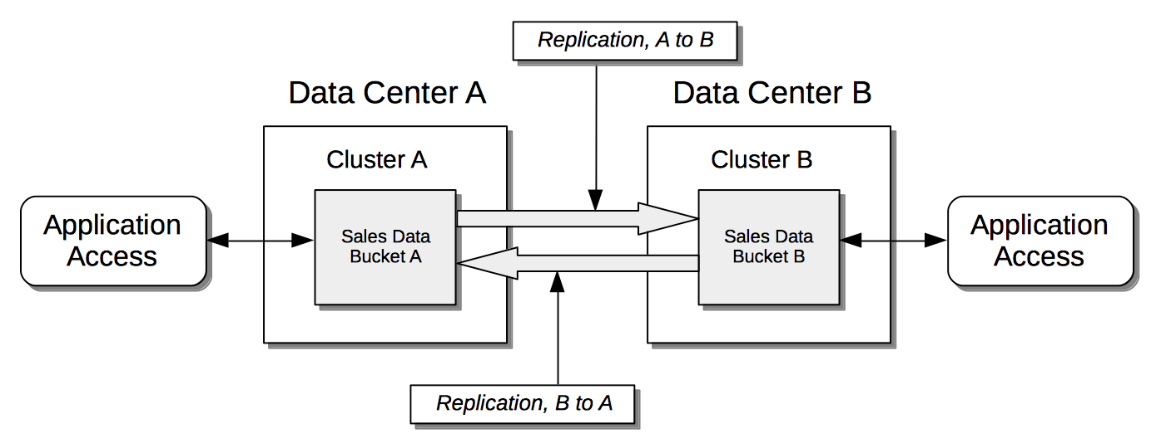
XDCR Replication
  Replication Bidirectional Data Flow Diagram
Notes:
Bidirectionally: The data contained in a specified source bucket is replicated to a specified target bucket; and the data contained in the target bucket is, in turn, replicated back to the source bucket. This allows both buckets to be used for the serving of data, which may provide faster data-access for users and applications in remote geographies.

Slide 25
Create XDCR replication (for Duplex mode)
  Pre-requisites:
  - All buckets are created on both DBs
  - Both have same bucket names.
Please run the below commands for setting the replication between both the database nodes
  Code Block: XDCR primary commands
kubectl exec -it -n cnf-apps couchbase-0 -c couchbase -- couchbase-cli xdcr-setup -c localhost:8091 -u Administrator -p password --create --xdcr-cluster-name secondary --xdcr-hostname couchbase-secondary-0.cb-secondary-svc-headless.cnf-apps.svc.cluster.local --xdcr-username Administrator --xdcr-password password

Slide 26
Create XDCR replication (for Duplex mode)
kubectl exec -it -n cnf-apps couchbase-secondary-0 -c couchbase couchbase-cli xdcr-setup -c localhost:8091 -u Administrator -p password --create --xdcr-cluster-name primary --xdcr-hostname couchbase-0.cb-svc-headless.cnf-apps.svc.cluster.local --xdcr-username Administrator --xdcr-password password
Code Block: XDCR secondary commands

Slide 27
Create XDCR replication (for Duplex mode)
Please run the below commands to start the replication of the individual buckets for both the nodes.
kubectl exec -it couchbase-0 -n cnf-apps -- couchbase-cli xdcr-replicate -c localhost:8091 -u Administrator -p password --create --xdcr-cluster-name secondary --xdcr-from-bucket AuthVector --xdcr-to-bucket AuthVector kubectl exec -it couchbase-0 -n cnf-apps -- couchbase-cli xdcr-replicate -c localhost:8091 -u Administrator -p password --create --xdcr-cluster-name secondary --xdcr-from-bucket BatchProcessor --xdcr-to-bucket BatchProcessor kubectl exec -it couchbase-0 -n cnf-apps -- couchbase-cli xdcr-replicate -c localhost:8091 -u Administrator -p password --create --xdcr-cluster-name secondary --xdcr-from-bucket ContextManagement --xdcr-to-bucket ContextManagement kubectl exec -it couchbase-0 -n cnf-apps -- couchbase-cli xdcr-replicate -c localhost:8091 -u Administrator -p password --create --xdcr-cluster-name secondary --xdcr-from-bucket EMSProxy --xdcr-to-bucket EMSProxy kubectl exec -it couchbase-0 -n cnf-apps -- couchbase-cli xdcr-replicate -c localhost:8091 -u Administrator -p password --create --xdcr-cluster-name secondary --xdcr-from-bucket PCF --xdcr-to-bucket PCF kubectl exec -it couchbase-0 -n cnf-apps -- couchbase-cli xdcr-replicate -c localhost:8091 -u Administrator -p password --create --xdcr-cluster-name secondary --xdcr-from-bucket pcfportaldb --xdcr-to-bucket pcfportaldb kubectl exec -it couchbase-0 -n cnf-apps -- couchbase-cli xdcr-replicate -c localhost:8091 -u Administrator -p password --create --xdcr-cluster-name secondary --xdcr-from-bucket portaldb --xdcr-to-bucket portaldb kubectl exec -it couchbase-0 -n cnf-apps -- couchbase-cli xdcr-replicate -c localhost:8091 -u Administrator -p password --create --xdcr-cluster-name secondary --xdcr-from-bucket SubscriptionManagement --xdcr-to-bucket SubscriptionManagement kubectl exec -it couchbase-0 -n cnf-apps -- couchbase-cli xdcr-replicate -c localhost:8091 -u Administrator -p password --create --xdcr-cluster-name secondary --xdcr-from-bucket SubscriptionPolicy --xdcr-to-bucket SubscriptionPolicy kubectl exec -it couchbase-0 -n cnf-apps -- couchbase-cli xdcr-replicate -c localhost:8091 -u Administrator -p password --create --xdcr-cluster-name secondary --xdcr-from-bucket SystemConfiguration --xdcr-to-bucket SystemConfiguration
Code Block: Primary database replication

Slide 28
Create XDCR Replication (for Duplex mode)
Please run the below commands to start the replication of the individual buckets for both the nodes.
kubectl exec -it couchbase-0 -n cnf-apps -- couchbase-cli xdcr-replicate -c localhost:8091 -u Administrator -p password --create --xdcr-cluster-name secondary --xdcr-from-bucket AuthVector --xdcr-to-bucket AuthVector kubectl exec -it couchbase-0 -n cnf-apps -- couchbase-cli xdcr-replicate -c localhost:8091 -u Administrator -p password --create --xdcr-cluster-name secondary --xdcr-from-bucket BatchProcessor --xdcr-to-bucket BatchProcessor kubectl exec -it couchbase-0 -n cnf-apps -- couchbase-cli xdcr-replicate -c localhost:8091 -u Administrator -p password --create --xdcr-cluster-name secondary --xdcr-from-bucket ContextManagement --xdcr-to-bucket ContextManagement kubectl exec -it couchbase-0 -n cnf-apps -- couchbase-cli xdcr-replicate -c localhost:8091 -u Administrator -p password --create --xdcr-cluster-name secondary --xdcr-from-bucket EMSProxy --xdcr-to-bucket EMSProxy kubectl exec -it couchbase-0 -n cnf-apps -- couchbase-cli xdcr-replicate -c localhost:8091 -u Administrator -p password --create --xdcr-cluster-name secondary --xdcr-from-bucket PCF --xdcr-to-bucket PCF kubectl exec -it couchbase-0 -n cnf-apps -- couchbase-cli xdcr-replicate -c localhost:8091 -u Administrator -p password --create --xdcr-cluster-name secondary --xdcr-from-bucket pcfportaldb --xdcr-to-bucket pcfportaldb kubectl exec -it couchbase-0 -n cnf-apps -- couchbase-cli xdcr-replicate -c localhost:8091 -u Administrator -p password --create --xdcr-cluster-name secondary --xdcr-from-bucket portaldb --xdcr-to-bucket portaldb kubectl exec -it couchbase-0 -n cnf-apps -- couchbase-cli xdcr-replicate -c localhost:8091 -u Administrator -p password --create --xdcr-cluster-name secondary --xdcr-from-bucket SubscriptionManagement --xdcr-to-bucket SubscriptionManagement kubectl exec -it couchbase-0 -n cnf-apps -- couchbase-cli xdcr-replicate -c localhost:8091 -u Administrator -p password --create --xdcr-cluster-name secondary --xdcr-from-bucket SubscriptionPolicy --xdcr-to-bucket SubscriptionPolicy kubectl exec -it couchbase-0 -n cnf-apps -- couchbase-cli xdcr-replicate -c localhost:8091 -u Administrator -p password --create --xdcr-cluster-name secondary --xdcr-from-bucket SystemConfiguration --xdcr-to-bucket SystemConfiguration
Code Block: Primary database replication

Slide 29
XDCR Replication
kubectl exec -it couchbase-secondary-0 -n cnf-apps -- couchbase-cli xdcr-replicate -c localhost:8091 -u Administrator -p password --create --xdcr-cluster-name primary --xdcr-from-bucket AuthVector --xdcr-to-bucket AuthVector kubectl exec -it couchbase-secondary-0 -n cnf-apps -- couchbase-cli xdcr-replicate -c localhost:8091 -u Administrator -p password --create --xdcr-cluster-name primary --xdcr-from-bucket BatchProcessor --xdcr-to-bucket BatchProcessor kubectl exec -it couchbase-secondary-0 -n cnf-apps -- couchbase-cli xdcr-replicate -c localhost:8091 -u Administrator -p password --create --xdcr-cluster-name primary --xdcr-from-bucket ContextManagement --xdcr-to-bucket ContextManagement kubectl exec -it couchbase-secondary-0 -n cnf-apps -- couchbase-cli xdcr-replicate -c localhost:8091 -u Administrator -p password --create --xdcr-cluster-name primary --xdcr-from-bucket EMSProxy --xdcr-to-bucket EMSProxy kubectl exec -it couchbase-secondary-0 -n cnf-apps -- couchbase-cli xdcr-replicate -c localhost:8091 -u Administrator -p password --create --xdcr-cluster-name primary --xdcr-from-bucket PCF --xdcr-to-bucket PCF kubectl exec -it couchbase-secondary-0 -n cnf-apps -- couchbase-cli xdcr-replicate -c localhost:8091 -u Administrator -p password --create --xdcr-cluster-name primary --xdcr-from-bucket pcfportaldb --xdcr-to-bucket pcfportaldb kubectl exec -it couchbase-secondary-0 -n cnf-apps -- couchbase-cli xdcr-replicate -c localhost:8091 -u Administrator -p password --create --xdcr-cluster-name primary --xdcr-from-bucket portaldb --xdcr-to-bucket portaldb kubectl exec -it couchbase-secondary-0 -n cnf-apps -- couchbase-cli xdcr-replicate -c localhost:8091 -u Administrator -p password --create --xdcr-cluster-name primary --xdcr-from-bucket SubscriptionManagement --xdcr-to-bucket SubscriptionManagement kubectl exec -it couchbase-secondary-0 -n cnf-apps -- couchbase-cli xdcr-replicate -c localhost:8091 -u Administrator -p password --create --xdcr-cluster-name primary --xdcr-from-bucket SubscriptionPolicy --xdcr-to-bucket SubscriptionPolicy kubectl exec -it couchbase-secondary-0 -n cnf-apps -- couchbase-cli xdcr-replicate -c localhost:8091 -u Administrator -p password --create --xdcr-cluster-name primary --xdcr-from-bucket SystemConfiguration --xdcr-to-bucket SystemConfiguration
Code Block: Secondary database replication

Slide 30
Show & Tell Session
  XDCR Replication
Notes:
ACL Show & Tell Session to be performed on Time availability.

Slide 31
Redundancy
  For a two node HA setup, Couchbase needs to be deployed in XCDR mode.
  Following sections will be covered for Redundancy:
    Primary Node
    Secondary Node
    Create Service Monitor for Primary and Secondary Node
    Apply Couchbase yaml and moitor –cb.yaml
    Initialize the databases

Slide 32
Show & Tell Session
  Redundancy

Slide 33
Corporate HQ
Austin, TX, USA
sales@alepo.com
Follow Us
www.alepo.com
AlepoUSA
@AlepoUSA
Company/Alepo

