Slide 1
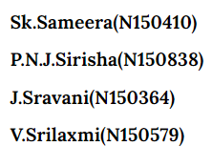
Mobile Application Using
React Native

Slide 2
Outline..
Abstract
Frameworks Used
Layouts
Future Scope
Conclusion
References

Slide 3
Abstract
In order to adopt with the emerging trends and technologies , we came up with an idea of developing a Mobile Application for shopping using React Native.

Slide 4
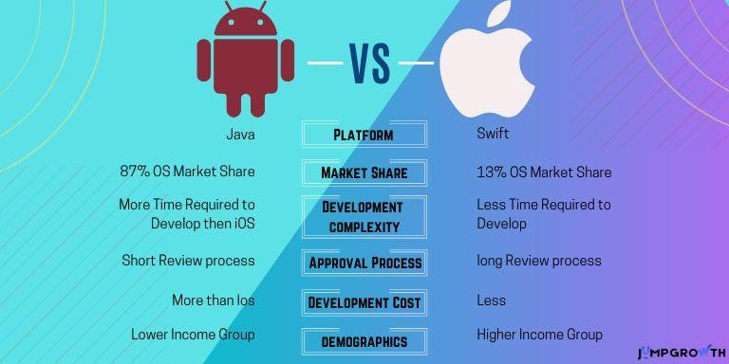

Slide 5
Introduction..
React is a framework for building applications using javascript.
React js is a javascript library we use for constructing a high performing UI layer.
React Native is an entire platform allows us to build native, cross-platform mobile apps.

Slide 6
React Native
React Native is an open-source mobile application framework.
Used to create cross platform mobile apps.
Cross platform is a type of software application which works on multiple operating systems (or) devices which are often referred to as Windows, Mac OS, Android or iOS.

Slide 7
Firebase
Firebase is a Backend as a Service (BaaS) that provides an advantage to mobile developers who use React Native for developing mobile applications.
As a React Native developer, by using Firebase you can start building an MVP (minimum viable product), keeping the costs low and prototyping the application pretty fast.

Slide 8
Continued…
Firebase supports a real-time NoSQL database for react-native.
Data is stored in JSON (JavaScript Object Notation) format.

Slide 9
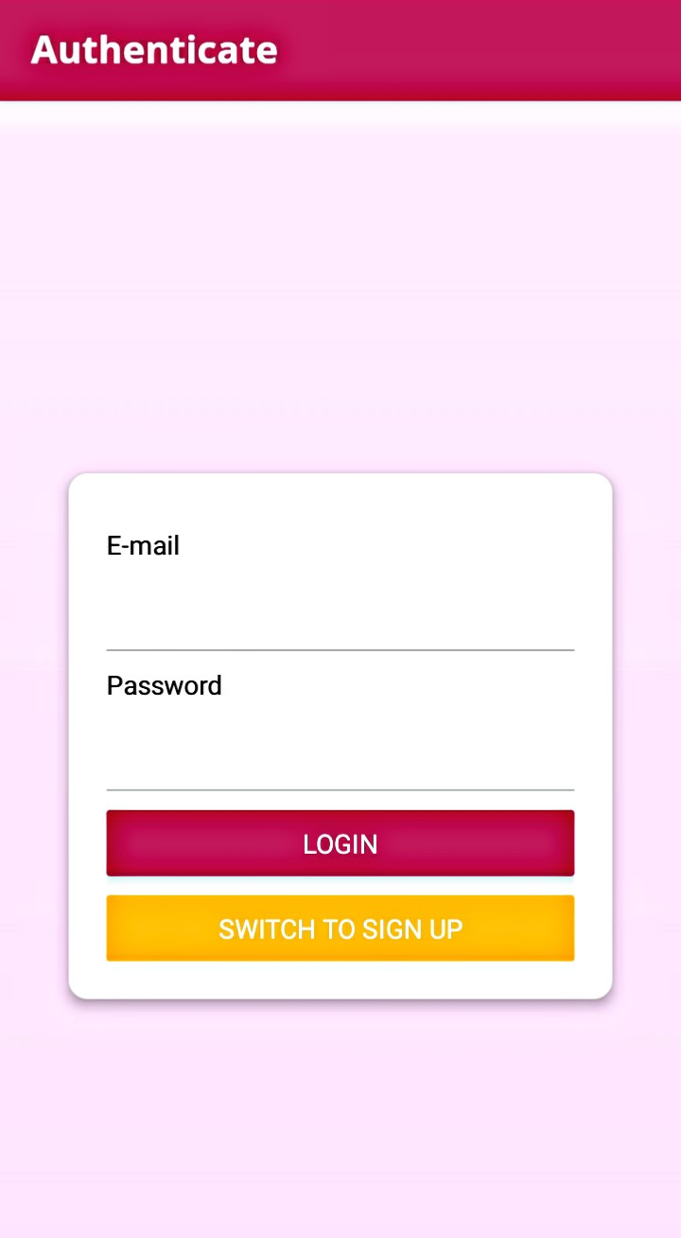
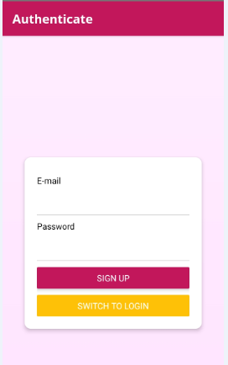
Layout of the Application

Slide 10
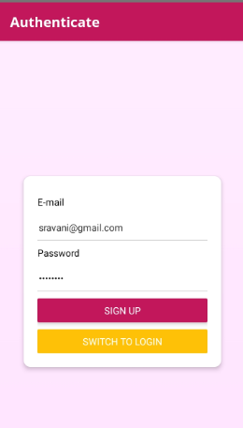
Continued...

Slide 11
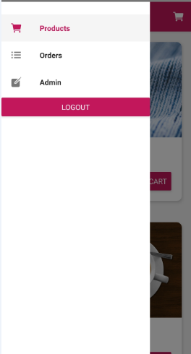
Continued….

Slide 12
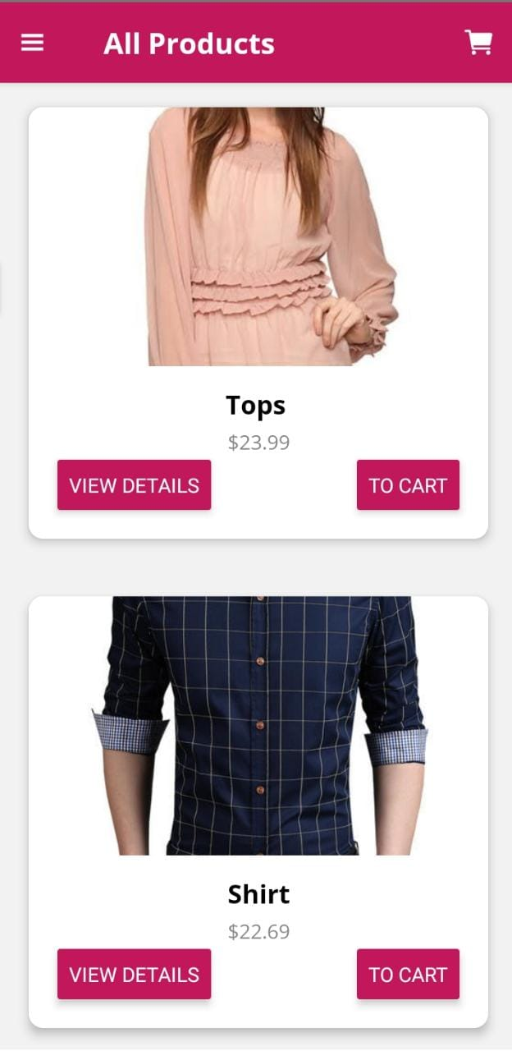
Continued…...

Slide 13
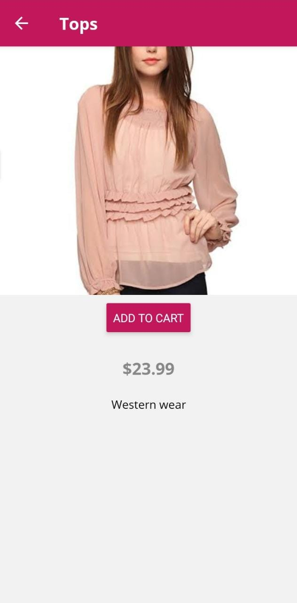
Continued....

Slide 14
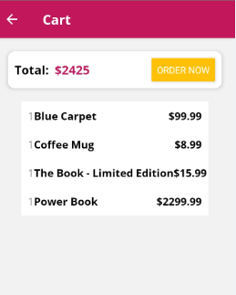
Continued….

Slide 15
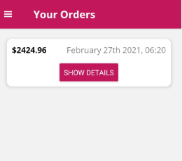
Continued….

Slide 16
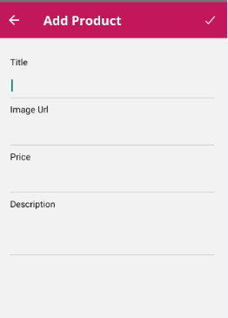
Continued….

Slide 17
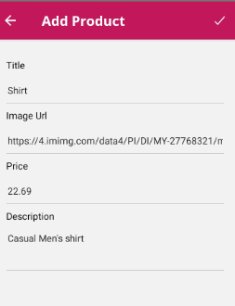
Continued...

Slide 18
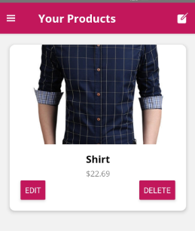
Continued….

Slide 19
Future Scope
This mobile application is just at its beginning phase. We can update more and more features based on user’s interest.

Slide 20
Conclusion
As we are living in a digital world we always fulfil our needs through mobile with the help of internet. So this mobile application using React Native attracts the people who prefer online shopping .

Slide 21
References
https://reactnative.dev/
https://hackernoon.com/introduction-to-firebase-218a23186cd7
https://www.couchbase.com/resources/why-nosql

Slide 22
Thank You….

