Slide 1
Overview
What do we need to do?
We need to move our main branch from Montreal to Toronto.
What are the hurdles?
We need to find our new homes, new schools for our kids,
and anything we can think of when moving to a new city.
What is the best way to do it?
Our goal is to make this transition as smooth as possible,
and for that we need things like a good moving bonus,
Enough time and ofcourse, an experienced mover.
Thanks to our hard work, our company is growing at an exponential pace. We need to keep growing and for that we need to expand our business to new locations.

Slide 2
Analysis
Why do we need to move?
Factors | Toronto | Montreal
Tax rates | Our business could save at least a million on taxes if we move to Toronto | Unfortunately, Quebec has one of the highest tax rates and it’s unlikely to change any time soon.
Location | We need a big city to expand our business. Since GTA is full of businesses we are likely to get more clients. | We have maxed out our growth in Montreal. Almost all the major tech companies in Montreal are our clients now.
Transportation | Transportation is better in Toronto. More number of air ports& highways, Efficient public transport etc. will help our business. | Montreal, since it’s not as big as Toronto, have some limitations when it come to transportation.
Business friendly environment | Toronto secured the number one spot for business friendliness among other major cities in Canada. | Montreal has unfortunately a lot of regulations, which we are having difficulties with.
Skilled workers | We are likely to get more skilled workers in Toronto, since it’s a bigger city. | We are having difficulties in finding workers with proper skillsets here in Montreal.

Slide 3
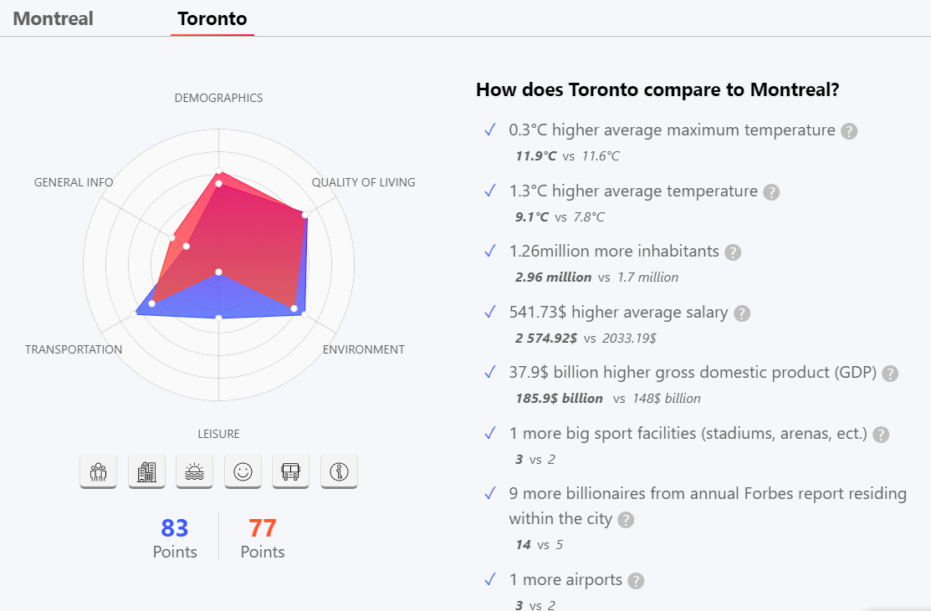
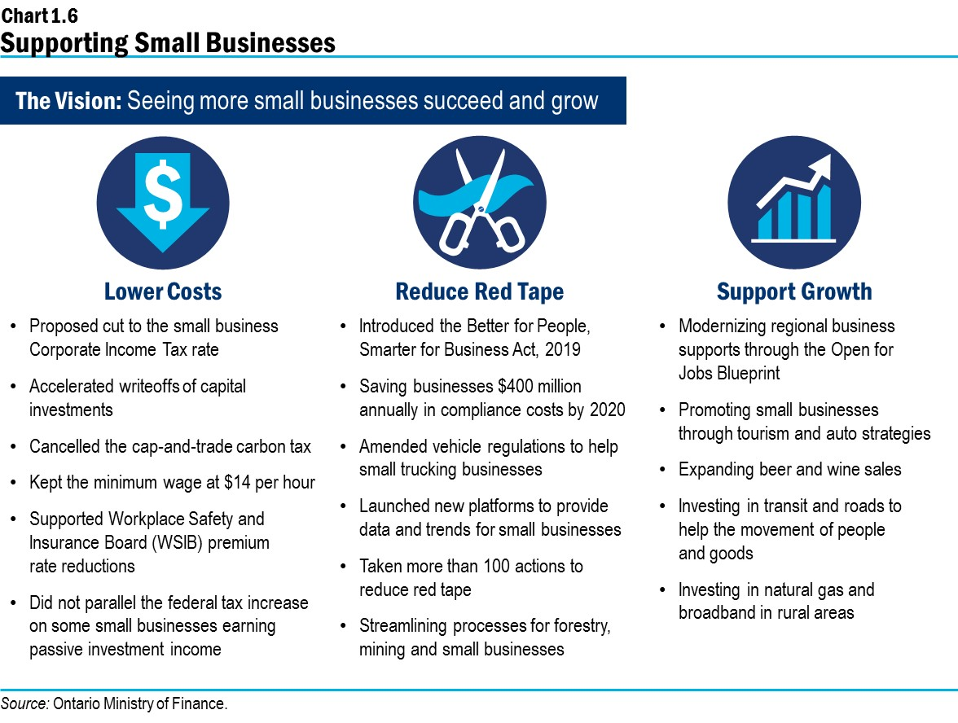
How it will benefit our employees? How it will benefit our business?

Slide 4
Points
Timelines& Targets
2010
Business started in Montreal.
2015
2nd Branch opened in Montreal
2020
Main branch to be moved to Toronto
2022
4th Branch to be opened in Newyork, US

Slide 5
Recommendation
All our data analysis shows that we need to expand our business in order to keep up our current growth rate. We have made clients with most of the tech companies here in Montreal. It has been 5 years since we have opened up a new branch. Our reserves is at all time high and our company is in it’s best shape. This is the time to make a move.
Since Toronto is the business capital of Canada, and the biggest city in Canada, it seems to be an optimal choice for our expansion. Our business team has considered other major cities in Canada, including Alberta and Vancouver for expansion, but Toronto remained the most appropriate Location.
We have plans to expand our business to US before 2022, and for that we need to be operational from a more Internationally accessible location, hence Toronto tops the chart.

