Slide 1
Overview
As the world’s most popular charity organization, we have a lot of responsibilities. We should examine whether we can improve our efficiency by any manner.
Mission
Our mission is to improve the lives of vulnerable people by mobilizing the power of humanity around the world.
How efficient are we?
On average, 91 cents of every dollar" goes to Red Cross services
How can you help us?
Call in your donation, by dialing 1-800-HELP NOW (1-800-435-7669).

Slide 2
Our principles
Humanity
Its purpose is to protect life and health and to ensure respect for the human being. It promotes mutual understanding, friendship, cooperation and lasting peace amongst all peoples.
Impartiality
It makes no discrimination as to nationality, race, religious beliefs, class or political opinions. It endeavors to relieve the suffering of individuals, being guided solely by their needs, and to give priority to the most urgent cases of distress.
Neutrality
In order to continue to enjoy the confidence of all, the Movement may not take sides in hostilities or engage at any time in controversies of a political, racial, religious or ideological nature.
Independence
The Movement is independent. The National Societies, while auxiliaries in the humanitarian services of their governments and subject to the laws of their respective countries, must always maintain their autonomy.
Voluntary Service
It is a voluntary relief movement not prompted in any manner by desire for gain.
Unity
There can be only one Red Cross or one Red Crescent Society in any one country. It must be open to all. It must carry on its humanitarian work throughout its territory.
Universality
The International Red Cross and Red Crescent Movement, in which all Societies have equal status and share equal responsibilities and duties in helping each other, is worldwide.

Slide 3
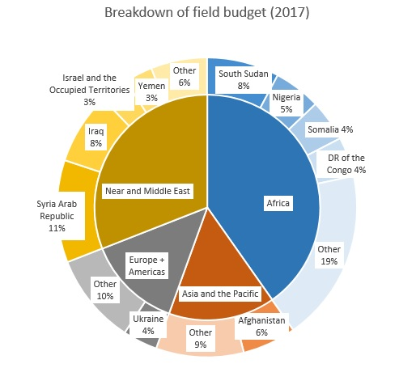
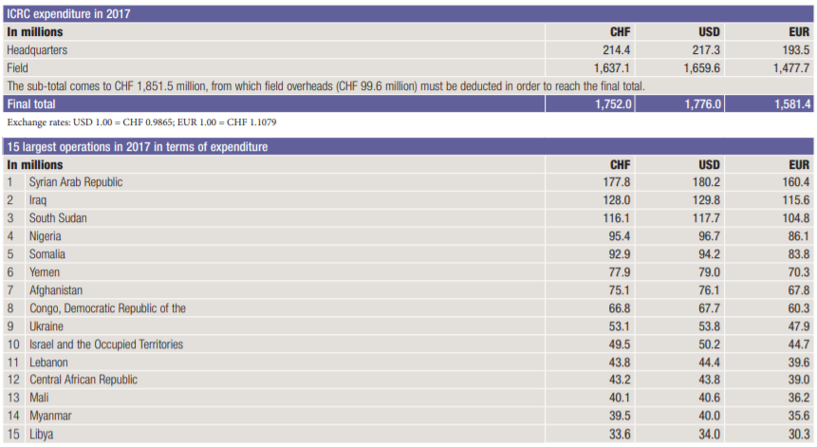
Analysis
We spend most of our money in African continent.
We spend least amount of money in Europe
We Spend most of our money in Syria

Slide 4
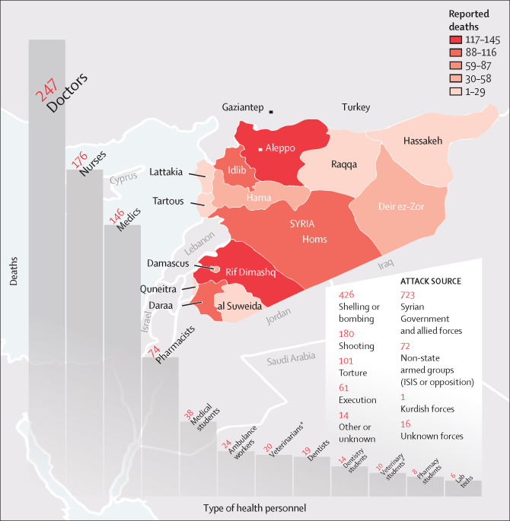
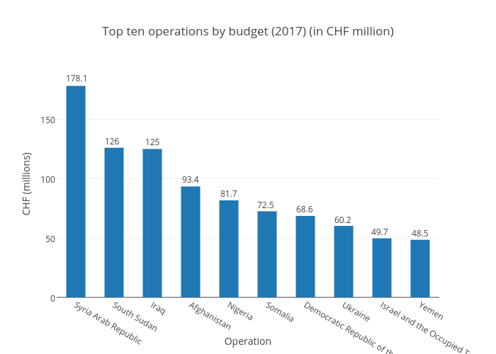
Top 10 spending by country
We need to be efficient where we spend the most
We need to find ways to spend less without making any sacrifices on countries we spend the most.

Slide 5
Where we can improve?
VISITS TO DETAINEES
ICRC delegates visited 1,437 places of detention, which held a total of 940,326 detainees
RESTORING FAMILY LINKS
The ICRC collected 176,629 and distributed 150,622 RCMs, enabling members of families separated
FORENSICS
The ICRC carried out forensic activities in some 70 contexts to ensure the proper and dignified management of human remains
ECONOMIC SECURITY
The ICRC, often in cooperation with National Societies, worked to enhance the economic security of vulnerable individuals, households and communities of about7,794,788 people
WATER AND HABITAT
Rehabilitation of water-supply, sanitation and other infrastructure affected35,519,089 civilians and 336,626 detainees.
HEALTH
The ICRC conducted 5,736 first-aid training sessions for 134,528 people, including National Society volunteers

Slide 6
How can we improve?
Using drones first instead of volunteers to survey an affected area so we know where to send mobile teams
Invest more in Mobile digital imaging equipment such as portable x-ray and ultrasound machines that can easily be brought to remote locations
Find more innovative solutions to package equipment so it’s lighter and quicker to setup
Invest in Solar energy to reduce ecological footprint and reduce dependence to fossil fuels
Invest in 3D printing technologies to produce specific pieces of equipment right in the disaster zone

Slide 7
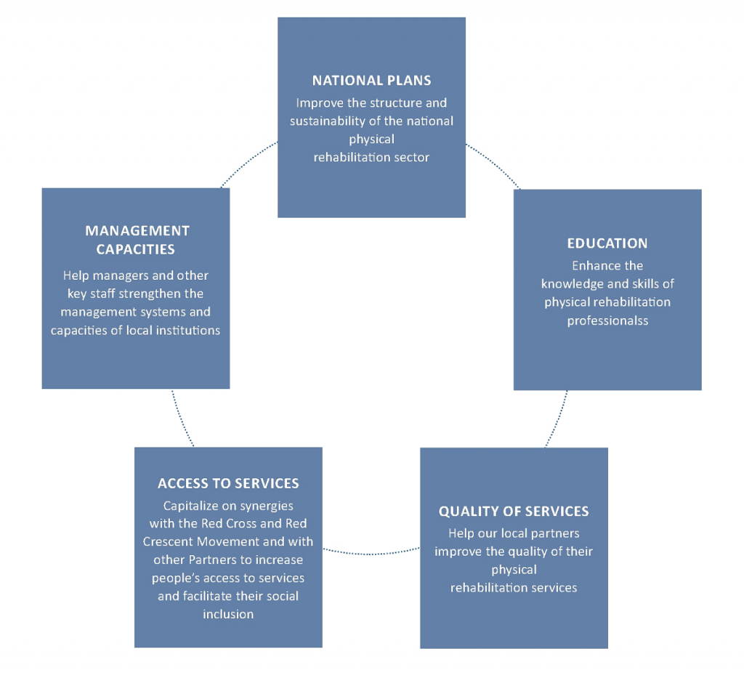
What to do next?
National Plans:
We need to improve our roots in every countries. Need more campaigning and infrastructure.
Education:
We should find ways to educate children in affected areas. Schools are as important as hospitals.
Quality of Services:
Poor infrastructure and lack of professional volunteers are still our biggest challenges
Access To Services:
Make our system more transparent. Find more ways to improve people’s participation.
Management Capacities:
Engage more frequently with our managers, give them confidence and assist them swiftly.

Slide 8
Conclusion
We explored the possibilities of being more efficient. For that we had to find out where we are spending the most. Once we figured out we spend most money in Syria, then we speculated various scopes for improvement in Syria. We need to set goals and move forward as well, hence we attempted to address some of our long term goals.

