Slide 1
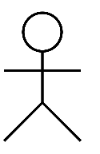
Use Case Diagram
Generate Pair of Random Numbers
System
Perform Transfer of Random Numbers
User
Compute Product of Random Numbers
Display product Output
Compliance

